Slide 1
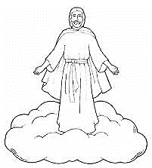
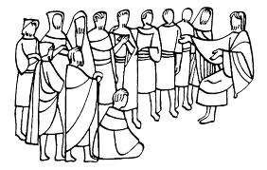
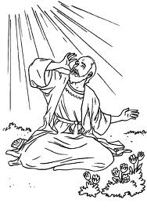

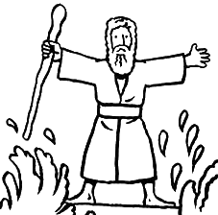
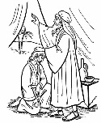



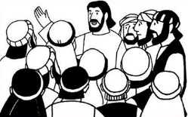


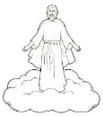
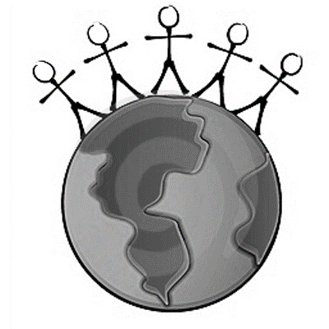


The Book of Revelation
Jesus Christ
John’s 7 Letters to 7 Churches
Throne Theophany
Seven Seals Overview
Revelation 1
Revelation 2-3
Revelation 4-5
Revelation 6-9
The Little Book
2 prophets in Jerusalem
The Dragon, The Beast, and the Victory
Righteous Rewarded
Revelation 10
Revelation 11
Revelation 12-14
Revelation 15
Armageddon
Wicked Destroyed
The Second Coming
Millennium & Final Judgment
Celestialized Earth
Revelation 16
Revelation 17-18
Revelation 19
Revelation 20
Revelation 21-22

Slide 2
The Book of Revelation: Major Events
John’s Witness of Christ Rev 1
7 Letters to 7 Churches Rev 2-3
Throne Theophany Rev 4-5
7 Seals Rev 6-22
Seals Overview Rev 6:1-17
1 Adam/Enoch
2 Noah
3 Abraham-Moses
4 Divided Kingdom
5 Christ/Apostasy
6 Signs of Times (Seven Trumpets, Righteous Sealed Up; Rev 7-9)
Two Prophets
Rev 11
Destruction of the Wicked
Rev 15-16
Babylon
Destroyed
Rev 17-18
Christ Appears
Rev 19:1-21
Millennium Begins
Rev 20:1-6
Final Battle & Judgment
Rev 20:7-10
The World Celestialized
Rev 21-22
“Little Book” Interlude
Rev 10
7 Second Coming, Resurrection, Millennium, Judgment
THE DRAGON
Satan, in the Pre-Earth life, opposed the Church and kingdom of Christ, resulting in the Great Apostacy (Rev 12)
THE BEAST
Antichrist sentiment with political influence oppressing the Church; followers sealed with a mark of allegiance (Rev 13)
THE VICTORY
Restoration, lead by Moroni, culminating at Adam Ondi Ahman, and Saints in the Celestial Kingdom (Rev 14-15)

Slide 3
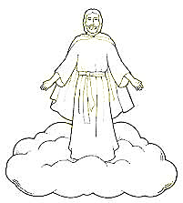

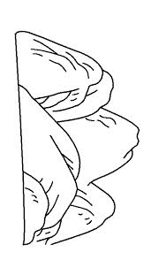
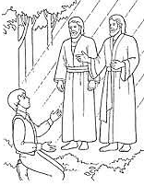
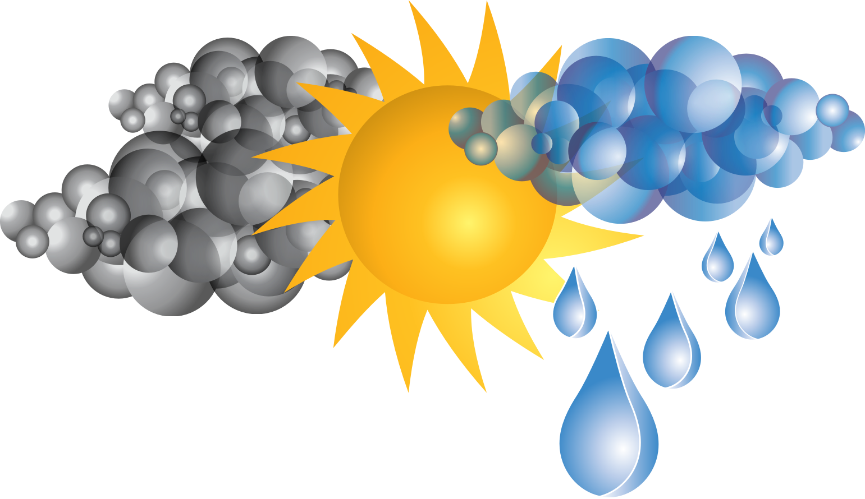



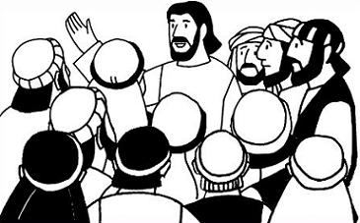
The Book of Revelation
Pre-Earth Life
Seven Seals Overview
Jesus Christ
John’s 7 Letters to 7 Churches
The Apostasy and Dark Ages
Revelation 12
Revelation 4-6,10
Revelation 1
Revelation 2-3
Revelation 6,13
The Restoration & Adam-Ondi-Ahman
Signs of the Times
Armageddon
Two prophets in Jerusalem
Revelation 7,14
Revelation 8-9
Revelation 16
Revelation 11
Righteous Rewarded
Wicked Destroyed
The Second Coming
Millennium & Final Judgment
Celestialized Earth
Revelation 15
Revelation 16-18
Revelation 19
Revelation 20
Revelation 21-22

