Slide 1
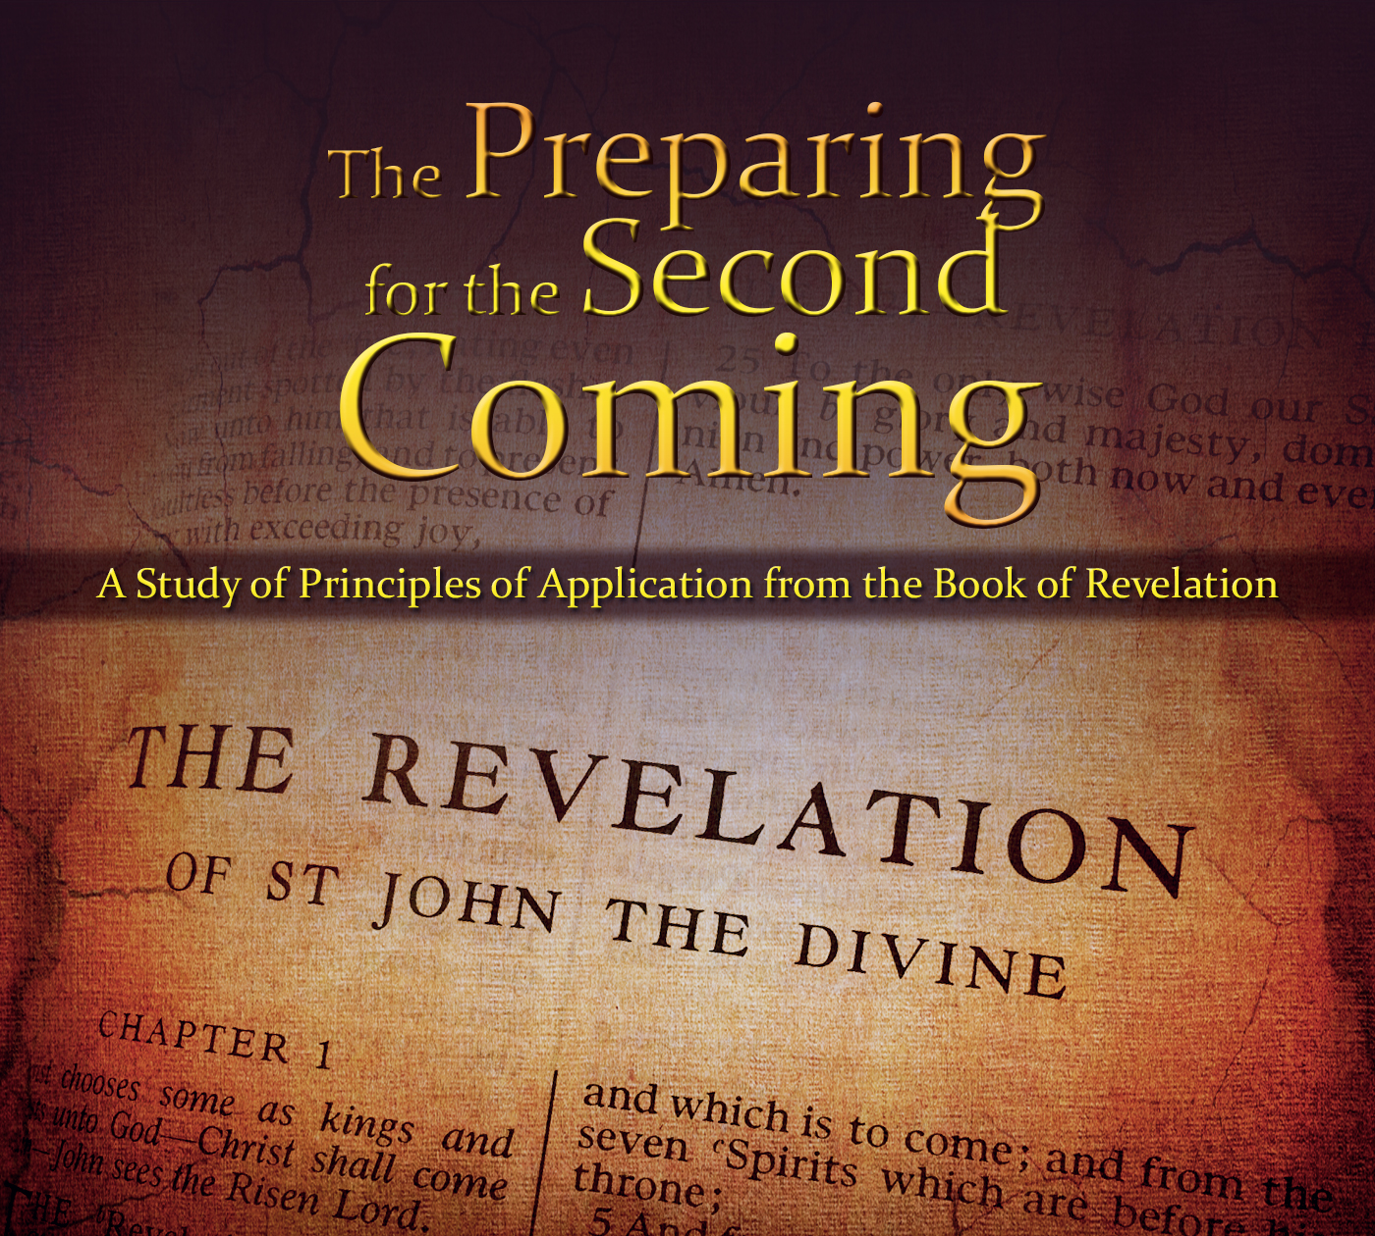

Slide 2
The Book of Revelation
HANDOUT
John’s Witness of Christ Rev 1
7 Letters to 7 Churches Rev 2-3
Throne Theophany Rev 4-5
7 Seals Rev 6-22
Seals Overview Rev 6:1-17
1 Adam/Enoch
2 Noah
3 Abraham-Moses
4 Divided Kingdom
5 Christ/Apostasy
6 Signs of Times (Seven Trumpets, Righteous Sealed Up; Rev 7-9)
Two Prophets Rev 11
Destruction of the Wicked Rev 15-16
Babylon Destroyed Rev 17-18
Christ Appears
Rev 19:1-21
Millennium Begins
Rev 20:1-6
Final Battle & Judgment
Rev 20:7-10
The World Celestialized
Rev 21-22
“Little Book” Interlude Rev 10
7 Second Coming, Resurrection, Millennium, Judgment
THE DRAGON
Satan, in the Pre-Earth life, opposed the Church and kingdom of Christ, resulting in the Great Apostacy (Rev 12)
THE BEAST
Antichrist sentiment with political influence oppressing the Church; followers sealed with a mark of allegiance (Rev 13)
THE VICTORY
Restoration, lead by Moroni, culminating at Adam Ondi Ahman, and Saints in the Celestial Kingdom (Rev 14-15)

Slide 3
Chapter 21-22
The Exalted Earth

Slide 4
Earth follows a Plan of Salvation
The Earth has a Spirit - Moses 7:48
The Earth and Veil – D&C 101:23
"When the earth was framed and brought into existence and man was placed upon it, it was near the throne of our Father in heaven. When man fell, the earth fell into space, and took up its abode in this planetary system, and the sun became our light." (Brigham Young, JD, 17: 143.)
"The earth has been redeemed by the blood of Jesus Christ." (Joseph Fielding Smith, DS, 1:74.)
The Earth was baptized & received the Holy Ghost
"This earth is living and must die, but since it keeps the law it shall be restored through the resurrection by which it shall become celestialized." (Joseph Fielding Smith, Doctrines of Salvation, 1: 73.)
The Earth will become Celestial Kingdom – D&C 88:18-26

Slide 5
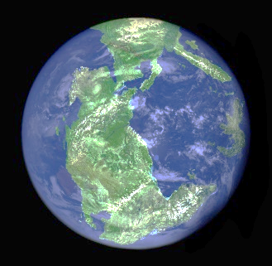
Earth follows a Plan of Salvation
The Creation (CELESTIAL)
Exaltation (CELESTIAL)
The Garden (TERRESTRIAL)
The Millennium (TERRESTRIAL)
Post-Fall condition (TELESTIAL)
(see Joseph Fielding Smith, Doctrines of Salvation, 1: 82.)

Slide 6
New Heaven-New Earth Revelation 21:9-11
“After the close of the millennial reign, the earth will die and be purified and receive its resurrection. During this cleansing period the city Zion, or New Jerusalem will be taken from the earth; and when the earth is prepared for the celestial glory, the city will come down according to the prediction in the Book of Revelation. (Elder Joseph Fielding Smith, Answers 2:106)
Size? Revelation 21:12-17

Slide 7
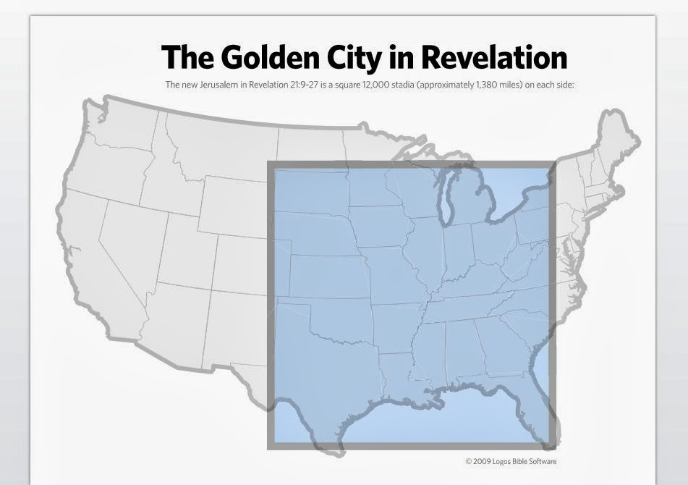
Revelation 21:12-17
1 furlong = 660 feet
12,000 furlongs = 1,500 miles
12 = Priesthood
1000 = Perfection

Slide 8
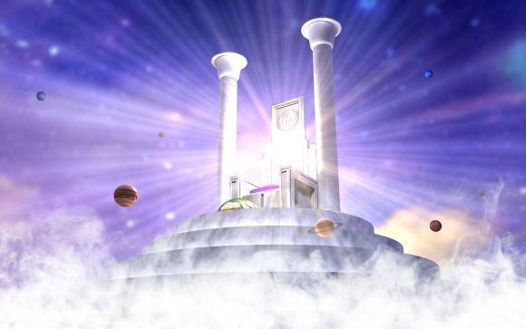
Revelation 21:22-27
“The tabernacle of God is with men” (Rev 21:3)
“I saw no temple therein; for the Lord God Almighty and the Lamb are the temple of it” (Rev 21:22).
“Temples, now and during the millennium, are to prepare men for a celestial inheritance. When that glorious goal is gained, heaven itself becomes a temple” (Elder McConkie, DNTC3:588).
MORE DETAIL: Revelation 22:1-6

Slide 9
Reverse the Curse
Genesis | Revelation
Heavens and earth created (1:1) | New heavens and earth (21:1)
Sun created (1:16) | No need of the sun (21:23)
The night established (1:5) | No night there (21:25; 22:5)
The seas created (1:10) | No more seas (21:1)
The curse announced (3:14-17) | No more curse (22:3)
Death enters history (3:19) | No more death (21:4)
Man driven from the tree (3:24) | Man restored to paradise (21:2)
Sorrow and pain begin (3:17) | No more sorrow/pain (21:4)

Slide 10
What Will the Celestial Kingdom be Like?
1 Corinthians 2:9 Eye hath not seen, nor ear heard, neither have entered into the heart of man, the things which God hath prepared for them that love him.
D&C 130:2 That same sociality which exists among us here will exist among us there, only it will be coupled with eternal glory, which glory we do not now enjoy.
“When the elect are exalted…then the cycle begins again. Exalted parents are to their children as our Eternal Parents are to us. Eternal increase, a continuation of the seeds forever and ever, eternal lives. For them new earths are created, and thus the on-rolling purposes of the Gods of Heaven go forward from eternity to eternity.” (Elder McConkie, The Millennial Messiah, p. 22-23)

Slide 11
What Will the Celestial Kingdom be Like?
"Is there anything that you have ever dreamed of that you wanted, that you longed for? Into the hands of those who attain this glory shall all things be given. What a world of meaning! It is not possible for mortals to think of a thousandth part of what this means. (Elder Melvin J Ballard, Three Degrees of Glory, p.8)

Slide 12
What Will the Celestial Kingdom be Like?
“A Saint expects a heaven with lands, houses, cities, vegetation, rivers, and animals; with food, raiment, musical instruments, etc., organized into families, embracing all the relationships of husbands and wives, parents and children, where sorrow, crying, pain, and death will be known no more. On it they expect to live, eat, drink, converse, worship, sing, play on musical instruments, engaged in joyful, innocent, social amusements, visit neighboring towns and neighboring worlds.” (Orson Pratt, Millennial Star, November 17, 1866, 28:721-22)

Slide 13
Revelation 22:18-19
Revelation 22:20-21

Slide 14
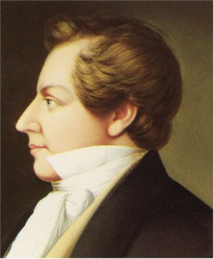
THE
REVELATION
OF ST. JOHN THE DIVINE
ROBER G INGERSOLL, 19th Century agnostic
“The insanest of all books"

Slide 15
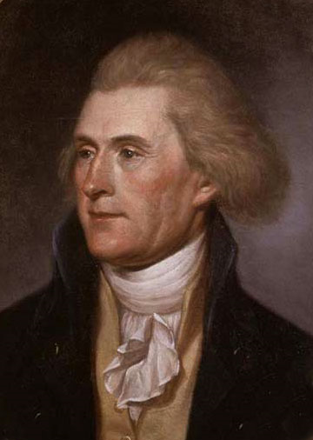
THE
REVELATION
OF ST. JOHN THE DIVINE
THOMAS JEFFERSON, principal author of “Declaration”
“Merely the ravings of a maniac, no more worthy nor
capable of explanation that the incoherencies of our own nightly dreams."

Slide 16
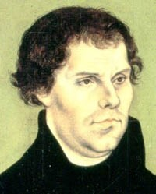
THE
REVELATION
OF ST. JOHN THE DIVINE
MARTIN LUTHER, Reformer in 1500’s
“An offensive piece of work…
Neither apostolic nor prophetic…
Christ is neither taught nor known in it."

Slide 17
THE
REVELATION
OF ST. JOHN THE DIVINE
JOSEPH SMITH, HC 5:342
“One of the plainest books God ever caused to be written"

