Slide 1
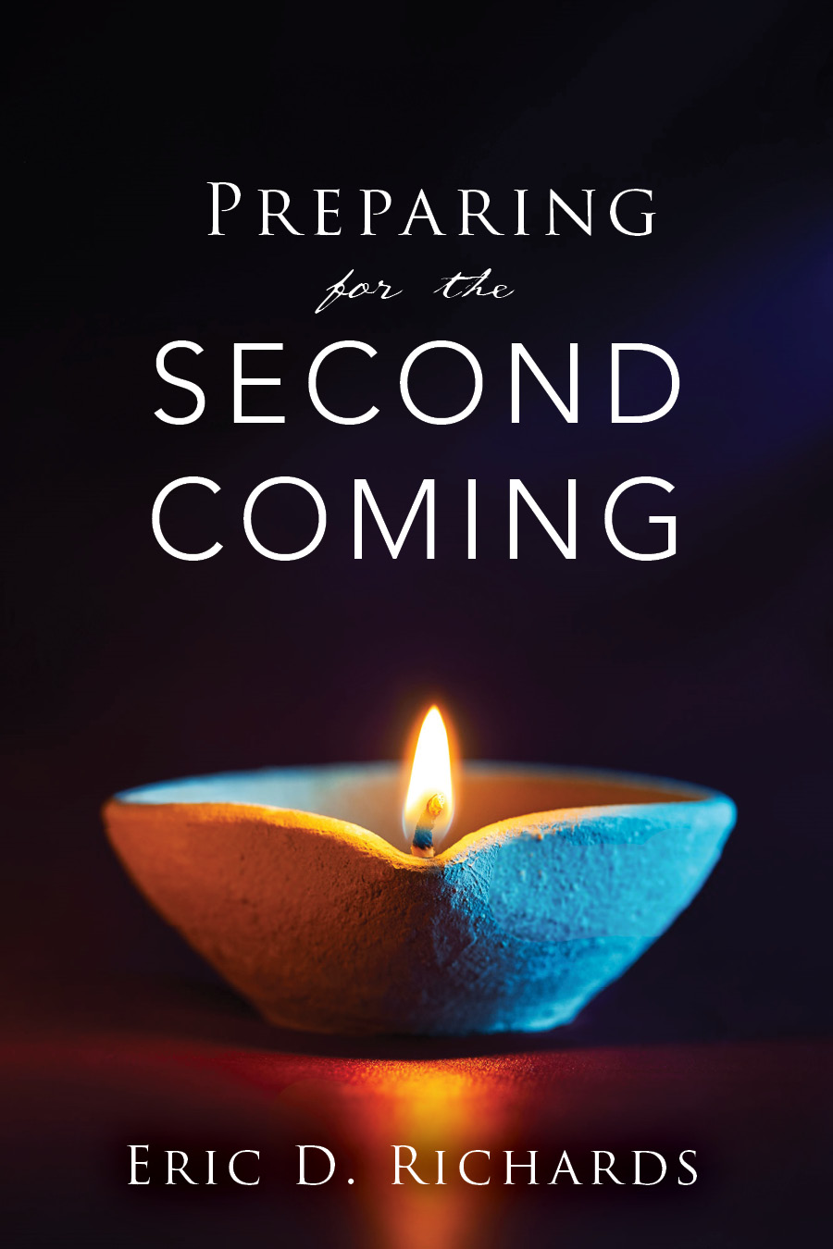
The Book of Revelation

Slide 2
The Book of Revelation
Title | Chapter
Jesus Christ | Revelation 1
7 Letters to 7 Churches | Revelation 2-3
Throne Theohpany | Revelation 4-5
7 Seals Overview | Revelation 6-9
The Little Book Prophecy | Revelation 10
2nd Woe - 2 Witnesses (Jerusalem) | Revelation 11
The Dragon: Pre-Earth Life | Revelation 12
The Beast: Satan’s Kingdom | Revelation 13
The Victory: Mornoni | Revelation 14
Righteous Rewards | Revelation 15
Wrath of God (and Armageddon) | Revelation 16
Satan’s Kingdom Destroyed | Revelation 17-18
3rd Woe (Appearance to the World) | Revelation 19
Millennium, Resurrection, and Final Judgment | Revelation 20

Slide 3
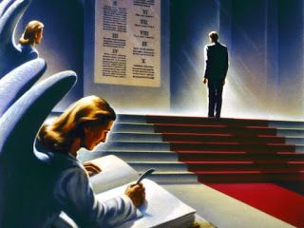
Chapter 20
Final Judgement
How do you picture the final judgment?
Does God judge everyone equally?
Does God judge everyone the same?

Slide 4
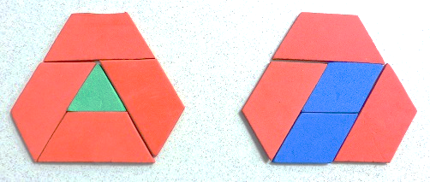
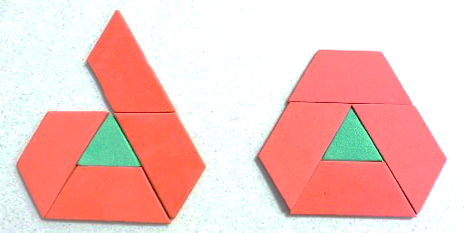
Equal vs same
D&C 46:15
Justice is when God gives us what we deserve.
Mercy is when God doesn't give us what we deserve.
How can God be both merciful but also just?
Grace is when God gives us what we don't deserve.

Slide 5
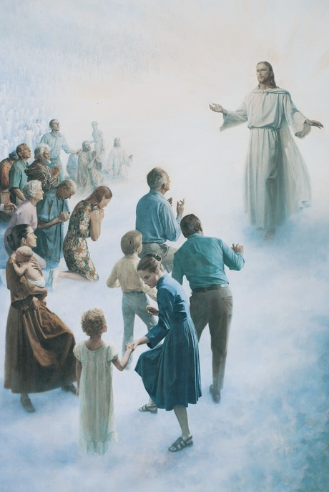
When you get to heaven,
you will likely view,
many folks who’s presence there
will be a shock to you.
But keep it very quiet,
do not even stare,
likely they’ll be many folks
surprised to see you there.

Slide 6
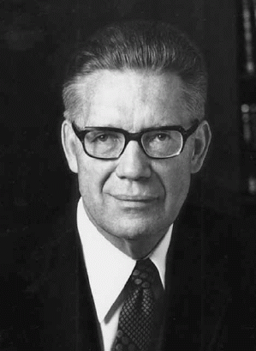
Final Judgment
“In the final day, all men will stand before the bar of God in a final day of judgment. The eventual destiny of all men will have been determined before that day.”
Bruce R. McConkie, The Millennial Messiah, p.515
What word or phrase will likely be heard most often at the Final Judgment?

Slide 7
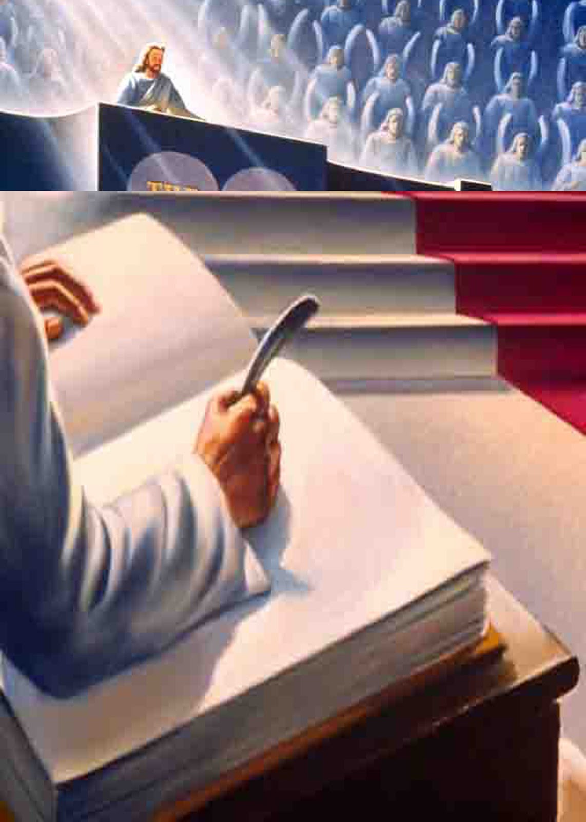
What is the Book of Life?
Hint: There are 3
1. Book of life in Heaven (Revelation 20:12)
2. Records kept on Earth
3. Our body
See Romans 2:15, Isaiah 3:9

Slide 8
"In a real though figurative sense, the book of life is the record of the acts of men as such record is written in their own bodies. It is the record engraven on the very bones, sinews, and flesh of the mortal body. That is, every thought, word and deed has an effect on the human body; all these leave their marks, marks which can be read by Him who is Eternal as easily as the words in a book can be read (Mormon Doctrine, p. 97).
Bruce R. McConkie, Book of Life, Mormon Doctrine

Slide 9
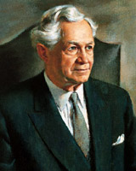
“We are spinning our own fates, good or evil… Every smallest stroke of virtue or of vice leaves its never so little scar…. Down among his nerve cells and fibers, the molecules are counting, registering and storing it to be used against him when the next temptation comes.” (Pres. David O. McKay, quoting William James in Conference Report, April 1956, 7-8.)

Slide 10
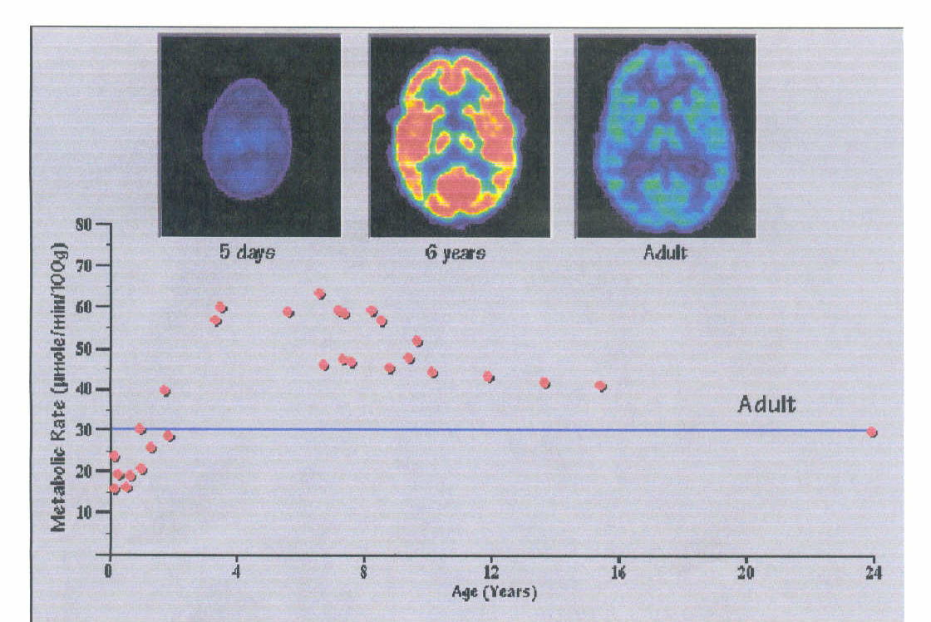

Slide 11
5 days 6 years Adult

Slide 12
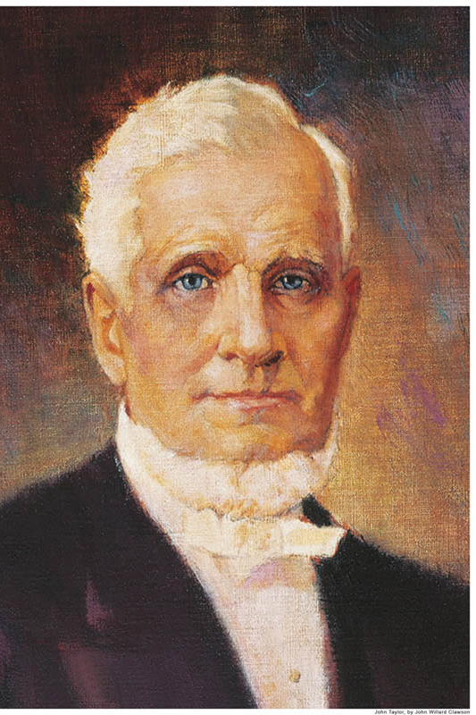
“Man is a self-registering machine; his eyes, his ears, his nose, the touch, the taste, and all the various senses of the body lays up for himself a record; and when the time comes for that record to be unfolded, all men will be able to read all things as God himself reads them.” (President John Taylor, The Gospel Kingdom, p.36; Journal of Discourses, 26:31-32)
What role do the atonement and resurrection play in our ‘record’?

Slide 13
4 Stories
Claire Sylvia - new heart and lungs - beer and chicken nuggets.
Scott Phillips - bar fight. Jamie Sherman rage and Mexican food.
William Sheridan - art skills
Bill Wohl - song
“Synapses may be like a concert pianist’s fingers. Even if Chopin did not have his fingers, he would still know how to play his sonatas.” (David Glanzman, U.C.L.A. neurologist).
https://mormonhub.com/blog/faith/final-judgment-organ-memories/

Slide 14
Claire Sylvia was 47 when she received a new heart and lungs. After the surgery, she started to notice that things weren’t quite the same. She suddenly craved beer and, oddly enough, chicken nuggets—something unusual for her. She felt … not herself.
Time passed and she traced her new organs back to her donor, Tim LaMiranda, who had died in a motorcycle accident. She contacted the family. They met. She soon discovered that her donor was a huge fan of beer and chicken nuggets. Authorities had even found a box of McDonalds chicken nuggets in LaMiranda’s pocket at the scene of the motorcycle crash.
https://mormonhub.com/blog/faith/final-judgment-organ-memories/

Slide 15
29-year-old Scott Phillips died from head trauma during a bar fight. 24-year-old Jamie Sherman received his heart. She woke up after surgery with a distinct feeling of rage. She also soon noticed a newfound love for Mexican food, which she later discovered was Phillips’ favorite food.
In 2006, William Sheridan felt his art skills had dramatically improved after receiving 24-year-old Keith Neville’s heart. Sheridan later discovered that Neville was a skilled artist.
A heart transplant in 2000 saved Bill Wohl’s life. While driving one day after his surgery, a song he’d never heard before made him break down and cry. He later met with his donor’s family and found out that the artist who made him cry was his donor’s favorite.
“Synapses may be like a concert pianist’s fingers. Even if Chopin did not have his fingers, he would still know how to play his sonatas.” (David Glanzman, U.C.L.A. neurologist).
https://mormonhub.com/blog/faith/final-judgment-organ-memories/

Slide 16
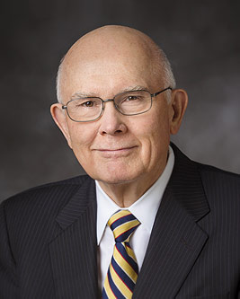
Using one word, what are we judged on?
“The Final Judgment is not just an evaluation of a sum total of good and evil acts – what we have done. It is an acknowledgment of the final effect of our acts and thoughts – what we have become.” (Elder Oaks, “The Challenge to Become,” Ensign, Nov. 2000, p. 32)

Slide 17
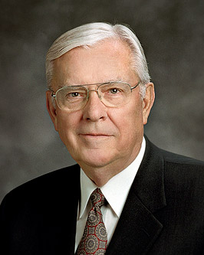
Final Judgment
“When he does judge us, he will take all things into consideration: our genetic and chemical makeup, our mental state, our intellectual capacity, the teachings we have received, the traditions of our fathers, our health, and so forth.”
M. Russell Ballard, “Suicide: Some Things We Know,
and Some We Do Not,” Ensign, Oct. 1987, p. 8

Slide 18
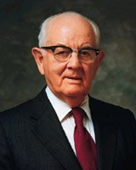
Advance from Kingdom to Kingdom?
“After a person has been assigned to his place in the kingdom, either in the telestial, the terrestrial, or the celestial, or to his exaltation, he will never advance from his assigned glory to another glory. That is eternal! That is why we must make our decisions early in life and why it is imperative that such decisions be right.” (The Teachings of Spencer W. Kimball, p.50; The Miracle of Forgiveness, p.243-244)

Slide 19
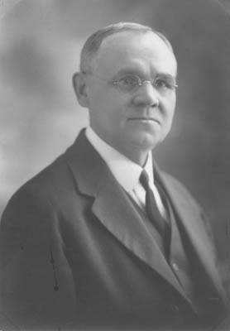
Advance from Kingdom to Kingdom?
“It is reasonable to believe, in accordance with God's plan of eternal progression, advancement from grade to grade within any kingdom, and from kingdom to kingdom, will be provided for” (James E. Talmage, Articles of Faith 1899 edition)
“It is reasonable to believe, in accordance with God's plan of eternal progression, advancement within each of the three specified kingdoms will be provided for; though as to possible progress from one kingdom to another the scriptures make no positive affirmation” (James E. Talmage, Articles of Faith p.371 (current edition)

Slide 20
Visiting and Ministering
D&C 76:86-88, 112
“Those who attain to the higher glories may minister unto and visit and associate with those of the lesser kingdoms. While the lesser may not come up, they may still enjoy the companionship of their loved ones who are in higher stations” (Melvin J. Ballard, "The Three Degrees of Glory," (Excerpts from sermon delivered in the Ogden Tabernacle, Ogden, Utah, on September 22, 1922); N. B. Lundwall, comp., The Vision (SLC: Bookcraft Publishing Co., n.d.), 50.

Slide 21
Gradation
“The three kingdoms are organized on a plan of gradation. The Telestial kingdom comprises subdivisions; this also is the case with the Celestial; and we conclude that a similar condition prevails in the Terrestrial. Thus the innumerable degrees of merit amongst mankind are provided for in an infinity of graded glories." (James E. Talmage, Articles of Faith, p. 409; see also Mormon Doctrine).
D&C 76:98 And the glory of the telestial is one, even as the glory of the stars is one; for as one star differs from another star in glory, even so differs one from another in glory in the telestial world.

Slide 22
Becoming the Person You Were Born to Be
January 10, 2016, Sister Wendy W. Nelson (begin @6:28)

Slide 23
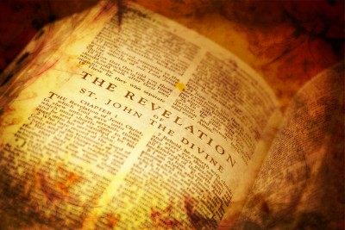
Application for Preparation
Have there been any sins in your life that should have been cleared with priesthood leaders but haven’t been?

Slide 24
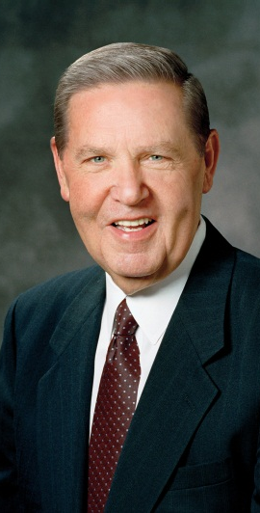
Justice and Mercy
“One thing God enjoys most about being God is the thrill of being merciful, especially to those who don’t expect it and often feel they don’t deserve it.” (Elder Holland, Laborers in the Vineyard, April 2012)

Slide 25
The Book of Revelation

