Slide 1
The Book of Revelation

Slide 2
The Second Coming
Timeline of Events
Resurrection: Terrestrial
New Jerusalem
Three Degrees of Glory (O.D.)
Appearance to the World
Satan Bound
Wicked Destroyed
Resurrection: Telestial
Resurrection of the Celestial
Resurrection: O.D.
Final Battle
Millennium
1000 years

Slide 3
EXPERIENCE OF ZEKE JOHNSON, son of Joel Hills Johnson, born in 1869. (Recorded in the JOHNSON BULLEITN, September 1973)
“I was working hard to clear the ground to plant a few acres of corn. I discovered there were ancient houses there. As I was plowing around I noticed that my plow had turned out the skull and backbone of a small child. I stopped immediately. As I was looking, all of a sudden, to my surprise, I saw the bones begin to wiggle and they began to change position and to take different color and within a minute there lay a beautiful little skeleton. Then I saw the inner parts of the natural body coming in (the entrails, etc). I saw the flesh coming on, and I saw the skin come on the body when the inner parts of the body were complete.
A beautiful head of hair adorned the top of the head, and a beautiful crystal decoration in the hair. It was combed beautifully and parted on one side. In about half a minute, the child raised up on her feet with her back toward me.
As she raised, a beautiful robe came down over her left shoulder. She looked at me and I looked at her, and for a quarter of a minute we just looked at each other smiling. Then in my ambition to get hold of her, I said, ‘Oh you beautiful child.’ I reached out as if I would embrace her and she disappeared. That was all I saw…
Notes:
Look at the quote by Elder Christofferson from the Teacher’s Manual

Slide 4
EXPERIENCE OF ZEKE JOHNSON, son of Joel Hills Johnson, born in 1869. (Recorded in the JOHNSON BULLEITN, September 1973)
“Why was I, just a common man, allowed to see such a marvelous manifestation of God’s powers? I prayed incessantly for an answer as to why I was privileged to see that resurrection.
I was told why. When the child was buried there, it was either in time of war or it was wintertime when the ground was frozen, and they had no tools to dig deep graves. The sorrowing Mother cried out to the little group, ‘That little shallow grave, the first beast that comes along will smell her body, and will dig her up and scatter her to the four winds, scattered all over these flats.’
There just happened to be a man present holding the Priesthood (a Nephite or a Jaredite, I don’t know which, because they both had been in this country.) This man said, ‘Sister, calm your sorrows. Whenever that little body is disturbed or uncovered, the Lord will call her up and she will live.’
Since that time I have taken great comfort, great cheer, consolation, and satisfaction, until I haven’t the words to express it, that it was I that uncovered that little body.”
Notes:
Look at the quote by Elder Christofferson from the Teacher’s Manual

Slide 5
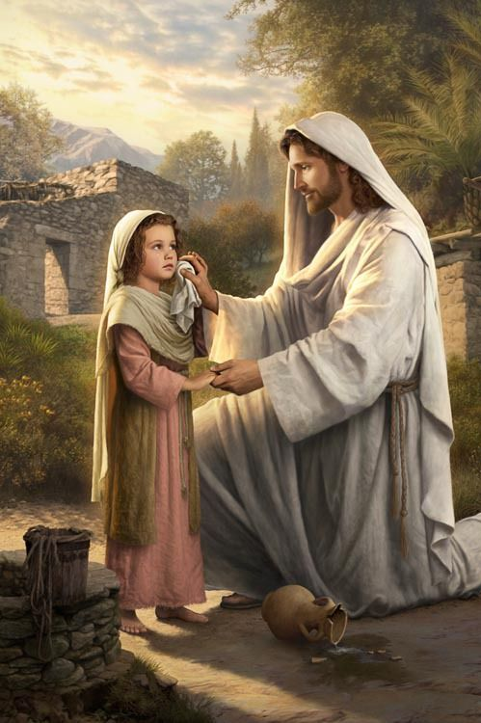
Resurrection
Eight Great Teachings

Slide 6
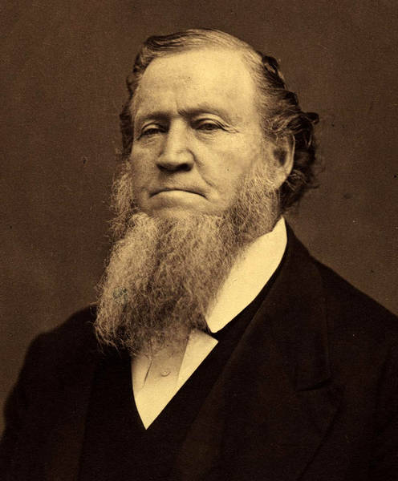
Resurrection is an ordinance
“We have not the ordinance and the keys of the resurrection. They will be given to those who have passed off; they will be ordained by those who hold the keys of the resurrection, to go forth and resurrect the Saints just as we receive the ordinance of baptism. This is one of the ordinances we cannot receive here, and there are many more.”
Discourses of Brigham Young, pp. 397-398.
See also Spencer W. Kimball, "Our Great Potential," in CR April 1977, pp. 69-72

Slide 7
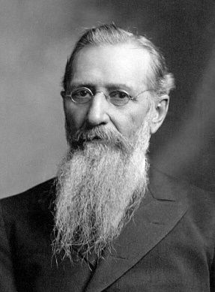
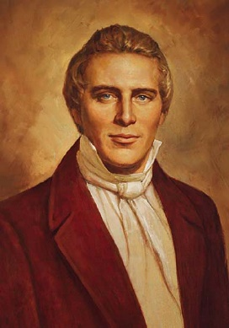
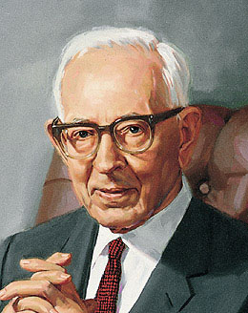
RESURRECTION and Age
“Children who die do not grow in the grave. They will come forth with their bodies as they were laid down, and then they will grow to the full stature of manhood or womanhood after the resurrection.” (Joseph F. Smith, Doc of Salv 2:293.)
“All men will come from the grave as they lie down, whether old or young; there will not be 'added unto their stature one cubit,' neither taken from it; all will be raised by the power of God.” (Joseph Smith, HC, 4:555-56.)
“People will come forth even to the wounds in the flesh. Not that a person will always be marred by scars forever, for these will be removed in their proper time...” (Joseph Fielding Smith, Doctrines of Salvation 2:293-294.)

Slide 8
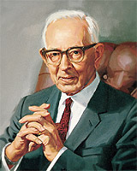
RESURRECTION and cremation
“It makes no difference whether a body is consumed by fire, buried in the depths of the sea, or placed in the tomb, the time will come when every essential particle will be called back again to its own place, and the individual will be reassembled with every essential part restored.”
Joseph Fielding Smith, Answers to Gospel Questions, 2:100

Slide 9
DIFFERENCES IN Bodies
“In both of the (lower) kingdoms there will be changes in the bodies and limitations. They will not have the power of increase, neither the power or nature to live as husbands and wives, for this will be denied them and they cannot increase. Some of the functions in the celestial body will not appear. I take it that men and women will, in these kingdoms, be merely immortal beings having received the resurrection…”
Joseph Fielding Smith, Answers to Gospel Questions, 2:100

Slide 10
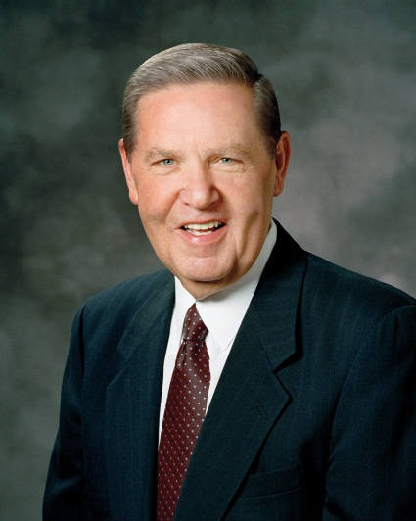
Resurrection and mental deficiencies
“One day loved ones whom we knew to have disabilities in mortality will stand before us glorified and grand, breathtakingly perfect in body and mind. What a thrilling moment that will be! I do not know whether we will be happier for ourselves that we have witnessed such a miracle or happier for them that they are fully perfect and finally ‘free at last.’”
Jeffrey R. Holland, October 2013 General Conference

Slide 11
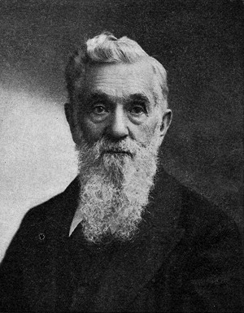
Our appearance after the Resurrection
“We bear the image of our earthly parents, but by…the holy resurrection, we shall put on the image of the heavenly, in beauty, glory, power and goodness.
Brigham Young, Discourses of Brigham Young, p.374
“There is nothing grander that I can imagine than a resurrected body.”
Lorenzo Snow, 5 October 1900, CR, p. 4; Teachings of Lorenzo Snow, p.99

Slide 12
RESURRECTION AND MARRIAGE
“I think it has been taught by some that if a wife does not love her husband in this state, she cannot love him in the next. This is not so.
Every man and woman that [is resurrected] will be as beautiful as the angels that surround the throne of God. You need entertain no fears that the wife will be dissatisfied with her husband, or the husband with the wife.” (Journal of Discourses, 10:24, Remarks by President Brigham Young, made in the Bowery, Great Salt Lake City, Oct. 6, 1862.)

Slide 13
Animals and resurrection
“Although we don’t have a complete understanding of what happens to animals after they die, we believe that they will enjoy some kind of salvation and immortality” (New Era, March 2011, To the Point).
“It is very probable that they, like mankind, will be distributed in the various kingdoms, celestial, terrestrial, and telestial." (Joseph Fielding Smith, Answers to Gospel Questions, vol. 2)

Slide 14
Resurrection Questions?
Resurrection: Terrestrial
Millennium Begins
Three Degrees of Glory (O.D.)
Appearance to the World
Satan Bound
Wicked Destroyed
Resurrection: Telestial
Resurrection of the Celestial
Resurrection: O.D.
Final Battle
Millennium
1000 years

Slide 15
The FINAL Battle
“Gog and Magog are the prophetic names given in the scriptures to that combination of nations which will fight against the purposes of the Lord on two separate and future occasions: At the ushering in of the millennial era; and at the end of the Millennium.” (Elder Bruce R. McConkie, Mormon Doctrine, Gog)

Slide 16
Gog and Magog: Definitions
Genesis 10: Magog is a person (son of Japheth, son of Noah)
Ezekiel 38-39: Gog is a leader and Magog is his land (see Guide to the Scriptures, Magog)
Revelation 20:7-8: Gog and Magog are the hostile nations of the world.
Gog and Magog: The Wars
1. Armageddon
2. At the end of the Millennium (See D&C 88:111-114)

Slide 17
FINAL BATTLE Questions?
Judgment Revelation 20:12-15
Resurrection: Terrestrial
Millennium Begins
Three Degrees of Glory (O.D.)
Appearance to the World
Satan Bound
Wicked Destroyed
Resurrection: Telestial
Resurrection of the Celestial
Resurrection: O.D.
Final Battle
Millennium
1000 years

Slide 18
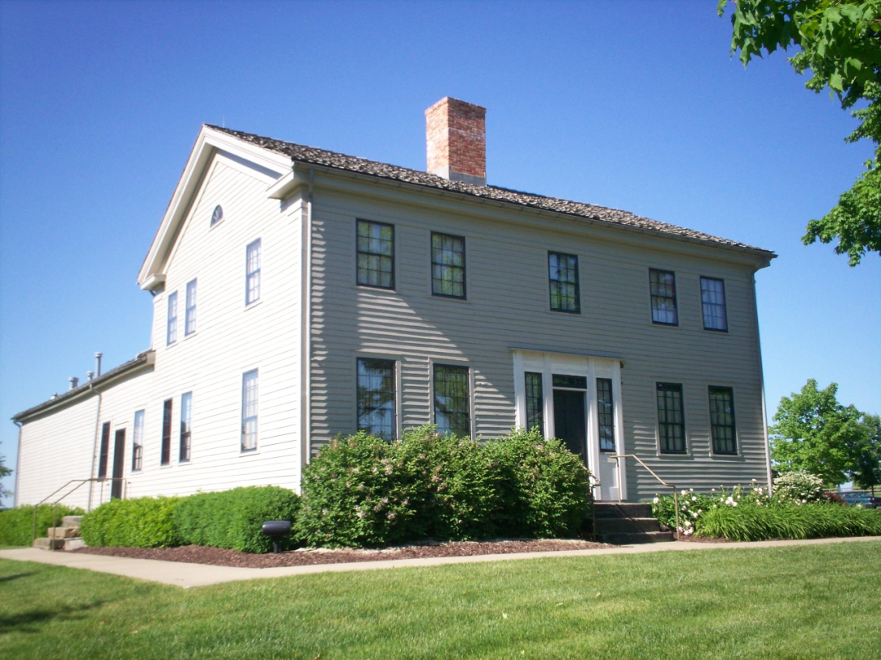
Concerns…
President Brigham Young said, "It was a new doctrine to this generation, and many stumbled at it" (Discourses of Brigham Young, 391).
"My traditions were such, that when the Vision came first to me, it was directly contrary and opposed to my former education. I said, ‘Wait a little.’ I did not reject it; but I could not understand it."
With time President Young came to view it as "one of the best doctrines ever proclaimed to any people" (in Journal of Discourses, 6:281).
Is it purely LDS Doctrine?

Slide 19
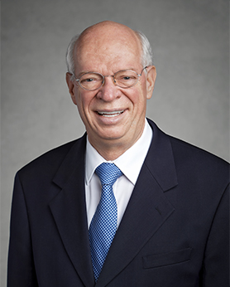
“Let me be direct and clear. You are going to make it as long as you keep repenting and do not rationalize or rebel. God is not a heartless referee looking for any excuse to throw us out of the game. Please take hope and comfort from this eternal truth: He intends for us to make it!” (Elder Cornish, October 2016 General Conference
D&C 88:22-24, 32 (cross reference Mormon 9:4)

Slide 20
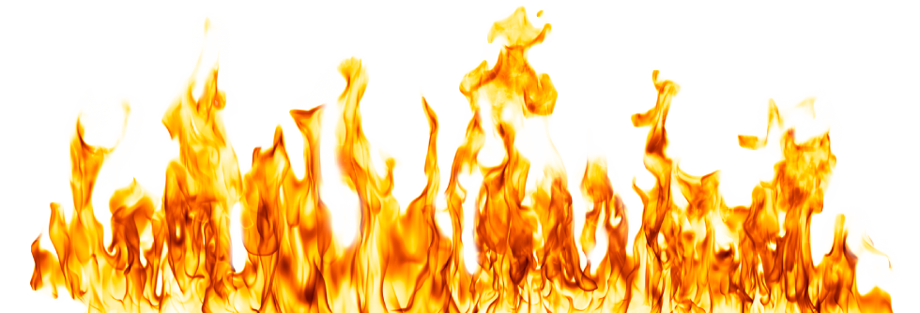
DEFINE ‘Hell’
Anything other than “Celestial”
Location of Satan and his followers and the sons of perdition, who are not redeemed by the Atonement of Jesus Christ. (BD, Hell)
Spirit prison.
A place within Spirit Prison (see Alma 40:13-14)
A condition of mind (see Alma 40:13-14)

Slide 21
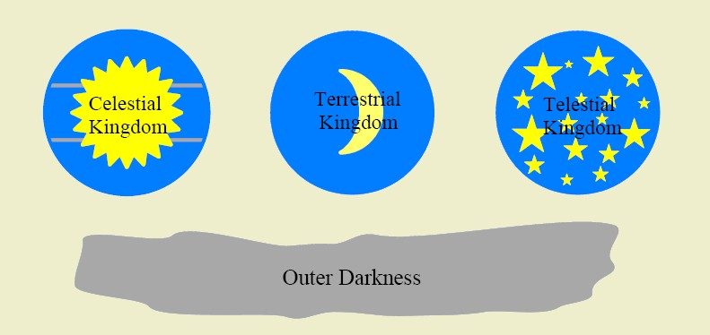
The Celestial Kingdom
D&C 76:50-70, 92-96
Received the testimony of Jesus
Received the ordinances of salvation
Kept the commandments
Repented of sins
Made perfect through Christ

Slide 22
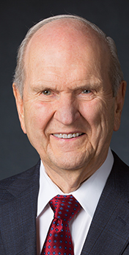
What does “Perfection” mean?
“Perfection is much more than errorless performance.… The Lord restored his church to help us prepare for perfection. The perfect man is the completed person; the glorified soul!
“We need not be dismayed if our earnest efforts toward perfection now seem so arduous and endless. Perfection is pending. It can come in full only after the Resurrection and only through the Lord.” (“Perfection Pending,” Ensign, Nov. 1995, 87, 88).

Slide 23
The Terrestrial Kingdom
D&C 76:75-79
Honorable people (D&C 76:75).
Those who were “not valiant in the testimony of Jesus” (D&C 76:79).
Those who *rejected the opportunity* to receive the gospel in mortality but who later received it in the spirit world (D&C 76:73-74).

Slide 24
The Telestial Kingdom
D&C 76:89-103
Murderers, liars, sorcerers, adulterers, and whoremongers, etc (see D&C 76:103).
Telestial glory surpasses all human understanding (see D&C 76:89).
Joseph Smith: "The telestial kingdom is so great, if we knew what it was like we would kill ourselves to get there."
According to Charles Lowell Walker, Wilford Woodruff referred to a saying of Joseph Smith: “If the People knew what was behind the veil, they would try by every means to commit suicide that they might get there, but the Lord in his wisdom had implanted the fear of death in every person that they might cling to life and thus accomplish the designs of their creator." (From Richard Neitzel Holzapfel, "Eternity Sketch'd in a Vision," The Heavens Are Open (1992 Sperry Sympsoium, Deseret Book, 1993), p. 155)

Slide 25
Perdition
D&C 76:35-43
Rebelled during premortality
“Having denied the Holy Spirit and having denied the Only Begotten Son of the Father, having crucified him unto themselves and put him to open shame” (D&C 76:35).
Joseph Smith: “He must receive the Holy Ghost, have the heavens opened unto him, and know God, and then sin against Him. He has got to say that the sun does not shine while he sees it; he has got to deny Jesus Christ when the heavens have been opened unto him and from that time he begins to be an enemy.” (Teachings of the Prophet Joseph Smith, p.358)
Cain shall be called Perdition, Moses 5:24.

Slide 26
Perdition
“They must have had a fullness of knowledge; a testimony which cannot be destroyed. It is doubtful if even Judas, who betrayed Jesus, was sufficiently enlightened to become a son of perdition.” (Joseph F. Smith, Gospel Doctrine, p. 545)
“It is a lie that our sins can run too deep that any one of us has sunk below the reach of the Savior and his atonement. The scriptures give us only one exception: those who have sinned against the Holy Ghost. If we do not fall into this category (and those who do are few), we can, with the help of the Lord, come back onto the path and become clean.” (Elder Ballard, Ensign, September 1990)

Slide 27
Questions?
Resurrection: Terrestrial
Millennium Begins
Three Degrees of Glory (O.D.)
Appearance to the World
Satan Bound
Wicked Destroyed
Resurrection: Telestial
Resurrection of the Celestial
Resurrection: O.D.
Final Battle
Final Judgment
Millennium
1000 years

Slide 28
The Book of Revelation

