Slide 1
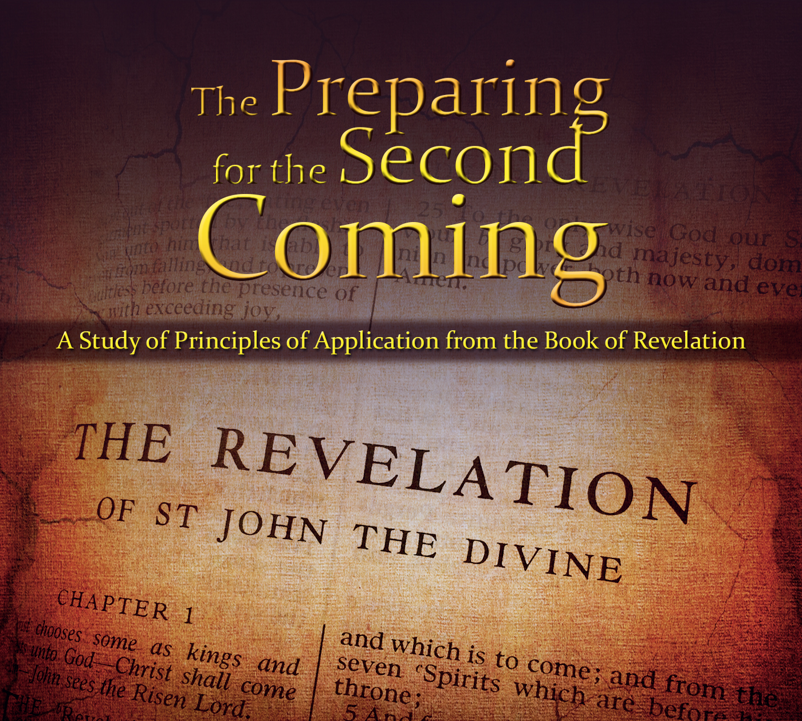
The Book of Revelation:
Preparing for
The Second Coming

Slide 2
The Second Coming is like…

Slide 3
Studio C 5 Day Weather Forecast: www.youtube.com/watch?v=zbHW1T7boSc

Slide 4
The Second Coming
Timeline of Events
Adam Ondi Ahman
Armageddon
Appearance in Jerusalem
Resurrection of the Celestial
Righteous Caught Up
Appearance to the World
Resurrection of the Terrestrial
New Jerusalem
3 Degrees of Glory (O.D.)
Millennium Begins
Satan Bound
Resurrection of the Telestial
Resurrection of the O.D.
Wicked Destroyed
Final Battle
Celestial
1000 years
“The resurrection is followed immediately by the Final Judgment” Elder Oaks (April 2000), (see 2 Ne. 9:15, 22; Mosiah 26:25; Alma 11:43–44; Alma 42:23; Morm. 7:6; Morm. 9:13–14).

Slide 5
Chapter 20
The Millennium

Slide 6
The Millennium
First things first: Revelation 20:1-3
More details: Revelation 21:1-4
Even more: D&C 130:8-11

Slide 7
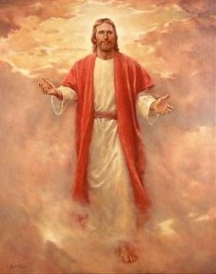
True/False Millennium Events

Slide 8
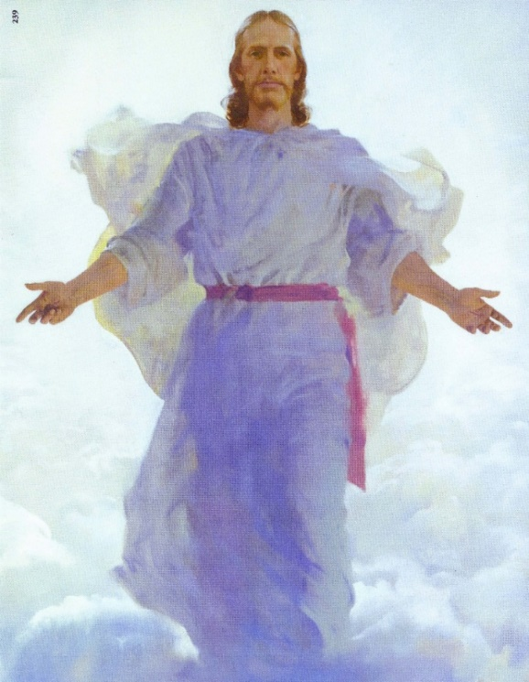
True or False? (D&C 133:46-48; Isa. 63:2-4)
Christ will appear clothed in pure white dazzling clothing at the Second Coming.

Slide 9
True or False? (Malachi 4:1)
The Telestial and Terrestrial people will be burned
“Only those who have lived the telestial law will be removed. The earth will be cleansed of all its corruption and wickedness. Those who have been honest in their dealings with their fellow man and have endeavored to do good shall remain” (Joseph Fielding Smith, Doctrines of Salvation, 3:62).

Slide 10
True or False?
We can speed up the Second Coming through Righteous Living
“He will come at the appointed time. The Millennium will not be ushered in prematurely because men turn to righteousness, nor will it be delayed because iniquity abounds.” (Bruce R. McConkie, The Millennial Messiah,26–27).

Slide 11
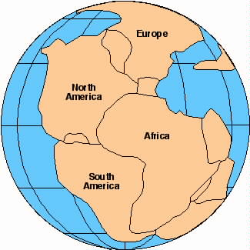
True or False? (D&C 133:23-24; Isa.62:4)
The continents will come back together at the second coming?

Slide 12
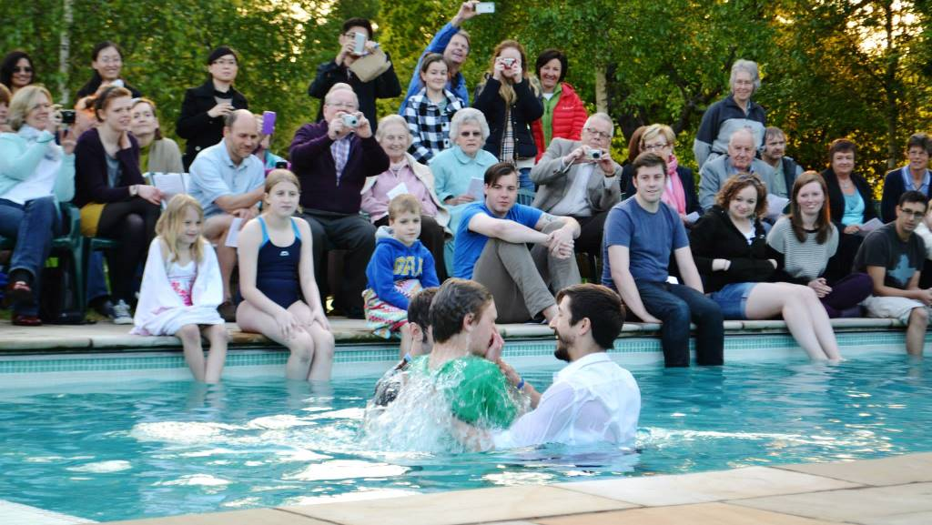
True or False? (Micah 4:5)
At the beginning of the millennium all people will join the church.

Slide 13
other religions during the millennium?
“There will be every sort of sect and party, and every individual following what he supposes to be the best in religion, and in everything else, similar to what it is now." (Brigham Young, JD 2:316.) "In the millennium men will have the privilege of being Presbyterians, Methodists or Infidels, but every knee shall bow and every tongue confess to the glory of God the Father that Jesus is the Christ." (Brigham Young, JD 12:274.)

Slide 14
other religions during the millennium?
"The gospel will be taught far more intensely and with greater power during the millennium, until all the inhabitants of the earth shall embrace it. . . .eventually, all people will embrace the truth." (Joseph Fielding Smith, Doctrines of Salvation, 3:64.)

Slide 15
True or False?
Christ will be on the earth every day of the millennium
“Christ and the resurrected Saints will reign over the earth during the thousand years. They will not probably dwell upon the earth, but will visit it when they please, or when it is necessary to govern it” (History of the Church 5:212).

Slide 16
True or False? (Zephaniah 3:9)
Language classes will be very popular during the Millennium

Slide 17
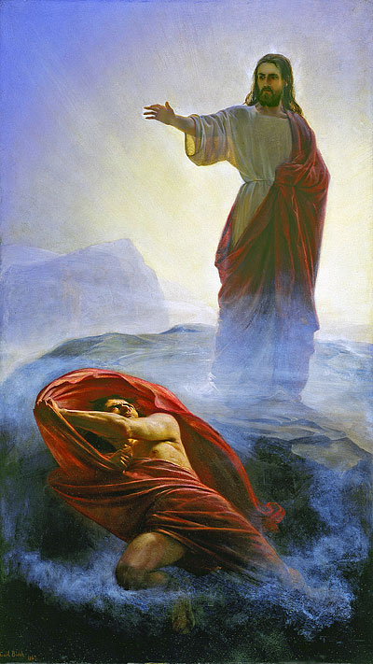
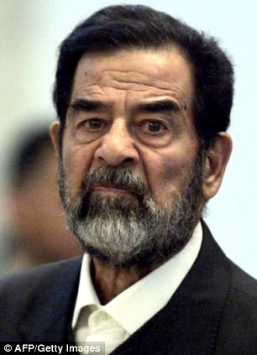
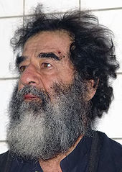
True or False? (Isa.14:12-17)
We will be shocked at how wimpy Satan looks when we see him after the Second Coming?

Slide 18
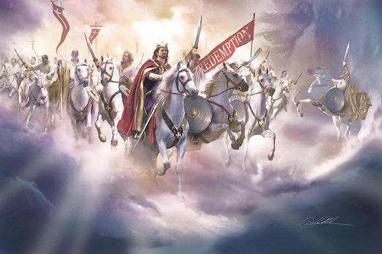
True or False? (Isa.65:17; Rev. 21:1; D&C 101:25)
We will tell war stories to our children about what it was like in the old days when Satan was around.

Slide 19
True or False? (Isa.65:20)
100th birthday parties will be quite the party!

Slide 20
True or False? (Isa. 35:5-6)
All parents who lost babies to premature death will be able to raise their children.
"Singleness, childlessness, death, and divorce frustrate ideals and postpone promised blessings. . . . The Lord has promised that in the eternities no blessing will be denied his sons and daughters who keep the commandments. Many of the most important deprivations of mortality will be set right in the Millennium [including] temple ordinances and family relationships and experiences.” Dallin H. Oaks, in Conference Report, October 1993, 101.

Slide 21
Millennial FAMILIES
“If parents are righteous, they will have their children after the resurrection. Little children who die, whose parents are not worthy of an exaltation, will be adopted into the families of those who are worthy.” (Joseph Fielding Smith, Doctrines of Salvation, comp. Bruce R. McConkie, 3 vols. [1954-1956], 2:56).

Slide 22
True or False? (1 Nephi 22:15; D&C 101:28)
During the Millennium Children will no longer have curfews.

Slide 23
True or False? (Isa.65:21-22)
We will not work or live in homes during the Millennium?

Slide 24
Millennium Housing
“We will have the privilege of associating with those who have received their resurrection. Our Lord and Savior will be a familiar figure among the righteous saints. Instruction will be given by resurrected prophets. . . . Those who have passed through the resurrection will not, however, dwell with those in mortality. They will not stay in earthly, or human homes nor sleep in the beds of mortals.“
Joseph Fielding Smith, The Way to Perfection (Salt Lake City: Deseret Book, 1975), 312-13.

Slide 25
The Millennium
“Crops will be planted, harvested, and eaten; industries will be expanded, cities built, and education fostered; men will continue to care for their own needs, handle their own affairs, and enjoy the full endowment of agency. Dwelling in peace, living without disease, and progressing as the Holy Spirit will guide, the advancement and perfection of society during the millennium will exceed anything men have supposed.”
(Mormon Doctrine, pp. 496–97, as quoted in the Old Testament
Institute Student Manual, Isaiah 65.)

Slide 26
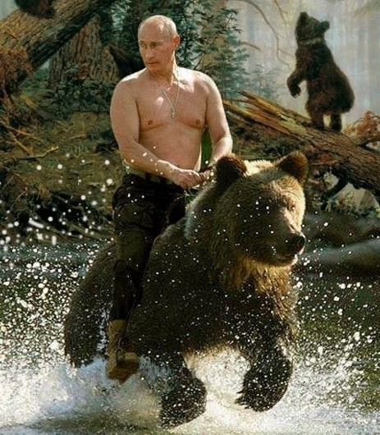
True or False? (Isaiah 65:25; D&C 101:26, Isa.1 1:6-9)
You will be able to wrestle with a bear and he will not bite your head off.

Slide 27
True or False? (Isa.11:6-8; 65:25)
All people will be vegetarians in the Millennium?
“…Man and all forms of life will be vegetarians in the coming day; the eating of meat will cease, because, for one thing, death as we know it ceases. There will be no shedding of blood, because man and beast are changed (quickened) and blood no longer flows in their veins.”
(Bruce R. McConkie, The Millennial Messiah: The Second Coming of the Son of Man [Salt Lake City: Deseret Book Co., 1982], 658.)

Slide 28
True or False? (D&C 101:29-31)
Physicians, beauticians, and morticians will all be unemployed.

Slide 29
True or False? (D&C 101:32-34, Isa. 11:9, ISA 65:24)
Siri, Alexa, and Google Search will retire during the Millennium

Slide 30
True or False? (1 Nephi 22:26)
Satan will not be able to tempt during the Millennium
“In that day Satan shall not have power to tempt any man." (D&C 101:28.)
“Because of the righteousness of his people, Satan has no power; wherefore, he cannot be loosed for the space of many years." (1 Ne. 22:15, 24-26.)

Slide 31
True or False? (1 Nephi 22:26)
Satan will not be able to tempt during the Millennium
“Satan will be bound by the power of God [and] bound also by the determination of the people of God not to listen to him…To deprive men of their agency is contrary to the purposes of our God” (Cannon,Gospel Truth, 1:86).

Slide 32
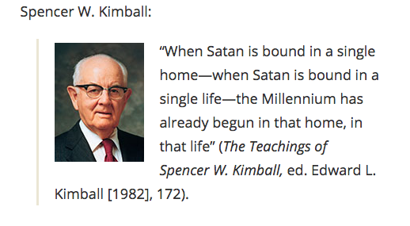

Slide 33
True or False? (Isaiah 13:10)
At the end of the Millennium, the earth will roll back toward Kolob
“The earth will abide its creation, and will be counted worthy of receiving the blessings designed for it, and will ultimately roll back into the presence of God who formed it and abide for ever and for ever” (Brigham Young, Discourses of Brigham Young, 101–2).

Slide 34
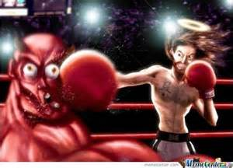
True or False?
After Satan is loosed for a short season, Michael and his host will destroy him forever.

Slide 35
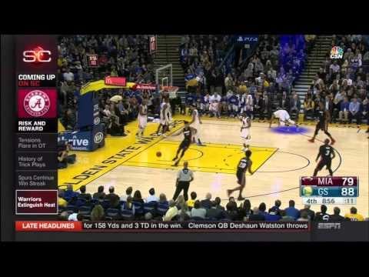
Sportscenter
88
69

Slide 36
Sportscenter
88
69
GS Warriors mount huge comeback to beat MIA Heat 109-98

Slide 37
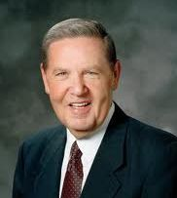
“The future of this world has long been declared; the final outcome between good and evil is already known. There is absolutely no question as to who wins because the victory has already been posted on the scoreboard. The only really strange thing in all of this is that we are still down here on the field trying to decide which team’s jersey we want to wear!” (BYU Devotional, 1983)

Slide 38
The Book of Revelation:
Preparing for
The Second Coming

