Slide 1
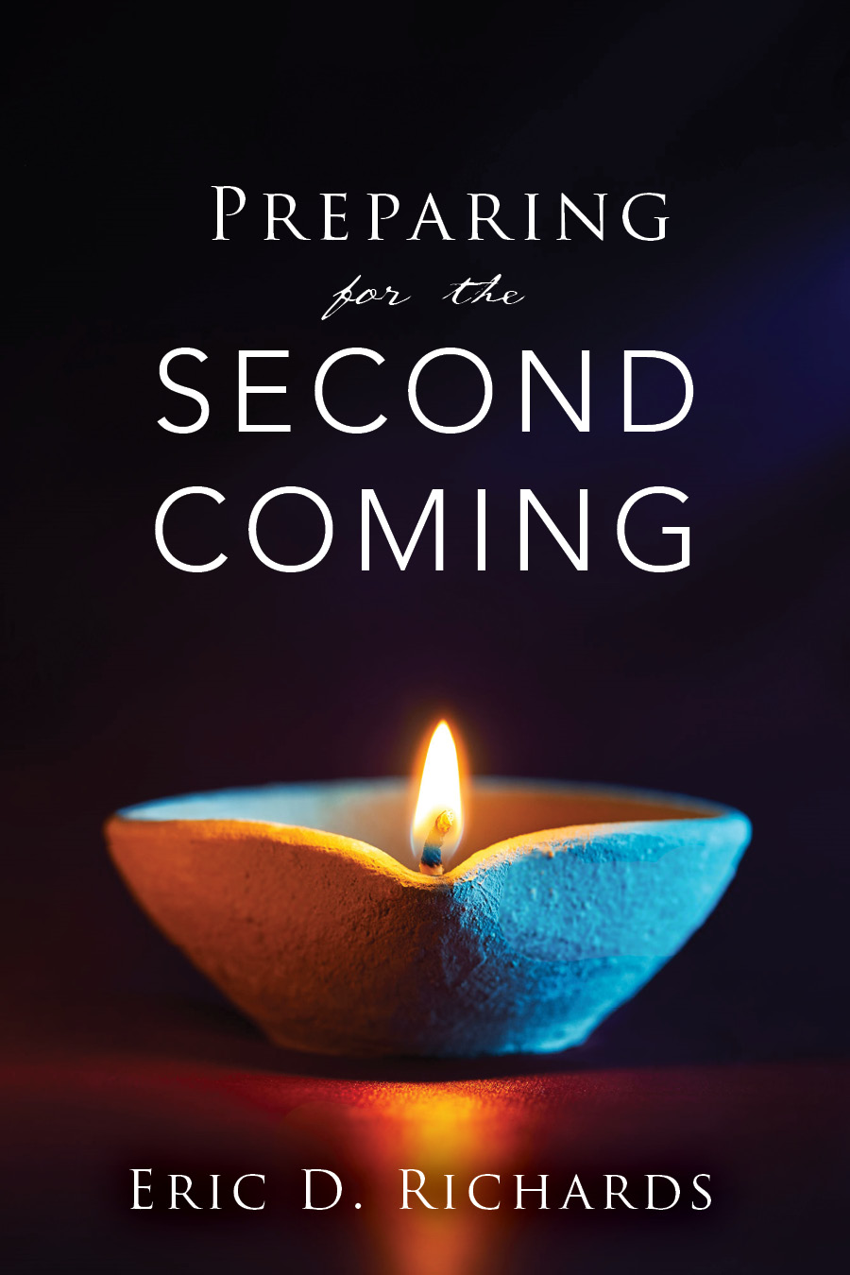
The Book of Revelation

Slide 2
Yet to Happen
Myth #1: We’re going to walk to Missouri to prepare for the Second Coming.
BACKGROUND: Joseph F. Smith: “When God leads the people back to Jackson County, how will he do it? I think I see people wending their way across the great plain and not traveling by railroads...”

Slide 3
Yet to Happen
Myth #1: We’re going to walk to Missouri to prepare for the Second Coming.
Elder Bruce R. McConkie: “‘The place of gathering for the Mexican Saints is in Mexico; … Japan is for the Japanese; Korea is for the Koreans; Australia is for the Australians; every nation is the gathering place for its own people.’” (Ensign, July 1973, p. 5.)

Slide 4
Yet to Happen
Myth #2: Immense destructions in Missouri
BACKGROUND: Amanda H. Wilcox reports Heber C. Kimball as saying, “Missouri will be swept so clean of its inhabitants that, as President Young tells us, when we return to that place, there will not be left so much as a yellow dog to wag his tail.’” (Prophetic Sayings of Heber C. Kimball to Sister Amanda H. Wilcox, n.p., n.d., p. 6.)

Slide 5
Yet to Happen
Myth #2: Immense destructions in Missouri
BACKGROUND 2: Joseph Smith said, “‘God’s wrath hangs over Jackson County … and you will live to see the day when it will be visited by fire and sword. The fields and farms and houses will be destroyed, and only the chimneys will be left to mark the desolation.’
TRUTH: “Elder B. H. Roberts published this statement from Joseph Smith based on what Joseph told to Alexander Doniphan (his lawyer) and what Doniphan’s brother-in-law said about it 70 years after it occurred.

Slide 6
Yet to Happen
Myth #3: The Mormons will save the Constitution
BACKGROUND: “You will see the Constitution of the United States almost destroyed. It will hang like a thread as fine as a silk fiber and it will be preserved and saved by the efforts of the White Horse…” (John J. Roberts, "Reminiscences and Diaries 1898-1902", Microfilm Manuscript, Church History Library, Salt Lake City, Utah).
TRUTH: “The so-called 'White Horse Prophecy' is based on accounts that have not been substantiated by historical research and is not embraced as Church doctrine.“ ("Church Statement on 'White Horse Prophecy' and Political Neutrality", Public Affairs Department, LDS Church, August 25, 2011)

Slide 7
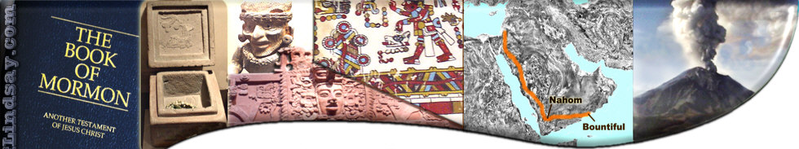
Book of Mormon Evidences
“The Farm Boy does it again!”
Joseph Smith’s Greatest Hits
Hail to the 3rd Grade Teacher

Slide 8
Book of Mormon Evidences
Stylometrics
The study of linguistic style, often used to attribute authorship to anonymous or disputed documents.
https://www.youtube.com/watch?v=-Ke4d7HXae0

Slide 9
Book of Mormon Evidences
Word Print Analysis
There is a roughly 1 in 15 trillion chance of Nephi and Alma having the same author.
There is a .001% chance it was written by Joseph Smith, Sydney Rigdon, Oliver Cowdrey, Solomon Spaulding. etc
The Title Page At the End
“Scriptorio” (putting the title page at the END of the book, something which is a hallmark of ancient writings on plates from the Middle East)
Word-Print Analysis & Scriptorio
Notes:
“The title-page of the Book of Mormon is a literal translation, taken from the very last leaf, on the left hand side of the collection or book of plates, the language of the whole running the same as all Hebrew writing in general [that is, from right to left]; it is not by any means a modern composition, either of mine or of any other man who has lived or does live in this generation. … It is a genuine and literal translation of the title-page of the original Book of Mormon as recorded on the plates. (from “History of the Church” manuscript), book A-1, pp. 34–35, Church Archives.)

Slide 10
Book of Mormon Evidences
1 Nephi 4:4 Walls of Jerusalem
Emma Smith remarked when Joseph stopped and said, 'Emma, did Jerusalem have walls surrounding it?' When I informed him it had, he replied, 'O, I thought I was deceived.' (Cited in Cook, David Whitmer Interviews, 126â€“27. In a personal communication dated 18 August 2001, Royal Skousen suggests, plausibly enough, that Joseph probably kept pronouncing Sariah as Sarah.)
Nephi always (perfectly) describes going UP to Jerusalem (e.g., 1 Nephi 3:9; 4:4; 5:6; 7:3–4), and leaving Jerusalem as going down (e.g., 1 Nephi 2:5; 3:4, 16, 22; 4:35; 5:1; 7:2, 5).
Broken Bow + New Arrows?
Jacob 5: Olive Trees
Jewish History, Archery, & Olive Production

Slide 11
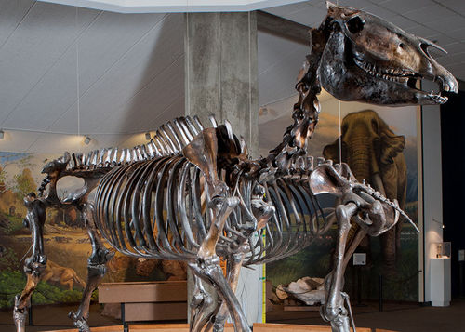
Book of Mormon Evidences
Enos 1:21 Horses
A horse skeleton from the La Brea Tar Pits California. The Museum notes that this is an example of the "extinct Western horse."
Equine History

Slide 12
Alma 11:1-20
Book of Mormon Evidences
Alma 11: Weights and Measures
1 2 4 7
Gold senine seon shum limnah
Silver senum amnor ezrom onti
$1 $2 $3 $4 $5 $6 $7 $8 $9
U.S. CURRENCY ($1 $2, $5,$10) 1 2 3 4 1 2 3 4 5
NEPHITE MONEY (1,2,4,7) 1 1 2 1 2 2 1 2 2
A PERFECT MONETARY SYSTEM
Monetary Systems

Slide 13
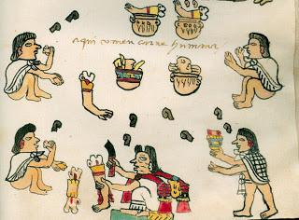
Book of Mormon Evidences
Alma 17: Cutting off Arms
Murals painted in Mexico's National Palace

Slide 14
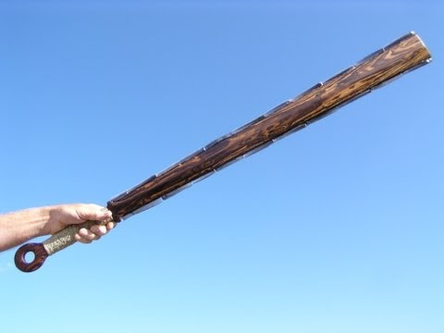
The Art of War in Mesoamerica
Macuahuitl
(Maca-Whee-Tull)
“There was a sort of broadsword set with flint blades that cut much better than our [steel] swords. They killed the mare with a single sword stroke.”
Morrison, Journals of Christopher Columbus, p. 327.
Diaz, Conquest of New Spain, p. 142-3, 145, 158, 228.

Slide 15
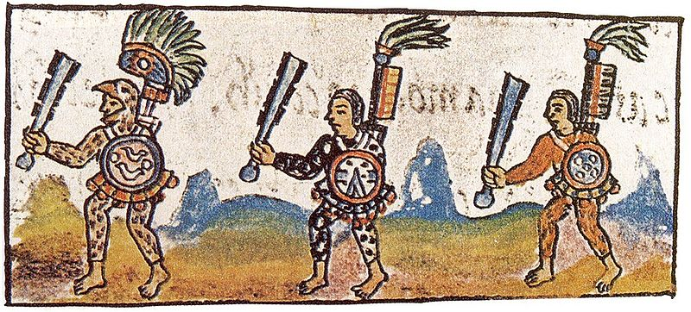
“Pedro de Morón reported that the natives wounded him badly…and then they slashed cut his mare’s head off at the neck so that it hung by the skin, and she fell dead.”
Bernal Díaz del Castillo, ca.1568. In Genaro Garcia, The Discovery and Conquest of Mexico 1517-1521.
Florentine Codex, IX

Slide 16
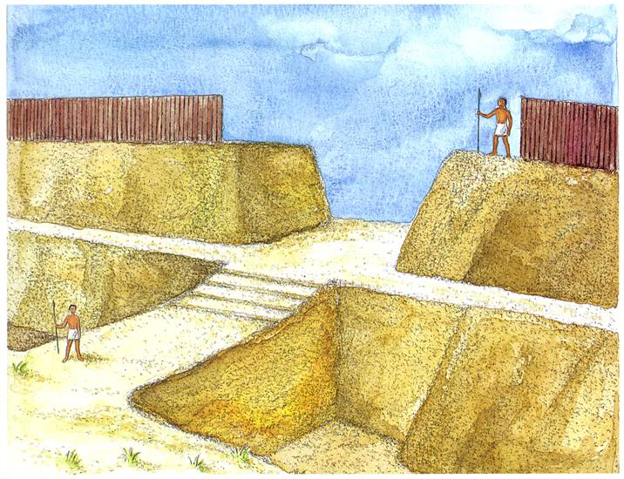
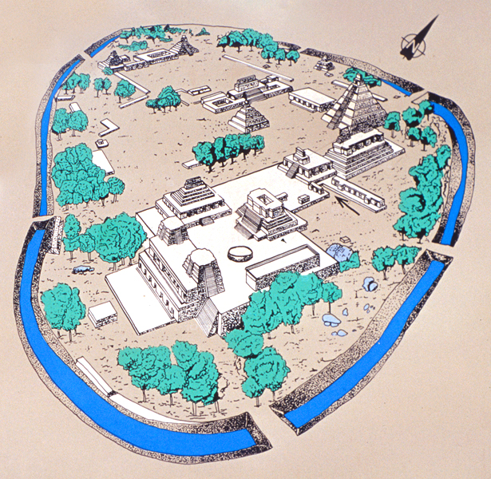
Alma 49:18: The Lamanites could not get into their forts of security because of the highness of the bank which had been thrown up, and the depth of the ditch which had been dug round about.

Slide 17
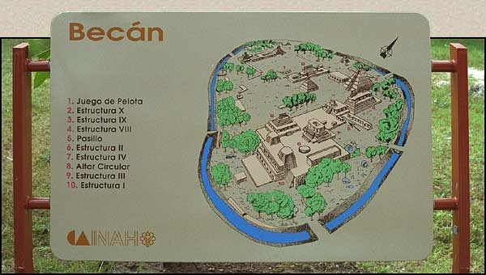
Becán means "ravine or canyon formed by water" in Maya.
Military and War Studies

Slide 18
Book of Mormon Evidences
Alma 63: Polynesia
Helaman 3:9-11 Cement

Slide 19
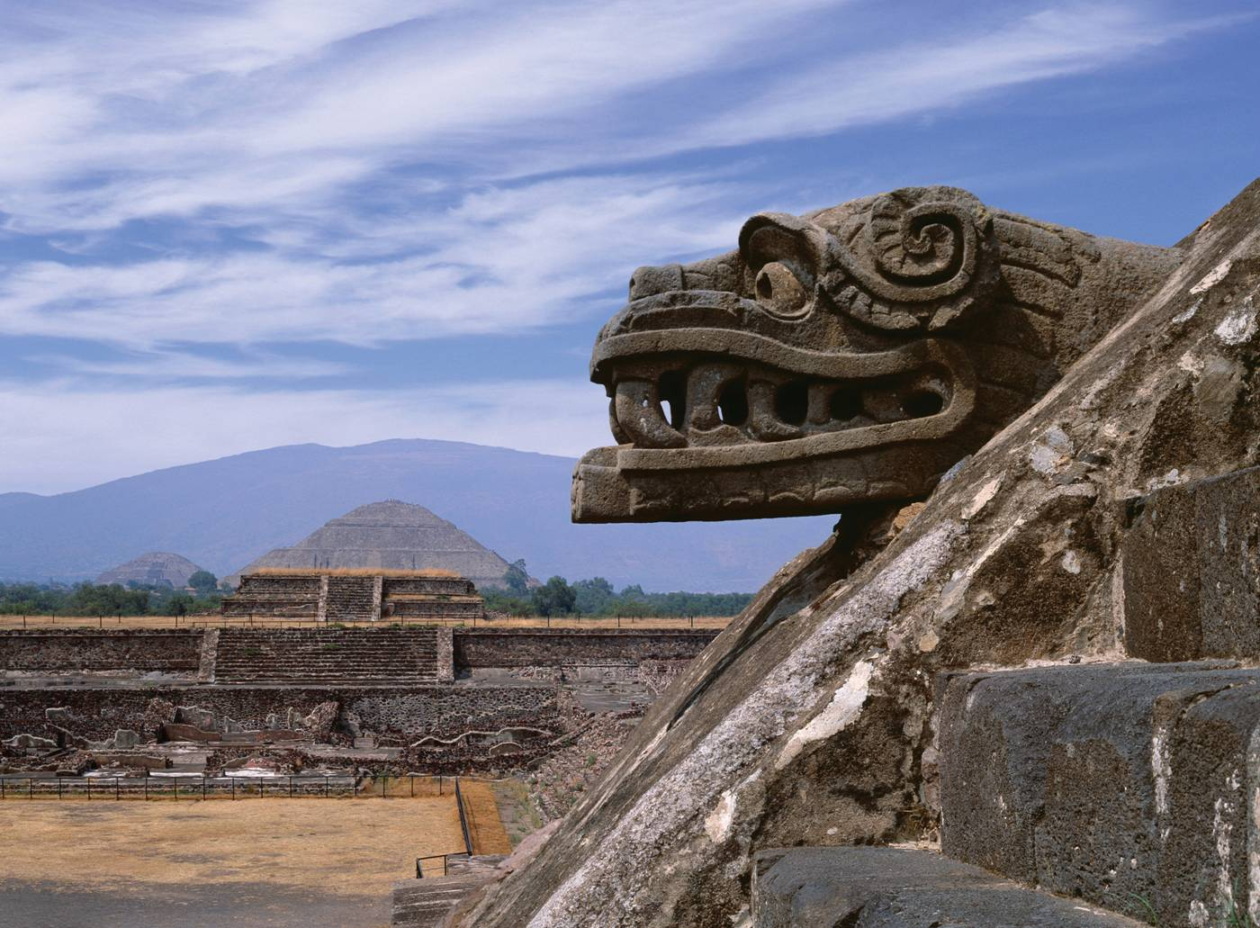
Cement Houses and Cities
(Photo by Val Brinkerhoff)

Slide 20
Temples
Temple at Lamanai, Belize.

Slide 21
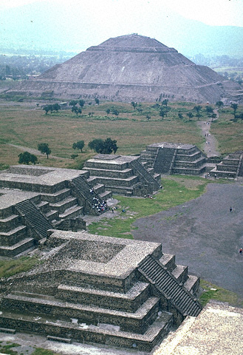
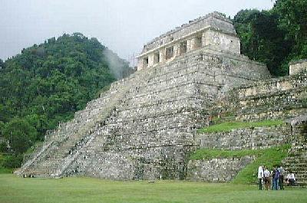
Temples
Teotihuacán
Temple of the Sun (AD 300)
Palenque
Temple of the Inscriptions (AD 692)

Slide 22
Cement Houses and Cities
Masonry roof combes at Yaxchilan, near the Usumacinta River, Chiapas.
Construction Management and Materials

Slide 23
Book of Mormon Evidences
3 Nephi 4: Execution
After Zemnarihah’s execution (3 Ne. 4:28), the tree was chopped down. Why?
3 Nephi 6:8 Highways
“There were many highways cast up, and many roads made, which led from city to city, and from land to land, and from place to place.”

Slide 24
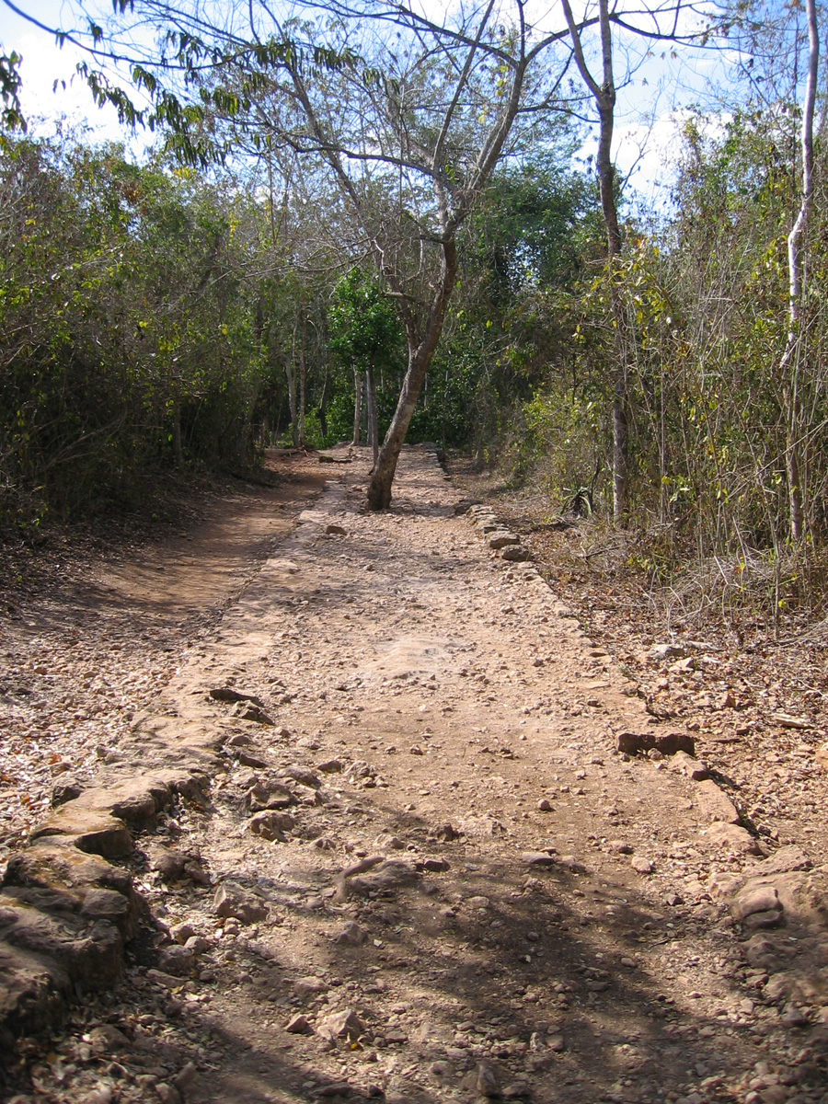
Chichen Itza
Notes:
Tourist information

Slide 25
Book of Mormon Evidences
Deseret
ASSOCIATED PRESS: THURSDAY, SEPTEMBER 06, 2007
“JERUSALEM —ARCHAEOLOGISTS DIGGING IN NORTHERN ISRAEL HAVE DISCOVERED EVIDENCE OF A 3,000-YEAR-OLD BEEKEEPING INDUSTRY….”

Slide 26
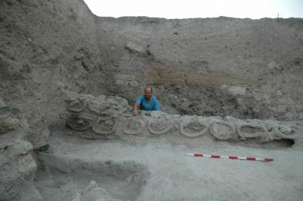
Apiology (Beekeeping)
“IT OFFERS UNIQUE EVIDENCE THAT AN ADVANCED HONEY INDUSTRY EXISTED IN THE HOLY LAND DURING OLD TESTAMENT TIMES.

Slide 27
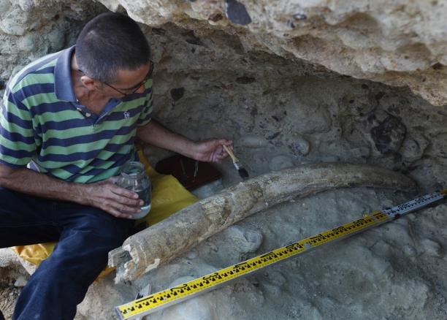
Book of Mormon Evidences
Ether 9:19 Elephants
Tegucigalpa, Honduras

Slide 28
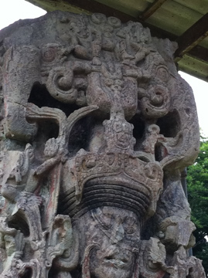

Slide 29
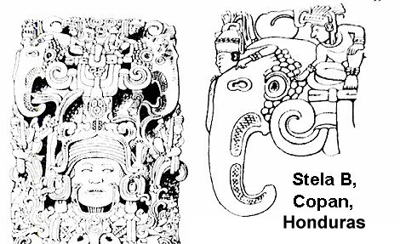
Elephantology
Notes:
Parrot or elephant

Slide 30
Book of Mormon Evidences
Ether 15: Shiz
According to Dr. M. Gary Hadfield, M.D.: "Shiz's death struggle illustrates the classic reflex posture when the upper brain stem is disconnected from the brain. The extensor muscles of the arms and legs contract, and this reflect action could cause Shiz to raise up on his hands.” (M. Gary Hadfield, "Neuropathy and the Scriptures," _BYU Studies_33/2 (1993): 312-20.)
According to Alister Kershaw in "A History of the Guillotine": "It has often been reported that the eyes and mouths of people beheaded have shown signs of movement. It has been calculated that the human brain has enough oxygen stored for metabolism to persist about seven seconds after the head is cut off.”
Execution Methodology

Slide 31
Book of Mormon Evidences
More?
What other evidences have you found?

Slide 32
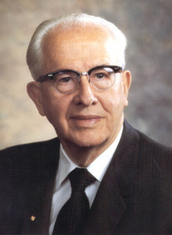
“In the Book of Mormon we find a pattern for preparing for the Second Coming. A major portion of the book centers on the few decades just prior to Christ’s coming to America. By careful study of that time period we can be prepared.”
EXAMPLES?

Slide 33
Third Nephi
A Pattern of the Second Coming
3 Nephi | Subject | Second Coming
3 Nephi 1:4, 8 | Ancient prophecies fulfilled | D&C 29:14
3 Nephi 1:9 | Disbelief from non-believers | JS-Matthew 1:51
3 Nephi 1:15 | Wonders in the heavens | Zechariah 14: 6-7
3 Nephi 1:29-30 | The youth | Isaiah 3:5
3 Nephi 2:1-2 | Antichrist sentiment | 2 Peter 3:3-4, D& C 45:26
3 Nephi 2:11 | Mass use of weapons | D&C 42:64
3 Nephi 2:13 | Wars | D&C 45:26; D&C 87:1-3; JS-M 1:28
3 Nephi 2:14-16 | The Lamanites | D&C 49:24
3 Nephi 3: 13 | What is proclaimed? | September 23, 1995

Slide 34
Third Nephi
A Pattern of the Second Coming
3 Nephi | Subject | Second Coming
3 Nephi 4:4 | Food storage | Pres Benson, Ensign, 1/1991
3 Nephi 5:3 | Immorality | 2 Timothy 3:6
3 Nephi 6:5 | Industry/technology | Dan. 12:4; Rev. 13:16-17
3 Nephi 6:16-18 | Personal apostasy | 2 Nephi 28:8-11
3 Nephi 6:21 | Reign of the Judges
3 Nephi 6:23 | The innocent and righteous | 1 Nephi 13:5, 9; D&C 135:4
3 Nephi 7:1-2 | Deteriorating Governmental conditions | D&C 101:76-80
3 Nephi 7:7 | How large is righteous population? | 1 Nephi 14:12
3 Nephi 7:10 | Who lead the opposition? (look at the chapter heading) | Ezekiel 38:2

Slide 35
3 Nephi 7:19
Helaman 5, 11 & Revelation 11
Helaman | Subject | Revelation
Helaman 5:18 | Two Prophets | Revelation 11:3
Helaman 5:40-41 | Preaching to faithless | Revelation 11:2
Helaman 11:3-6 | Seal Heavens Shut | Revelation 11:5-6
Helaman 5:22 | To be Put to Death | Revelation 11:7
Helaman 5:23, 25, 28 | Enemies Felt Great Fear | Revelation 11:11
Helaman 5:27-33 | Earth Shakes | Revelation 11:13
Helaman 5:30-33 | Hear Voice From Heaven | Revelation 11:12
Helaman 5:36 | Raised From Affliction | Revelation 11:11-12

Slide 36
Third Nephi
A Pattern of the Second Coming
3 Nephi | Subject | Second Coming
3 Nephi 8:5-7 | Storms, tempest, thunder | Rev. 16:21; D&C 88:88-90
3 Nephi 8:12, 17 | Whole face of land changed | D&C 133:20-24
3 Nephi 8:14-16 | Destruction of wicked | D&C 133:41; Malachi 4:1
3 Nephi 8:17-18 | Major earthquake | Rev. 16:18
3 Nephi 8:23 | Darkness | Moses 7:61
3 Nephi 9:3-5 | Destruction of three cities | D&C 84:114
3 Nephi 10:1-2 | Period of silence | Rev. 8:1; D&C 38:12
3 Nephi 10:18-19 | Resurrections | D&C 88:96-98
3 Nephi 11:8 | Christ descends from heaven | J.S. Matt. 1:26

Slide 37
Elder Holland Second Coming

Slide 38
The Book of Revelation

