Slide 1
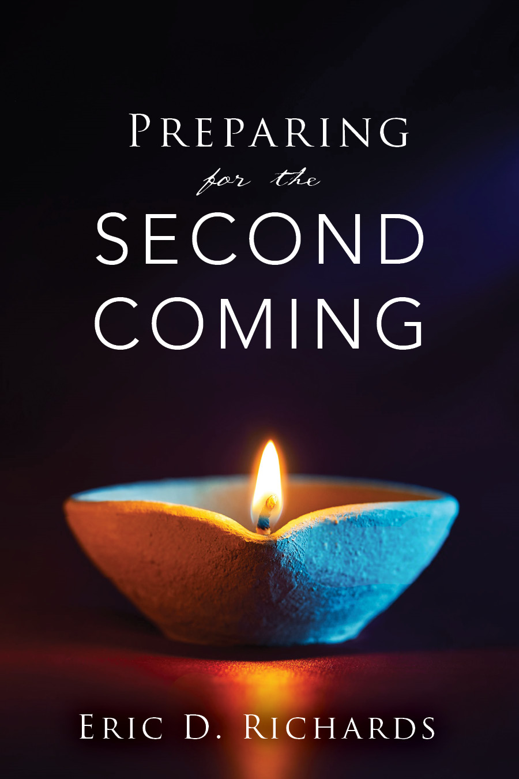
The Book of Revelation

Slide 2
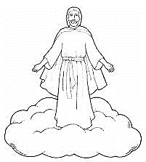
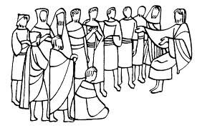
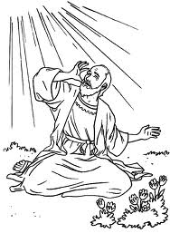
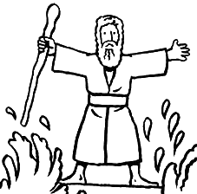
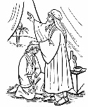
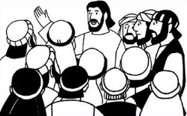
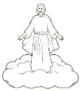
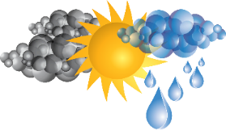
The Book of Revelation
Jesus Christ
John’s 7 Letters to 7 Churches
Throne Theophany
Seven Seals Overview
Revelation 1
Revelation 2-3
Revelation 4-5
Revelation 6-9
The Little Book
2 prophets in Jerusalem
The Dragon, The Beast, and the Victory
Righteous Rewarded
Revelation 10
Revelation 11
Revelation 12-14
Revelation 15
Armageddon
Wicked Destroyed
The Second Coming
Revelation 16
Revelation 17-18
Revelation 19

Slide 3
Chapter 19
Appearance To the World

Slide 4
POPULAR BIBLICAL THEMES
Being born again
9 passages
Baptism
52 passages
Repentance
89 passages
The Second Coming
Over 1,800 passages
(Sterling W. Sill, in Conference Report, Apr. 1966, 19).

Slide 5
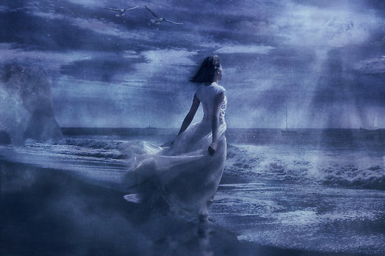
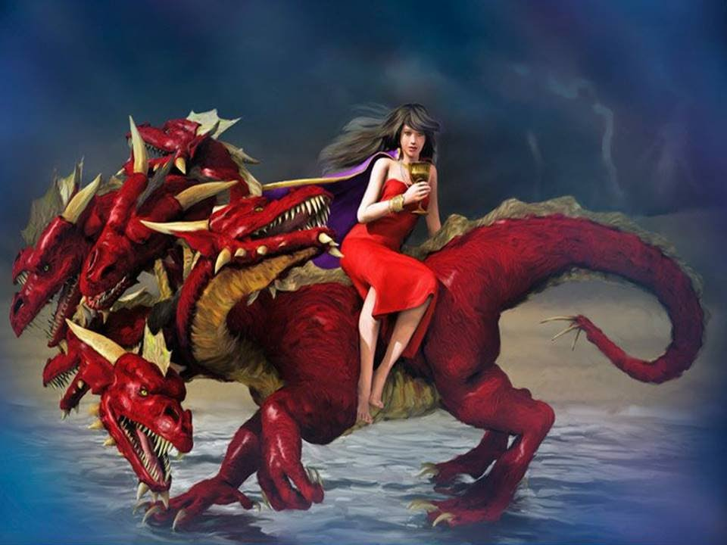
Revelation 19:6-9
How does marriage symbolize the 2nd Coming?
Contrast from Revelation 17?

Slide 6
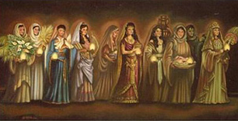
Step | Description | Scriptures
Marriage Covenant | The bride is paid for and the father establishes the marriage covenant. | Acts 20:28; 1Cor. 1Cor. 6:19-20; 1Cor. 11:25 Eph. Eph. 5:25-27
Bridal Chamber Prepared | The son prepares the bridal chamber, adding on to his father-in-law-to-be’s house. | John 6:62; John 14:2; Acts Acts 1:9-11
Bride Fetched | At a time determined by the father, the groom fetches the bride to bring her to his father’s house. | John 14:3; 1Th. 1Th. 4:13-18
How many are there?
How many were wise?
How many were foolish?
How many had oil?
How many had enough oil (in vessels?)
How many were sleeping when the bridegroom came?
What does the oil represent? (Hint: D&C 45:57)

Slide 7
Step | Description | Scriptures
Marriage Covenant | The bride is paid for and the father establishes the marriage covenant. | Acts 20:28; 1Cor. 1Cor. 6:19-20; 1Cor. 11:25 Eph. Eph. 5:25-27
Bridal Chamber Prepared | The son prepares the bridal chamber, adding on to his father-in-law-to-be’s house. | John 6:62; John 14:2; Acts Acts 1:9-11
Bride Fetched | At a time determined by the father, the groom fetches the bride to bring her to his father’s house. | John 14:3; 1Th. 1Th. 4:13-18
Bride Cleansed | The bride undergoes ritual cleansing prior to the wedding ceremony. | 1Cor. 3:12-15; Rev. 19:7-8

Slide 8
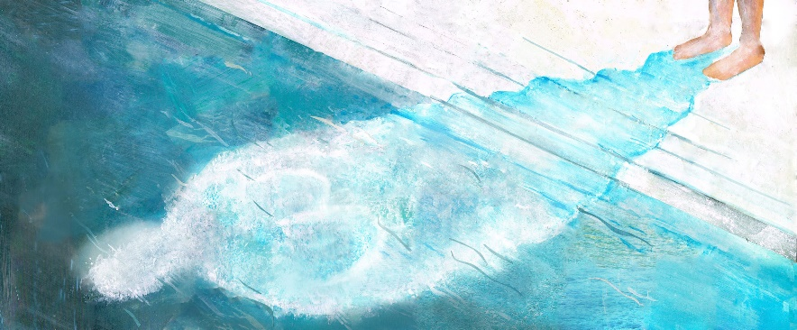
Mikveh
A ritual bath prior to a wedding to allow the bride to quietly mark the transition from being single to being married.
FIRST IMMERSION
“Praised are You, Adonai, God of all creation, who sanctifies us with Your commandments.”
SECOND IMMERSION
“I will betroth you to me forever with righteousness and with justice, with lovingkindness and with compassion and we will come to know God.”
THIRD IMMERSION
“May I step forth into a life filled with continued wisdom and deeds of kindness as a loving mate, partner, and friend to my beloved. Be with me as I enter this new time in my life.”

Slide 9
Step | Description | Scriptures
Marriage Covenant | The bride is paid for and the father establishes the marriage covenant. | Acts 20:28; 1Cor. 1Cor. 6:19-20; 1Cor. 11:25 Eph. Eph. 5:25-27
Bridal Chamber Prepared | The son prepares the bridal chamber, adding on to his father-in-law-to-be’s house. | John 6:62; John 14:2; Acts Acts 1:9-11
Bride Fetched | At a time determined by the father, the groom fetches the bride to bring her to his father’s house. | John 14:3; 1Th. 1Th. 4:13-18
Bride Cleansed | The bride undergoes ritual cleansing prior to the wedding ceremony. | 1Cor. 3:12-15; Rev. 19:7-8
Wedding Ceremony | A private wedding ceremony. | Rev. 19:7
Consummation | In the privacy of the bridal chamber the bride and groom consummate the marriage. | Rev. Rev. 19:7
Marriage Feast | The celebratory marriage feast to which many are invited. | Mat. 22:1-14; Mat. 25:1-13; Luke Luke 12:36

Slide 10
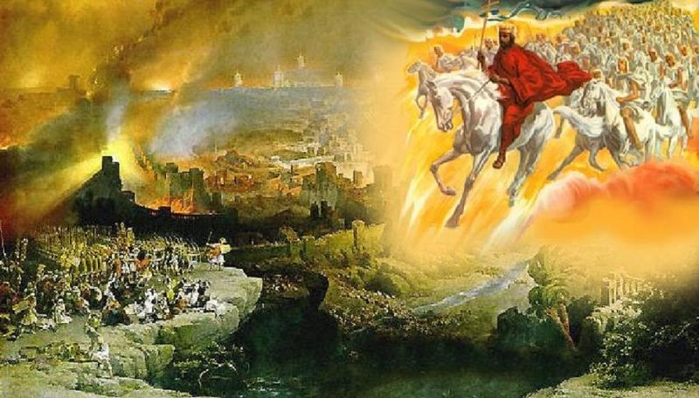
Revelation 19:11-16
What symbols do you see?

Slide 11
SECOND COMING PROPHECIES
D&C 130:14-17
Spirit of Elijah
Gospel Preached in all the World
How?
Online Proselyting
Global Education Initiative
Will the Church be big or small at the Second Coming?
1 Ne 14:12 “…I beheld that the church of the Lamb were upon all the face of the earth; and their dominions upon the face of the earth were small, because of the wickedness of the great whore...”

Slide 12
Will there be no rainbows the year Jesus returns?
Joseph Smith said, "The rainbow is not to be seen. It is a sign of the commencement of famine, pestilence, and so forth, and that the coming of the Messiah is not far distant. So long as you see the rainbow stretching across the heavens, there will be seed time and harvest, and the Son of Man will not come that year (Joseph Smith's Commentary on the Bible).
Date: March 10, 1844.
William Miller predicted the Second Coming would occur sometime before March 21 1844.

Slide 13
APPEARANCES (Woes - Revelation 8:13 )
Adam Ondi Ahman (Rev. 9:1-12.)
Armageddon/2 Prophets/Mt of Olives (Rev. 9:12-21; 11:1-14.)
Christ appears to the World
*(New Jerusalem)
PROPHECIES (Revelation 16)
7 Angels with 7 Vials
Yet to Happen
Missionaries called home (D&C 88:88-89)
Fall of the Abominable Church (D&C 88:94-95)
A Night with no Darkness (Hel 14:3-4, Zech 14:1-7)
The Jews re-inhabit Jerusalem (D&C 45:63–75)
Temple(s) at the New Jerusalem(s) (D&C 45:63–75)
Saints caught up to be with Him (Matthew 24:29-31, 2 Thessalonians 4:16-17, D&C 45:45, Isaiah 40:5)
Others?

Slide 14
“The sun shall be turned into darkness, and the moon into blood, before the great and the terrible day of the LORD come” (Joel 2:28-31)
JS-H 1:41 – “The Angel Moroni quoted the second chapter of Joel, from the twenty-eighth verse to the last. He also said that this was not yet fulfilled, but was soon to be.”
President Gordon B. Hinckley (October 2001 General Conference): "The vision of Joel has been fulfilled wherein he declared [Joel 2:28–32]."

Slide 15
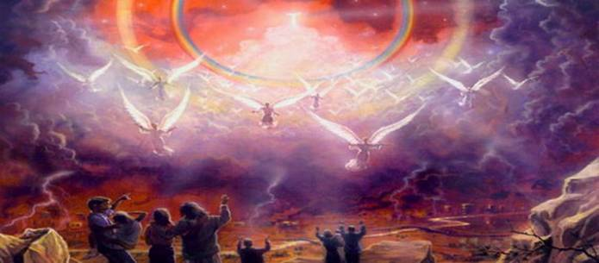
Revelation 19:20-21

Slide 16
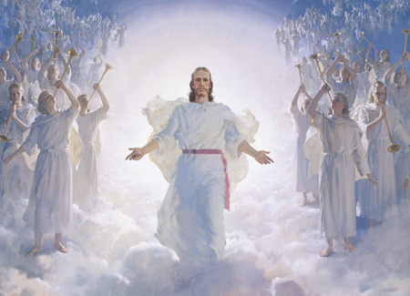
“He comes! The earth shakes, and the tall mountains tremble; the mighty deep rolls back to the north and the rent skies glow like molten brass.
He comes! The dead Saints burst forth from their tombs. The ungodly rush to hide themselves from his presence, and call upon the quivering rocks to cover them.
He comes! The breath of his lips strikes death to the wicked. His glory is a consuming fire. The proud and rebellious are as stubble; Satan and his dark hosts are taken and bound—the prince has lost his dominion, for He whose right it is to reign has come.’” (Charles Penrose, “Second Advent,” 583, as quoted in the Doctrines of the Gospel Institute Student Manual).

Slide 17
“But what will the world do? They will say it is a planet, a comet, etc. But the Son of Man, which will be as the light of the morning cometh out of the east” (Joseph Smith, History of the Church 5:337).
“When the Lord comes in his glory, in flaming fire, intense shall be the heat and so universal the burning, the very elements of which this earth is composed shall melt. The mountains, made of solid rock, shall melt like wax. They shall become molten and flow down into the valleys below. The very earth itself, as now constituted, shall be dissolved. And out of it all shall come new heavens and a new earth whereon dwelleth righteousness” (McConkie, Millennial Messiah, 526–27 as quoted in the Doctrines of the Gospel Institute Manual, Second Coming).

Slide 18
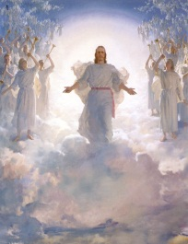
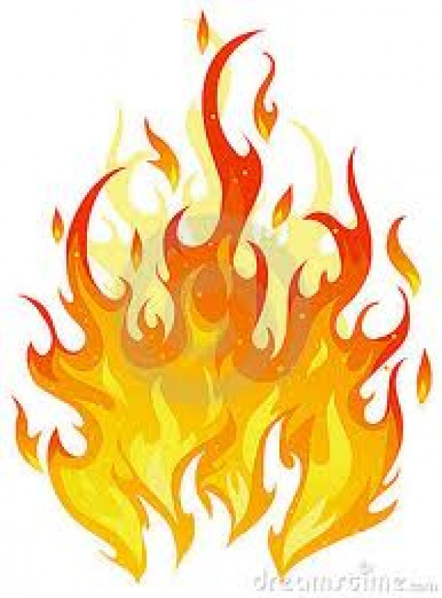
Appearance To the World
Who gets burned?
Why burning?
Malachi 4:1 For, behold, the day cometh, that shall burn as an oven; and all the proud, yea, and all that do wickedly, shall be stubble.

Slide 19
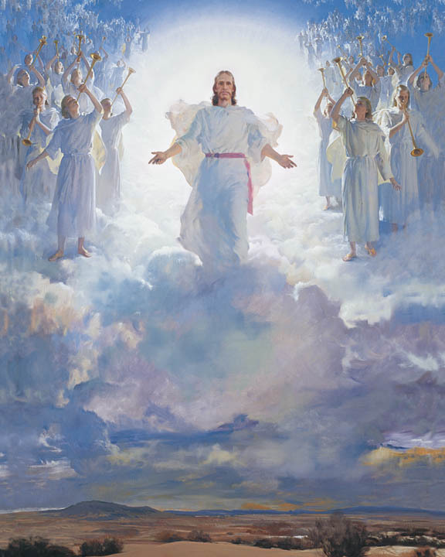
When He Comes Again
I wonder, when he comes again,
Will herald angels sing?
Will earth be white with drifted snow,
Or will the world know spring?
I wonder if one star will shine
Far brighter than the rest;
Will daylight stay the whole night through?
Will songbirds leave their nests?
I’m sure he’ll call his little ones
Together ’round his knee,
Because he said in days gone by,
“Suffer them to come to me.”
Words and music: Mirla Greenwood Thayne, 1907–1997 © 1952 by Mirla Greenwood Thayne, Provo, Utah. Renewed 1980. Used by permission. This song may be copied for incidental, noncommercial church or home use.

Slide 20
When He Comes Again
I wonder, when he comes again, Will I be ready there To look upon his loving face And join with him in prayer? Each day I’ll try to do his will And let my light so shine That others seeing me may seek For greater light divine. Then, when that blessed day is here, He’ll love me and he’ll say, “You’ve served me well, my little child; Come unto my arms to stay.”
Words and music: Mirla Greenwood Thayne, 1907–1997 © 1952 by Mirla Greenwood Thayne, Provo, Utah. Renewed 1980. Used by permission. This song may be copied for incidental, noncommercial church or home use.

Slide 21
The Book of Revelation

