Slide 1
The Book of Revelation

Slide 2
Chapter 17-18
Satan’s Kingdom Destroyed

Slide 3
7 Seals (Revelation 6:1-13)
APOSTASY/
SIGNS
ADAM
NOAH
AB/JOSEPH
HEROD/ALEX
MARTYRS
2nd COMING
1st Seal
2nd Seal
3rd Seal
4th Seal
5th Seal
6th Seal
7th Seal
4000 BC
3000 BC
2000 BC
1000 BC
0
1000 AD
2000 AD
7 Trumpets (Revelation 8:2-6)
1st Angel
2nd Angel
3rd Angel
4th Angel
5th Angel
6th Angel
7th Angel
Hail with Fire &Blood
Sea to Blood
Fresh Water Poisoned
Darkness
Wars
Armageddon
Announcing Christs Return
7 Vials (Revelation 16)
1st Angel
2nd Angel
3rd Angel
4th Angel
5th Angel
6th Angel
7th Angel
Sores
Sea to Blood
Fresh Water to Blood
Heat
Darkens
Armageddon
Hail, Thunder, Lightning
The Fall of Babylon (Rev 17-18)

Slide 4
Symbolism of Color
Red
Sin and sinfulness (Isaiah 1:18, Psalm 75:8, Isaiah 63:2, 2Kings 3:22, Nahum 2:3, Zechariah 1:8, 6:2, Revelation 6:4, 12:3, Proverbs 23:31).
Blue
God (Exodus 24:10, 25:3, 38:18, Numbers 4:6 - 12, 2Chronicles 2:7, Ezekiel 1:26, etc.), or service to God and Godly living (Exodus 28:6, 8, 13, 31, Numbers 15:38 - 40, Esther 8:15).
Purple (Red+Blue)
Royalty, majesty (Judges 8:26, Esther 8:15)
Used in the tabernacle (veils) and carpets found in the tabernacle; the robe Pontius Pilate's soldiers placed on Jesus was purple or scarlet colored (Matthew 27:28).

Slide 5
Symbolism of Color
Yellow
Trials; usually connected with leprosy (Leviticus 13:30, 32, 36).
Green
Victory; life (Yellow + Blue) Psalm 1:3.
White
Righteousness and purity (Daniel 7:9, Matthew 17:2, Mark 9:3, Luke 9:29, Revelation 1:12 - 14, 6:11, 19:8, 20:11) or purity (Daniel 11:35, 12:10, Psalm 51:7, Isaiah 1:18, Revelation 3:18, 7:9, 13 - 14).
Black
Death and mourning (Psalm 104:2, 1John 1:5)
Gold/Silver
Power, wealth, status; something that endures fire and affliction.

Slide 6
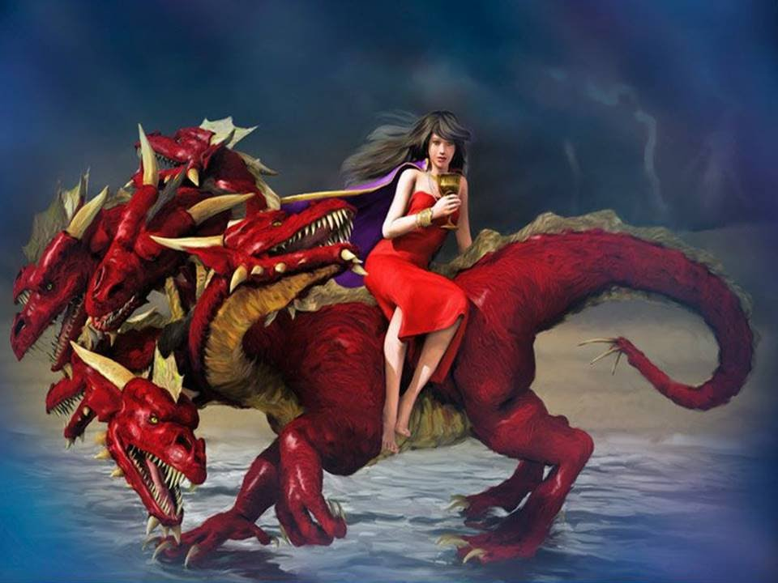

Slide 7
Why fornication?
Why a woman?

Slide 8
Eve – Flesh
Adam – Spirit
“ Let your women keep silence in the churches: for it is not permitted unto them to speak” (1 Cor 14:33)
“I suffer not a woman to teach, nor to usurp authority over the man, but to be in silence.For Adam was first formed, then Eve.” (1 Tim 2)
“Neither was the man created for the woman; but the woman for the man.” (1 Cor 11:9)
“Wives, submit yourselves unto your own husbands, as unto the Lord. For the husband is the head of the wife.” (Eph 5:22-23)

Slide 9
Revelation 17:3-6
Revelation 17:9-13
10 horns = Limited power
7 Crowns = Kingdoms and Governments
5 fallen kingdoms: Assyria, Babylon, Media, Persia, Greece
6th (current) kingdom: Rome
Cross-reference Daniel 7:23-24

Slide 10
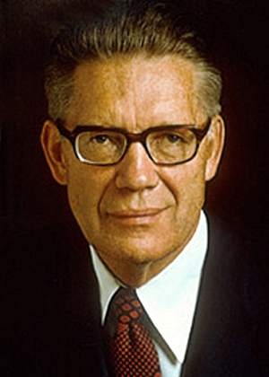
“All of the governments of the earth are in league with the great whore. From time to time, they do such things as: Prohibit the worship of God; deny freedom of religion; fail to guarantee the free exercise of conscience; enact laws which curtail the agency of man; require the teaching of false principles in schools; deny churches the right to teach their doctrines; fail to punish crime and protect the rights of their citizens…” (Elder McConkie, Doctrinal New Testament Commentary, 3 vols. [Salt Lake City: Bookcraft, 1965-1973], 3: 553-554.)
Final kingdom (vs 12-13) will be overcome by the kingdom of God (vs 14). How?

Slide 11
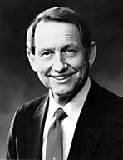
“The Prophet Joseph Smith … said, ‘Patriotism should be sought for and will be found in right living.’ Isn’t that interesting? You can’t be really patriotic unless you’re righteous. No man can be a good Latter-day Saint and not be true to the best interests and welfare of his country.”
Hartman Rector, Jr. “The Land Choice Above All,” in Speeches of the Year, 1974 [Provo: Brigham Young University Press, 1975]

Slide 12
AMERICA
Elder L. Tom Perry: “As Church members, we live under the banner of many different flags. How important it is that we understand our place and our position in the lands in which we live! We should be familiar with the history, heritage, and laws of the lands that govern us.” (in Conference Report, Oct. 1987, 87; or Ensign, Nov. 1987, 72).
What blessings have come as you’ve been involved in your school/community/national clubs/politics?

Slide 13
AMERICA: THE QUIZ
Who sewed the first American flag?
Who wrote the National Anthem?
Which document, drafted in 1215, lead to the colonization of the United States?
Who said, “We hold these truths to be self-evident, that all men are created equal’?
What are the first 10 Amendments to the Constitution called?
How many Amendments have been added to the Constitution?
Who said, “Give me liberty or give me death’?
Which war inspired the writing of the Star Spangled Banner?
What other animal did the Founding Fathers almost select as our National Mascot?
How many Presidents have we had in the United States?

Slide 14
Description
1 Nephi 12:17 Blindeth the eyes, and hardeneth the hearts. 1 Nephi 8:26 …People both old and young, both male and female mocking and pointing their fingers 1 Nephi 11:35 … The house of Israel gathered together to fight against the twelve apostles Lamb. 1 Nephi 12:18 … Vain imaginations and pride… 1 Nephi 13:5-7 Slayeth, tortureth, bindeth, and yoketh them 1 Nephi 13:8-9 Fine-twined linen and all manner of precious clothing; … 1 Nephi 13:9 For the praise of the world do they destroy the saints of God… 1 Nephi 14:6 … The devil is the founder. 1 Nephi 14:10 … The mother of abominations, the whore of the earth. 1 Nephi 14:11 …Dominion among all people.

Slide 15
Consequences
1 Nephi 8:23 … they who had commenced in the path did lose their way and wandered off and were lost. 1 Nephi 8:28 … They were ashamed because of those that were scoffing at them. 1 Nephi 8:32… Wandering in strange roads. 1 Nephi 13:29, 34 … Exceedingly great many do stumble; Satan hath great power over them…. 2 Nephi 28:14… They do err because of the precepts of men. 1 Nephi 8:32 … Many were drowned in the depths of the fountain

Slide 16
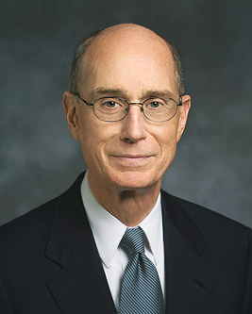
“The spiritual strength sufficient to stand firm just a few years ago will soon not be enough. Many are remarkable in their spiritual maturity and in their faith. But even the best are sorely tested. And the testing will become more severe. Many, say to themselves: “Well, I know I may have to repent some day; I’m only young once. For now, I’ll go with the flow.” Well, the flow has become a flood and soon will be a torrent. It will become a torrent of sounds and sights and sensations that invite temptation and offend the Spirit of God. Swimming back upstream to purity against the tides of the world was never easy. It is getting harder and may soon be frighteningly difficult. We must raise our sights.” (President Eyring, “We Must Raise our Sights,” Ensign, September 2004)

Slide 17
STRENGTH: https://www.youtube.com/watch?v=9aaVy1AmFX4

Slide 18
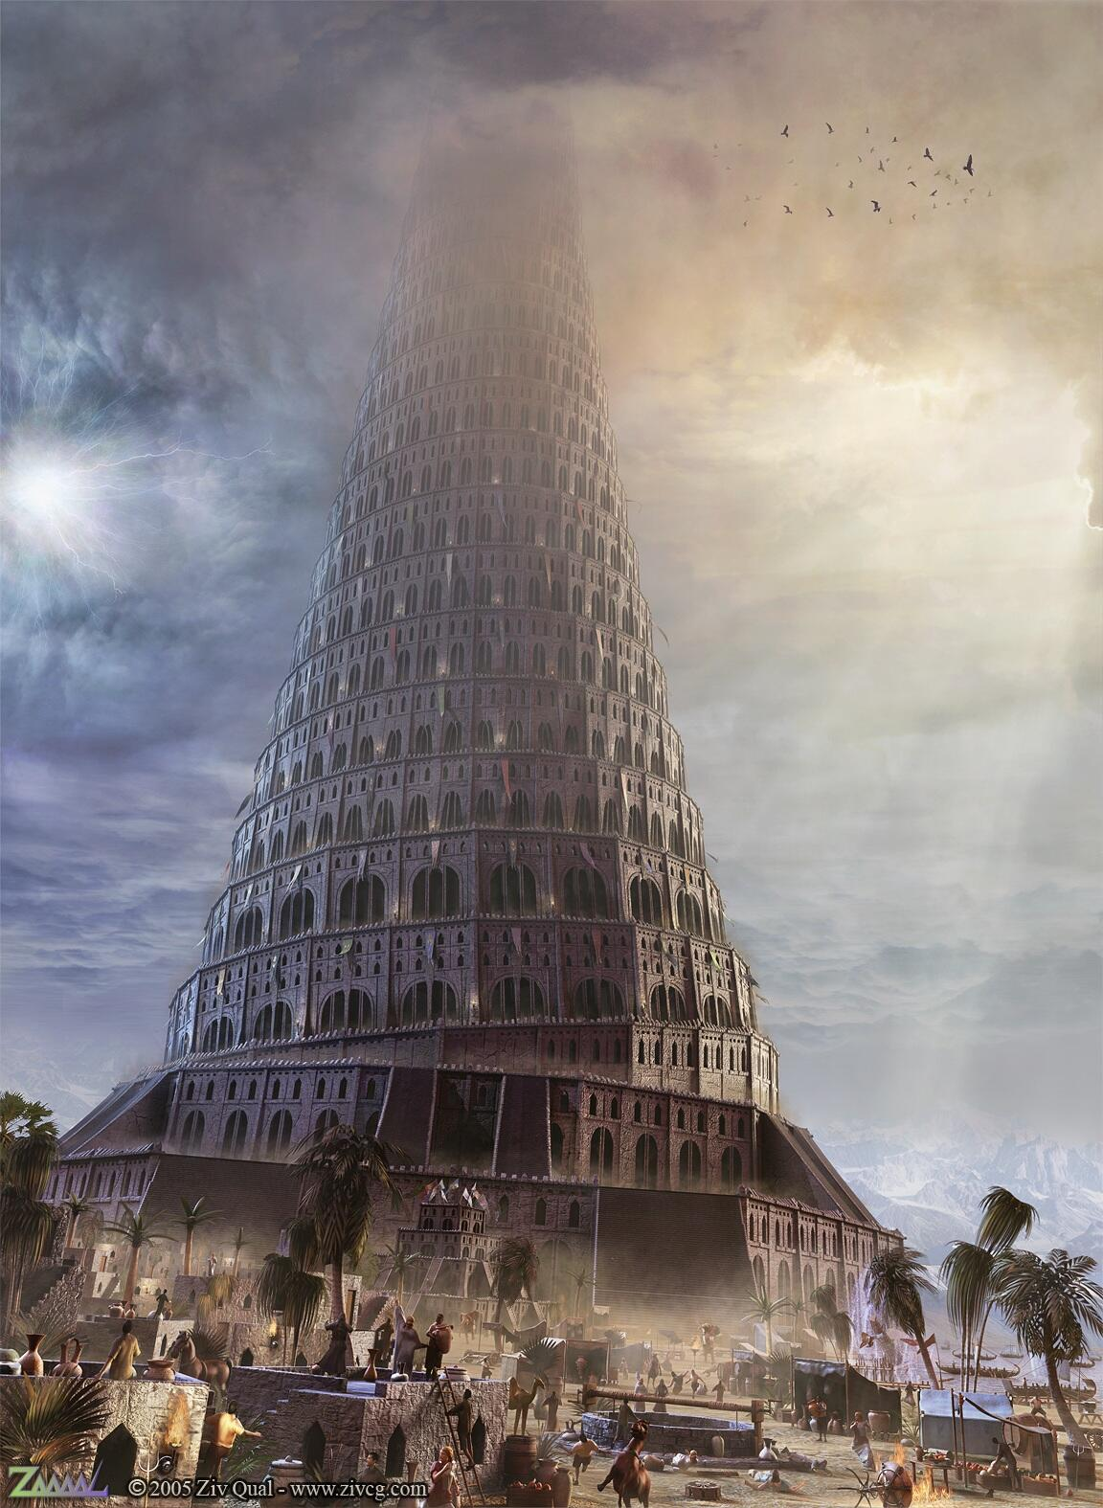
Revelation 18
What do you know about Babel and Babylon?
The Proclamation: Revelation 18:1-4
The world’s reaction: Revelation 18:9-11, 15-16

Slide 19
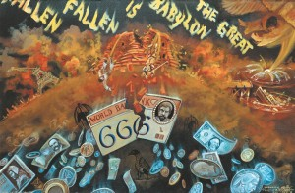
Revelation 18:21-24

Slide 20
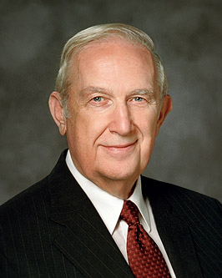
“Despite pockets of evil, the world overall is majestically beautiful, filled with many good and sincere people. God has provided a way to live in this world and not be contaminated by the degrading pressures evil agents spread throughout it. You can live a virtuous, productive, righteous life by following the plan of happiness” (“How to Live Well amid Increasing Evil,” Ensign or Liahona, May 2004, 100).

Slide 21
The Book of Revelation

