Slide 1
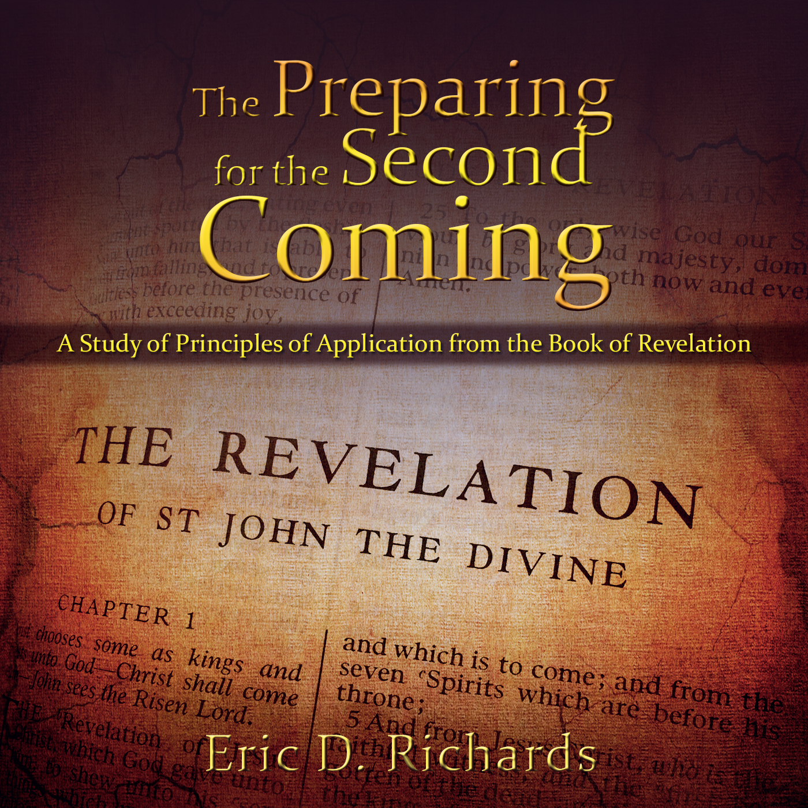
The Book of Revelation:
Preparing for
The Second Coming

Slide 2
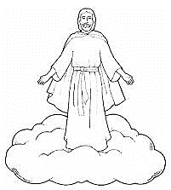
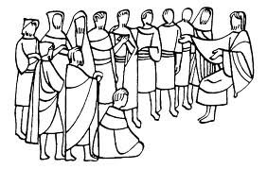
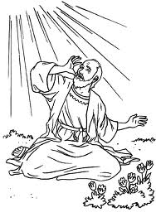
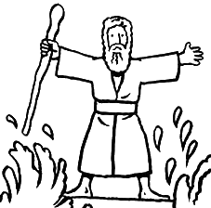
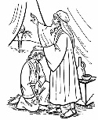
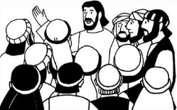
The Book of Revelation
Jesus Christ
John’s 7 Letters to 7 Churches
Throne Theophany
Seven Seals Overview
Revelation 1
Revelation 2-3
Revelation 4-5
Revelation 6-9
The Little Book
2 prophets in Jerusalem
The Dragon, The Beast, and the Victory
Righteous Rewarded
Revelation 10
Revelation 11
Revelation 12-14
Revelation 15

Slide 3
Chapter 15
Righteous Rewards

Slide 4
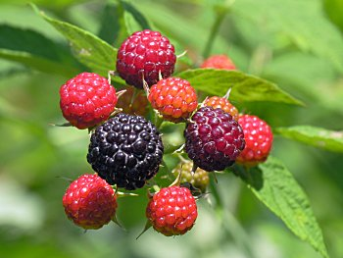
Define “ripe”
Revelation 14:18

Slide 5
The Rewards
Revelation 15:1-4
Cross Reference D&C 25:12
Is the opposite also true?
What testimony can you share of music?

Slide 6
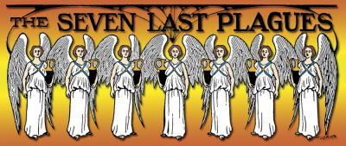
Revelation 15:5-8

Slide 7
Chapter 16
7 Vials
7 Seals
1 2 3 4 5 6 7
7 Trumpets
1 2 3 4 5 6 7
7 Vials
1 2 3 4 5 6 7

Slide 8
7 Seals (Revelation 6:1-13)
APOSTASY/
SIGNS
ADAM
NOAH
AB/JOSEPH
HEROD/ALEX
MARTYRS
2nd COMING
1st Seal
2nd Seal
3rd Seal
4th Seal
5th Seal
6th Seal
7th Seal
4000 BC
3000 BC
2000 BC
1000 BC
0
1000 AD
2000 AD
7 Trumpets (Revelation 8:2-6)
1st Angel
2nd Angel
3rd Angel
4th Angel
5th Angel
6th Angel
7th Angel
Hail with Fire &Blood
Burning Mountain
Fresh Water Poisoned
Darkness
Wars
Armageddon
Announcing Christs Return
7 Vials (Revelation 16)

Slide 9
John Taylor’s Dream/Vision Wilford Woodruff’s Journal, June 15, 1878, “A Vision, Salt Lake City, Dec 16, 1877
“I went to bed as usual at about 7:30PM. I had been read­ing a revela­tion in the French lan­guage. My mind was calm, so I composed myself for sleep, but could not. I felt a strange feeling come over me and the first thing that I recognized was that I was then in a dream, im­mediately in the city of Salt Lake, and wandering around in the streets, and on the doors of the houses I found badges of mourn­ing. I seemed to be in their houses with the sick, but saw no funeral proces­sion, but people were praying. And it seemed that they had controlled the dis­ease…

Slide 10
John Taylor’s Dream/Vision Wilford Woodruff’s Journal, June 15, 1878, “A Vision, Salt Lake City, Dec 16, 1877
“The next thing I knew I was in Omaha. As I passed along upon my way east I saw the road full of people, mostly women, with just what they could carry in bundles on their backs.
The states of Illinois and Mis­souri were in a tumult, men killing one an­other, women joining the fight­ing, fam­ily against family in the most horrid manner.
I imagined next that I was in Wash­ington and I found desola­tion there. The White House was empty and the Halls of Congress the same, everything in ru­ins.
I was in Baltimore. In the square where the Monument of 1812 stands I saw dead piled up so as to fill the street square.

Slide 11
John Taylor’s Dream/Vision Wilford Woodruff’s Journal, June 15, 1878, “A Vision, Salt Lake City, Dec 16, 1877
“The water of Che­sapeake Bay were stagnant and the stench arising from it on ac­count of their throw­ing their bod­ies into it so terrible that the very smell carried death with it.
Next I found myself in Broadway. I saw the bodies of beautiful women lying, some dead and oth­ers in a dy­ing condition, on the sidewalks. I saw men come out of cellars and ravish the per­sons of some that were yet alive and then kill them and rob their bodies of all the valu­ables they had upon them. Then before they could get back to the cellar they would roll over a time or two and die in ag­ony.
In some of the back streets I saw them kill some of their own offspring and eat their raw flesh, and in a few minutes die them­selves. Every­where I went I saw the same scene of horror and de­struction and death and rap­ine.

Slide 12
John Taylor’s Dream/Vision Wilford Woodruff’s Journal, June 15, 1878, “A Vision, Salt Lake City, Dec 16, 1877
“I cannot paint in words the horror that seemed to compass me about; it was beyond description of man. I sup­posed this was the end; I was given to understand the same horror was being en­acted all over the coun­try.
Immediately after I seemed to be standing on the bank of the Mis­souri River, opposite e the City of In­de­pendence. I saw twelve men dressed in temple robes, stand­ing in a square or nearly so. I saw myraids of an­gels hovering over them, and saw also an immense pil­lar of clouds over them and heard the angels singing the most heav­enly music. The words were “Now is estab­lished the King­dom of God and his Christ, which shall never more be thrown down.”
Then I rolled over in bed and awoke just as the city clock was strik­ing twelve.”

Slide 13
Comparisons
# | Plague (Exo) | Seal (Rev 6) | Trumpet (Rev 8) | Vial (Rev 16)
1 | Blood | White Horse | Hail, Fire, Blood | Sores
2 | Frogs | Red Horse | 1/3 Seas | Sea becomes blood
3 | Gnats | Black Horse | Fresh Water | Fresh water
4 | Flies | Pale Horse | Luminaries darkened | Scorching
5 | Disease | Martyrs | 5 Month War | Darkness
6 | Boils | Natural Judgment | Armageddon | Armageddon
7 | Hail | Announcing the Trumpet | Announces the Vials | Great Earthquake
8 | Locusts
9 | Darkness
10 | Death

Slide 14
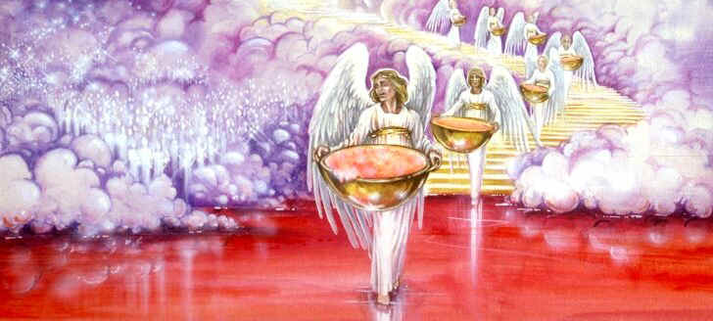
The 7 vials
1st Vial: A sore on the wicked (Revelation 16:2)
2nd Vial : The sea becomes as blood (Revelation 16:3)
3rd Vial : Fresh waters become as blood (Revelation 16:4-7)
4th Vial : Scorching heat (Revelation 16:8-9)
5th Vial : Darkness (Revelation 16:10-11)
6th Vial : Armageddon (Revelation 16:12-16)
7th Vial : Thunder, lightning, and the great earthquake; cities fall; islands flee, and mountains are leveled; a great plague of hail. (Revelation 16:17-21)
Exodus 7-10
Result? Rev 16:11

Slide 15
7 Seals (Revelation 6:1-13)
APOSTASY/
SIGNS
ADAM
NOAH
AB/JOSEPH
HEROD/ALEX
MARTYRS
2nd COMING
1st Seal
2nd Seal
3rd Seal
4th Seal
5th Seal
6th Seal
7th Seal
4000 BC
3000 BC
2000 BC
1000 BC
0
1000 AD
2000 AD
7 Trumpets (Revelation 8:2-6)
1st Angel
2nd Angel
3rd Angel
4th Angel
5th Angel
6th Angel
7th Angel
Hail with Fire &Blood
Sea to Blood
Fresh Water Poisoned
Darkness
Wars
Armageddon
Announcing Christs Return
7 Vials (Revelation 16)
1st Angel
2nd Angel
3rd Angel
4th Angel
5th Angel
6th Angel
7th Angel
Sores
Sea to Blood
Fresh Water to Blood
Heat
Darkens
Armageddon
Hail, Thunder, Lightning

Slide 16
7 Trumpets | 7 Vials
1 Hail, fire, blood (8:7) | 1 Sores (16:2)
2 Mountain; sea to blood (8:8) | 2 Sea to blood (16:3)
3 Fresh water bitter (8:10) | 3 Rives to blood (16:4)
4 Sun, Moon, Stars (8:12) | 4 Scorching heat (16:8-9)
5 Wars (9:1) | 5 Darkness & pain (16:10-11)
6 Armageddon (9:13) | 6 Armageddon (16:12)
7 Thunder, earthquakes, hail (11:15-19) | 7 Thunder, earthquakes, hail (16:17-21)

Slide 17
7 angels and 7 vials
1st Vial: A sore on the wicked (Revelation 16:2)
2nd Vial : The sea becomes as blood (Revelation 16:3)
3rd Vial : Fresh waters become as blood (Revelation 16:4-7)
4th Vial : Scorching heat (Revelation 16:8-9)
5th Vial : Darkness (Revelation 16:10-11)
6th Vial : Armageddon (Revelation 16:12-16)
7th Vial : Thunder, lightning, and the great earthquake; cities fall; islands flee, and mountains are leveled; a great plague of hail. (Revelation 16:17-21)
Exodus 7-10
Result? Rev 16:11

Slide 18
Armageddon
“Armageddon is the final great battle in a war that covers the earth and involves all nations. No nation in any land will be neutral. This coming conflict will be universal, and out of it will come the final day of destruction and burning. It will exceed in horror, intensity, and scope all prior wars… During this time, two prophets- valiant, mighty witnesses of the Lord Jesus Christ- will teach and testify and prophesy for three and a half years, at which time they will be slain, resurrected, and caught up to heaven. In the midst of Armageddon, Jerusalem will fall, the Lord will come, and Judah will accept the Nazarene as their King.” (Bruce R. McConkie, The Millennial Messiah: The Second Coming of the Son of Man, p.492)

Slide 19
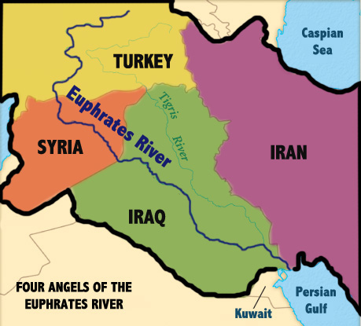
Where might the armies organize? Revelation 9:14
Army size: Revelation 9:16
War description: Revelation 9:17-18
Who is fighting?
And in that day will I make Jerusalem a burdensome stone for all people: all the people of the earth be gathered together against it (Zech 12:3)

Slide 20
About The Armies
Ezekiel 38: “Clothed with armor” (Ezekiel 38:4) coming like “a storm” and “a cloud to cover the land” (v. 9), “a mighty army” (v. 15).
Daniel 11: A “great army” which others have no “strength to withstand” (vs 13, 15) coming “like a whirlwind, with chariots, and with horsemen, and with many ships” (v. 40).
Joel 2: The greatest army in the history of the world (Joel 2:2). Like a “fire” that devours the land, leaving “a desolate wilderness” (Joel 2:3-5). Virtually invincible: “When they fall upon the sword, they shall not be wounded” (Joel 2:7-9).

Slide 21
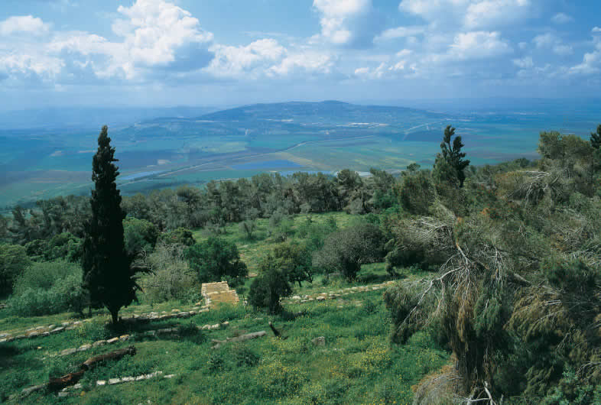
Bible Picture 21. All nations will gather here as part of the battle of Armageddon (see Zech. 11–14; Rev. 16:14–21).

Slide 23
2ND Woe – 2ND Appearance
Zechariah 14:4-5 4 And his feet shall stand and the mount of Olives shall cleave in the midst thereof toward the east and toward the west, and there shall be a very great valley;
5 And ye shall flee to the valley…
D&C 45:51-53 51 And then shall the Jews look upon me and say: What are these wounds in thine hands and in thy feet?
52 I will say unto them: These wounds are the wounds with which I was wounded in the house of my friends. I am he who was lifted up, I am Jesus that was crucified. I am the Son of God.

Slide 24
2ND Woe – 2ND Appearance
Ezekiel 39:22 “The house of Israel shall know that I am the LORD their God from that day and forward.”
Ezekiel 38:21 - The armies will turn upon each other, perhaps in the panic and confusion of the Mt of Olives splitting.
Ezekiel 39:2 Only one-sixth of the invading army will survive.
Ezekiel 39:9,12 - Seven years to destroy the weapons and seven months to bury the dead

Slide 25
7 angels and 7 vials
1st Vial: A sore on the wicked (Revelation 16:2)
2nd Vial : The sea becomes as blood (Revelation 16:3)
3rd Vial : Fresh waters become as blood (Revelation 16:4-7)
4th Vial : Scorching heat (Revelation 16:8-9)
5th Vial : Darkness (Revelation 16:10-11)
6th Vial : Armageddon (Revelation 16:12-16)
7th Vial : Thunder, lightning, and the great earthquake; cities fall; islands flee, and mountains are leveled; a great plague of hail. (Revelation 16:17-21)

Slide 26
7 angels and 7 vials
1st Vial: A sore on the wicked (Revelation 16:2)
2nd Vial : The sea becomes as blood (Revelation 16:3)
3rd Vial : Fresh waters become as blood (Revelation 16:4-7)
4th Vial : Scorching heat (Revelation 16:8-9)
5th Vial : Darkness (Revelation 16:10-11)
6th Vial : Armageddon (Revelation 16:12-16)
7th Vial : Thunder, lightning, and the great earthquake; cities fall; islands flee, and mountains are leveled; a great plague of hail. (Revelation 16:17-21)

Slide 27
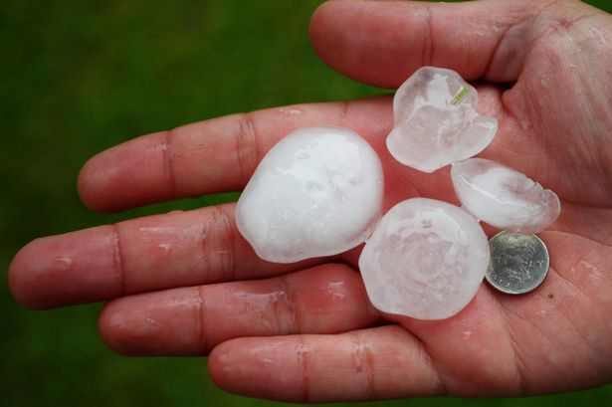
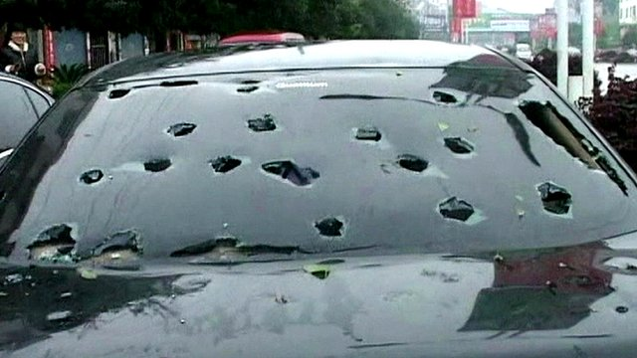
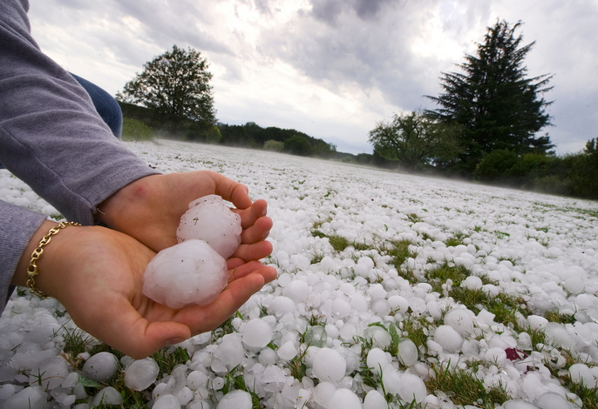
The Hailstorm Revelation 16:21 (Cross Reference D&C 29:16

Slide 28
Why would the Lord Allow this? REVELATION 9:20-21
Murder
In what manners are murders being committed (or depicted) today?
Theft
In what ways do thefts occur today?
Sorceries
In what ways do sorceries occur today?
Pharmakeia (Gr). “Pharmacy”
Fornication
Porneia (Gr). “Pornographic”

Slide 29
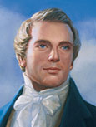
“It is a false idea that the Saints will escape all the judgments, whilst the wicked suffer; for all flesh is subject to suffer, and “the righteous shall hardly escape” [see D&C 63:34]; still many of the Saints will escape, for the just shall live by faith; yet many of the righteous shall fall a prey to disease, to pestilence, etc., by reason of the weakness of the flesh, and yet be saved in the Kingdom of God’ (Teachings of Presidents of the Church: Joseph Smith [2007], 253)” (New Testament Student Manual [Church Educational System manual,2014], 547).

Slide 30
7 vials
“The sun shall be turned into darkness, and the moon into blood, before the great and the terrible day of the LORD come” (Joel 2:28-31)
JS-H 1:41 – “The Angel Moroni quoted the second chapter of Joel, from the twenty-eighth verse to the last. He also said that this was not yet fulfilled, but was soon to be.”
President Gordon B. Hinckley (October 2001 General Conference): "The vision of Joel has been fulfilled wherein he declared [Joel 2:28–32]."

Slide 31
AFTER ARMAGEDDON
Earth’s land masses shall unite; islands and continents shall become one land.
The great deep—presumably the Atlantic ocean—shall return to its place in the north, ‘and the earth shall be like as it was in the days before it was divided.’ (D. & C. 133:21–24) (Doctrinal New Testament Commentary,3:543.)
Every valley shall be exalted and every mountain shall be made low. Jerusalem will be smoothed out and become like “a plain” (Zechariah 14:10).
Earthquake
Creates a spring in Jerusalem which will form a new river, flowing to the Dead Sea healing its waters. (see Zechariah 14:8–9; Joel 3:18; Ezekiel 47:1–5). Ezekiel 47:6–12; Joseph Smith, Teachings of the Prophet Joseph Smith, p. 286).

Slide 32
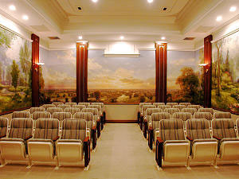
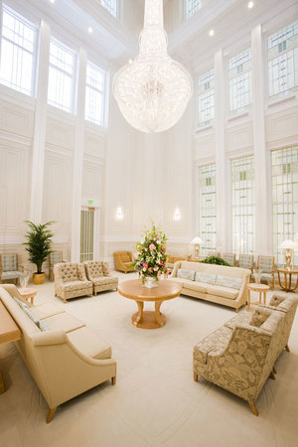
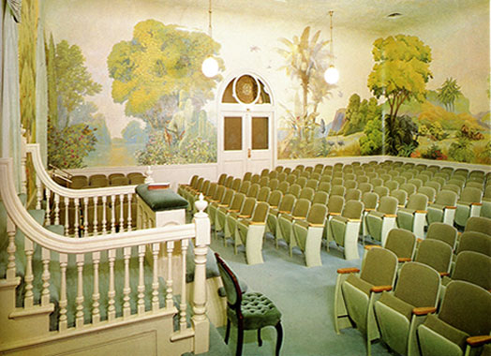
Revelation 16:15
“Tarry ye in Jerusalem, until ye be endued with power from on high” (Luke 24:49).
Endued (Greek): “To sink into a garment” or “To take on characteristics and virtues of another.”
lds.org/topics/endowment

Slide 33
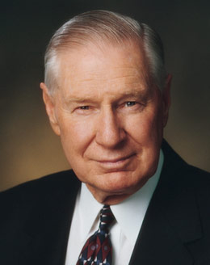
Elder James E. Faust was asked only one question by President Harold B. Lee: “Do you wear the garment properly?” He answered in the affirmative. He then asked if President Lee wasn’t going to ask him about his worthiness. President Lee replied that he didn’t need to, for he had learned from experience that how one wears the garment is the expression of how the individual feels about the Church and everything that relates to it. It is a measure of one’s worthiness and devotion to the gospel.

Slide 34
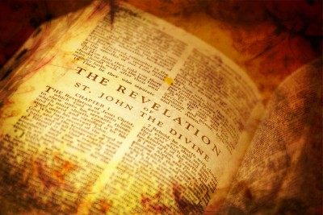
Application for Preparation
If you have been endowed, do you properly wear your Temple garment?
If you have not yet been endowed, is your wardrobe ‘temple-ready’?

Slide 35
The Book of Revelation:
Preparing for
The Second Coming

