Slide 1
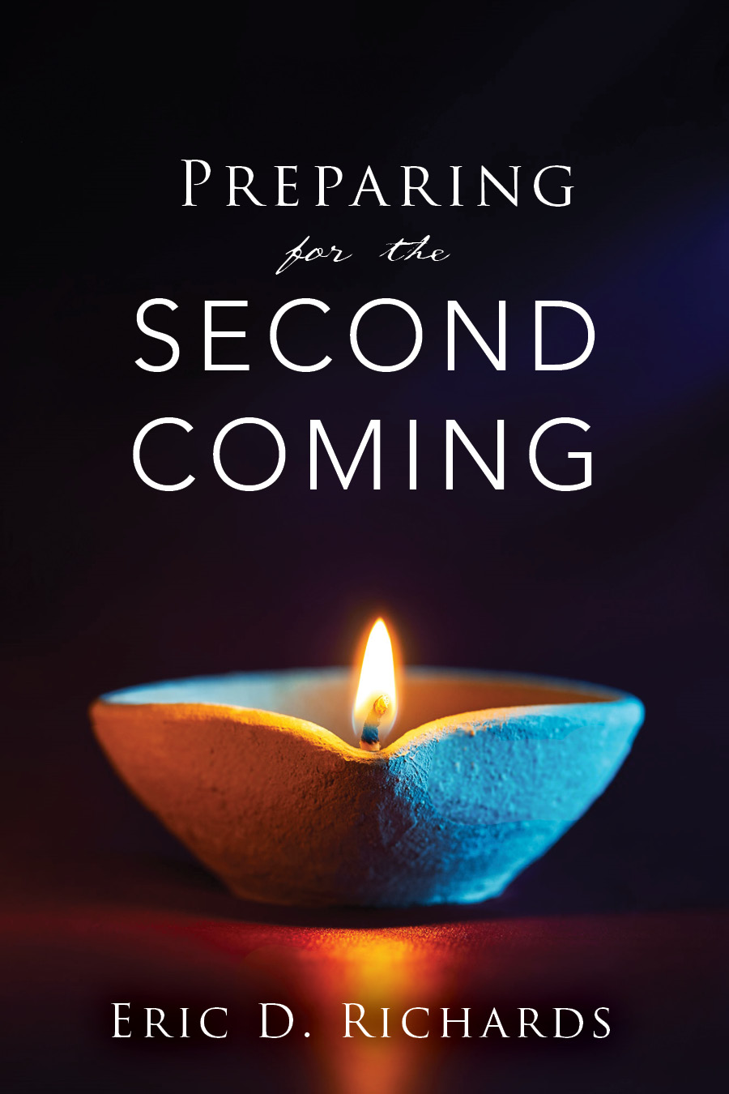
The Book of Revelation

Slide 2
Revelation 14
The Victory

Slide 3
REVELATION 14:1-5 What is Mount Zion? Who goes there?
Zion, Mount (Guide to the Scriptures)
The Lord performs his whole work upon Mount Zion, 2 Ne. 20:12 (Isa. 10:12).
Celestial heirs come to Mount Zion (D&C 76:66, D&C 84:2) and shall be filled with glory upon Mount Zion, D&C 84:32.
In the latter-day, Christ shall stand upon Mount Zion, D&C 133:18, 56.
The Guests:
Kept the law of chastity (vs 4)
Followed the Savior (vs 4)
Speak without guile* (vs 5)
Notes:
http://rsc.byu.edu/archived/book-mormon-fourth-nephi-through-moroni-zion-destruction/18-moroni-last-nephite-prophets

Slide 4
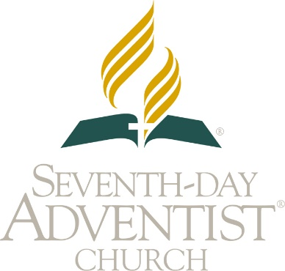
Revelation 14
First Angel: Proclaims the gospel.
Second Angel: Announces the fate Babylon.
Third Angel: Reminds followers to reject the mark of the Beast.
Mission Statement: “To proclaim to all peoples the everlasting gospel of God's love in the context of the three angels' messages of Revelation 14:6–12, leading people to accept Jesus as their personal Saviour and Lord.”

Slide 5
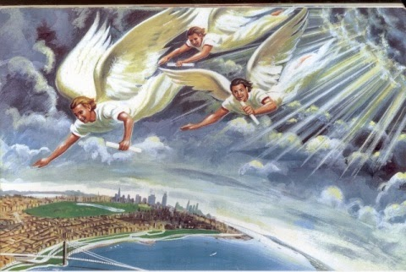
Three angels
Angel 1: Revelation 14:6-7
“John the Revelator ‘saw another angel’ (Revelation 14:6). That angel has come. His name is Moroni.”
Gordon B. Hinckley, Oct. 1995 Gen. Conf.
Notes:
http://rsc.byu.edu/archived/book-mormon-fourth-nephi-through-moroni-zion-destruction/18-moroni-last-nephite-prophets

Slide 6
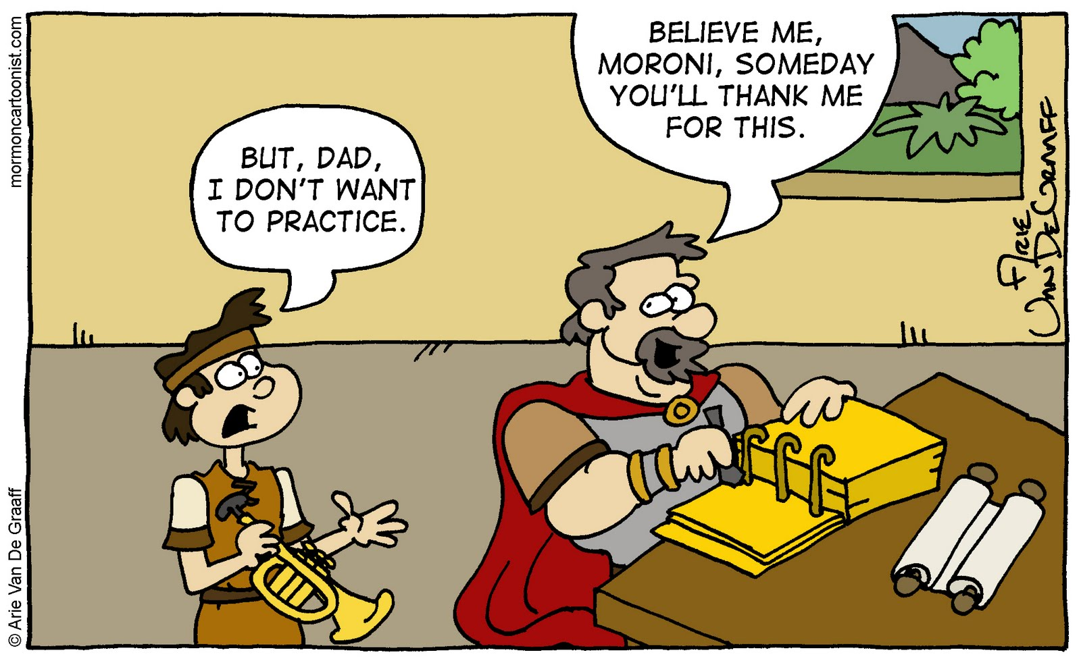

Slide 7
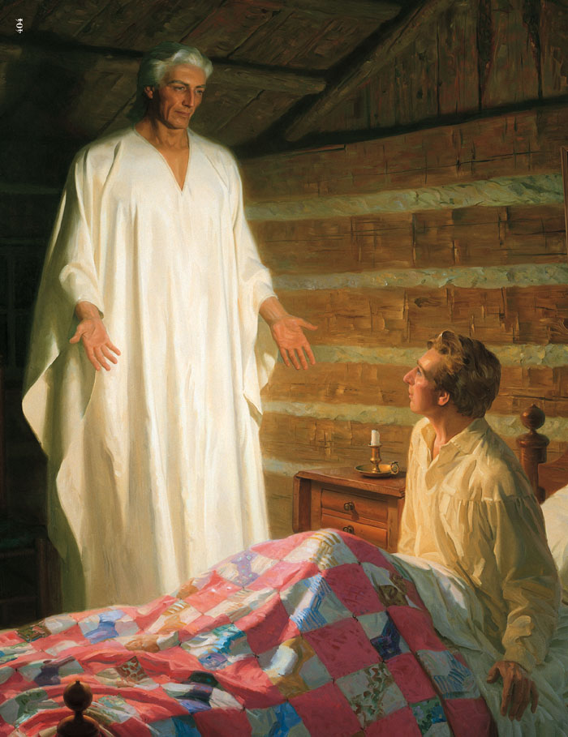
So How Many Times Did Moroni Come?
22 visits have been documented.
1st visit: Sept 21, 1823
22nd visit: June, 1829

Slide 8
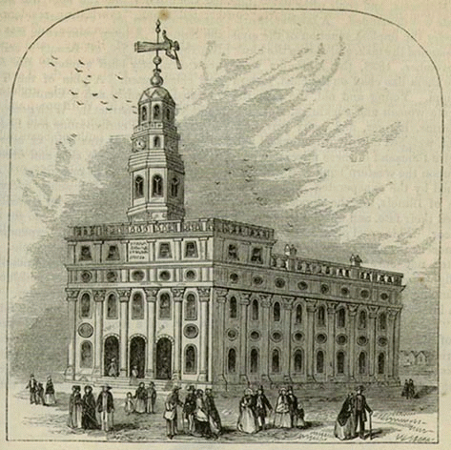
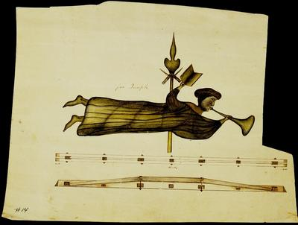
The First Angel Moroni
Nauvoo Temple weather vain

Slide 9
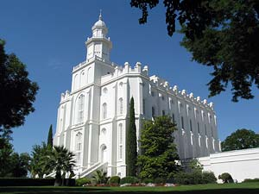
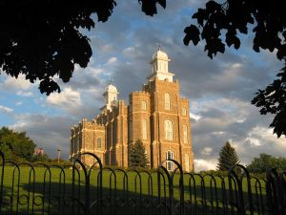
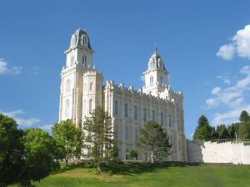
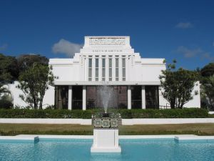
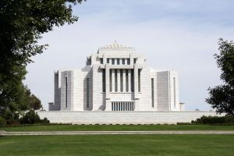
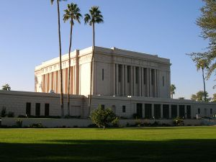
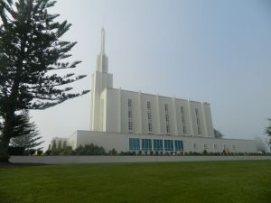
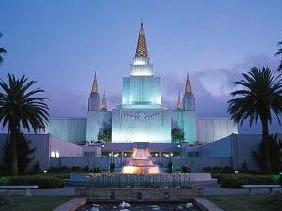
8 Temples Have No Angel Moroni
St. George, Utah
Logan, Utah
Manti, Utah
Laie, Hawaii
Cardston, Alberta
Mesa, Arizona
Hamilton, NZ
Oakland, California

Slide 10
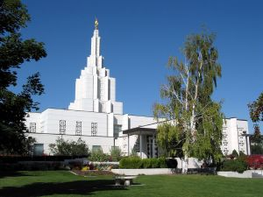
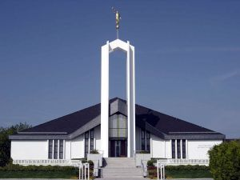
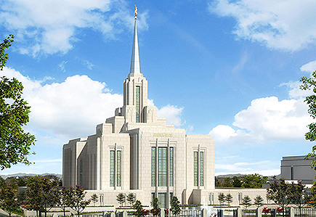
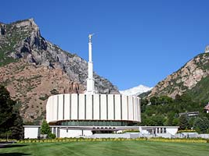
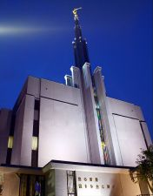
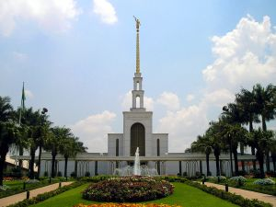
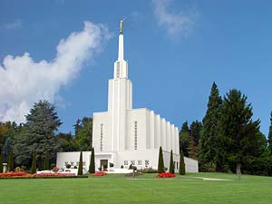
8 Temples have had an Angel Added
Idaho Falls, Idaho
Freiberg, Germany
Ogden, Utah
Provo, Utah
Sao Paulo, Brazil
Tokyo, Japan
Bern, Switzerland
London, England

Slide 11
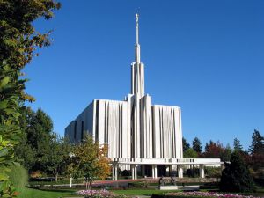
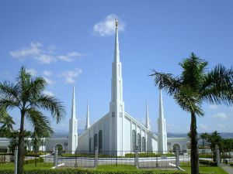
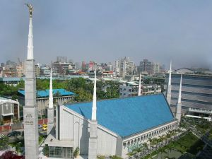
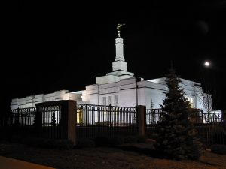
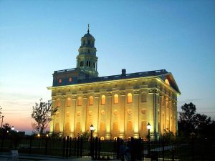
Moroni usually faces East…
5 temples have west facing angels due to the orientation of the lots and placement of the spires.
Seattle, Washington
Manila, Philippines
Taipei, Taiwan
Spokane, Washington
Nauvoo, Illinois

Slide 12
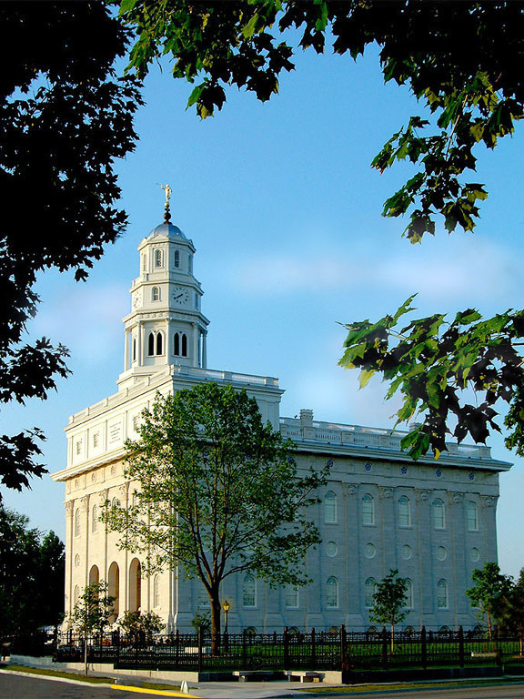
The Angel Moroni
Today, facing west, on the high bluff overlooking the city of Nauvoo, across the Mississippi, and over the plains of Iowa, there stands Joseph’s temple, a magnificent house of God.
Here in the Salt Lake Valley, facing east to that beautiful temple in Nauvoo, stands Brigham’s temple, the Salt Lake Temple.
They look toward one another as bookends between which there are volumes that speak of the suffering, the sorrow, the sacrifice, even the deaths of thousands who made the long journey from the Mississippi River to the valley of the Great Salt Lake.
Gordon B. Hinckley, Oct. 1995 Gen. Conf.

Slide 13
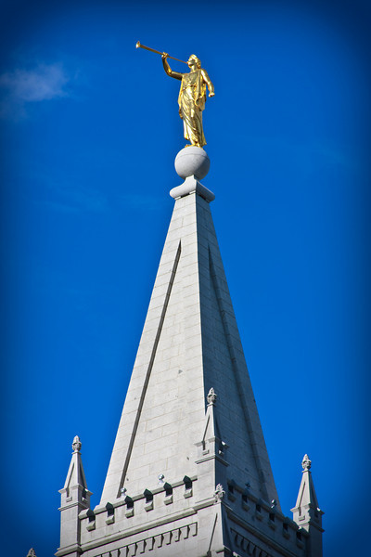
12’5” tall leafed in 22 carat gold.
Original plans had 2 Angel Moroni’s...

Slide 14
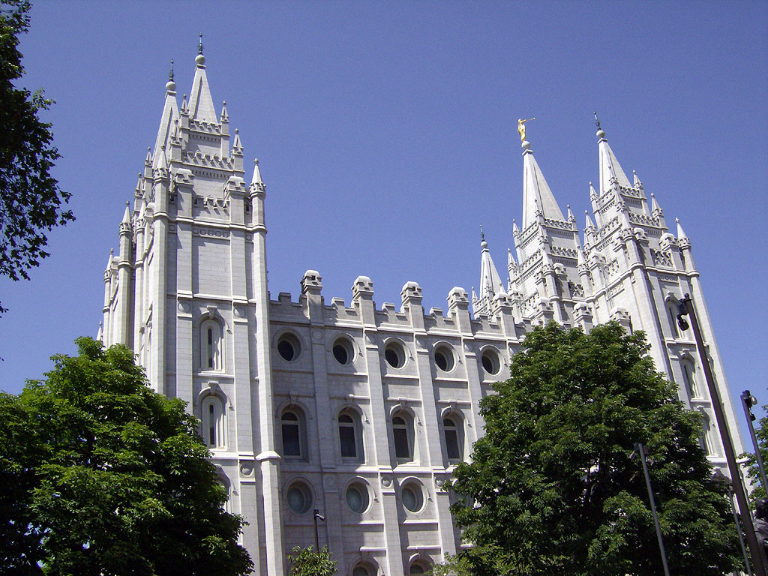

Slide 15
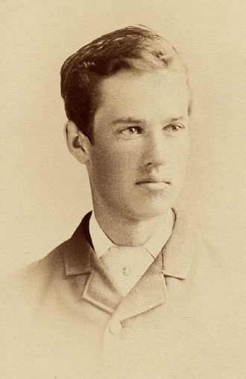
The First Standing Angel Moroni
The Salt Lake Temple Angel Moroni was sculpted by Paris-trained sculptor Cyrus Edwin Dallin in 1893.
Cyrus was a non-member and was simply asked to come up some kind of ornament for the spires. He decided on the Angel Moroni after he started reading the Book of Mormon.
He claimed that “My angel Moroni brought me nearer to God than anything I ever did.”

Slide 16
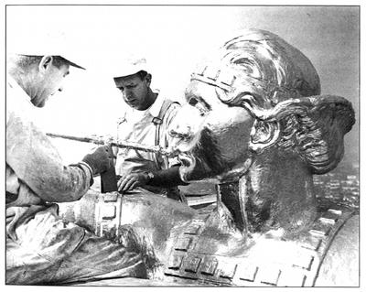
How Big Are They?
LARGEST: 20’ tall (Jordan River Temple)
SMALLEST: 7’ tall (mini temples)

Slide 17
Moroni
BACKPACKS AND BRASS PLATES
“When I was returning to Fayette, with Joseph & Oliver, a very pleasant, nice-looking old man suddenly appeared by the side of our wagon. We invited him to ride but he said very pleasantly, “No, I am going to Cumorah.”
“…He was about five feet eight or nine inches tall and heavy set. … He was dressed in a suit of brown woolen clothes, his hair and beard were white. … also remember that he had on his back a sort of knapsack with something in, shaped like a book.
“It was the messenger who had the plates, who had taken them from Joseph just prior to our starting from Harmony.” (David Whitmer: Jack M. Lyon, Linday Rine Gundry, and Jay A. Parry, eds. Best-Loved Stores of the LDS People [Salt Lake City, Deseret Book Co., 1997}, 39. See also Millennial Star, 9 Dec. 1878, p. 772).
Notes:
http://rsc.byu.edu/archived/book-mormon-fourth-nephi-through-moroni-zion-destruction/18-moroni-last-nephite-prophets

Slide 18
Moroni
MORONI’S FINAL DAY ON EARTH
Thomas B. Marsh: “Joseph became very anxious to know something of the fate of Moroni and in answers to prayer, the Lord gave Joseph a vision. A wild country appeared and on the scene was Moroni, after whom were six Lamanites in pursuit; he stopped and one of the Lamanites stepped forward and measured swords with him; Moroni smote him and he fell dead; another Lamanite advanced and contended with him; this Lamanite also fell … Another advanced and contended with Moroni; he experienced the same fate; a fourth afterwards contended with him, but, in the struggle with the fourth, Moroni, being exhausted, was killed. Thus ended the life of Moroni.” (Charles D. Evans. Msd 3864 Church Archives)

Slide 19
Moroni
ASSISTED IN AMERICA’S PURPOSE
“In those early and perilous times our men were few and our reserves limited. By whose power [did] victory so often perch on our banner? It was by the agency of that same angel that appeared unto Joseph. … This same angel presides over the destinies of America and feels a lively interest in all our doings. He was in the camp of Washington and, by an invisible band, led our fathers to conquest and victory; this same angel was with Columbus and gave him deep impressions by dreams and visions respecting this New World. Under the guardianship of this same angel, the Prince of America, the United States has grown, increased and flourished, like the sturdy oak by the rivers of water.” (Brigham Young, Journal of Discourses 6:369)

Slide 20
Moroni
THE DECLARATION OF INDEPENDENCE
The debate to sign or not to sign the Declaration of Independence created great ambivalence. When it appeared to many that the enterprise to declare independence from Great Britain was a tabled issue, an old and dignified patriot took the floor and addressed the congress. This dignified patriot told them it was incumbent upon them to sign the document – “This” he said,” is your finest hour”. He insured them that they would be remembered with gratitude throughout all history, if they would but sign. When the wise patriot concluded his remarks, Jefferson said, “our spirits were rekindled and they (the 34 signers) flocked the table to sign the document.”
Orson Hyde, an apostle, declared that Moroni was that distinguished man, the chosen guardian of the Americas” (Orson Pratt,. Journal of Discourses. 4 July 1854. 6:367-371

Slide 21
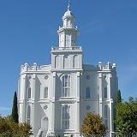
Moroni
MANTI TEMPLE SITE
Brother Warren S. Snow: “President Young took me to the spot where the temple was to stand; we went to the southeast corner, and President Young said: “Here is the spot where the prophet Moroni stood and dedicated this piece of land for a Temple site and that is the reason why the location is made here, and we can’t move it from this spot (Life of Heber C. Kimball, pg 447).

Slide 22
Moroni
THE TEMPLE GARMENT
While in Nauvoo … the prophet came to my grandmother (a seamstress) and told her that the angel Moroni had shown him the temple garment and asked her to assist him in cutting it out. She had to cut out a third pair, however, before he said it was satisfactory. …. He told her he wanted as few seems as possible and to cut the sleeves without piecing. . . Emma Smith proposed that they have a collar as she thought they would look more finished…” (Early Pioneer Hist. Eliza M A Munson, p. 2. Diary by James T S Allred, Typescript copy BYU Library).

Slide 23
Moroni
A Vision in the Night Sky (October 2007 Ensign)
“It began on September 22, 1827, Heber C. Kimball said, in the eastern horizon—a white smoke rising toward the heavens with the sound of a mighty wind. The smoke moved across the sky, in the shape of a rainbow toward the western horizon.
As Heber watched with his family and several neighbors, a large, commanding army appeared, marching in platoons across the sky from east to west.
“We could distinctly see the muskets, bayonets and knapsacks of the men,” Heber recorded, “And also saw their officers with their swords and [heard] the clashing and jingling of their implements of war, and features of the men.
“No man could judge of my feelings; it seemed as though every hair of my head was alive. This scenery we gazed upon for hours, until it began to disappear.”
Notes:
http://rsc.byu.edu/archived/book-mormon-fourth-nephi-through-moroni-zion-destruction/18-moroni-last-nephite-prophets

Slide 24
Moroni
A Vision in the Night Sky (October 2007 Ensign)
Brigham Young (who at that time was not acquainted with Heber C. Kimball), wrote in his journal that night, “Tonight there was a great light in the East and it went to the West and it was very bright.” As he gazed at it with his wife, Miriam, they saw “great armies” marching across the night sky. He recorded that the vision remained for several hours.
Notes:
http://rsc.byu.edu/archived/book-mormon-fourth-nephi-through-moroni-zion-destruction/18-moroni-last-nephite-prophets

Slide 25
Moroni
A Vision in the Night Sky (October 2007 Ensign)
“Heber and Brigham and their family members who witnessed the amazing scene on 22 September 1827 felt it must have been a sign from God, but they did not know its meaning. “The following year, Brigham Young and Miriam moved to Mendon, New York, less than a half mile northeast of where Heber Kimball and his wife, Vilate, lived. Brigham and Heber, just 13 days apart in age, and their wives, just 6 days apart in age, soon became close friends and both families eventually met the Prophet Joseph and joined the church and learned that he had received the gold plates containing the Book of Mormon on 22 September 1827 – the same day as their vision in the sky - at the Hill Cumorah, just 20 miles to the east.
Notes:
http://rsc.byu.edu/archived/book-mormon-fourth-nephi-through-moroni-zion-destruction/18-moroni-last-nephite-prophets

Slide 26
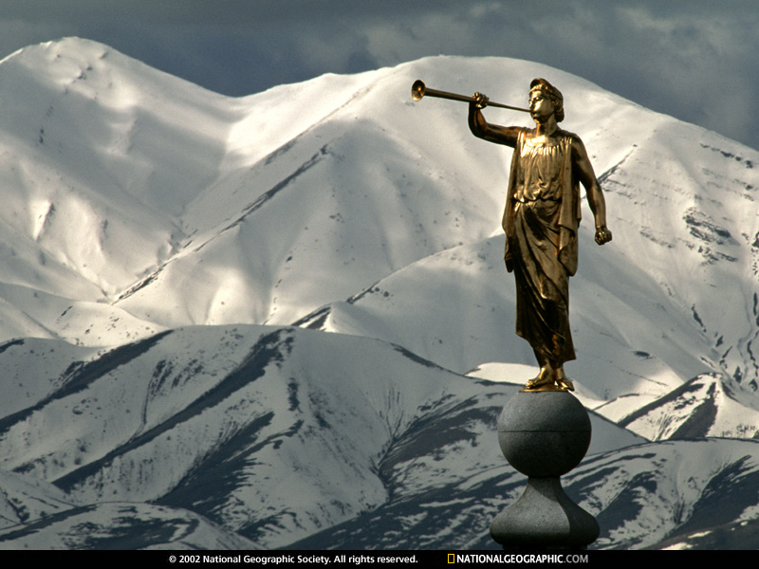

Slide 27
Angels 2&3: Revelation 14:8-10

Slide 28
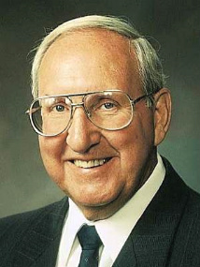
“The season of the world before us will be like no other. Satan will unleash every evil scheme, every vile perversion ever known to man in any generation.
“If we come to the temple for light and safety, we will find quiet, sacred havens where the storm cannot penetrate. There unseen angels watch over us.
“The time will come when even the elect will begin to lose hope if they do not come often to the temples…
“Those who are prepared and therefore spared on that glorious, triumphant day will be a temple-loving people…Come, oh, come up to the temples of the Lord."
Vaughn J. Featherstone, The Incomparable Christ, Our Master and Model.

Slide 29
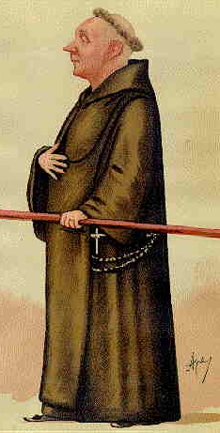
Revelation 14:12-13
Fun fact: With what purpose was the mechanical clock created?
Amazing Answer: As an instrument to remind people to pray.
http://www.clockmakersgallery.com/history.html

Slide 30
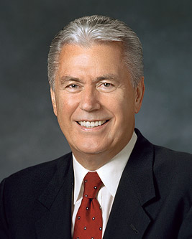
“Isn’t it true that we often get so busy? And, sad to say, we even wear our busyness as a badge of honor, as though being busy, by itself, was an accomplishment or sign of a superior life.
“I think of our Lord…I have tried to imagine Him bustling between meetings or multitasking to get a list of urgent things accomplished. I can’t see it.” (President Uchtdorf, Ensign, November 2012)

Slide 31
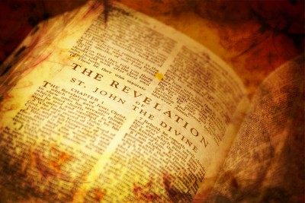
Application for Preparation
Are you “too busy”?
Do you get adequate rest each day? Do you take time to ponder and meditate?
STORY: Upper Balcony

Slide 32
Revelation 14
SPOILER ALERT
The Savior’s Appearance:
Revelation 14:14-20

Slide 33
The Book of Revelation

