Slide 1
The Book of Revelation

Slide 2
Chapter 13
The Beast

Slide 3
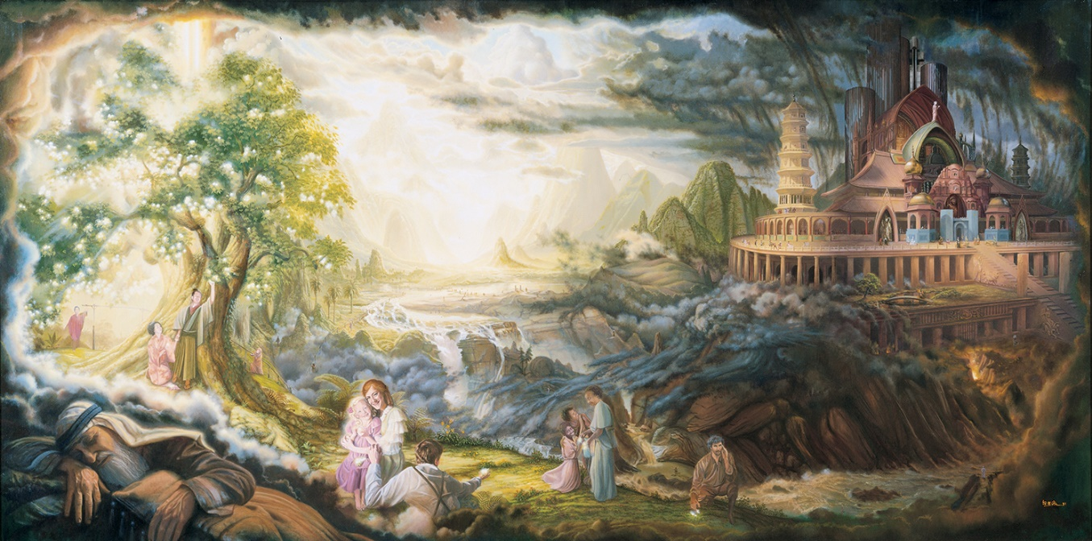
Revelation 13:1-8 Look for the Great and Spacious Building
1 Nephi 15:25-28 The things which thou shalt see hereafter thou shalt not write; for the Lord God hath ordained the apostle of the Lamb of God that he should write them. And I, Nephi, heard and bear record, that the name of the apostle of the Lamb was John. And behold, I, Nephi, am forbidden that I should write the remainder of the things which I saw and heard…

Slide 4
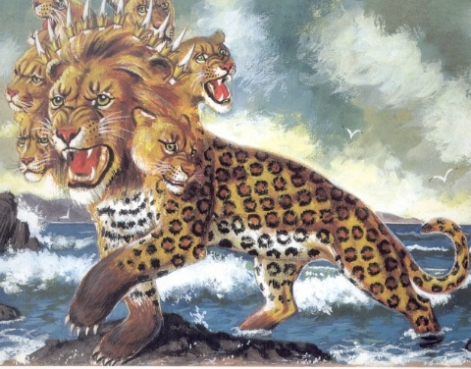
Revelation 13:1-8
Lion (Power of the Babylonian Empire)
Bear (Power of the Persian Empire)
Leopard (Speed of the Greek Empire).
Kingdom | Animal (Rev 13) | Symbol (Daniel 2)
Babylonians | Lion | Gold
Persians | Bear | Silver
Greeks | Leopard | Brass
Romans | Beast with Teeth | Iron
Great Apostasy | - | Iron & Clay
Event | Symbol (Dan 2) | Fulfillment
Stone Cut out of the Mountain | Without Hands | Kingdom of God
Abomination of Desolation | 666 | The Antichrist

Slide 5
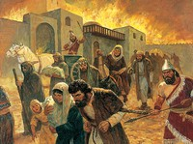
ABOMINATION OF DESOLATION
Daniel spoke of “the abomination that maketh desolate” (Dan. 11:31; 12:11) and Jesus spoke of “the abomination of desolation, spoken of by Daniel the prophet” (Matt. 24:15). These events were to occur twice in fulfillment of Daniel’s words: the first when Jerusalem was destroyed following Jesus’ death (Matt. 24:15; JS—M 1:12) and the second following the Restoration: “Again shall the abomination of desolation, spoken of by Daniel the prophet, be fulfilled” (JS—M 1:31–32).
In a general sense, abomination of desolation describes the latter-day judgments to be poured out upon the wicked before the Second Coming (Guide to the Scriptures).

Slide 6
ABOMINATION OF DESOLATION
7 Seals
7 Trumpets/7 Vials (Rev 16:1)
Christ’s Ministry (READ Dan 9:27)
Abomination of Desolation (READ Dan 12:11, Matt 24:15 and D&C 84:117)
The 2nd Coming
The Millennium
<--3.5 YEARS-->
1260 DAYS
<--3.5 YEARS-->
1260 DAYS
Destruction of the Wicked
--------------------------------------------------------
The Beast, the Anti Christ, and God’s Judgement

Slide 7
The Anti-Christ: Revelation 13
Anti: "the opposite of" or "instead of."
Guide to the Scriptures: “Anyone or anything that counterfeits the plan of salvation and that openly or secretly opposes Christ. The great antichrist is Lucifer, but he has many assistants, both spirit beings and mortals.
The Dragon: anti-Father
The Antichrist (False Prophet): anti-Christ
The Beast: anti-Holy Ghost

Slide 8
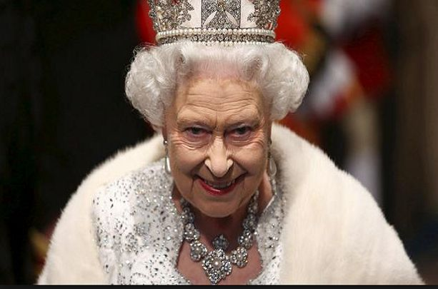
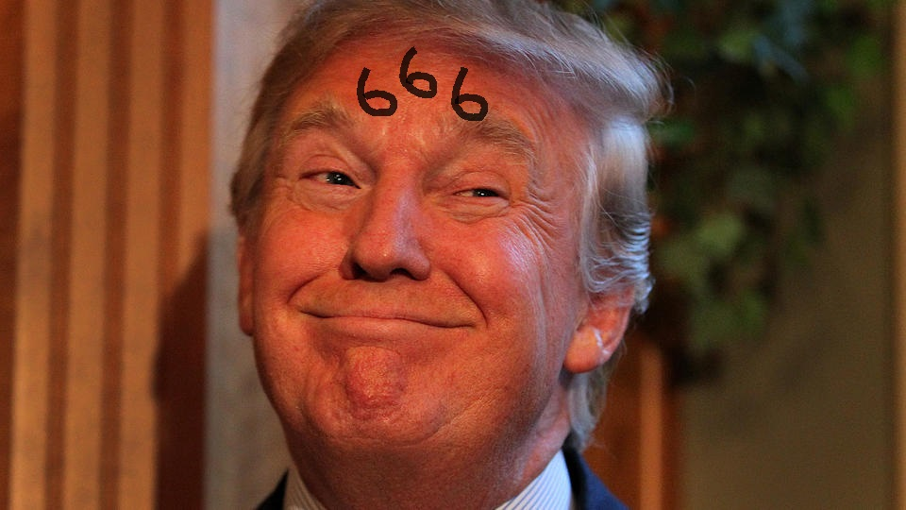
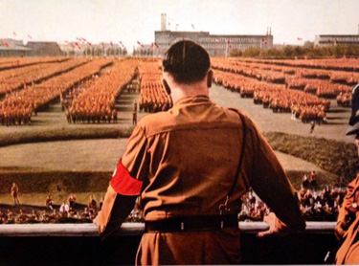
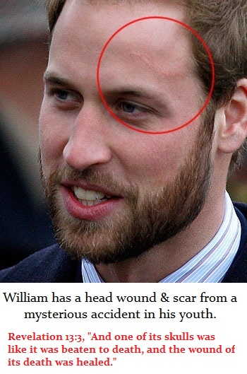
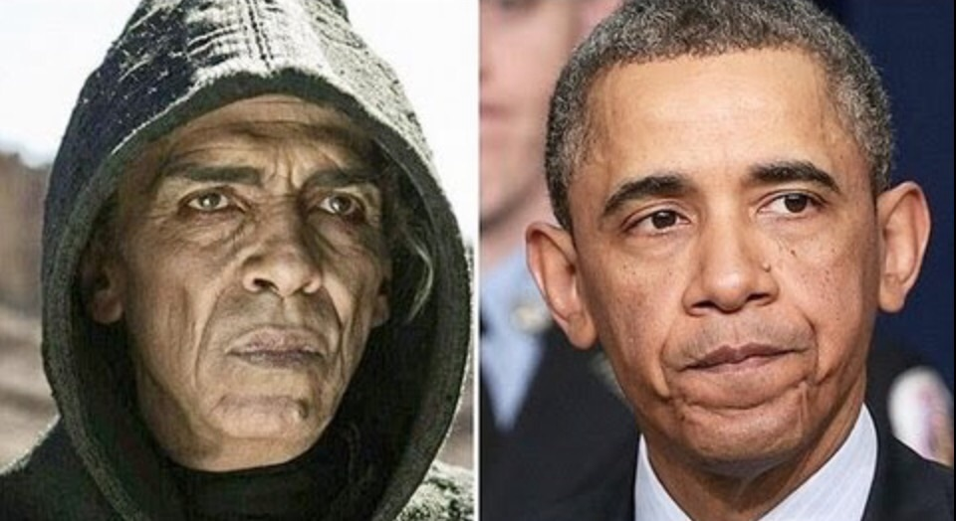
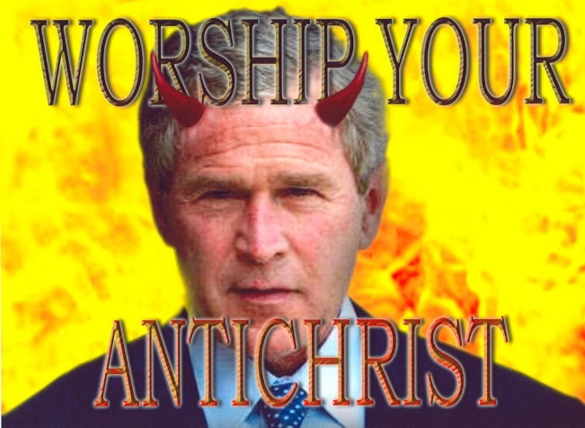

Slide 9
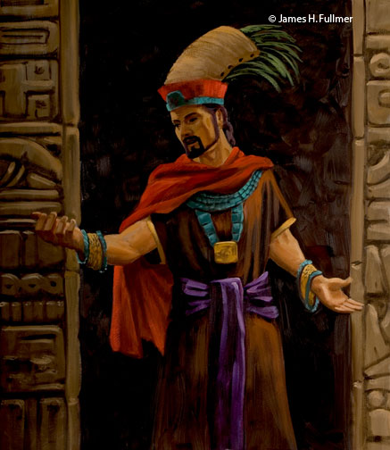
Anti Christ
Jacob 7:2-7
Alma 1:2-5
Alma 30:13-18
What has the book of Mormon taught you about Anti Christs?

Slide 10
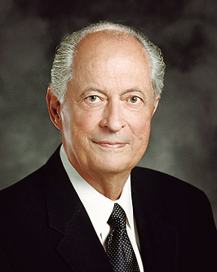
Anti Christ
“The world is moving away from the Lord faster and farther than ever before. The adversary has been loosed upon the earth. As we watch, hear, read, study, and share the words of prophets, we will be forewarned and protected. For example, “The Family: A Proclamation to the World” was given long before we experienced the challenges now facing the family. “The Living Christ” was prepared in advance of when we will need it most.”
Elder Hales OCT 2013 “Strengthening Faith and Testimony”

Slide 11
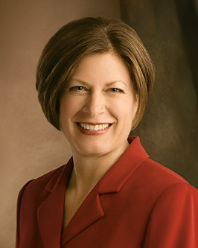
Anti Christ
“There are media messages everywhere that are anti-family; all electronic devices are delivering anti-family messages every day. Increasingly, youth are seeing no reason to form a family or get married.... They are being desensitized about the need to form eternal families....Anti-family is anti-Christ. Because Satan can’t have a family, he’s luring away many women, and also men, and they’re losing confidence in their ability to form eternal families.” (Sister Beck, An address to Seminary and Institute Teachers, 4 August 2009)

Slide 12
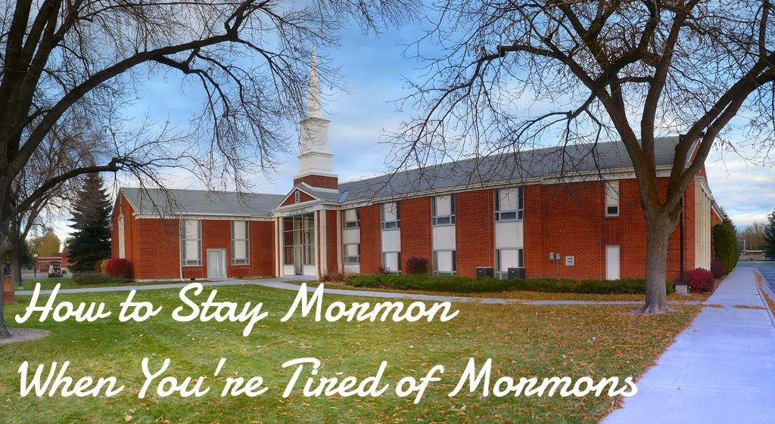
PowerPoint: How to Stay in the LDS Church After a Major Trial of Faith
Latter-Day examples of a beast “speaking great things and blasphemies”?

Slide 13
Staying LDS is not for everyone
Especially if you have no interest in being social
I am not advocating disobedience
These are solutions to keep from leaving the church completely

Slide 14
Practical Reasons to Stay
Spirituality
Culture/identity
Community
Family
Children
Clean living
Undeniably good
Much of the doctrine
A place to serve.
The hymns ROCK!!!!

Slide 15
The truth behind Mormon “Myths”
Divine worth (civil rights, respect, decency)
Prayer (meditation)
Faith (optimism)
Baptism (commitment)
Repentance (positive change)
Revelation (being “present”)
Service (love)
Priesthood power (natural law)
Authority/hierarchy (order, leadership)
“Traditional families” (important component of society)
Family Home Evening
Gender-based roles (order)
Genealogy (appreciation for history)
Personal purity (clean living)
Scripture study (deep thought, meditation)
Lay clergy (self-governance)
Tithing (sacrifice, charity)
Home teaching

Slide 16
When you leave…
Go slowly
Don’t burn bridges
Be careful who you talk to
Don’t try to “shock” or “enlighten” people
Common Courtesy, Good Manners
Supplement your spirituality
Good books, Nature, Family time, friends, exercise

Slide 17
Bring others
Build credit
Serve, serve, serve
Change hearts and minds one at a time
Seek out like-minded folk
Focus on the “average” member, not the most vocal
Inactives, Quiet

Slide 18
How to Stay in the LDS Church After a Major Trial of Faith

Slide 19
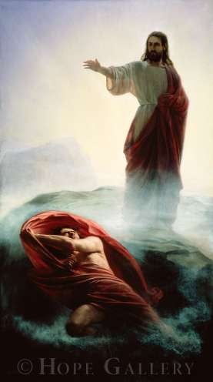
President James E. Faust: “Satan is the greatest imitator, the master deceiver, the arch counterfeiter, and the greatest forger ever in the history of the world. His disguise is so perfect that it is hard to recognize him or his methods” (“The Devil’s Throat,” Ensign or Liahona, May 2003, 51).
“One of the major techniques of the devil is to cause human beings to think they are following God’s ways, when in reality they are deceived by the devil to follow other paths” (Bible Dictionary, “Devil”).

Slide 20
Revelation 13:18
Barney
CUTE PURPLE DINOSAUR
CVTE PVRPLE DINOSAVR
C V V L D I V
100 5 5 50 500 1 5
Add them all up…

Slide 21
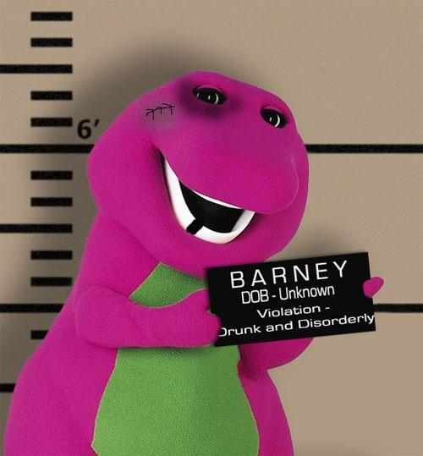
Barney is the Devil!
666

Slide 22
Revelation 13:18 Mark of the Beast: 666
When “Nero Caesar” is transliterated into Hebrew (nrwn qsr), the numerical value is 666.
When the Greek word for ”beast” is translated into Hebrew, the numerical value is 666.
All the numbers from 1 to 36 add up to 666. Beast appears 36 times in the Bible.
All of the roulette numbers added up equal 666.
Solomon's wages (1 Kings 10:14) 666 talents of gold yearly. Maybe the Antichrist, like Solomon, is a good man who becomes corrupted.
The Greek term for ‘mark’ is charagma
“The brand a master places upon an animal or a slave” or “The mark left by a serpent’s bite.”

Slide 23
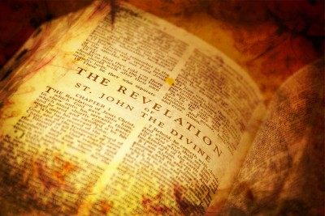
Application for Preparation
Have you marked your life with indications of Christianity?
Do pictures of temples and the Savior adorn your home?
Does your appearance show the marks of being a faithful follower of the Savior?

Slide 24
The Book of Revelation

