Slide 1
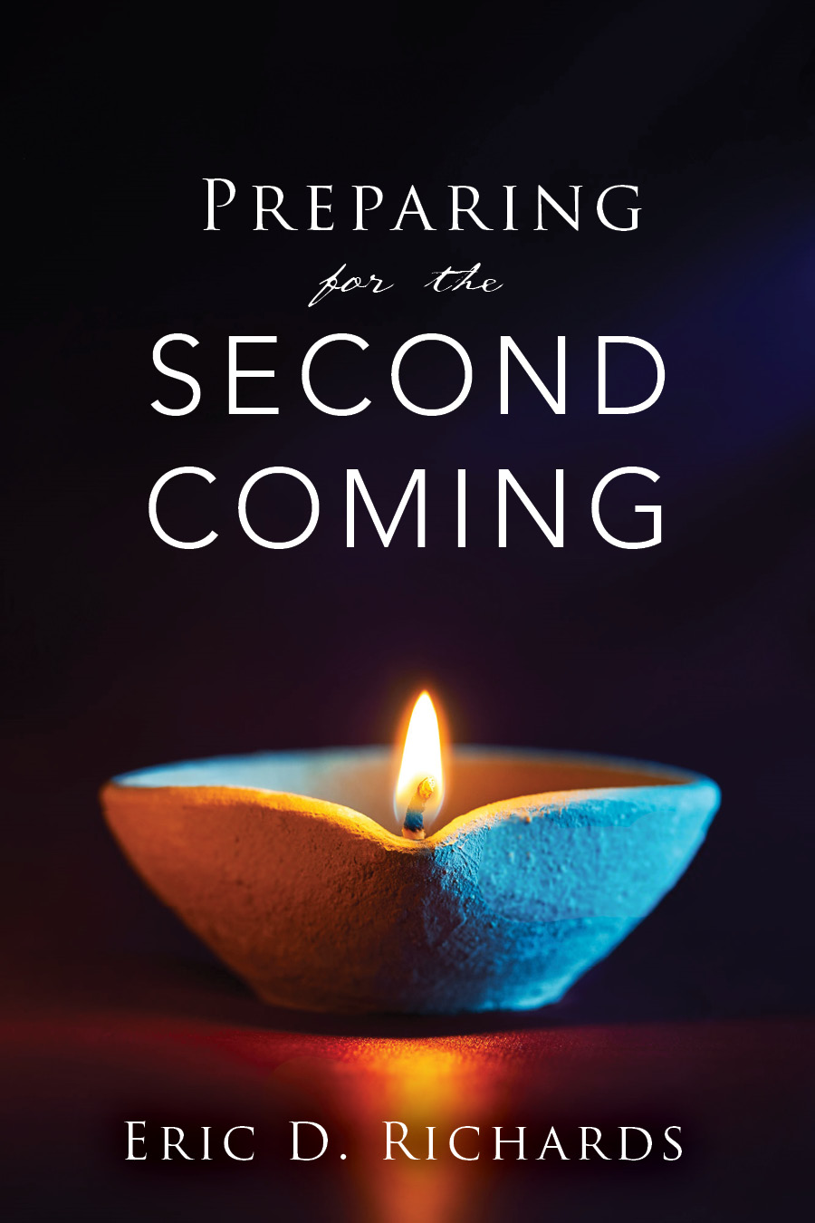
The Book of Revelation

Slide 2
Chapter 11
2nd Woe - 2 Witnesses

Slide 3
NEW JERUSALEM PROPHECIES
Jews will reoccupy Israel (see Ezekiel 36:10–12, 33–36).
Israel will become fruitful (see Ezekiel 36:8, 29–30, 34–35).
Jerusalem will be reestablished as the capital (see Zechariah 1:16–17; 2:12; 12:6;).
Judah will become powerful in politics and warfare (see Isaiah 19:16–17; Zechariah 10:3, 5–6
“A temple is to be reared in ancient Palestine where it formerly stood. Ezekiel saw it in vision (see Eze 43:1-4, 44:1-4) and he saw the glory of God coming by the way of the East, and this glorious personage entered through the East Gate of that temple, and entered into the temple.” (JD, O PRATT 20:18)

Slide 4
NEW JERUSALEM
Wilford Woodruff: “… the time is not far distant when the rich men among the Jews may be called upon to use their abundant wealth to gather the dispersed of Judah, and purchase the ancient dwelling places of their fathers in and about Jerusalem, and rebuild the holy city and temple.” (Millennial Star, vol. 41, p. 244.)
“Judah also shall fight at Jerusalem; and the wealth shall be gathered together, gold, and silver, and apparel, in great abundance.” (Zech. 14:14.)

Slide 5
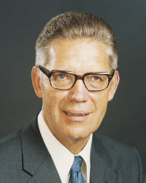
“Almost all men upon all the face of the earth will be wicked; a few only will stand in holy places and find a covert to shield them from the terrible storm. As to the others, the wicked shall slay the wicked until there are few men left. It shall be an awful day....
Never has there been a day like unto this day. Even in the days of Noah there was not so great wickedness as in this gloomy and mournful hour. Men are prepared for the slaughter, and the armies are assembling.” (The Millennial Messiah, p.453, 455)

Slide 6
Two Prophets
Revelation 11:3-6 Who are the two witnesses?
D&C 77:15
“The two prophets are followers of that humble man Joseph Smith, through whom the Lord of Heaven restored the fulness of his everlasting gospel in this final dispensation of grace. No doubt they will be members of the Council of the Twelve or of the First Presidency of the Church.” (Doctrinal New Testament Commentary, 3:509, as quoted in the Doctrine and Covenants Institute Student manual, Section 77.)
NOTE: The two witnesses are raised up “to the Jewish nation” and are not necessarily from the Jewish nation.

Slide 7
DAVID
“The throne and kingdom of David is to be taken from him and given to another by the name of David in the last days, raised up out of his lineage" (TPJS, p. 339).
“The Jews will return to Jerusalem and in time a leader called David, even a descendant from the loins of ancient David, [will] be their king" (Elder Orson Hyde, in his dedicatory prayer on the Mount of Olives, October 24, 1841, HC 4:457).
Israelites will return in the latter days and seek the LORD their God, and David their king (Hosea 3:5).
"David their king, whom I will raise up unto them" (Jer. 30:9; cf. 23:5; 33:15-22).
"I will set up one shepherd over them, and he shall feed them, even my servant David" (Ezek. 34:23-24; cf. also 44:1-3).

Slide 8
Two Prophets
Which two prophets are symbolized in Revelation 11:6?
Cross Reference Malachi 4:4-5 and Matthew 17:1-5

Slide 9
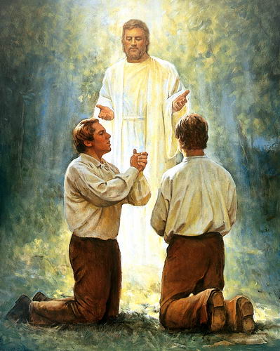
When was the AARONIC priesthood restored?
When was the MELCHIZEDEK priesthood restored?

Slide 10
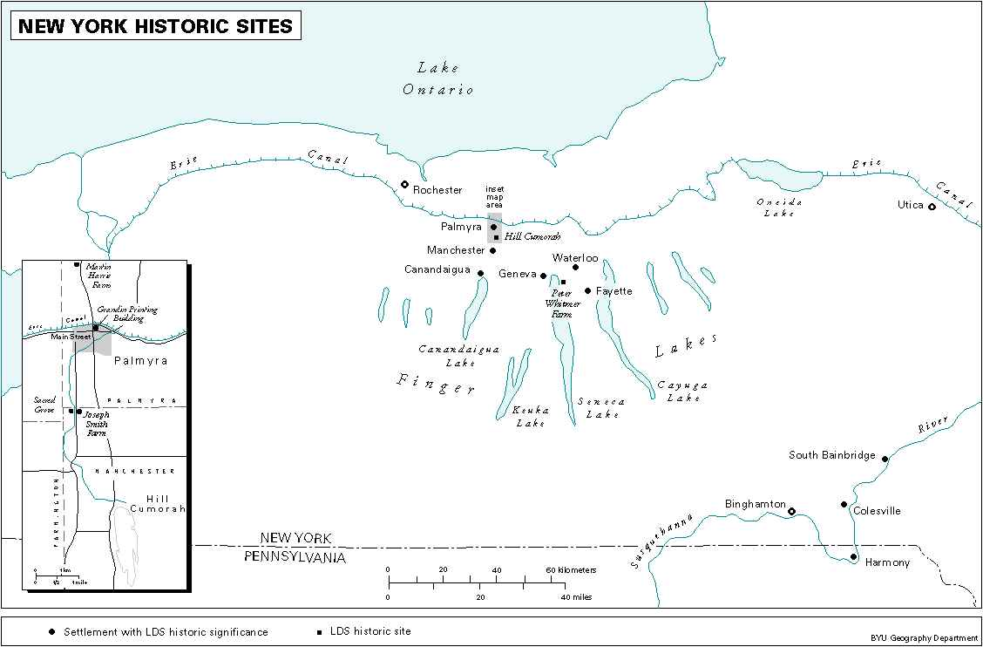
Joseph and Oliver had been arrested at Colesville for preaching.
Their attorney helped them escape through a window as a mob had begun to gather in front of the house. “It was night and they traveled through brush and water and mud, fell over logs, etc., until Oliver was exhausted; then Joseph helped him along through brush and water, almost carrying him.
They traveled all night, and just at the break of day Oliver exclaimed, "Brother Joseph, how long have we got to endure this thing?" They sat down on a log to rest and Joseph said that at that very time Peter, James, and John came to them and ordained them.
They had 16 or 17 miles to go to get back home, but Oliver did not complain any more of fatigue
Sesqehanna
Notes:
(Letter of Addison Everett to Oliver B. Huntington, St. George, Utah, 17 Feb. 1881, recorded in “Oliver Boardman Huntington, Journal #14, [under back-date of] 31 Jan. 1881,” Harold B. Lee Library, Brigham Young University. See also O. B. Huntington Diary #15, 18 Feb. 1883, pp. 44–47, where additional particulars are recorded. Original spelling has been retained.)

Slide 11
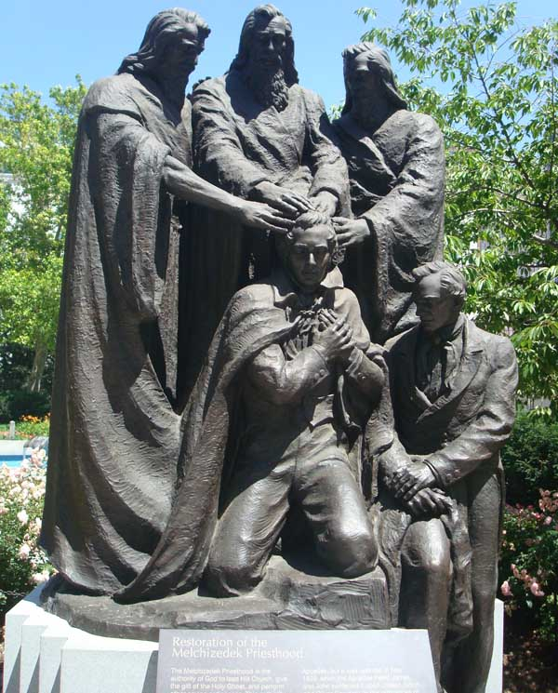
“And again, what do we hear?… The voice of Michael on the banks of the Susquehanna, detecting the devil when he appeared as an angel of light! The voice of Peter, James, and John in the wilderness between Harmony and Colesville on the Susquehanna river, declaring themselves as possessing the keys of the kingdom, and of the dispensation of the fulness of times! (D&C 128:20)

Slide 12
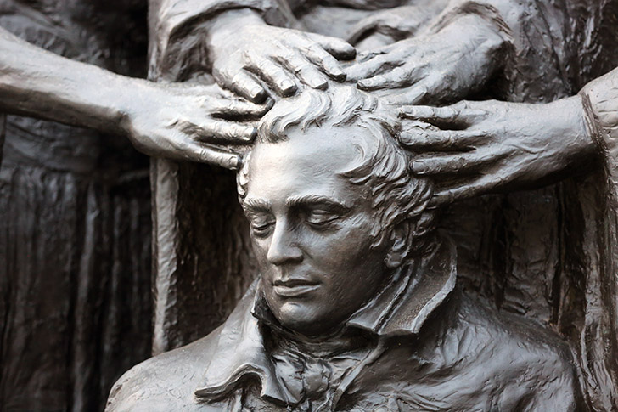
“The attempt made by Lucifer to thwart the bestowal of the Melchizedek Priesthood by Peter, James and John upon the heads of Joseph Smith and Oliver Cowdery: Apparently, not having yet received the Higher Priesthood, they were not able to detect the presence of Lucifer, who, according to the words of the Prophet Joseph Smith, appeared on the Susquehanna River as an angel of light to deceive them and no doubt to attempt to interfere with the conferring of the Holy Priesthood upon them. We are informed by the Prophet of the appearance there of Michael, the archangel, who came to detect the deception of Lucifer and banish him from the scene.” (Dyer, Alvin R. Meaning of Truth, Deseret Book Company, Salt Lake City, 1961, pp. 153-54.)
Notes:
We don’t have enough evidence to narrow the date to one specific day, but based on all the context and circumstances we can assume that Peter, James and John returned to the earth sometime between Saturday, May 16, 1829 and before Saturday, May 29, 1829.
Based on Addison Everett’s recollections, we can rule out the following dates in May that year (based on the court schedule): May 16, 17, 18, 23, 24, 25. Based on Joseph’s record of the baptism of Samuel Harrison Smith (May 25), we can likely rule out May 26 and May 27 (because of the distance to travel to Colesville). Joseph also received some revelations in May, apparently before May 29. This likely rules out May 19, 20, 21 and 22.
In order for David Whitmer to get Joseph and Oliver to Fayette by June 1, he would have had to taken them on May 29 at the latest. Based on all these assumptions, the most likely day of the visitation of Peter, James and John is Thursday, May 28, 1829.

Slide 13
D&C 110 Kirtland Temple April 3, 1836
When were the Keys of the priesthood restored?

Slide 14
 | Moses D&C 110:11 | Elias D&C 110:12 | Elijah D&C 110:13–16
Priesthood keys | Gathering of Israel | Gospel of Abraham | Keys of this dispensation
What these keys direct | Missionary work | Celestial marriage | Temple/family history work
Who is/was Elias?

Slide 15
Two Prophets
Revelation 11:7-10

Slide 16
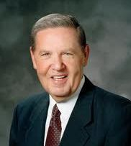
“Remember to cling to your faith and hold on to hope. If the bitter cup does not pass, drink it and be strong, trusting in happier days ahead. Even if you cannot always see that silver lining on your clouds, God can...He is your Heavenly Father, and surely He matches with His own the tears His children shed.” (Elder Holland, Ensign, November 2013)

Slide 17
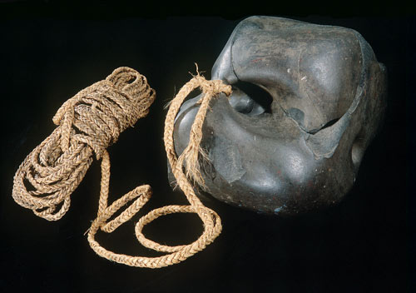
Hebrews 6:19 “Hope is the anchor of our soul.”
Zecheriah 9:12 “Prisoners of hope”
DANIEL 3:17 “But if not…”
~“I hope I find great stories as I read Church history, but if not…” ~“I hope God revels doctrines that feel right to me… but if not…” ~“I hope the prophet implements church policies that align with my viewpoint… but if not…” (Boy on Park Bench)

Slide 18
“It takes faith – unseeing faith – for young people to proceed immediately with their family responsibilities in the face of financial uncertainties.
“It takes faith for the young woman to bear her family instead of accepting employment, especially when schooling for the young husband is to be finished.
“It takes faith to observe the Sabbath when ‘time and a half’ can be had working, when profit can be made, when merchandise can be sold.
“It takes great faith to pay tithes when funds are scarce and demands are great.
“It takes faith to fast and have family prayers and to observe the Word of Wisdom.
“It takes faith to fill full-time missions.
“But know this – that all these are of the planting, while faithful families, spiritual security, peace, and eternal life are the harvest.” (Faith Proceeds the Miracle, 3-5, 10-11).

Slide 19
Two Prophets
Revelation 11:11-13

Slide 20
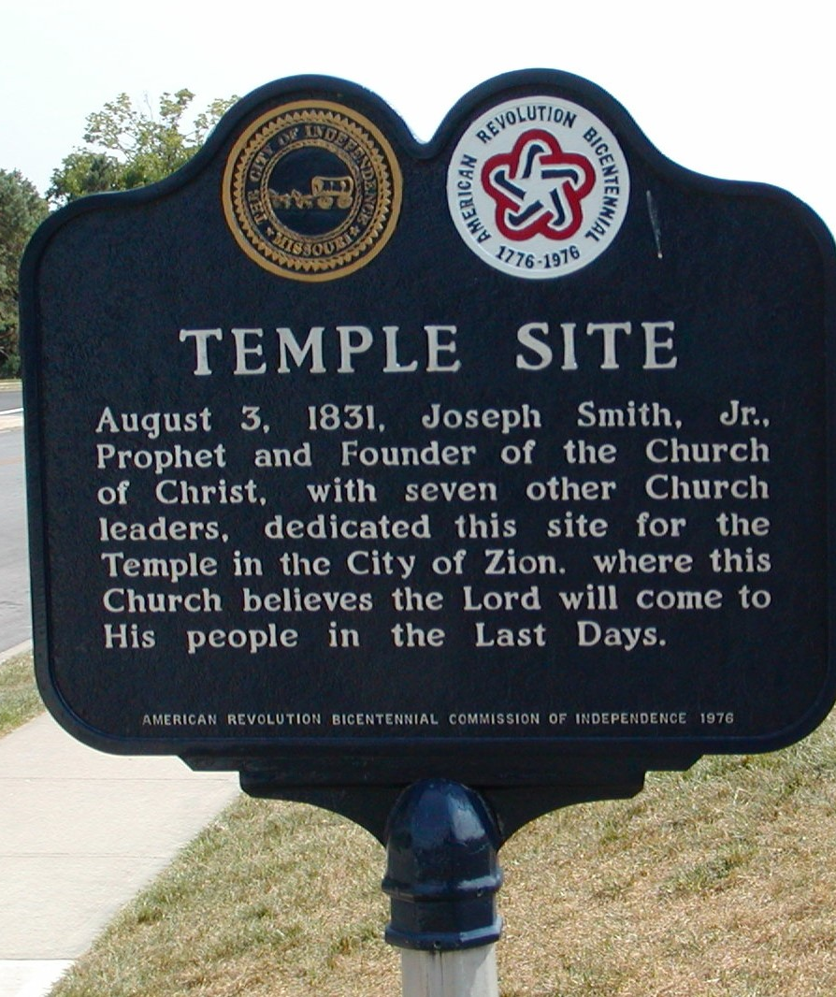
New Jerusalem
Doctrine and Covenants 52:42–43; 57:1 - 3

Slide 21
New Jerusalem
“There will a cloud of glory rest upon that temple by day, the same as the cloud rested upon the tabernacle of Moses. Not only that, but also a flaming fire will rest upon the temple by night, covering the whole temple; and if you go inside of the temple, the glory of God will be seen there as it was anciently; it shall come to pass that every man and every woman who is pure in heart, who shall go inside of that temple, will see the Lord.” (Orson Pratt, J.D., Vol. 21:330-31)
“Those 24 rooms will be all joined together in a circular form There will be tabernacles, there will be meeting houses. The Temple will be dedicated to the Priesthood of the Most High God, and for most sacred and holy purposes.” (Joseph Smith, DHC, Vol. 1, pp. 359-362, June 25, 1833. See also Orson Pratt, Journal of Discourses, Vol. 24, pp. 24-25, October 26, 1879.)

Slide 22
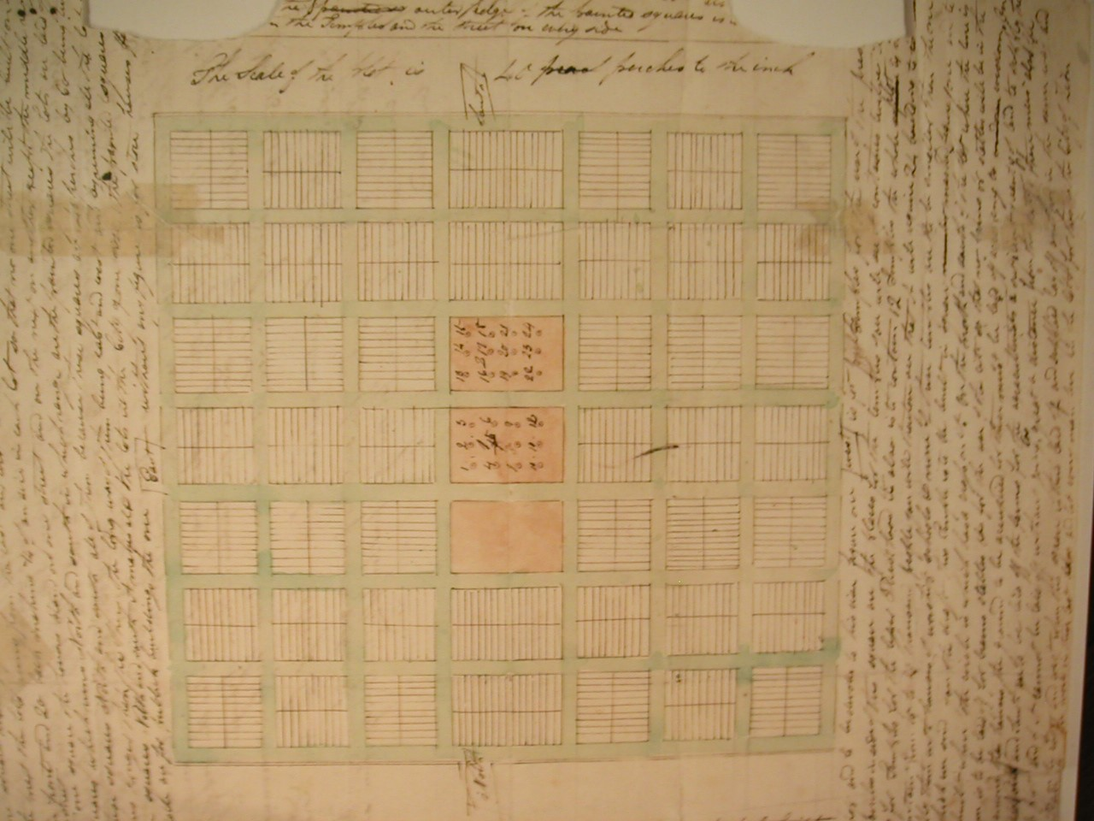

Slide 23
Depository of Sacred Records
"Moroni was inspired, thirty six years later, to make a great sacred depository of the numerous volumes hid up by his father…located in another department of the hill, and its contents under the charge of holy angels, until the day should come for them to be transferred to the sacred temple of Zion.” (Orson Pratt, Millennial Star 28:417-19)

Slide 24
Depository of Sacred Records
“When Joseph and Oliver went, the hill opened, and they walked into a cave, in which there was a large and spacious room. It was just as light as day. They laid the plates on a table.
Under this table there was a pile of plates as much as two feet high, and there were altogether in this room more plates than probably many wagon loads; they were piled up in the corners and along the walls.
The first time they went there the sword of Laban hung upon the wall; but when they went again it had been taken down and laid upon the table across the gold plates; it was unsheathed, and on it was written these words: "This sword will never be sheathed again until the kingdoms of this world become the kingdom of our God and his Christ.” (in Journal of Discourses 19:38-39)

Slide 25
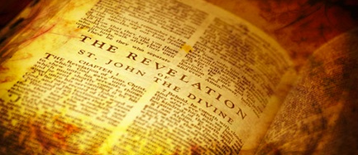
Revelation 11:14
“The second woe is past; and, behold, the third woe cometh quickly.”

Slide 26
REVIEW
https://www.youtube.com/watch?v=5nvVVcYD-0w

