Slide 1
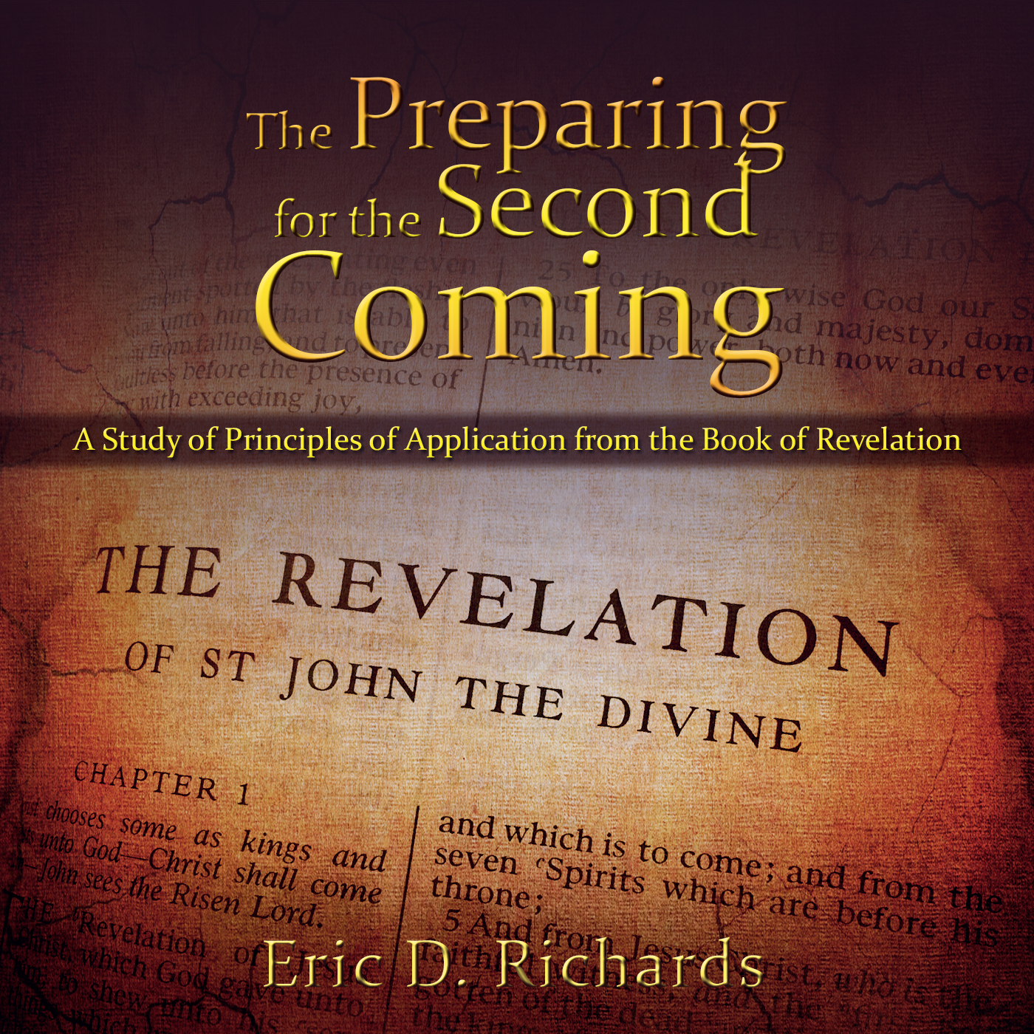
The Book of Revelation:
Preparing for
The Second Coming

Slide 2
Trumpets
Three Woes
Battles at the time of Adam Ondi Ahman (Rev. 9:1-12.)
The final great war (Armageddon) (Rev. 9:12-21; 10; 11:1-14.)
The destruction of the wicked when Christ appears to the World (Revelation 19)
FOURTH APPEARANCE: The New Jerusalem

Slide 3
revelation 9
The First Woe
D&C 77:13

Slide 4
Gordon B. Hinckley general conference, April 1995
“This is a time to be strong. It is a time to move forward without hesitation, knowing well the meaning, the breadth and the importance of our mission. It is a time to do what is right regardless of the consequences that might follow. It is a time to be found keeping the commandments.”

Slide 5
Revelation 9
Wars and Wickedness

Slide 6
“It is not improbable that these ancient prophets were seeing such things as men wearing or protected by strong armor; as troops of cavalry and companies of tanks and flame throwers; as airplanes and airborne missiles which explode, fire shells and drop bombs; and even other weapons yet to be devised in an age when warfare. And perhaps John is seeing such things as the effects of poisonous gas or bacteriological warfare, or atomic fallout…” (Bruce McConkie, DNTC, 3:502)

Slide 7
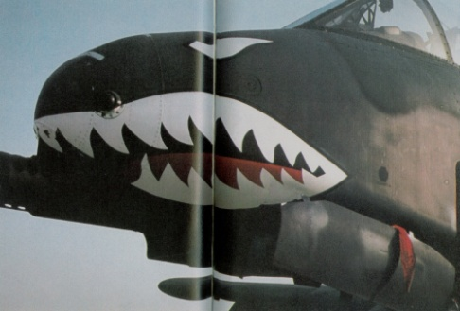
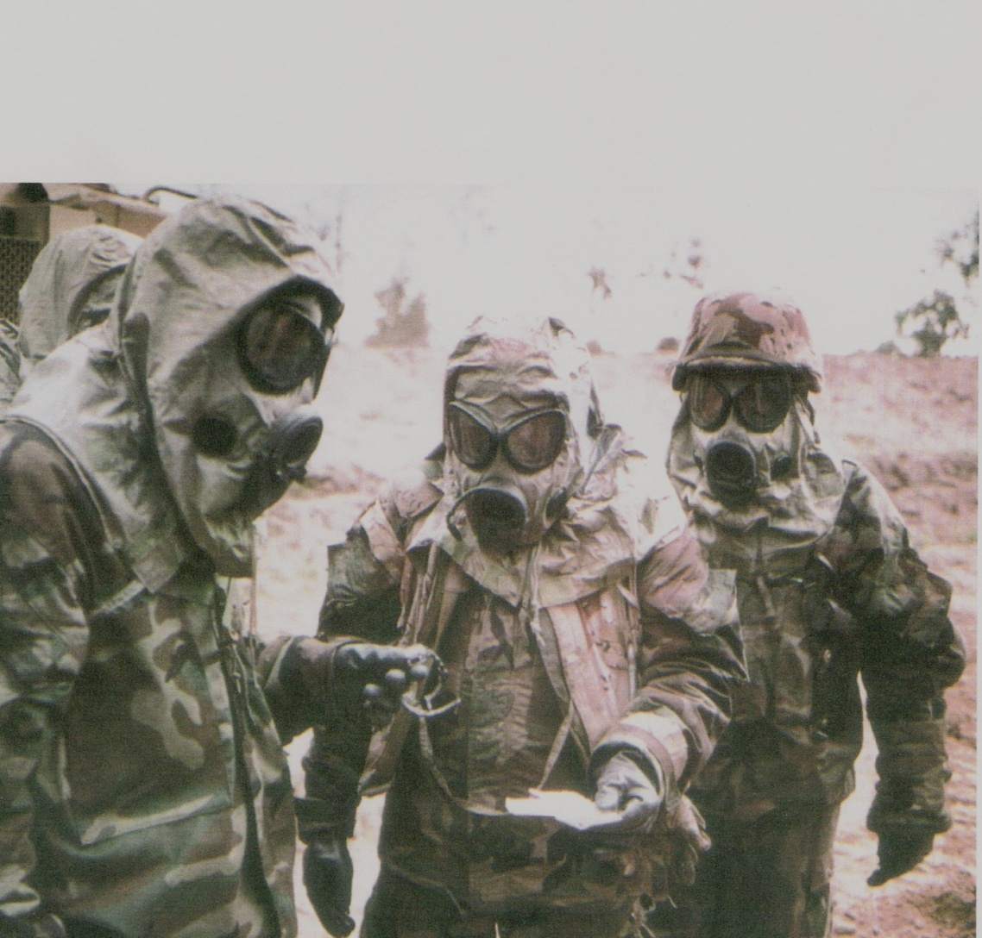
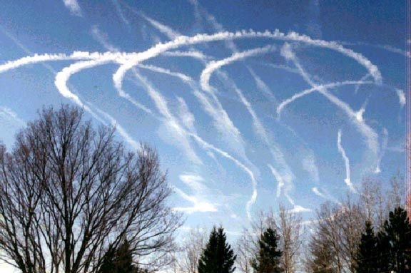
Rev 9:7?
Rev 9:8?

Slide 8
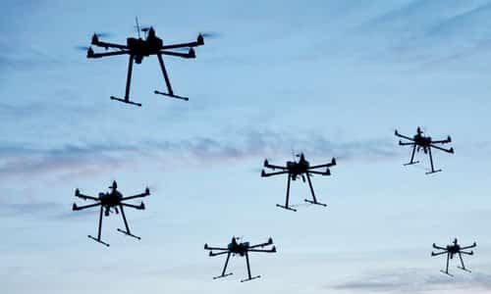
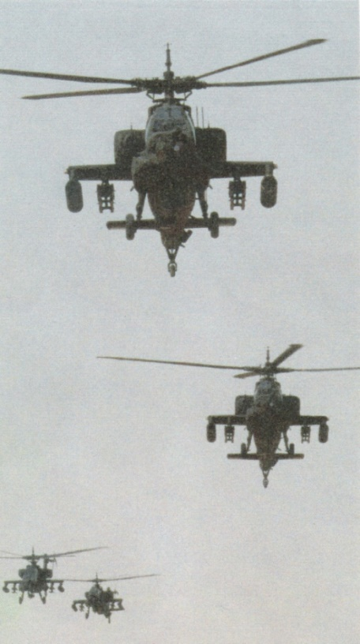
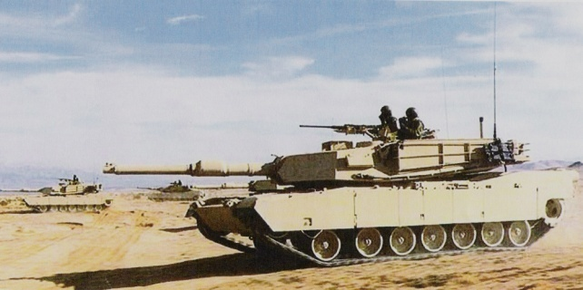
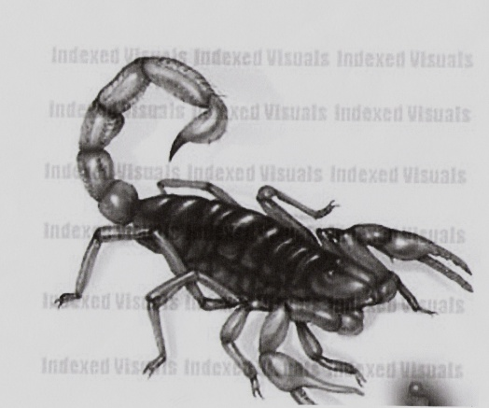
Rev 9:9?
Rev 9: 10

Slide 9
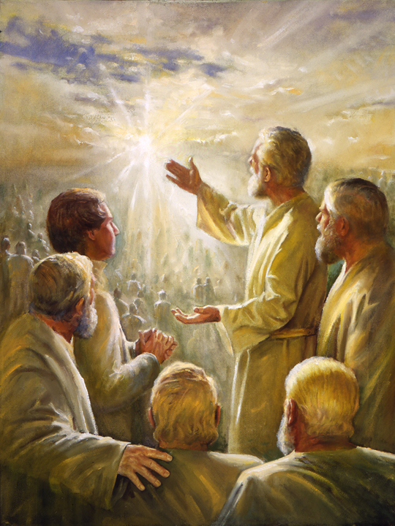
Adam-Ondi- Ahman

Slide 10
Adam-Ondi-Ahman
What does ‘Adam Ondi Ahman’ mean?
"Ahman is one of the names by which God was known to Adam. Adam-ondi-Ahman, a name carried over from the pure Adamic language into English, is one for which we have not been given a revealed, literal translation. As near as we can judge, Adam-ondi-Ahman means the place or land of God where Adam dwelt.” Mormon Doctrine, 19-20
D&C 107:53-57

Slide 11
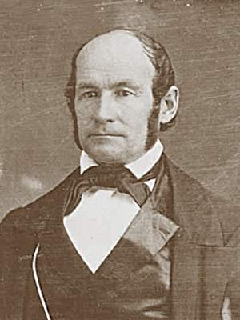
“While there, we laid out a city on a high elevated piece of land. . . .
“The Prophet Joseph called upon Brigham Young , myself and others, saying, ‘Brethren, come go along with me, and I will show you something.’ He led us a short distance to a place where were the ruins of three altars built of stone, one above the other, and one standing a little back of the other. ‘There,’ said Joseph, ‘is the place where Adam offered up sacrifice after he was cast out of the garden.’ The altar stood at the highest point of the bluff. I went and examined the place several times while I remained there” (Life of Heber C. Kimball, August 1838, pp. 208-10.).

Slide 12
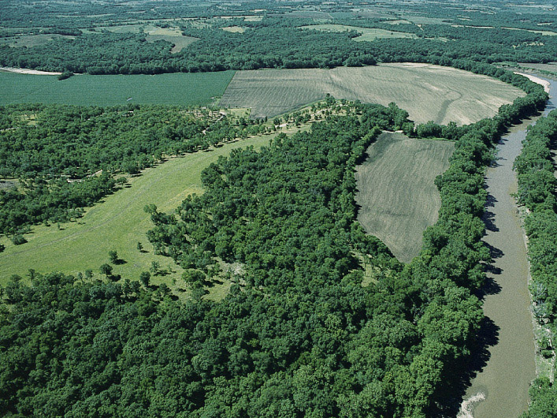

Slide 13
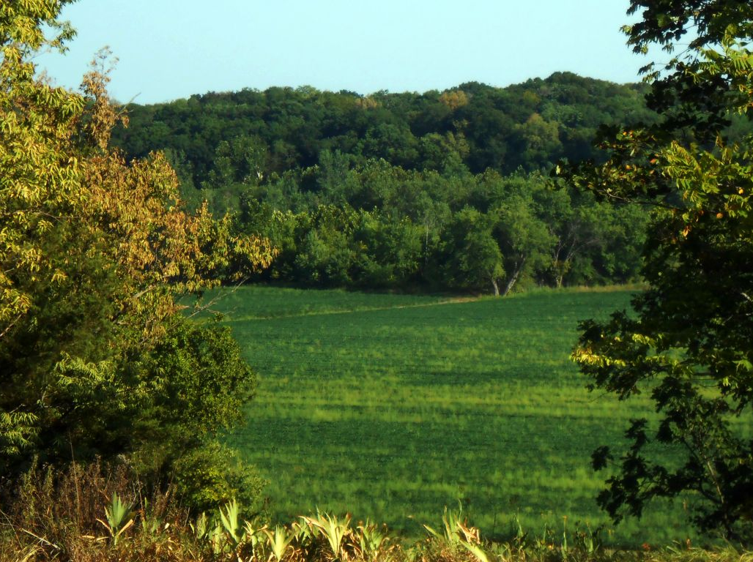
Temple planned
1500 Latter-day Saints
Lilburn Boggs (Eextermination order)

Slide 14
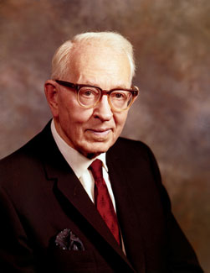
“Adam-ondi-Ahman, the place to which Adam and Eve fled when cast out of the Garden of Eden, is where Adam erected an altar unto God, and offered sacrifices, and that Far West was the spot where Cain killed Abel.” (Joseph Fielding Smith, Jr., and John J. Stewart, The Life of Joseph Fielding Smith [Salt Lake City: Deseret Book Co., 1972], 335.)
Is Adam Ondi Ahman purely LDS Doctrine?
Daniel 7:9-10, 13-14

Slide 15
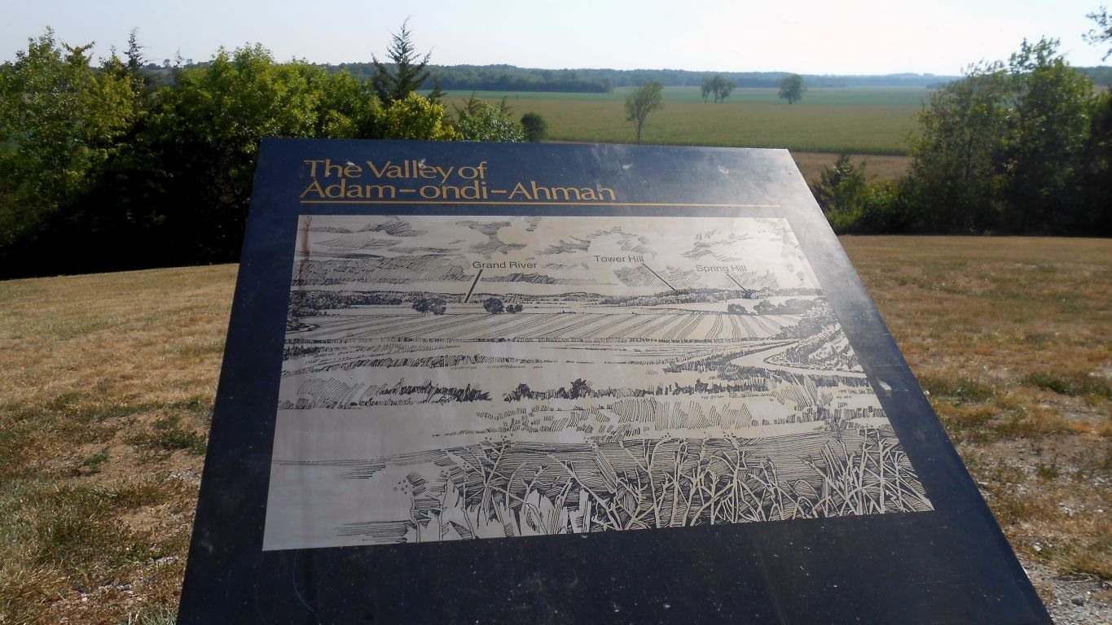
The Future of Adam Ondi Ahman

Slide 16
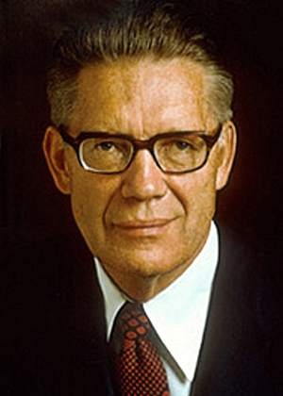
“Before any of his appearances, He will come in private to his prophet and to the apostles. Those who have held keys and powers and authorities in all ages from Adam to the present will be present...
“Every prophet, apostle, president, or church officer -- all who have held keys -- shall stand before him who holds all of the keys. They will then be called upon to give an account of their stewardships and to report how and in what manner they have used their priesthood and their keys. The Son of Man stands before him. Adam delivers up his stewardship to Christ but retains his standing as head of the human family.”
Elder Bruce R. McConkie
The Millennial Messiah (Salt Lake City: Deseret Book, 1982), pp.578-588

Slide 17
1st Woe – 1st Appearance – Adam Ondi Ahman
“Adam-Ondi-Ahman will be the most momentous event of this earth.” (Joseph Fielding Smith, The Way to Perfection, p. 289)
“Adam-Ondi-Ahman will adjust the affairs of the world.” (John Taylor, the Gospel Kingdom, p. 216-217)
“Without Adam-Ondi-Ahman, everything would be in confusion at the Second Coming of the Lord.” (Orson Pratt, Journal of Discourses, 18:344)
“When this gathering is held, the world will not know of it; the members of the Church at large will not know of it.” (Joseph Fielding Smith, The Way to Perfection, 1943, pp. 788-91).

Slide 18
1st Woe – 1st Appearance – Adam Ondi Ahman
“There will be many meetings during this grand event including the sacrament meeting, some for leadership training, some for business, some for worship, some for the edification of all present.” (Bruce R. McConkie, The Millennial Messiah, pp. 585-586)
“Saints will be prepared to live in a paradisiacal glory.” (John Taylor, the Gospel Kingdom, p. 218)
“Christ will come to the meeting and be sustained in His calling as King of Kings and Lord of Lords.” (Joseph Fielding Smith, Doctrines of Salvation, 1:106)
“We will receive them into our bosom and they shall see us; and we will fall upon their necks and they shall fall upon our necks, and we will kiss each other; it shall be Zion; and for the space of a thousand years the earth shall rest.” (Moses 7:63–64)

Slide 19
1st Woe – 1st Appearance – Adam Ondi Ahman
“The sons of Levi will offer unto the Lord an offering in righteousness” (3 Nephi 24:2-3)
“144,000 sealed priests will be at Adam Ondi Ahman” (Joseph Smith, History of the Church, 5:326).
“Both men and women will be present.” (B.R.McConkie, Millennial Messiah)
“The righteous shall receive all the blessings of the temple, the fullness of the priesthood, and the Second Comforter” (ETB, Ensign, August 1985, pp. 6-10)

Slide 20
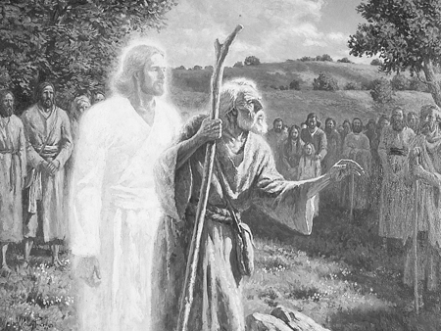
Adam Ondi Ahman
Highlight: D&C 27:5
Guest list: D&C 27:6-12
How to Preare: D&C 27:15-18
Revelation 9:12

Slide 21
The Book of Revelation:
Preparing for
The Second Coming

