Slide 1
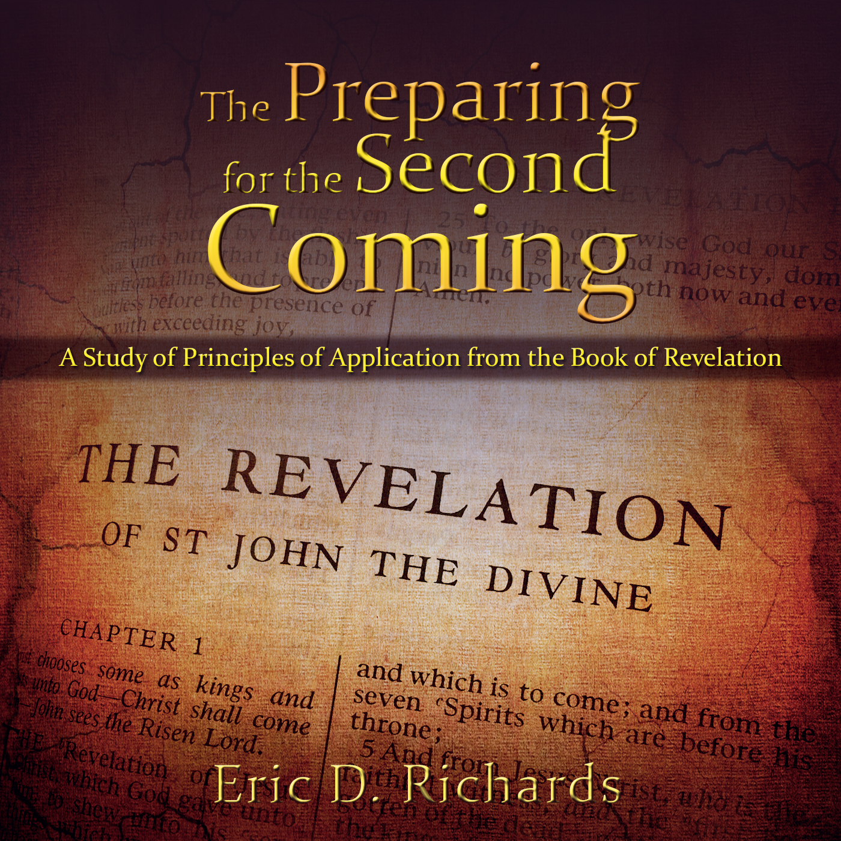
The Book of Revelation:
Preparing for
The Second Coming

Slide 2
Chapter 10
Little Book Prophecy

Slide 3
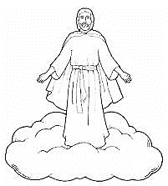
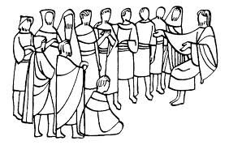
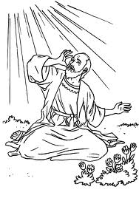
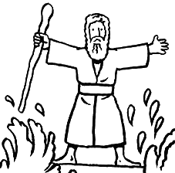
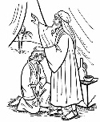
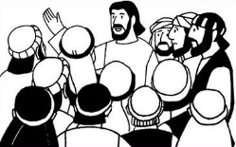
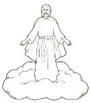
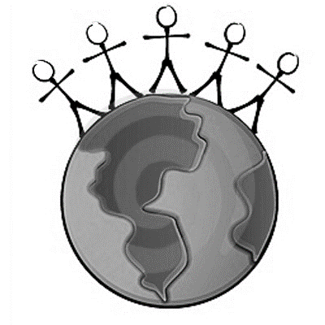
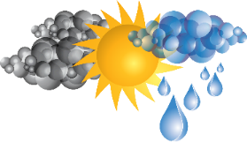
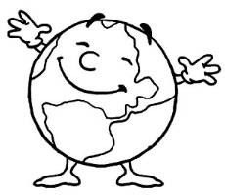
The Book of Revelation
Jesus Christ
John’s 7 Letters to 7 Churches
Throne Theophany
Seven Seals Overview
Revelation 1
Revelation 2-3
Revelation 4-5
Revelation 6-9
The Little Book
2 prophets in Jerusalem
The Dragon, The Beast, and the Victory
Righteous Rewarded
Revelation 10
Revelation 11
Revelation 12-14
Revelation 15
Armageddon
Wicked Destroyed
The Second Coming
Millennium & Final Judgment
Celestialized Earth
Revelation 16
Revelation 17-18
Revelation 19
Revelation 20
Revelation 21-22

Slide 4
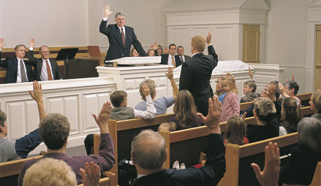
What is your current calling?

Slide 5
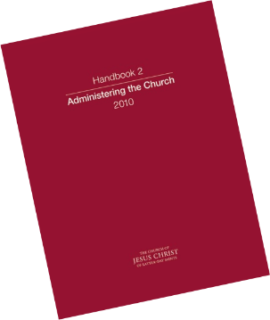
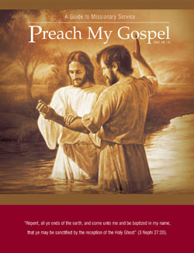
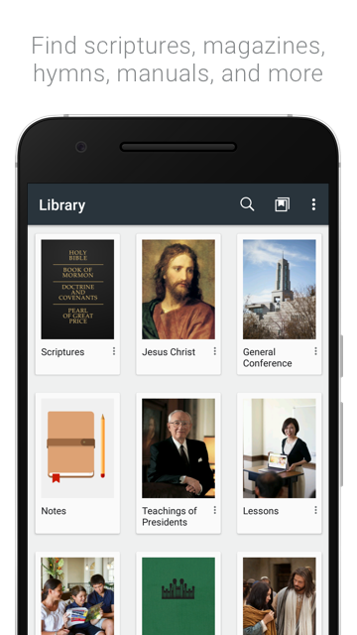
When you are called, do you receive a book?

Slide 6
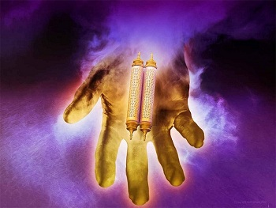
The Little Book Interlude
Revelation 10:1-7
Vs 2 Sea AND EARTH?
Vs 3-4: Who were these messengers? (hint: think of Revelation 6)
Vs 7: Who is the 7th messenger
What is the ‘mystery of God’ that John will assist with?
(hint: D&C 77:14)

Slide 7
HOUSE OF ABRAHAM (HEBREWS) “I will multiply thee, and thy seed after thee, like unto these [stars]; and if thou canst count the number of sands, so shall be the number of thy seeds.” (Abr. 3:14.)
Sarah
Isaac
Hagar
Ishmael
Keturah (Gen 25)
Zimran, Jokshan, Medan, Midian, Ishbak, and Shuah.
What does “Gentile” mean?

Slide 8
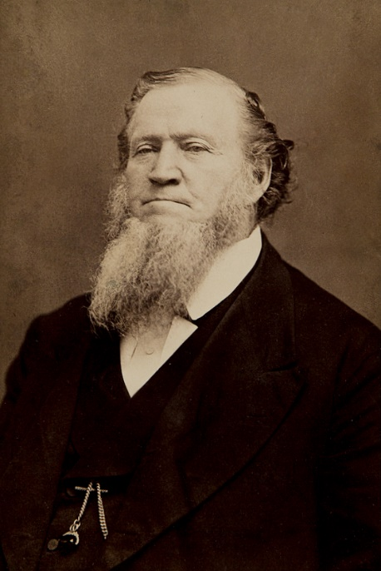
“Take the Elders and you can scarcely find one out of a hundred who is not of the house of Israel. …
“Will we go to the Gentile nations to preach the Gospel? Yes, and gather out the Israelites … We want the blood of Jacob, and that of his father Isaac and Abraham, which runs in the veins of the people…
“We will lay our hands upon the Gentiles that they may receive the Holy Ghost, and the Lord will make them of the house of Israel. They will be broken off from the wild olive tree, and be grafted into the good and tame olive tree, and will partake of its sap and fatness.” (Brigham Young, Journal of Discourses 2:268–69 as quoted in Ensign, January 1991.)
What do we know about Pre-Earth Israelites?

Slide 9
HOUSE OF ISRAEL
"The Lord said he would scatter Israel among the Gentile nations, and by doing so he would bless the Gentile nations with the blood of Abraham." (Joseph Fielding Smith, Answers to Gospel Questions, 3:63.)
In what ways has the Lord done this? (Hint: think back to the 5th Seal)
“It is very possible that the majority of those who come into the Church have the blood of two or more of the tribes of Israel as well as the blood of the Gentiles" (Joseph Fielding Smith, Improvement Era, Oct. 1923, p. 1149).
"Since families are of mixed lineage, it occasionally happens that members of the same family have blessings declaring them to be of different lineage….The blood of one tribe may be dominant in one child and the blood of another tribe dominant in another child, so children from the same parents could belong to different tribes" (President James E Faust, "Your Patriarchal Blessing," BYU, March 30, 1980).
What gifts/responsibilities are found within each tribe?
What is John doing to fulfill his calling?

Slide 10
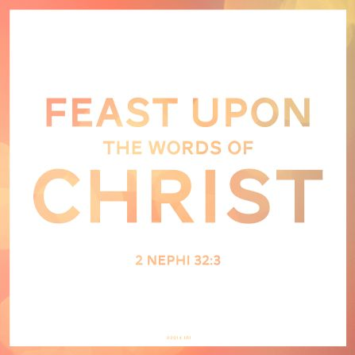
Revelation 10:8-11
Cross Reference Ezekiel 2:8-10-3:3
Why is it bitter and also sweet?

Slide 11
CARL B. COOK, SERVE GEARS

Slide 12
CARL B. COOK, SERVE GEARS

Slide 13
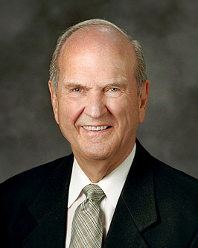
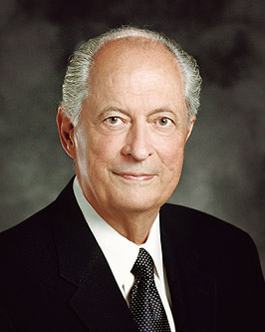
“To feast means to savor. We savor the scriptures by studying them in a spirit of delightful discovery and faithful obedience. The words of Christ become embedded ‘in fleshy tables of the heart’ and they become an integral part of our nature.”
Russell Nelson, “Living by Scriptural Guidance,” October 2000
“To feast upon the words of Christ, we must study the scriptures and absorb His words through pondering them and making them a part of every thought and action.”
Robert Hales, “Healing Soul and Body,” October 1998
1 Nephi 15:24

Slide 14
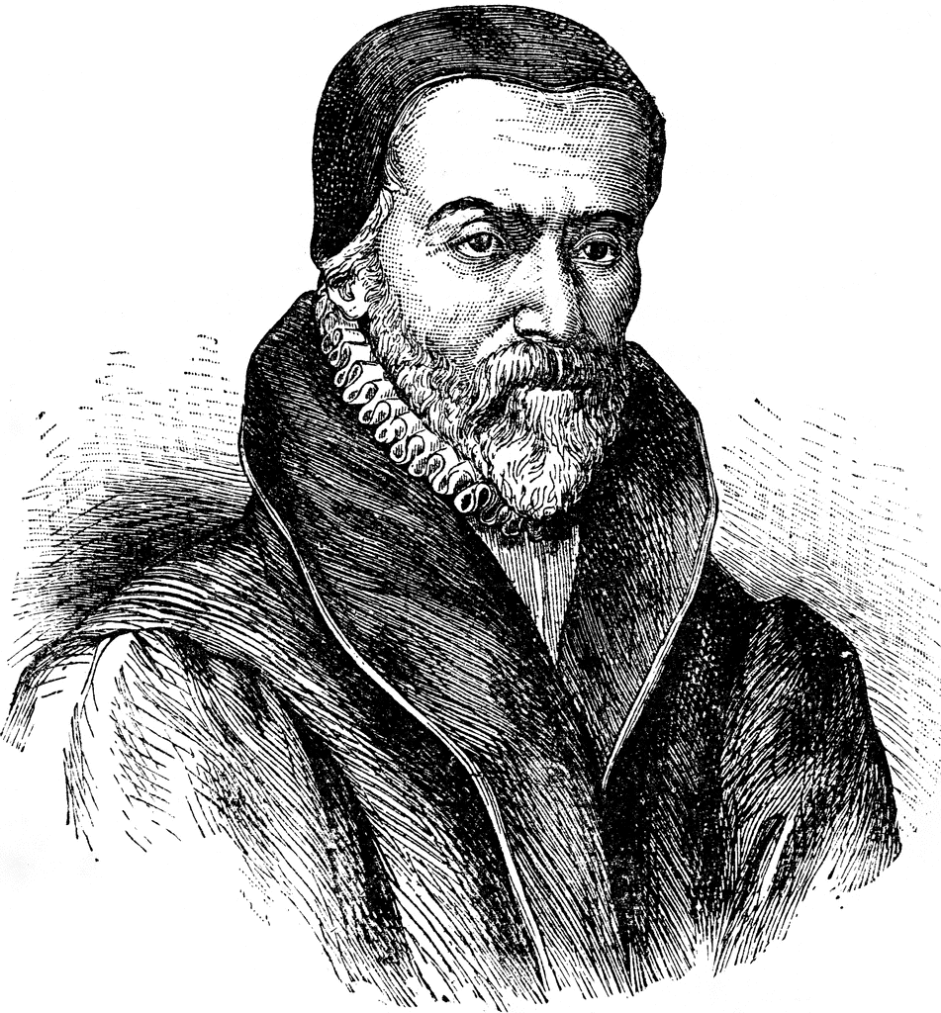
After translating the bible into English and after facing fierce opposition from the king, William Tyndale was imprisoned for almost 2 years, given little eat or drink, had no blankets or pillow and was then strangled to death and then his body was burned and the ashes destroyed and cast off the continent because the king thought he was such a heretic.
About 90% of our King James bible comes from his translation; he added a slough of phrases that have become part of English vernacular as well.

Slide 15
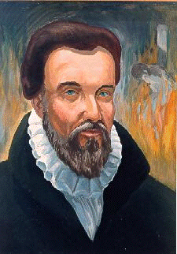
Tyndale’s idioms:
§ knock and it shall be opened unto you
§ twinkling of an eye
§ a moment in time
§ seek and you shall find
§ ask and it shall be given you
§ judge not that you not be judged
§ let there be light
§ the powers that be
§ my brother's keeper
§ the salt of the earth
§ filthy lucre
§ it came to pass
§ gave up the ghost
§ the signs of the times
§ fight the good fight

Slide 16
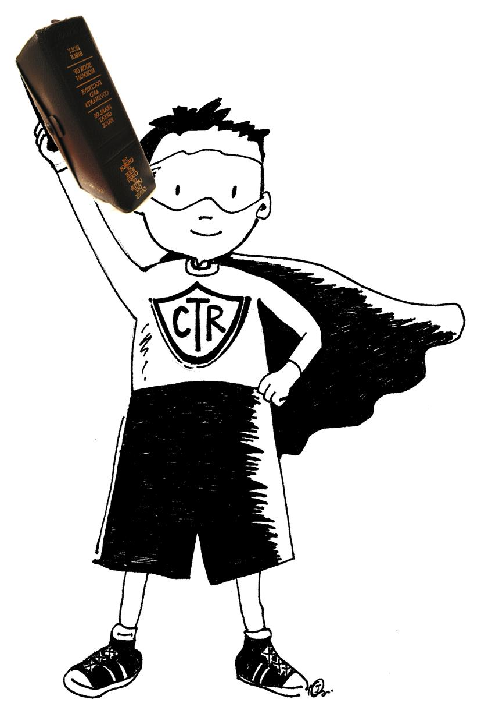
Steps to Successful Scripture Study
Before you study
As you start to read
While you are reading
As you conclude your reading
After you conclude your reading
Psalm 117

Slide 17
Seventeen Steps to Successful Scripture Study
Before you study
Plan a time for study (alarm on a phone or studying with a friend)
Write down a systematic plan for study
Invite the help of the Holy Ghost before you being reading (‘pray’ over your food before you eat)
As you start to read
Read the Chapter Heading
Visualize
Insert your name as you read
Look for Footnotes (Heb., Gr., IE., OR, JST, BD, TG, Maps, Gazetteer)
While you are reading
Ask, “Why might the Lord have inspired the writer to include this detail?”
Mark
Look for symbolism

Slide 18
Seventeen Steps to Successful Scripture Study
As you conclude your reading
Consider memorizing a verse
Look up unfamiliar words or the original definitions or the Lord’s definitions
Read commentaries and manuals
Record application, additional insights, correlations, cross-references, questions
After you conclude your reading
Pray to invite the help of the Holy Ghost for additional relevancy
Make a plan to act in Faith based on the day’s study; consider sharing what you learned with others

Slide 19
Sister Celia Cruz Ayala was attacked by a bandit who stole her purse and with it a wrapped copy of the Book of Mormon. A few days later she received this letter:
Mrs. Cruz: Forgive me, forgive me. You will never know how sorry I am for attacking you. I want you to know that you seemed to have a radiance about you. That light seemed to stop me from harming you, so I ran away instead. But because of it, my life has changed and will continue to change. The Book of Mormon - the message you wrote in that book brought tears to my eyes. I have not been able to stop reading it. I have prayed and asked God to forgive me, and I ask you to forgive me.
I want you to know that you will see me again, but when you do, you won’t recognize me, for I will be your brother . . . . Here, where I live, I now go to the church you belong to…
Sincerely,
Your brother

Slide 20
“There is no question – personal or social or political or occupational – that need go unanswered. In the scriptures, we find principles of truth that will resolve every confusion and every problem and every dilemma that will face the human family.”
Elder Boyd K. Packer
“Teach the Scriptures,” October 1977 Address to Religious Educators

Slide 21
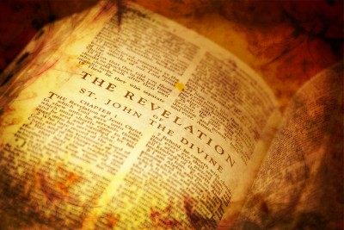
Application for Preparation
Are you feasting?
Personal scripture study?
Family scripture study? Family home evening? Sunday School?

Slide 22
The Book of Revelation:
Preparing for
The Second Coming

