Slide 1
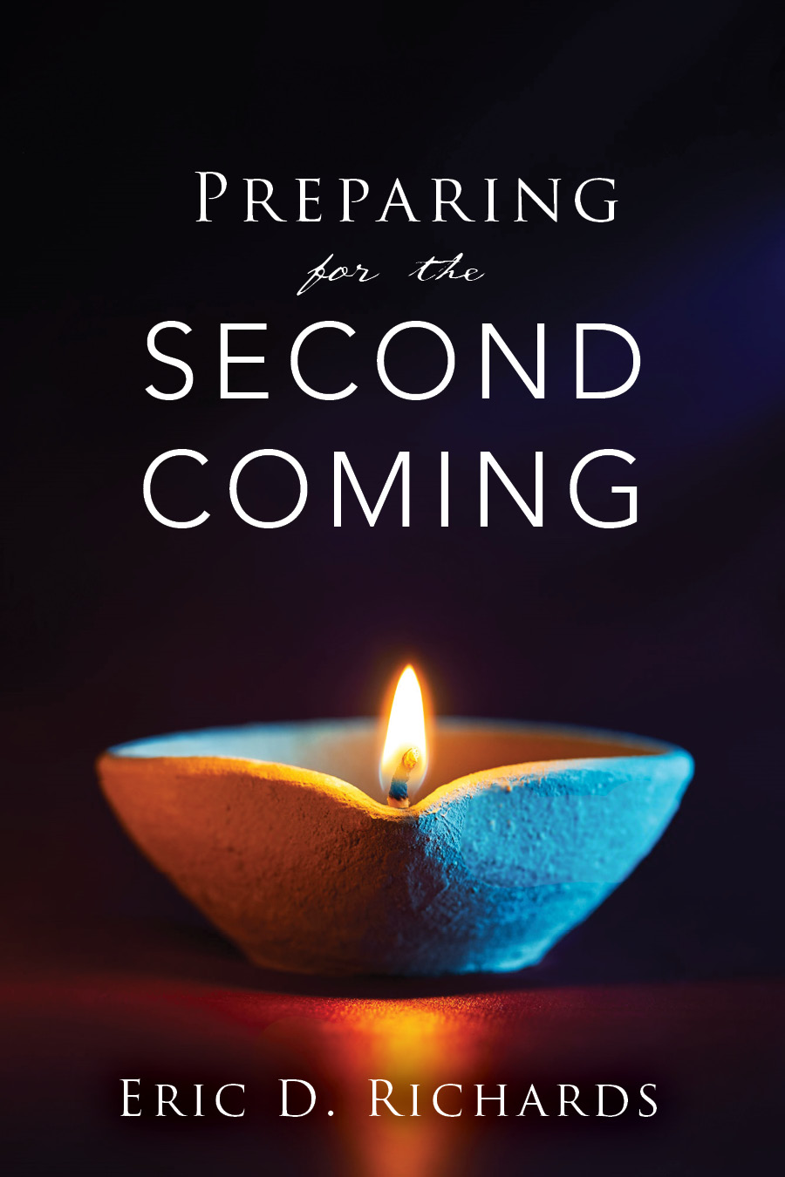
The Book of Revelation

Slide 2
REVELATION 4-5
REVELATION 1
Jesus Christ
REVELATION 2-3
7 Letters 7 Churches
Throne Theophany

Slide 3
Favorite Resources
LDS.org, Student Manuals, Ensign
BYU Religious Study Center (RSC)
Scriptures.BYU.edu
Blue Letter Bible
FairMormon.org
Book of Mormon Central
ScottWoodward.org
Bruce Satterfield (emp.byui.edu/satterfieldb)
Elder McConkie

Slide 4
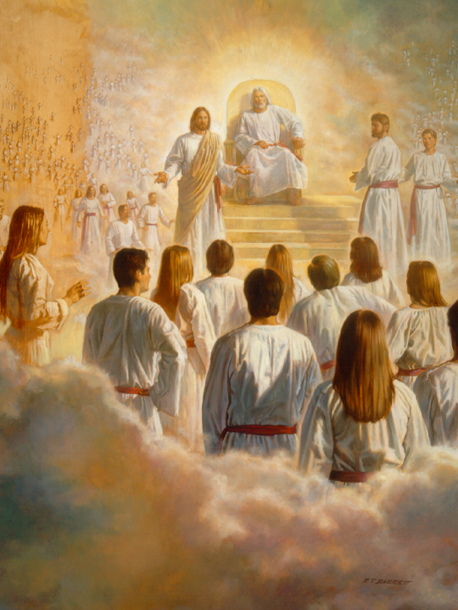
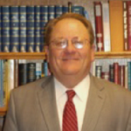
Trinity
The Trinity Debate
“Theological Looking Lenses”
Revelation 4:2 - Who is this?
Revelation 5:1-6
Revelation 5:6 - Who is this?
Please explain Revelation 5:7
“Revelation 5:7 is a problematic verse for contemporary Christians…”

Slide 5
Revelation 5:10
Revelation 4:10
President Ezra Taft Benson: "Men and women who turn their lives over to God will discover that He can make a lot more out of their lives than they can. He will deepen their joys, expand their vision, quicken their minds, strengthen their muscles, lift their spirits, multiply their blessings, increase their opportunities, comfort their souls, raise up friends, and pour out peace."
Cross Reference John 6:1-11

Slide 6
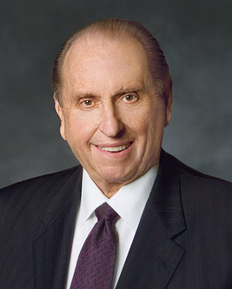
How many people surround God’s throne in Revelation 5:11? Why does John provide that detail?
“I believe that the Lord will help us. I believe that our Heavenly Father wants to save every one of his children. I do not think he intends to shut any of us off because of some slight transgression, some slight failure to observe some rule or regulation. There are the great elementals that we must observe, but he is not going to be captious about the lesser things. I believe that in his justice and mercy, he will give us the maximum reward for our acts, give us all that he can give; in the reverse, I believe that he will impose upon us the minimum penalty which it is possible for him to impose” (President Thomas S Monson, Ensign, May 1995, quoting J Reuben Clark)

Slide 7
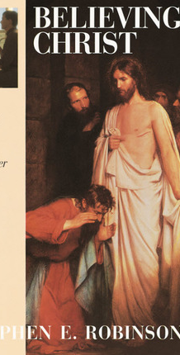
“I once counseled a man who said, ‘Bishop, I’m just not celestial material.’ Well, I’d heard those words once too often, so I said, ‘You’re not celestial material? Welcome to the club. Why don’t you admit your real problem? Why don’t you admit that you don’t believe Christ can do what he says he can do?’
He got angry. ‘I have a testimony of Jesus!’ I said, ‘Yes, you believe in Christ. You simply do not believe Christ. He says that even though you are not celestial, he can make you celestial—but you don’t believe it.’
Many of us are trying to save ourselves, holding the atonement of Jesus Christ at arm’s distance and saying, ‘When I’ve perfected myself, then I’ll be worthy of the Atonement. But that’s not how it works. That’s like saying, ‘I won’t take the medicine until I’m well.’

Slide 8
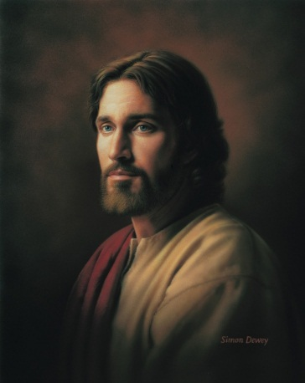
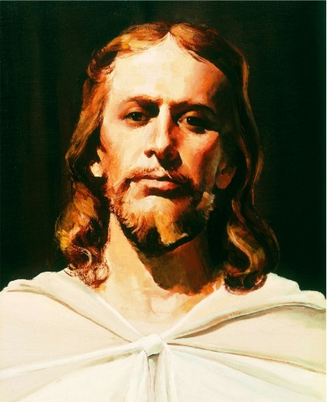
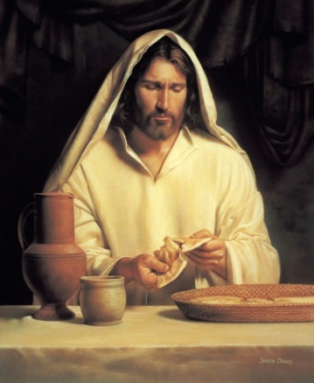
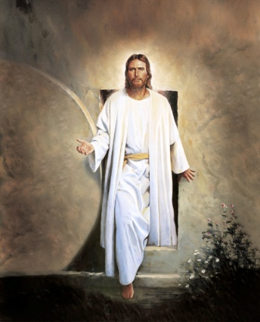
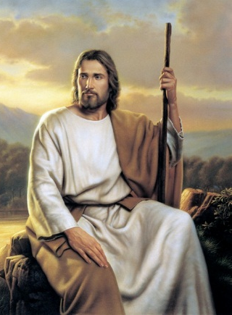
Grace is not the light at the end of the tunnel.
Grace is the light that moves us through the tunnel.
Grace doesn't help us earn heaven.
Grace helps us learn heaven
Grace is not about filling gaps.
Grace is about filling us.
Grace doesn't just save us from sin.
Grace saves us for heaven.
Grace isn't just a favor He gives to us.
Grace is an investment He made in us.

Slide 9
Grace doesn't just cleanse us.
Grace transforms us.
Grace does not just allow us to go home to heaven.
Grace helps us feel at home when we reach heaven.
Grace is not achieved down the road.
Grace is received right now.
Grace doesn’t make up the difference.
Grace makes all the difference.
Grace is not a finishing touch.
Grace is the Finisher’s touch.

Slide 10
Grace
Brad Wilcox

Slide 11
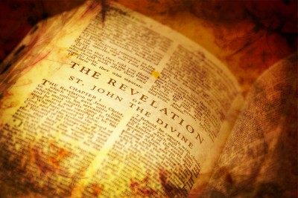
Application for Preparation
Is your view of the Godhead accurate?
Do you see Heavenly Father ‘rooting for you’?

Slide 12
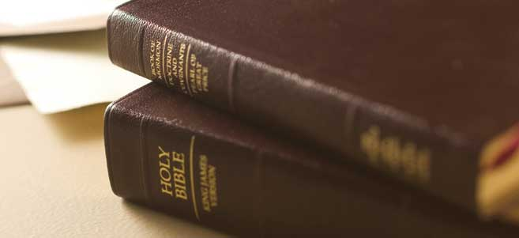
Modern Day Witnesses

Slide 13
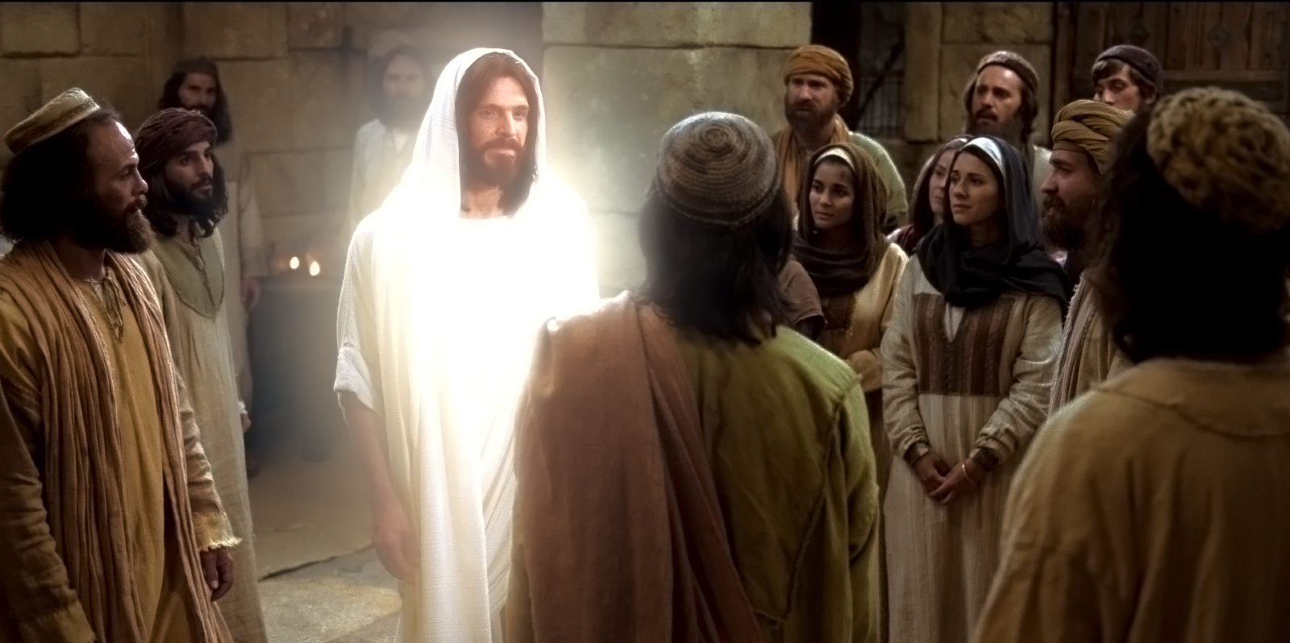
Bible Dictionary “Apostle”
The calling of an Apostle is to be a special witness of the name of Jesus Christ in all the world, particularly of His divinity and of His bodily resurrection from the dead (Acts 1:22; D&C 107:23). See also D&C 129.

Slide 14
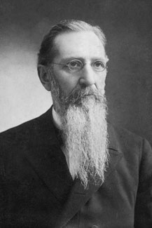
“The 12 disciples of Christ are supposed to be ear and eye witnesses of the divine mission of Jesus Christ. It is not permissible for them to say, “I believe...” It must be with them as if they had seen with their eyes and heard with their ears that they know.” (Joseph F. Smith, Gospel Doctrine)

Slide 15
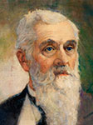
“In the large corridor leading into the celestial room, I was walking several steps ahead of grand-pa when he stopped me and said: “Wait a moment, Allie, I want to tell you something. It was right here that the Lord Jesus Christ appeared to me at the time of the death of President Woodruff. Then grand-pa came a step nearer and held out his left hand and said: “He stood right here, about three feet above the floor. It looked as though He stood on a plate of solid gold.
“Grand-pa described His hands, feet, countenance and beautiful white robes, all of which were of such a glory of whiteness and brightness that he could hardly gaze upon Him. Then grand-pa said: “Now, grand-daughter, I want you to remember that this is the testimony of your grand-father, who actually saw the Savior, here in the Temple, and talked with Him face to face”’
Alice Pond, in LeRoi C. Snow, “An Experience of My Father’s,” Improvement Era, Sept. 1933, 677]” (Teachings of Presidents of the Church: Lorenzo Snow [2012], 238–39)

Slide 16
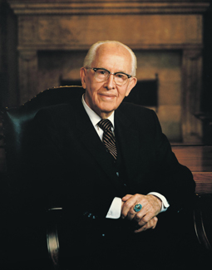
HE LIVES!
“There is no truth or fact of which I am more assured, or to know better by personal experience, than the truth of the literal resurrection of our Lord.” (Ezra Taft Benson, Dec 1980 New Era)

Slide 17
HE LIVES!
“I witness that this is the Lord’s church. He presides over it and is close to his servants. He is not an absentee Master; of that you can be assured.” (Ezra Taft Benson, Address to Religious Educators, Sept 17, 1976)

Slide 18
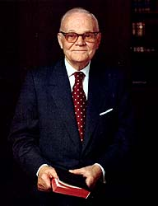
HE LIVES!
“I want to leave you with my witness. I know as I live that Jesus lives. I shall not know this better in the not-too-distant future when I shall stand before the Lord to give an account of my work in mortality.” (Marion G. Romney, CR Oct 1978)

Slide 19
HE LIVES!
“I don't know just how to answer people when they ask the question, "Have you seen the Lord?" I think that the witness that I have and the witness that each of us has, and the details of how it came, are too sacred to tell. I have never told anybody some of the experiences I have had, not even my wife. I know that God lives. I not only know that he lives, but I know him.” Marion G. Romney, cited in F. Burton Howard, Marion G. Romney: His Life and Faith (Salt Lake City, Utah: Bookcraft, 1988), 222.

Slide 20
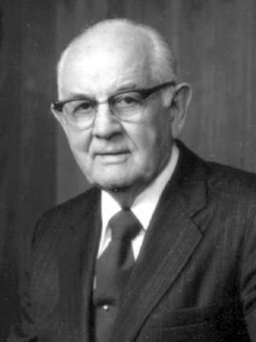
HE LIVES!
“I know that God lives. I know that Jesus Christ lives, said John Taylor, my predecessor, “for I have seen him.” I bear you this testimony.” (Spencer W. Kimball, CR April 1978)

Slide 21
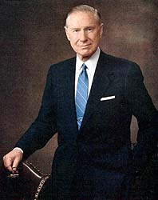
HE LIVES!
“I understand that the chief requirement for the holy apostleship is to be a personal witness of Jesus as the Christ. Perhaps on that basis alone, I can qualify” (James E. Faust, CR Oct 1978)

Slide 22
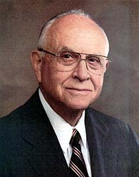
HE LIVES!
“I had the opportunity to be all alone in that upper room of the temple, to get onto my knees and to pour out my heart and soul to my Heavenly Father. I had an event happen to me at that time that I may witness and testify to you that Jesus is the Christ, the Son of God, that He lives - that he lives - that he is real.” (David B. Haight, BYU Speeches, 1977)

Slide 23
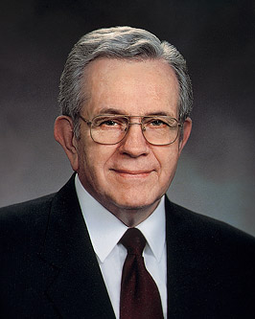
HE LIVES!
“Joseph Smith and Sidney Rigdon recorded: ‘And now, after the many testimonies which have been given of him, this is the testimony, last of all, which we give of him: That he lives! For we saw him’ (D&C 76:22–23).
Their words are my words.”
(Boyd K. Packer, Ensign, April 2014)

Slide 24
HE LIVES!
“We do not talk of those sacred interviews that qualify the servants of the Lord to bear a witness of Him, for we have been commanded not to do so.” (Boyd K. Packer, CR Ap 1980)

Slide 25
HE LIVES!
“I have heard one of the brethren declare, ‘I know from experiences too sacred to share that Jesus is the Christ’. I have only one qualification as an apostle and that is, I have that witness. ” (Boyd K. Packer, CR April 1971)

Slide 26
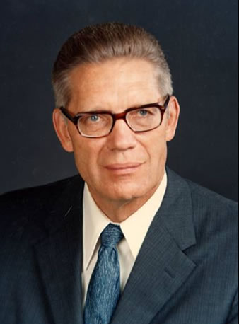
HE LIVES!
“I have a perfect knowledge that Jesus Christ is the Son of the living God and that he was crucified for the sins of the world.” (Bruce R. McConkie, CR October 1972)

Slide 27
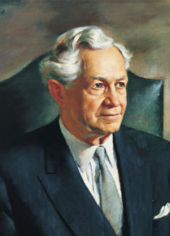
HE LIVES!
“My testimony of the risen Lord is just as real as Tomas’. I know that he lives.” (David O. McKay, CR 1968)

Slide 28
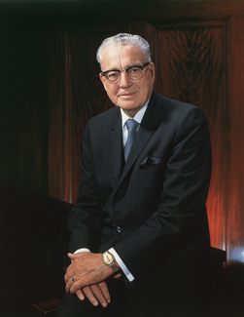
HE LIVES!
“I bear my witness to you this morning. There are some witnesses I cannot give now, perhaps sometime later. Many things are too sacred to share at this time. I have received a witness that I cannot or dare not deny. When I see Jesus, I cannot mistake His identity. I know that He lives!” Harold B. Lee, Teachings of Harold B. Lee (Salt Lake City, Utah: Bookcraft, 1996), 636

Slide 29
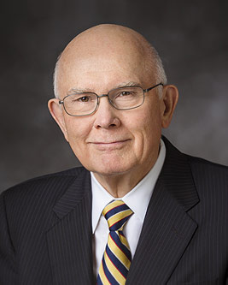
HE LIVES!
“Visions do happen. Voices are heard from beyond the veil. I know this.” Dallin H. Oaks, "Teaching and Learning by the Spirit," Ensign (March 1997), 14

Slide 30
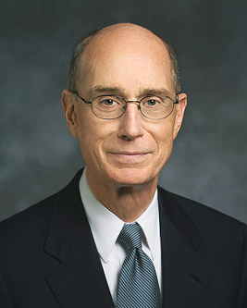
HE LIVES!
“I am grateful that I know as surely as did the Apostles Peter, James, and John that Jesus is the Christ, our risen Lord.” Henry B. Eyring, "Witnesses for God," Ensign (November 1996), 30

Slide 31
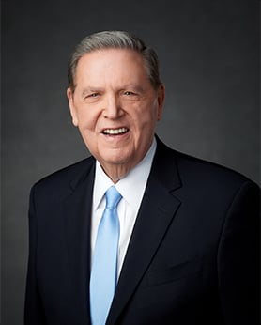
HE LIVES!
“I declare to you with the conviction Peter called the “more sure word of prophecy.” What was once a tiny seed of belief for me has grown into the tree of life.” (Elder Holland, “Lord I Believe, October 2014)

Slide 32
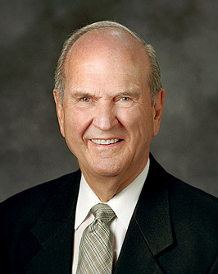
HE LIVES!
“A witness is a person with special knowledge. So when one of us, as special witnesses of the Lord, says we know, we have special knowledge obtained in temples and in sacred places that we don’t speak in detail about. But take my word for it: we know what we’re saying.” (Interview 9/17 Cache Valley Devotional for Young Adults)

Slide 33
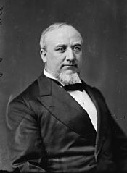
HE LIVES!
“I know that God lives. I know that Jesus lives; for I have seen Him” - George Q. Cannon quoted by Spencer W. Kimball, Ensign (May 1974): 119; George Q. Cannon talk given on 6 October 1896, published in Deseret News Semi–Weekly (27 October 1896); Gospel Truth (vol. 1, iv, 1st edition, 1957, compiled by Jerreld L. Newquist).

Slide 34
https://www.lds.org/media-library/video/2010-03-07-he-lives-testimonies-of-jesus-christ?lang=eng

Slide 35
https://www.lds.org/media-library/video/2010-03-07-he-lives-testimonies-of-jesus-christ?lang=eng

Slide 36
Chapters 4-5
Throne Theophany

Slide 37
The Book of Revelation

