Slide 1
The Book of Revelation

Slide 2
REVELATION 4-5
REVELATION 1
Jesus Christ
REVELATION 2-3
7 Letters 7 Churches
Throne Theophany

Slide 4
“MESSIAH-GLADNESS”
Sweet John 3:16
1 Prince of Peace
1 Savior
8 Emmanuel
8 Healer
5 Mighty God
5 Lamb of God
4 The Rock
4 Faithful One
3 Redeemer
3 Good Shepherd
6 Holy One
6 Alpha & Omega
7 King of Kings
7 The Word
2 Messiah
2 Older Brother

Slide 5
“MESSIAH-GLADNESS”
Sweet John 3:16
1 Prince of Peace
1 Savior
8 Emmanuel
8 Healer
5 Mighty God
5 Lamb of God
4 The Rock
4 Faithful One
3 Redeemer
3 Good Shepherd
6 Holy One
6 Alpha & Omega
7 King of Kings
7 The Word
2 Messiah
2 Older Brother

Slide 6
“MESSIAH-GLADNESS”
Sweet John 3:16
1 Prince of Peace
1 Savior
8 Emmanuel
8 Healer
5 Mighty God
5 Lamb of God
4 The Rock
4 Faithful One
3 Redeemer
3 Good Shepherd
6 Holy One
6 Alpha & Omega
7 King of Kings
7 The Word
2 Messiah
2 Older Brother

Slide 7
“MESSIAH-GLADNESS”
Sweet John 3:16
1 Prince of Peace
1 Savior
8 Emmanuel
8 Healer
5 Mighty God
5 Lamb of God
4 The Rock
4 Faithful One
3 Redeemer
3 Good Shepherd
6 Holy One
6 Alpha & Omega
7 King of Kings
7 The Word
2 Messiah
2 Older Brother

Slide 8
“MESSIAH-GLADNESS”
Sweet John 3:16
1 Prince of Peace
1 Savior
8 Emmanuel
8 Healer
5 Mighty God
5 Lamb of God
4 The Rock
4 Faithful One
3 Redeemer
3 Good Shepherd
6 Holy One
6 Alpha & Omega
7 King of Kings
7 The Word
2 Messiah
2 Older Brother
Favorite title?

Slide 9
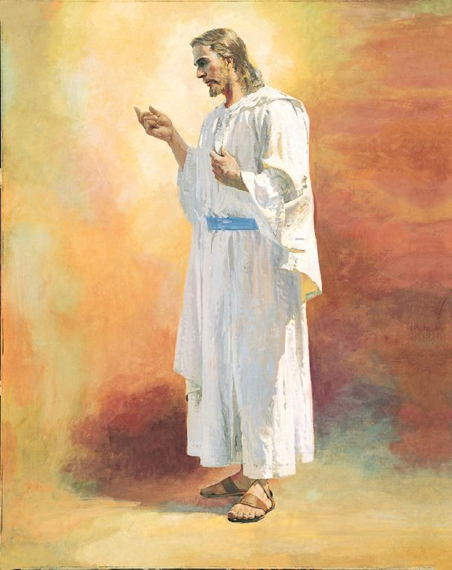
Names of The Lord
Jesus Christ …. Revelation1:1
Faithful Witness, First Begotten, Prince ….. Revelation 1:5
Alpha and Omega, First and Last ….. Revelation 1:8
Son of Man ….. Revelation 1:13
Son of God ….. Revelation 2:18
Holy and True ….. Revelation 3:7
The Amen ….. Revelation 3:14
The faithful and true witness ….. Revelation 3:14
The creation of God ….. Revelation 3:14
Lion of the tribe of Judah ….. Revelation 5:5,9
The root of David ….. Revelation 5: 5,9
Lamb ….. 5: 6-9
King of Kings - Lord of Lords ….. Revelation 17:14
Faithful and True ….. 19:11
The Word of God ….. Revelation 19: 13-16
Christ ….. Revelation 20: 4
The Lord God ….. Revelation 22:6
Beginning and the End ….. Revelation 22:13
The bright and morning star ….. Revelation 22: 16
Notes:
Adonai has become one of my favorite titles for God. It means ‘owner’ or ‘ruler’ and originally dealt with masters who owned slaves. Yet the title adonai didn’t merely connote ownership; it also bore within the name a certain responsibility for the care and well-being of that which was owned. The adonai (owner, ruler) was to provide for, protect, guide that which he owned. The psalmist pens in Psalm 97 that God is, “the [Adonai] of the whole earth.” He is not only the Creator, but He is also the Owner (Adonai). Since God is the absolute ruler and owner, our position should be one of surrender and of submission. Submission is a powerful tool when coupled with an All-powerful Adonai; if He truly is our Adonai, He should be allowed to rule. He should have the final say in our decisions. His perspective is the perspective we utilize in making choices. As we surrender our will (our crowns) to our Adonai, the heavens pour out blessings.

Slide 10
Names of The Lord
Elyon “The most high God” Genesis 14:17-20 (Abraham rescues Lot)
Roi “The strong one who sees” Genesis 16:13 (Sarah give Hagar)
El-Shaddai “The Almighty Creator of heaven and earth.” Gen. 17:1 and 49:24 (Abrahamic Cov)
Jireh “The Lord will provide” Genesis 22:13-14 (Abraham and Isaac)
Shammah “The Lord who is present” Genesis 28:16 (Jacob fleeing from Esau)
Rapha “The Lord our healer.” Exodus 15:26 (Post-Red Sea)
Nissi “The Lord our banner and victor” Exodus 17:15 (Mara)
Adonai “King of kings and the Lord of lords” Judges 6:15 (Gideon & Midianites)
Shalom “The Lord is peace” Judges 6:24 (Gideon & Midianites)
Sabbaoth “The Lord of Hosts” 1 Samuel 17:45 (David & Goliath)
Notes:
Adonai has become one of my favorite titles for God. It means ‘owner’ or ‘ruler’ and originally dealt with masters who owned slaves. Yet the title adonai didn’t merely connote ownership; it also bore within the name a certain responsibility for the care and well-being of that which was owned. The adonai (owner, ruler) was to provide for, protect, guide that which he owned. The psalmist pens in Psalm 97 that God is, “the [Adonai] of the whole earth.” He is not only the Creator, but He is also the Owner (Adonai). Since God is the absolute ruler and owner, our position should be one of surrender and of submission. Submission is a powerful tool when coupled with an All-powerful Adonai; if He truly is our Adonai, He should be allowed to rule. He should have the final say in our decisions. His perspective is the perspective we utilize in making choices. As we surrender our will (our crowns) to our Adonai, the heavens pour out blessings.

Slide 11
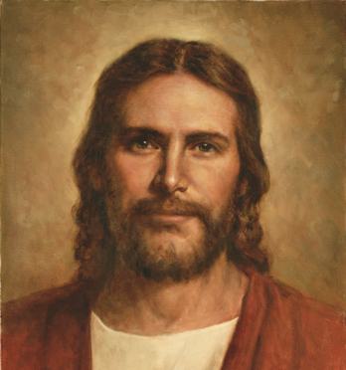
Who has seen him?
4 QUOTES

Slide 12
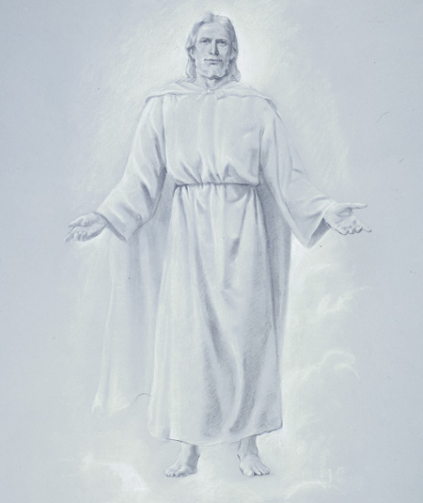
“God himself was once as we are now, and is an exalted man, and sits enthroned in yonder Heavens! If you were to see him today, you would see him like a man in form – like yourselves in all the person, image and very form as a man.” (Joseph Smith, HC, 6:305)

Slide 13
“If we could see our Father who dwells in the Heavens, we would learn that we are as well acquainted with him as we are with our earthly father...We would be ready to embrace him and fall upon his neck and kiss him, if we had the privilege.” (Brigham Young, JD 8:30)

Slide 14
“Nothing is going to startle us more when we pass through the veil to the other side than to realize how well we know our Father and how familiar his face is to us.” (President Ezra Taft Benson, Ensign, Dec 1988, p.6)

Slide 15
“How many Gods there are, I do not know. But there never was a time when there were not Gods and worlds, and when men were not passing through the same ordeals that we are now passing through. That course has been from all eternity, and it is and will be to all eternity. You cannot comprehend this, but when you can, it will be to you a matter of great consolation. ” (Discourses of Brigham Young, sel. John A. Widstoe [1998], pp. 22-23)

Slide 16
Throne Theophany
“Appearance of a throne god" or “The appearance of a throned deity to a human.”
History/Introduction
Vision
Reaction (usually with uneasiness
Commission
Moses
Isaiah
Ezekiel
Lehi
Joseph Smith
John (Revelation 4:1-9)

Slide 17
Favorite Resources
Using a search engine, type in…
“Resource name” + Verse
LDS.org, Student Manuals, Ensign
BYU Religious Study Center (RSC)
Scriptures.BYU.edu
Blue Letter Bible
FairMormon.org
Book of Mormon Central
ScottWoodward.org
Bruce Satterfield (emp.byui.edu/satterfieldb)
Elder McConkie

Slide 18
Revelation 4:6 earth
“This earth will become a celestial body—be like a sea of glass, or like a urim and thummim; and when you wish to know anything, you can look in this earth and see all the eternities of God” (in Journal of Discourses, 8:200; see also D&C 88:17–20, 25–26; 130:6–9).

Slide 19
Revelation 4:8 Creatures
“There will be beasts of various kinds, after the resurrection, in each of the kingdoms, telestial, terrestrial and celestial. It would be a very strange thing for any of the kingdoms to be devoid of animal and plant life. They are the creations of the Almighty; according to the divine plan, He will make all of his creatures as happy as it is possible for them to be under the conditions of their immortal states." (Joseph Fielding Smith, Church History and Modern Revelation, 1:298-99.)

Slide 20
Revelation 4:8 Creatures
“I suppose John saw beings there of a thousand forms, that had been saved from earths like this,—strange beasts of which we have no conception: all might be seen in heaven. John learned that God glorified Himself by saving all that His hands had made, whether beasts, fowls, fishes or men; and He will glorify Himself with them.” (Joseph Smith, Teachings, pp. 289–91.)

Slide 21
Revelation 4:8 Eyes
“When this spirit is freed from this mortal tabernacle, all senses will be greatly enlarged. We, by looking through these little eyes of ours, can see objects, but unclothe the spirit and instead of exposing a small portion, the whole of it would be exposed. I think we could then see in different directions at once, instead of looking in one particular direction.” (Orson Pratt, JD,2: 244.)
Joseph Smith reported after seeing the vision of the three degrees of glory (D&C 76), “My whole body was full of light and I could see even out at the ends of my fingers and toes.” (Nels B. Lundwall, The Vision, 11)

Slide 22
God’s Space and Time are Unique
The Theory of Relativity
Gravity, speed, motion, and time are interrelated.
“Right now we perceive music as a blind man perceives an object—sequentially. The blind man explores with his fingers, noting form, texture, and contours one by one, until he synthesizes his concept of what the object is.
“You and I don’t do that. We perceive objects immediately. We simply look at it, and we ‘know it’.
“God perceives time as instantaneously as we perceive objects.” (D&C Student Manual, Section 130)

Slide 23
God’s Space and Time are Unique
The Theory of Relativity
Gravity, speed, motion, and time are interrelated.
“Equally complete now is each of our lives before the Lord. We explore life sequentially because we are time-blind. But the Lord, perceiving time an object, sees us as we are, not as we are becoming. We are, for him, beings without time. We are continually before him.” (Lael Woodbury, dean of the College of Fine Arts and Communications at Brigham Young University, Continually before the Lord,Commissioner’s Lecture Series [Provo: Brigham Young University Press, 1974], pp. 5–6.)

Slide 24
The Book of Revelation

