Slide 1
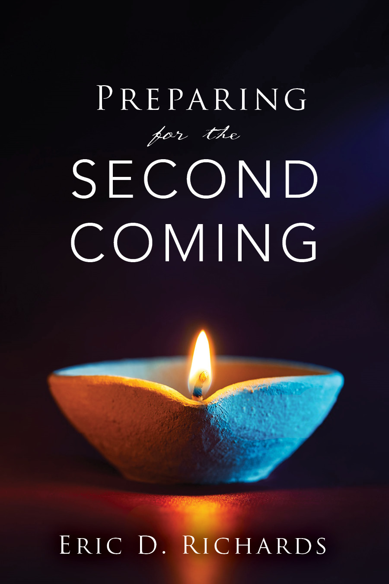
The Book of Revelation

Slide 2
the book of Revelation
Outline: Revelation 1:19
Write the things which…
Thou hast seen Revelation 1 Jesus Christ
Are Revelation 2-3 7 Churches

Slide 3
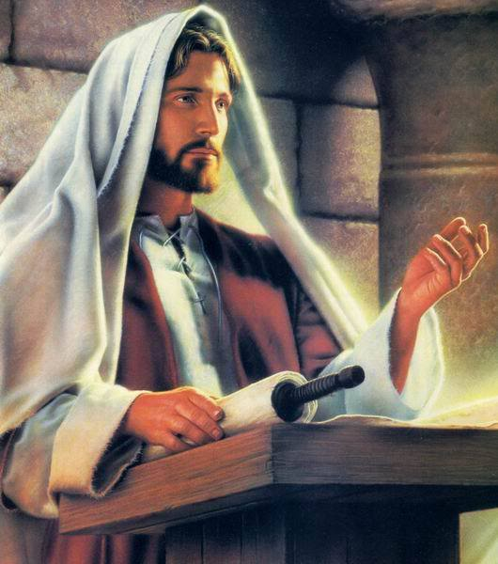
Doctrine: An unchanging truth of the gospel of Jesus Christ.
“FACT”
Modesty
Baptism
Family
Missionary Work
Fasting
Satan

Slide 4
Principle: Concentrated truth, packaged for application; “so, what should be done?”
“ACT”
Because my body is a temple (doctrine), I should … (principle).
Since the sacrament renews my baptismal covenant (doctrine), I should … (principle).
The prophet has asked me to seek marriage (doctrine), so I should … (principle)

Slide 5
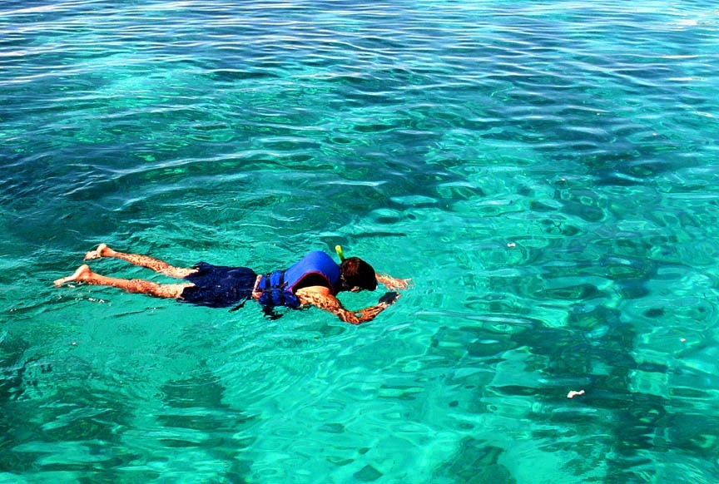
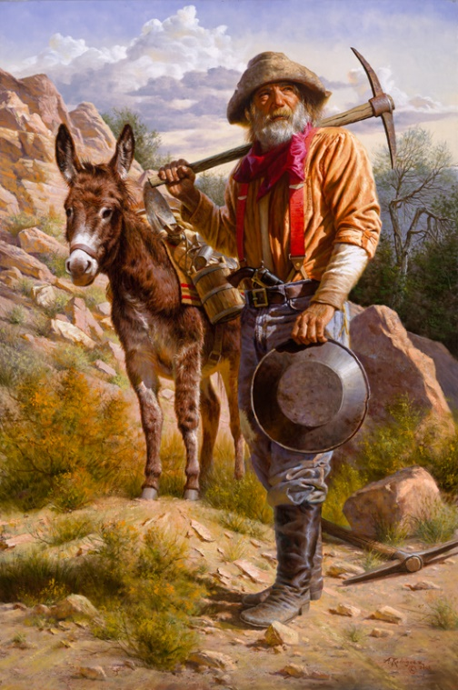
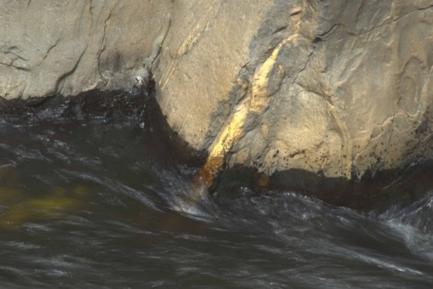
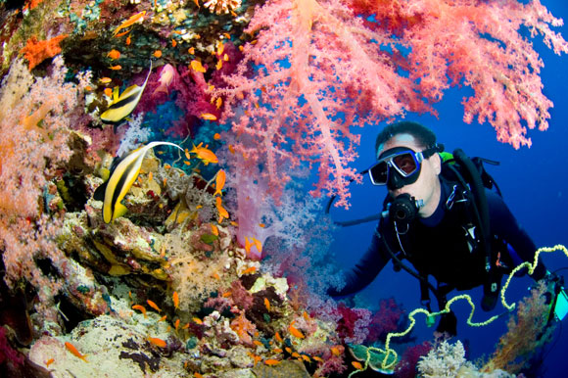
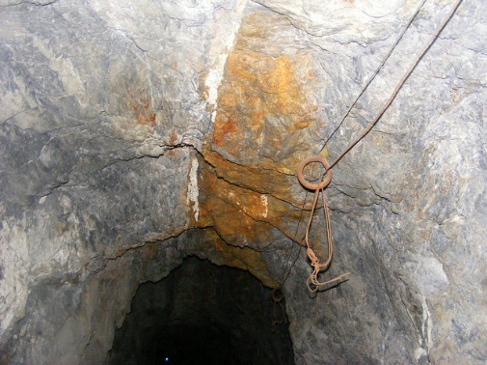
50% Doctrine 50% PRINCIPLES OF APPLICATION
Notes:
Patmos is located 50 miles offshore of western Turkey. The island is about 10 miles long and 5 miles wide.
Since there is no further identification of the writer other than “John,” it presumes a familiarity on the reader’s part. It is therefore not just anyone named “John,” but the apostle John, who is now an old man.
Emperor Domitian was assassinated in A.D. 96. Late in his reign, he forced his subjects to address him as “Lord and God.” Those who refused were harshly punished. Many Christians were exiled to penal colonies or executed.

Slide 6
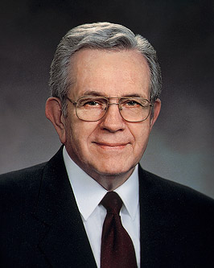
“As you seek spiritual knowledge, search for principles, carefully separate them from the detail used to explain them. Principles are concentrated truth, packaged for application to a wide variety of circumstances. . . . It is worth great effort to organize the truth we gather to simple statements of principle.
“A principle is an enduring truth: a law, a rule you can adopt to guide you in making decisions. Generally, principles are not spelled out in detail. That leaves you free to find your way with an enduring truth, a principle, as your anchor” (Elder Boyd K. Packer, “The Word of Wisdom: The Principle and the Promises,” Ensign, May 1996)

Slide 7
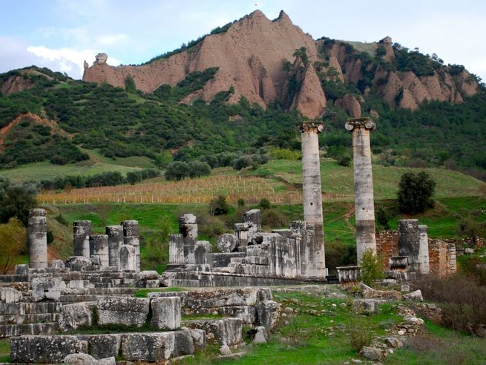
Ephesus Smyrna PergamOS Thyatira Revelation 2:18-20 Sardis Revelation 3:1-5 PhiladelphiaRevelation 3:7-10 Laodicea Revelation 3:14-16

Slide 8
Ephesus Smyrna PergamOS Thyatira Revelation 2:18-20 Sardis Revelation 3:1-5 Philadelphia Revelation 3:7-10 Laodicea Revelation 3:14-16

Slide 9
THYATIRA
Who was Jezebel?
Elijah lamented that only a few men in the entire nation were not swayed by her control (see 1 Kings 19:18).
Cross-reference Revelation 2:18-20 with Romans 13:14 “But put ye on the Lord Jesus Christ, and make no provision for the flesh, to fulfil the lusts thereof.”
Rephrase “make no provision.”
What is the opposite of addiction?
JST Revelation 2:26-27: How were they to overcome their Jezebels?
Have you seen scripture study helping you overcome temptation in your life?
(Cross-reference Helaman 3:29-30)

Slide 10
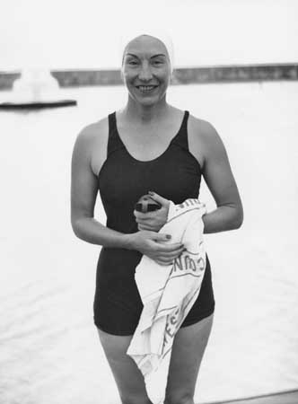
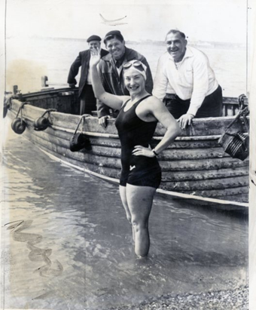
Florence Chadwick
1 Cor 13:12, “For now we see through a glass, darkly...”
Proverbs 28:18, “Where there is no vision, the people perish: but he that keepeth the law, happy is he.”

Slide 11
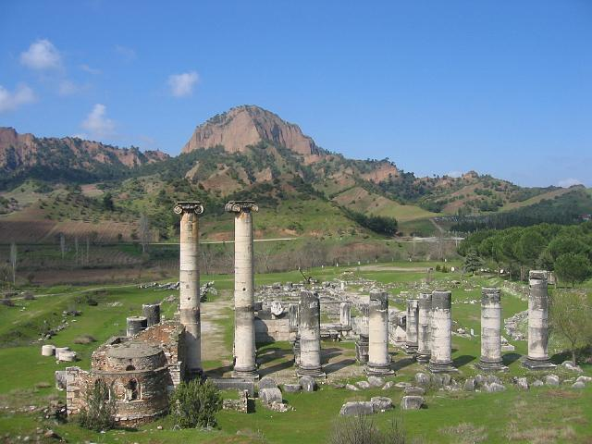
Ephesus Smyrna Pergamum Thyatira Sardis Philadelphia Laodicea
Revelation 3:1-3 What council did the Lord give?
In what ways do you remember/record the Lord’s dealing in your life? What blessings have come?

Slide 12
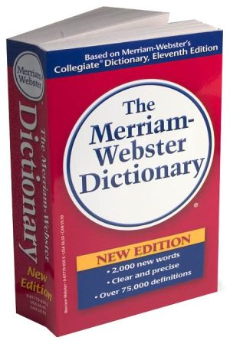
What is the most important word in the Dictionary?
“Remember”
It appears 240 times in the Book of Mormon.
“All of you have made covenants. Our greatest need is to remember. That is why everyone goes to sacrament meeting every Sabbath day, to take the sacrament and listen to the priests pray that they ‘may always remember him.’” (Spencer W. Kimball, Book of Mormon Student Study Guide, 147).
In what ways do you remember/record the Lord’s dealing in your life? What blessings have come?

Slide 13
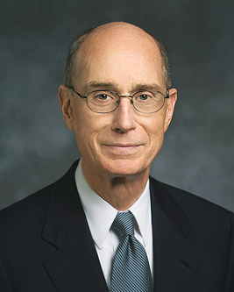
“When our children were very small, I started to write down a few things about what happened every day. I never missed a day no matter how tired I was or how early I would have to start the next day. Before I would write, I would ponder this question: “Have I seen the hand of God reaching out to touch us or our children or our family today?” As I kept at it, something began to happen: My testimony grew. I became ever more certain that our Heavenly Father hears and answers prayers.
“I urge you to find ways to recognize and remember God’s kindness...You might pray and ponder, asking the questions: Did God send a message that was just for me? Did I see His hand in my life? And then find a way to preserve that memory for the day.” (Ensign, October 2007)
President Henry B. Eyring

Slide 14
SARDIS
One way to remember: Revelation 3:4
“How wonderful it would be if all Church members walked with God in white and were numbered with the Saints in Sardis.” (Elder Carlos E. Asay, Ensign, August 1997)
The Hebrew meaning of atonement means to cover.
CROSS REFERNCE: Ezekiel 16:8 & Isaiah 61:10
What did Satan offer to Adam and Eve?

Slide 15
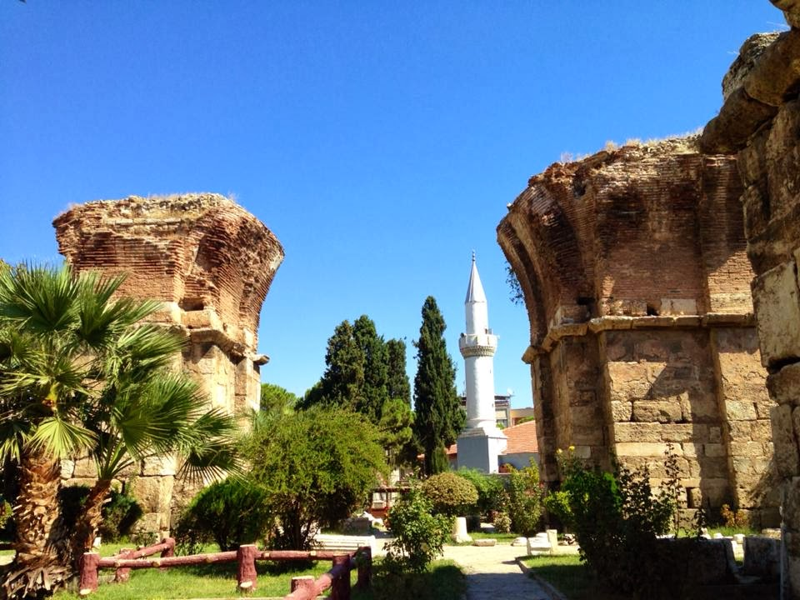
Ephesus Smyrna Pergamum Thyatira Sardis Philadelphia Laodicea
King Eumenes II had a brother named Attalus II. Attalus’ nickname was, "Philadelphos," meaning, “One who loves his brother"
Revelation 3:7-10 What council/blessing is promised?
How does patience help prevent temptation?
What scriptural examples are there of impatience?

Slide 16
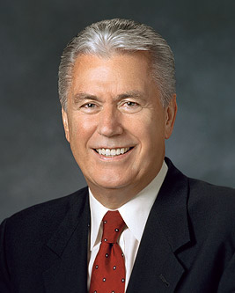
“We live in a world offering fast food, instant messaging, on-demand movies, and immediate answers to the most trivial or profound questions. We don’t like to wait. Patience is a precious and rare virtue. Patience is a purifying process. Our Heavenly Father knows what every good parent comes to understand over time: if children are ever going to mature and reach their potential, they must learn to wait.” (Ensign, May 2010)

Slide 17
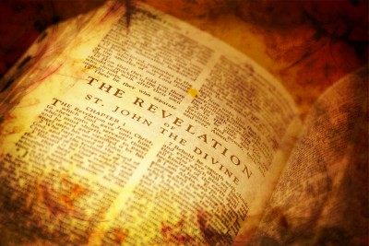
Application for Preparation
In what areas is your patience tested the most?

Slide 18
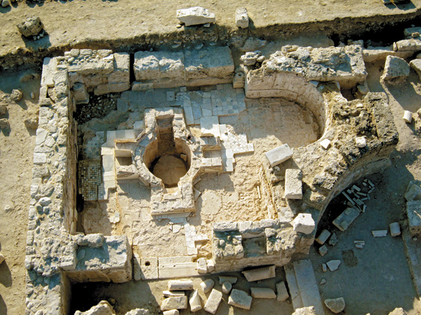
Ephesus Smyrna Pergamum Thyatira Sardis Philadelphia Laodicea
Revelation 3:14-16

Slide 19
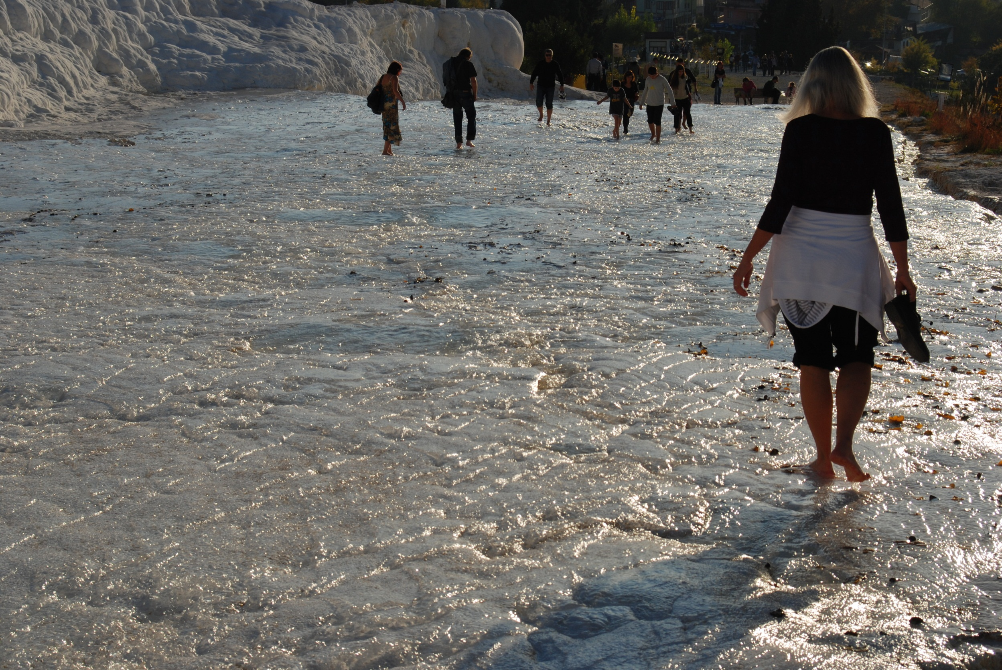
What does ‘lukewarm’ look like today?

Slide 20
Water was piped to Laodicea from Hierapolis (hot springs) and Colossae (cold springs), converging in Laodicea.
Room-temperature:
Hot cocoa
Soda
Shower
French Fries
What does ‘lukewarm’ look like today?

Slide 21
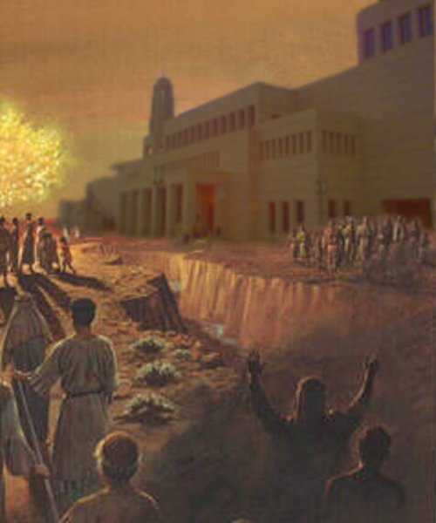
Laodicea
Marion G. Romney: “There are those among us who are trying to serve the Lord without offending the devil” (Brigham Young University devotional, September 1955).
“We can’t keep a summer cottage in Babylon” (Elder Neal A. Maxwell)

Slide 22
LOADICEA
Revelation 3:17
(Cross-reference Proverbs 28:20)
Elder Harold B. Lee: “Why get other things if one has the necessities and reasonable luxuries? Why continue to expand and increase? Why must we always be expanding to the point where our interests are divided? Certainly when one's temporal possessions become great, it is very difficult for one to give proper attention to the spiritual things.” (Conference Report, October 1953)
How to gauge our feelings about money:
Do not to confuse wants with needs
Live modestly
Avoid debt
Be generous in giving

Slide 23
Revelation 3:20
A Home Teacher was visiting his families. At one house it seemed obvious that someone was at home, but no answer came to his repeated knocks at the door. Therefore, he took out a card and wrote "Revelation 3:20" on the back of it and stuck it in the door….
At church the next Sunday, the mother of the family came up to him, sheepishly handed him his card back and saw she’d added to it, "Genesis 3:10."
Reaching for his Bible to check out the citation, he broke up in laughter…
“I heard thy voice in the garden, and I was afraid, because I was naked; and I hid myself.”

Slide 24
REVEALATON 2-3: Letters to 7 Churches
Ephesus (Revelation 2:1-7) The church had forsaken its “first love” (Rev 2:4)
Smyrna (Revelation 2:8-11) “be a faithful witness” (salt+light) (Rev 2:10)
Pergamum (Revelation 2:12-17) Seek for ‘hidden manna’ (Rev 2:17).
Thyatira (Revelation 2:18-29) “Those who overcome Jezebel did so with the word of God”
Sardis (Revelation 3:1-6) “Remember what thou hast received and heard...” (Rev 3:3)
Philadelphia (Revelation 3:7-13) “Because thou hast kept the word of my patience, I also will keep thee from the hour of temptation…” (Rev 3:10).
Loadicea (Revelation 3:14-22) “The Lukewarm” (Rev 3:15-16)

Slide 25
The Book of Revelation

