Slide 1
The Book of Revelation

Slide 2
the book of Revelation
Outline: Revelation 1:19
Write the things which…
Thou hast seen Revelation 1 Jesus Christ
Are Revelation 2-3 7 Churches

Slide 3
"Perhaps few chapters in scripture afford glimpses into the spirit of the Lord's judgment as do Revelation 2-3. The Lord's appraisal of the members faithfulness, endurance, patience, charity, and service - and their inactivity, cooling of love, tolerance of wickedness, false doctrines, lukewarmness, self-satisfaction, worldliness, and lack of zeal - have served to motivate thoughtful readers to evaluate their life-style." Jay M Todd, “The Seven Cities of Revelation,” Ensign, August 1976
Nicolaitans?

Slide 4
The Lord’s Chastisement Have you ever felt His chastisement?
Proverbs 13:24: He that spareth his rod hateth his son: but he that loveth him chasteneth him betimes.
Psalms 94:12: Blessed is the man whom thou chastenest…
D&C 90:36: I, the Lord, will…chasten her until she overcomes and is clean before me.
“Divine chastening has at least three purposes: (1) to persuade (2) to refine and (3) to redirect…Let us pray for His love-inspired correction.” (Elder D. Todd Christofferson, “As Many as I Love, I Rebuke and Chasten,” Ensign, May 2011, p. 98)
How do you seek correction without feeling overwhelmed?

Slide 5
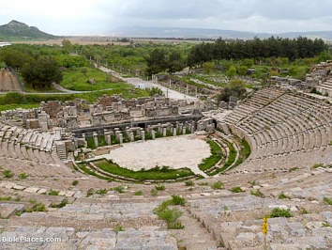
Ephesus Smyrna PergamOS Thyatira Sardis Philadelphia Laodicea

Slide 6
EPHESUS
Capital city where famous orators philosophers came. 50,000 seat amphitheater for entertainment.
Church founded by Paul (see Acts 18:19-21, 19:1-10) who spent about three years here--longer than any other place.
Revelation 2:1-7 – In what way were the Saints at Ephesus chastened?

Slide 7
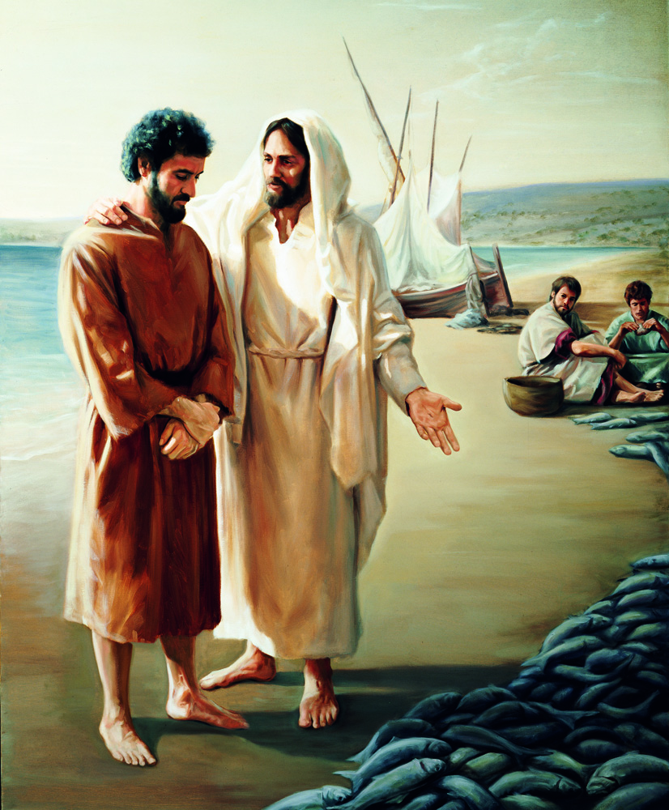
“Thou hast left thy first love” John 21:3-11,15-17
153

Slide 8
“Why are you here? Why are we back on this same shore, by these same nets, having this same conversation? Wasn’t it obvious then and isn’t it obvious now that if I want fish, I can get fish?
“What I need are disciples—and I need them forever. I need someone to feed my sheep and save my lambs. I need someone to preach my gospel and defend my faith. I need someone who loves me, truly, truly loves me, and loves what our Father in Heaven has commissioned me to do...Did not my life and my love touch you?”

Slide 9
“I will be very surprised if at some point God does not ask us exactly what Christ asked Simon Peter: “Did you love me?” And if at such a moment we can stammer out, “Yea, Lord, thou knowest that I love thee,” then He may remind us that the crowning characteristic of love is always loyalty.” (Elder Holland, October 2012 General Conference).

Slide 10
What does ‘Peter’ mean?
(rock)
What does ‘Simon’ mean?
(pebble)
What name did Jesus use in this story?

Slide 11
Do you have any fish in your life?
Have you left your first love?

Slide 12
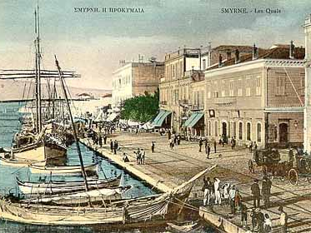
Ephesus Smyrna Pergamum Thyatira Sardis Philadelphia Laodicea
Largest marketplace in the world where Polycarp, a pupil of John and prominent leader in the church, was killed. Revelation 2:8-11

Slide 13
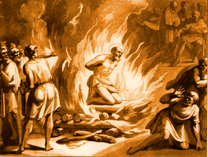
Polycarp
Unwilling to bow to Caesar and to worship him, Polycarp was tried in the presence of a mob before the governor and told to curse Christ. His reply was simple: “86 years have I served him, and he hath done me no wrong; how then can I blaspheme my king who saved me?" The governor persisted: "I have wild beasts; if thou repent not, I will throw thee to them." Polycarp replied, "Send for the beasts!" Again the governor spoke: "If thou dost despise the wild beasts, I will make thee to be consumed by fire." Polycarp courageously answered, '"Why delayest thou? Bring what thou wilt." The governor’s messenger instructed the assembled multitude to burn him alive. Timber and kindling were brought and Polycarp was thrown to the flames.
See Martyrium Polycarpi, a letter from the Church in Smyrna, in Documents of the Christian Church, 2nd edition, edited by Henry Bettenson [Oxford University Press, 1986], pp. 9-12.) As quoted by Elder Alexander Morrison, Feed My Sheep: Leadership Ideas for Latter-day Shepherds [Salt Lake City: Deseret Book Co., 1992], 165.

Slide 14
Revelation 2:10 “Fear none of those things which thou shalt suffer…ye shall have tribulation: be thou faithful unto death, and I will give thee a crown of life.

Slide 15
Salt prevents bacteria from growing.
Salt creates thirst.
Salt gives flavor.
“Just the right amount”
Are you salt on your job?
In your classes?
In your career?
As a parent?

Slide 16
Revelation 2:10 “Fear none of those things which thou shalt suffer…ye shall have tribulation: be thou faithful unto death, and I will give thee a crown of life.

Slide 17
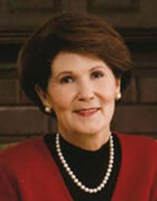
“I am most happy when I am comfortable being me and trying to do what my Father in Heaven expect me to be. For many years I tried to measure the quiet, reflective, thoughtful Pat Holland against the robust, bubbly, talkative, and energetic Jeff Holland. I have learned through several fatiguing failures that you can’t have joy in being bubbly if you are not a bubbly person. I have given up seeing myself as a flawed person because my energy level is lower than Jeff’s, and I don’t talk as much as he does, nor as fast as he does. Giving this up has freed me to embrace and rejoice in my own manner and personality in the measure of my creation. Ironically, that has allowed me to admire Jeff even more.
Patricia Holland, Portraits of Eve: God’s Promises of Personal Identity, LDS Women’s Treasury: Insights and Inspiration for Today’s Woman (Salt Lake City: Deseret Book Co., 1997), 104.
Have you learned this same lesson?

Slide 18
“Somewhere, somehow the Lord “blipped the message onto my screen” that my personality was created to fit precisely the mission and talents he gave me. For example, the quieter, calmer talent of playing the piano reveals much about the real Pat Holland. I would never have learned to play the piano if I hadn’t enjoyed the long hours of solitude required for its development. This same principle applies to my love of writing, reading, meditation, and talking with my children.
“Miraculously, I have found that I have untold abundant sources of energy to be myself. But the moment I indulge in imitation, I feel fractured and fatigued and find myself forever swimming upstream. When we frustrate God’s plan for us, we deprive this world and God’s kingdom of our unique contributions.”
Patricia Holland, Portraits of Eve: God’s Promises of Personal Identity, LDS Women’s Treasury: Insights and Inspiration for Today’s Woman (Salt Lake City: Deseret Book Co., 1997), 104.
How do you balance who you are with becoming more?

Slide 19
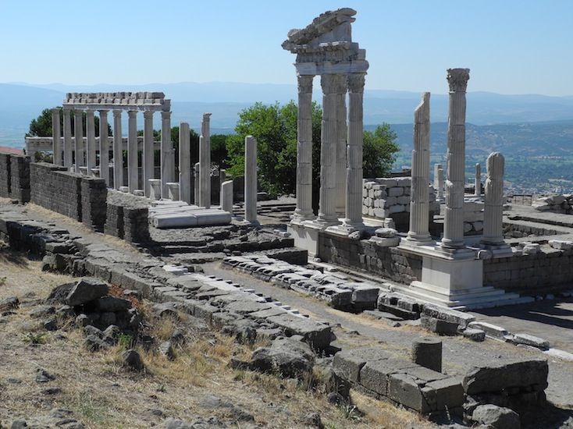
Ephesus Smyrna PergamOS Thyatira Sardis Philadelphia Laodicea
Revelation 2:12-17 What were they commanded to do?

Slide 20
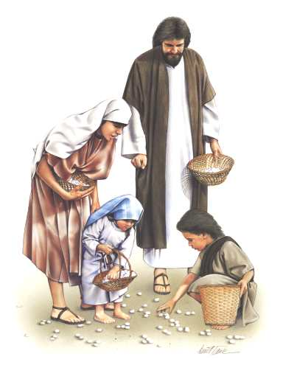
Manna
Rules: Exodus 16:16-26
What does Manna symbolize?
HIDDEN MANNA
Where do you find hidden manna in your life?
“Seek for hidden manna” (Rev 2:17)

Slide 21
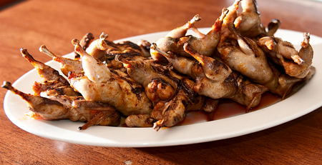
Manna
The rest of the story: Numbers 11:4-8
Cross-reference: D&C 63:16 (three things lusting causes)
“And verily I say unto you…they shall (1) not have the Spirit, (2) shall deny the faith and (3) shall fear.”

Slide 22
Manna
Opposite of lust?
D&C 121:45-46 “Let thy bowels also be full of charity … then shall thy (1) confidence wax strong and (2) the doctrine of the priesthood shall distil upon thy soul and (3) The Holy Ghost shall be thy constant companion…”

Slide 23
Charity Creates:
Companionship of the Spirit
Faith
Confidence
D&C 121:45-46
Lusting Causes:
Loss of the Spirit
Denial of faith
Fear
D&C 63:16

Slide 24
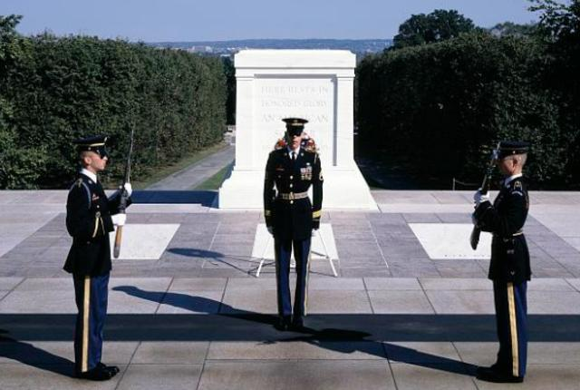
HIDDEN MANNA: An Analogy

Slide 25
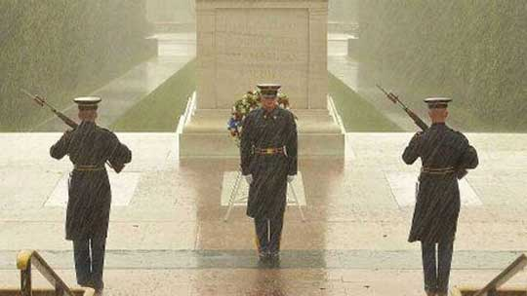

Slide 26
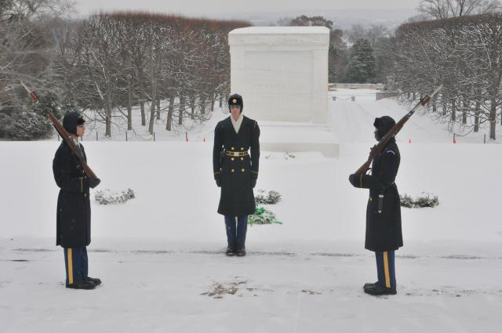

Slide 27
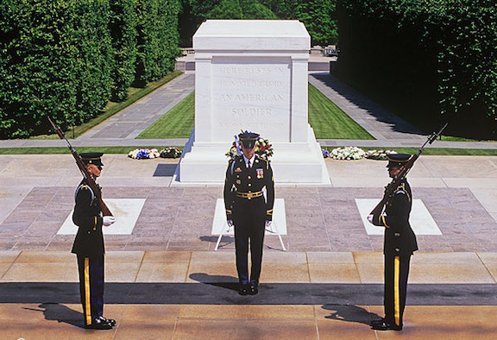

Slide 28
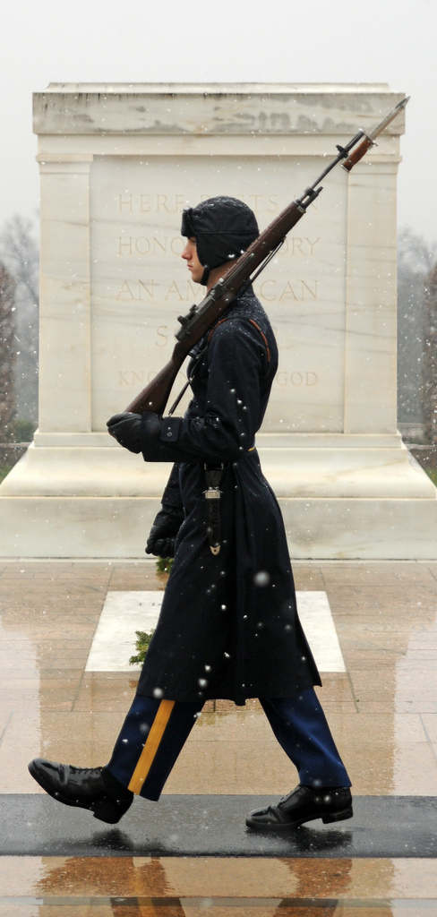
Each soldier must:
Be in superb physical condition
Be between 5’10” and 6’4”
Memorize and recite 7 pages of Arlington National Cemetery history.
Only 600 Badges been awarded since its creation in the late 1950’s (The Badge is one of the least awarded badges in the Army, second only to the one worn by Astronauts).
It takes 6 hours for a sentinel to prepare their uniform for a ‘Walk’.
During the Walk, the Sentinel takes 21 step down the mat, then turns and faces the Tomb for 21 seconds. They turn and face the mat for 21 seconds, then take another 21 steps down the mat. The Sentinel repeats this until the Guard Change ceremony begins.

Slide 29
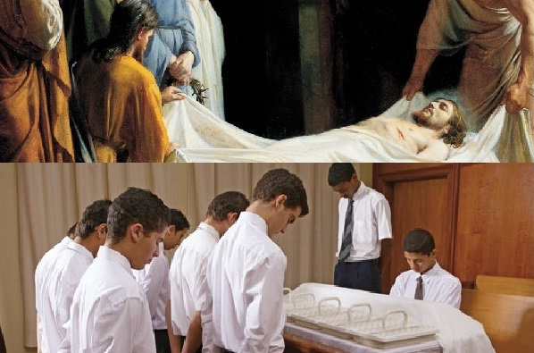

Slide 30
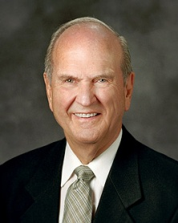
“The sacrament is the highlight of our Sabbath-day observance. Those participating should be seated at least five minutes before the meeting begins so they can be spiritually prepared for a worshipful experience. This is not a time for conversation or transmission of messages but a period of prayerful meditation as leaders and members prepare spiritually for the sacrament.”
Russell M. Nelson, Worldwide leadership Training, 21 June, 2003

Slide 31
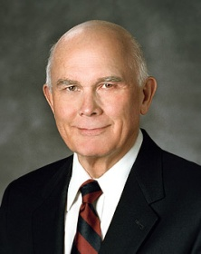
“Sacrament meeting is not a time for whispered conversations on cell phones or for texting. During sacrament meeting—and especially during the sacrament service—we should concentrate on worship and refrain from all other activities. How wonderful when every person in attendance joins in the worship of singing—especially in the hymn that helps us prepare to partake of the sacrament.”
Dallin H. Oaks, October 2008 General Conference

Slide 32
The Book of Revelation

