Slide 1
The Book of Revelation

Slide 2
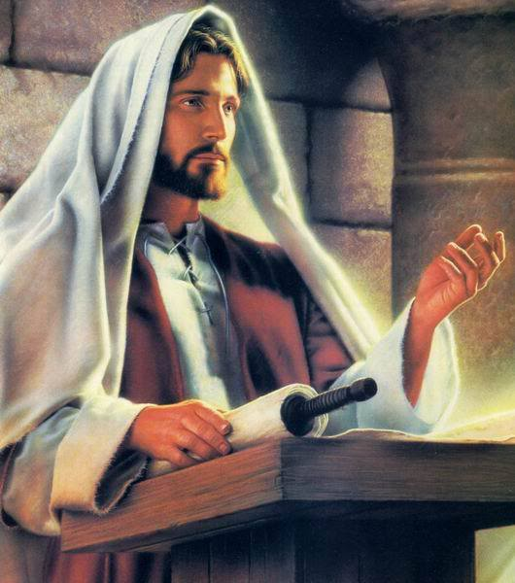
Doctrine: An unchanging truth of the gospel of Jesus Christ.
“FACT”
Modesty
Baptism
Family
Missionary Work
Fasting
Satan

Slide 3
Principle: Concentrated truth, packaged for application; “so, what should be done?”
“ACT”
Because my body is a temple (doctrine), I should … (principle).
Since the sacrament renews my baptismal covenant (doctrine), I should … (principle).
The prophet has asked me to seek marriage (doctrine), so I should … (principle)
Why? Revelation 1:1-3

Slide 4
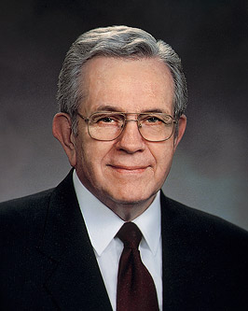
“As you seek spiritual knowledge, search for principles, carefully separate them from the detail used to explain them. Principles are concentrated truth, packaged for application to a wide variety of circumstances. . . . It is worth great effort to organize the truth we gather to simple statements of principle.
“A principle is an enduring truth: a law, a rule you can adopt to guide you in making decisions. Generally, principles are not spelled out in detail. That leaves you free to find your way with an enduring truth, a principle, as your anchor” (Elder Boyd K. Packer, “The Word of Wisdom: The Principle and the Promises,” Ensign, May 1996)

Slide 5
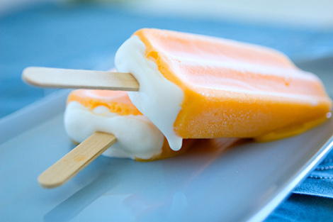
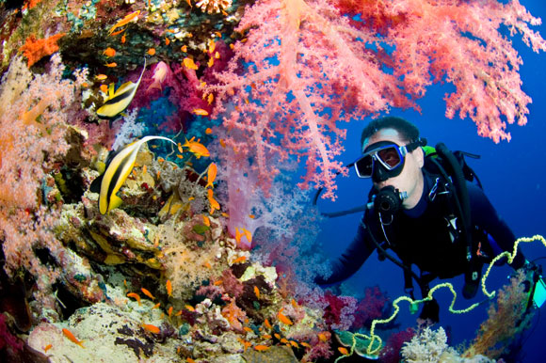
50% Doctrine 50% PRINCIPLES OF APPLICATION
Notes:
Patmos is located 50 miles offshore of western Turkey. The island is about 10 miles long and 5 miles wide.
Since there is no further identification of the writer other than “John,” it presumes a familiarity on the reader’s part. It is therefore not just anyone named “John,” but the apostle John, who is now an old man.
Emperor Domitian was assassinated in A.D. 96. Late in his reign, he forced his subjects to address him as “Lord and God.” Those who refused were harshly punished. Many Christians were exiled to penal colonies or executed.

Slide 6
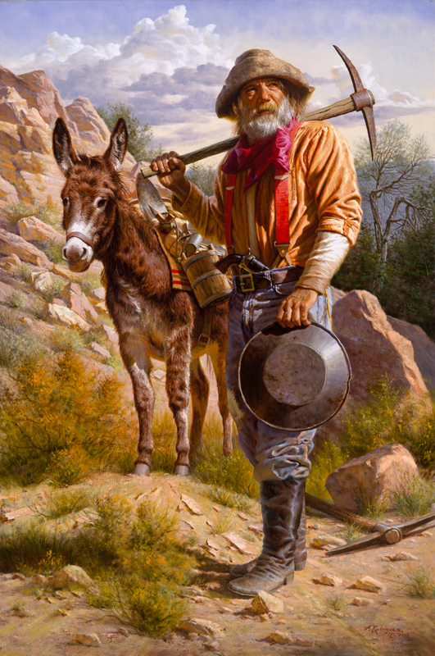
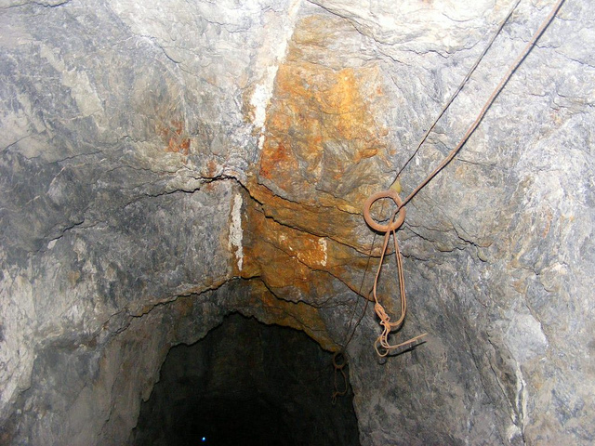
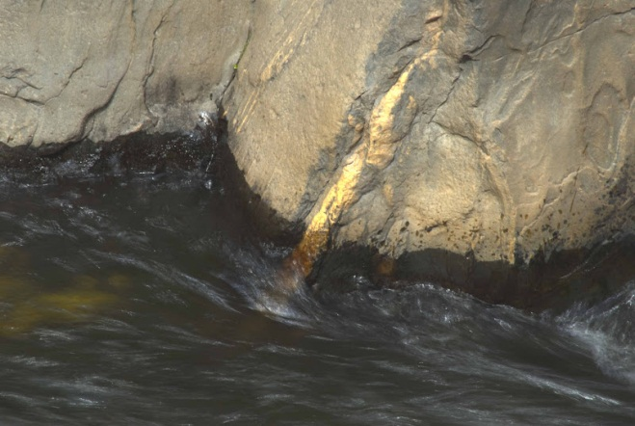
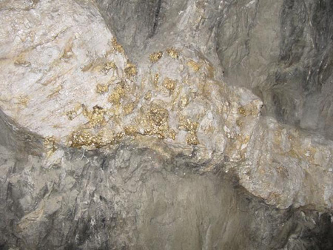
Doctrines & Principles of application

Slide 7
Doctrines & Principles of application
Revelation 1:4-6 – What’s the doctrine & application?
In 16 June 1844 sermon, Joseph Smith read Rev.1:6 and then stated, "It is altogether correct in the translation. The doctrine of a plurality of Gods is as prominent in the Bible as any other doctrine.” (Teachings of the Prophet Joseph Smith, 369, 370)
Revelation 1:8-10 - What’s the doctrine & application?
What do you do to be “in the Spirit” on the Lord’s day?

Slide 8
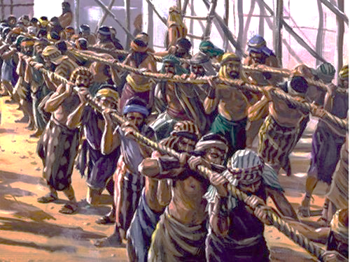
Notes:
How long were they in slaved?
How did their first Sabbath feel?
Principle: We are not machines; we need rest and time to worship

Slide 9
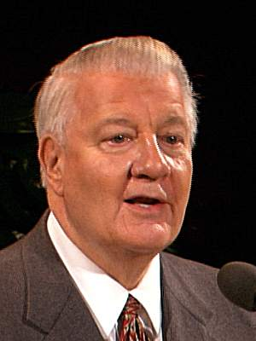
“Some time ago I was assigned to a conference in northern Utah in June. As I drove through Cache Valley on Saturday, I marveled at the temple in Logan—I was impressed with the green fields so rich with a variety of crops in the valley. I particularly noticed the great number of alfalfa fields and the constant activity in nearly all of them. What a pleasing sensation it was to smell that freshly mown hay and to see those meticulously groomed fields.
During my return trip the next day, Sunday, there was something different. No one is mowing or hauling hay today. I looked as far as I could and saw hay fields everywhere, tractors stopped, mowing machines idle, and trucks resting in the fields. No one working—for it was the Sabbath and this was Cache Valley and these were good Latter- day Saint people.
“As I continued north, I saw everywhere hay to be cut and stacked and hauled and equipment and weather to do it, but no man or woman in the fields. I went by dozens, even hundreds, of farms with machines waiting in the fields—I wondered to myself, “Will someone break this spell, will someone be out in his fields working?” Each time I rounded a corner or came to the top of a hill, I would look and look and then breathe a sigh of relief—no one working.

Slide 10
“Would anyone break the spell? Could it be a whole valley so dedicated to God that no one would work on the Sabbath?” The suspense became almost unbearable. Each curve I rounded or each hill I came over found me looking in almost fearful anticipation, then smiling as the same peaceful scene continued.
“Finally I came to the last curve with the main road that marked the end of Cache Valley. I looked and looked, but all was peaceful and quiet. I was so excited, I pulled the car over, got out, raised my hands and shouted, “You did it, Cache Valley. You did it! You didn’t know I was looking, but you did it—not one field being mowed, not one tractor at work, not one truck hauling. You did it!”
“I instinctively looked heavenward and said, “Did you see that? Did you see Cache Valley this Sunday afternoon?” For some time after that, I couldn’t get that Sunday afternoon off my mind. I kept feeling, “You have observed and witnessed something very special, something truly significant: an entire valley keeping His Sabbath holy.”

Slide 11
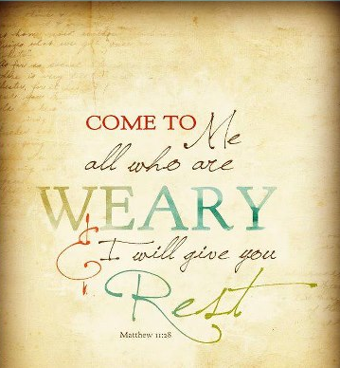
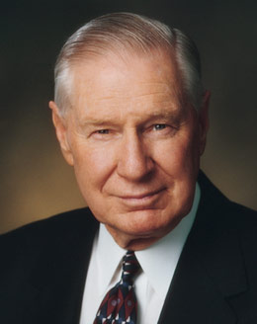
“Over a lifetime of observation, it is clear to me that the farmer who observes the Sabbath day seems to get more done on his farm than he would if he worked seven days. The mechanic will be able to turn out more and better products in six days than in seven. The doctor, the lawyer, the dentist, the scientist will accomplish more by trying to rest on the Sabbath than if he tries to utilize every day of the week for his professional work. I would counsel all students, if they can, to arrange their schedules so that they do not study on the Sabbath. If students and other seekers after truth will do this, their minds will be quickened and the infinite Spirit will lead them to the verities they wish to learn. This is because God has hallowed his day and blessed it as a perpetual covenant of faithfulness” (Ensign, Nov. 1991, 34). James E. Faust
Do you have a testimony of this?

Slide 12
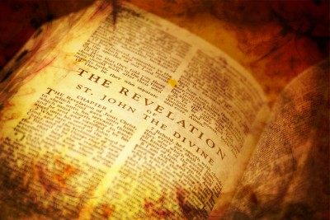
Application for Preparation
Do you prepare for and strive to keep the Sabbath Day holy?

Slide 13
Revelation 1:6-18 Doctrines and Principles of Jesus Christ

Slide 14
Description of Jesus Christ
"There is a man in Judea who I am amazed to have witnessed, and who will now describe to you. He is a tall man, well shaped, and of an amiable and reverential aspect. His hair is of a color that can hardly be matched. It falls into graceful curls, waving about and couched about his shoulders. It is parted on the crown of his head, running as a stream to the front after the fashion of the Nazarites. His forehead is high, large and imposing. His cheeks are without spot or wrinkle. His face is most beautiful with a lovely red. His nose and mouth formed with exquisite symmetry. His beard, reaching below his chin and parted in the middle like a fork.
Publius Lentulus. In The Catholic Encyclopedia. New York: Robert Appleton Company. Retrieved April 12, 2017 from New Advent: http://www.newadvent.org/cathen/09154a.htm

Slide 15
Description of Jesus Christ
“His eyes are bright and clear and innocent, dignified, manly and mature. Often times however, just before he reveals his divine powers, his eyelids are gently closed in reverential silence.
“In proportion of body it is most perfect and amazing to view. His arms and hands are lovely to behold.
“He rebukes with majesty, and counsels with mildness. Whether in word or deed, he is eloquent and sincere.
“No man has seen him laugh;, yet his manners are exceedingly pleasant. But he has wept frequently in the presence of men. He has temperate, modest and wise disposition; a man for his extraordinary beauty and divine perfection, surpassing the children of men in every sense.”
Publius Lentulus. In The Catholic Encyclopedia. New York: Robert Appleton Company. Retrieved April 12, 2017 from New Advent: http://www.newadvent.org/cathen/09154a.htm

Slide 16
Vs | SYMBOL | INTERPRETATION
6 | Kings and priests | Exaltation in the celestial kingdom
8 | Alpha and Omega | Christ’s role in God’s work
12 | Seven candlesticks | The seven churches that hold up the light of the gospel
16 | Right hand | Covenant hand and symbol of power
16 | Seven stars | Leaders over the seven churches
16 | Sharp, two-edged sword | The word of God, pronouncing judgment
18 | Keys of hell and of death | Keys that unlock the doors of spiritual and physical death

Slide 17
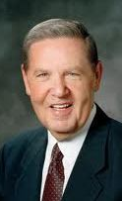
Revelation 1: Jesus Christ
“These letters from the Greek suggest the universal role of Jesus. He ought to be our Alpha and Omega...In every choice we make, he ought to be our point of reckoning. He should be the very brackets of existence. We should not stray outside him.” (Elder Holland, Sept 1974 Ensign)
What are some ways you can make Christ the beginning and end of your day/life?

Slide 18
Vs | SYMBOL | INTERPRETATION
6 | Kings and priests | Exaltation in the celestial kingdom
8 | Alpha and Omega | Christ’s role in God’s work
12 | Seven candlesticks | The seven churches that hold up the light of the gospel
13 | Son of Man | Son of Man of Holiness
16 | Right hand | Covenant hand and symbol of power
16 | Seven stars | Leaders over the seven churches
16 | Sharp, two-edged sword | The word of God, pronouncing judgment
18 | Keys of hell and of death | Keys that unlock the doors of spiritual and physical death
Notes:
Son of Man?
“Christ is the Son of Man, meaning that his Father (the Eternal God!) is a Holy Man. In the language of Adam, ‘Man of Holiness' is the name of God and the name of his Only Begotten is the Son of Man, even Jesus Christ. Thus Christ is the Son of Man of Holiness or more briefly put, the Son of Man.” (Bruce R. McConkie, DNTC, 3: 444.)

Slide 19
Vs | SYMBOL | INTERPRETATION
6 | Kings and priests | Exaltation in the celestial kingdom
8 | Alpha and Omega | Christ’s role in God’s work
12 | Seven candlesticks | The seven churches that hold up the light of the gospel
13 | Son of Man | Son of Man of Holiness
16 | Right hand | Covenant hand and symbol of power
16 | Seven stars | Leaders over the seven churches
16 | Sharp, two-edged sword | The word of God, pronouncing judgment
18 | Keys of hell and of death | Keys that unlock the doors of spiritual and physical death
Notes:
Son of Man?
“Christ is the Son of Man, meaning that his Father (the Eternal God!) is a Holy Man. In the language of Adam, ‘Man of Holiness' is the name of God and the name of his Only Begotten is the Son of Man, even Jesus Christ. Thus Christ is the Son of Man of Holiness or more briefly put, the Son of Man.” (Bruce R. McConkie, DNTC, 3: 444.)

Slide 20
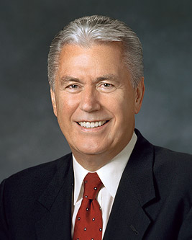
“To be perfectly frank, there have been times when members or leaders in the Church have simply made mistakes. There may have been things said or done that were not in harmony with our values, principles, or doctrine. I suppose the Church would be perfect only if it were run by perfect beings. But God works through us—His imperfect children—and imperfect people make mistakes. It is unfortunate that some have stumbled because of mistakes made by men.”
President Dieter F. Uchtdorf (October 2013)

Slide 21
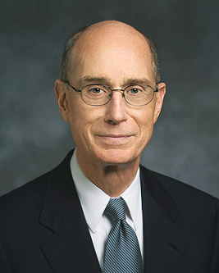
Why is The Mantel Important?
“On the day I was released as a bishop, one of the ward members came to my home afterwards and said: “I know you are no longer my bishop, but could we talk just one more time?”
Reluctantly I agreed. The member sat down in a chair opposite mine. It seemed to be just as it had been in the hundreds of times I had interviewed members of the ward. The conversation began. There came the moment when counsel was needed. I waited for the ideas, the words, and the feelings to flow into my mind, as they always had. Nothing came. In my heart and mind there was only silence. After a few moments, I said: “I’m sorry. I appreciate your kindness and your trust. But I’m afraid I can’t help you.”
God magnifies those He calls, even in what may seem to you a small or inconspicuous service.”

Slide 22
A look at the book of Revelation
Revelation has it’s own outline
Revelation 1:19
Write the things which… REFERENCE TOPIC
Thou hast seen Revelation 1 Jesus Christ
Are Revelation 2-3 7 Churches
Shall be hereafter Revelation 4-22 The 7 Seals

Slide 23
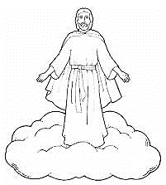
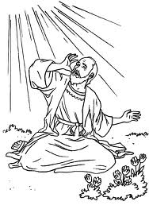
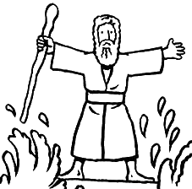
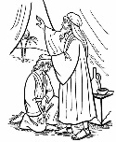
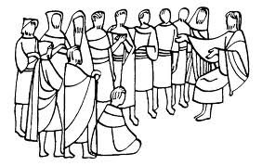
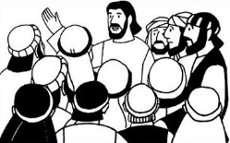
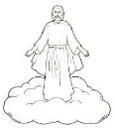
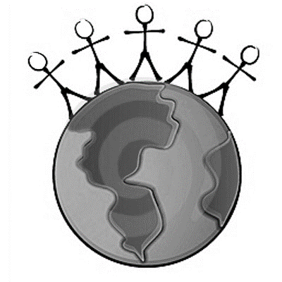
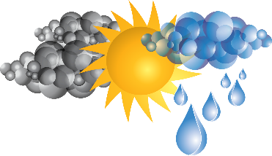
The Book of Revelation
Jesus Christ
John’s 7 Letters to 7 Churches
Throne Theophany
Seven Seals Overview
Revelation 1
Revelation 2-3
Revelation 4-5
Revelation 6-9
The Little Book
2 prophets in Jerusalem
The Dragon, The Beast, and the Victory
Righteous Rewarded
Revelation 10
Revelation 11
Revelation 12-14
Revelation 15
Armageddon
Wicked Destroyed
The Second Coming
Millennium & Final Judgment
Celestialized Earth
Revelation 16
Revelation 17-18
Revelation 19
Revelation 20
Revelation 21-22

Slide 24
 | T/F | STATEMENT
1 |  | Jesus Christ was the first spirit child of our Heavenly Parents (D&C 93:21)
2 |  | Joseph was Jesus’ step father (Matthew 1:18–24)
3 |  | Jesus Christ was also sent to other planets besides earth (D&C 88:51-62)
4 |  | Jesus Christ was born with a veil of forgetfulness (D&C 93:12)
5 |  | Jesus Christ created the earth (Moses 1:33)
6 |  | Jesus Christ, before he was born, before receiving a body and without being married, achieved Godhood in the pre-Earth life (Phil 2:6)
7 |  | Jesus Christ knows everything (D&C 38:2)
8 |  | Jesus Christ begot us, so He is also our Father (Mosiah 5:7)
9 |  | Jesus Christ has no siblings (Matthew 13:55-56)
10 |  | Heavenly Father was also a Savior (John 5:19)

Slide 25
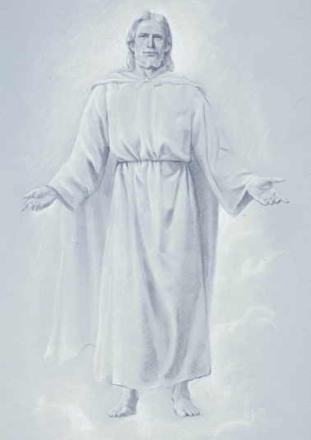
“Jesus said that the Father wrought precisely in the same way as His Father had done before Him. As the Father had done before? He laid down His life, and took it up the same as His Father had done before.” (Joseph Smith, History of the Church 6:373)

Slide 26
The Book of Revelation
Revelation 1: JESUS CHRIST

