Slide 1
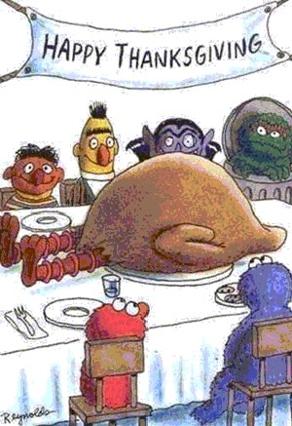

Slide 2
Thanksgiving Oragami

Slide 3
1. Mosiah 2:19-21
3. Alma 34:38
7. D&C 97:13
5. D&C 59:15
Thanksgiving Origami
(Remove this tab before starting
10. 2 Cor 9:15
4. D&C 46:7
CUT .
6. D&C 78:19
8. D&C 136:28
2. Alma 7:23
9. Psalms 100:4

Slide 5
Number 5 should be pointing away from you. Number 9 is at the bottom pointing at you.

Slide 6
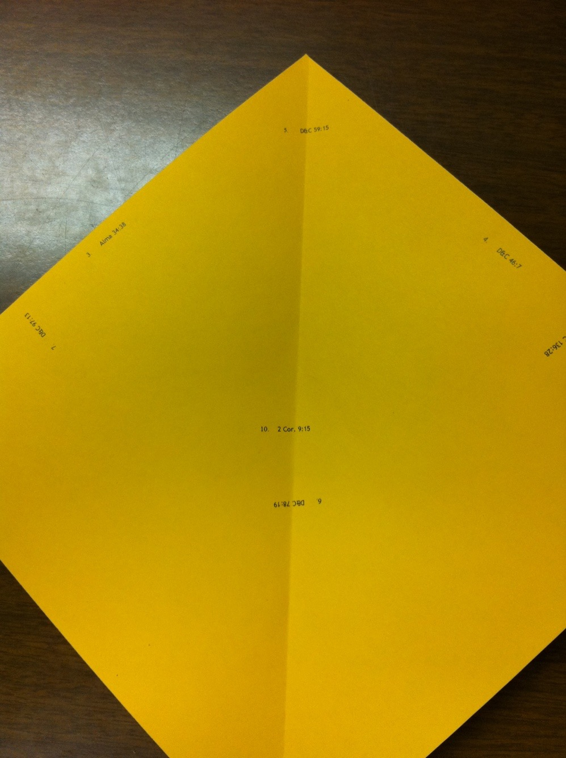
Fold a crease through the middle of the paper.

Slide 7
Flip the paper over. (Number 5 should still be pointing away from you).

Slide 8
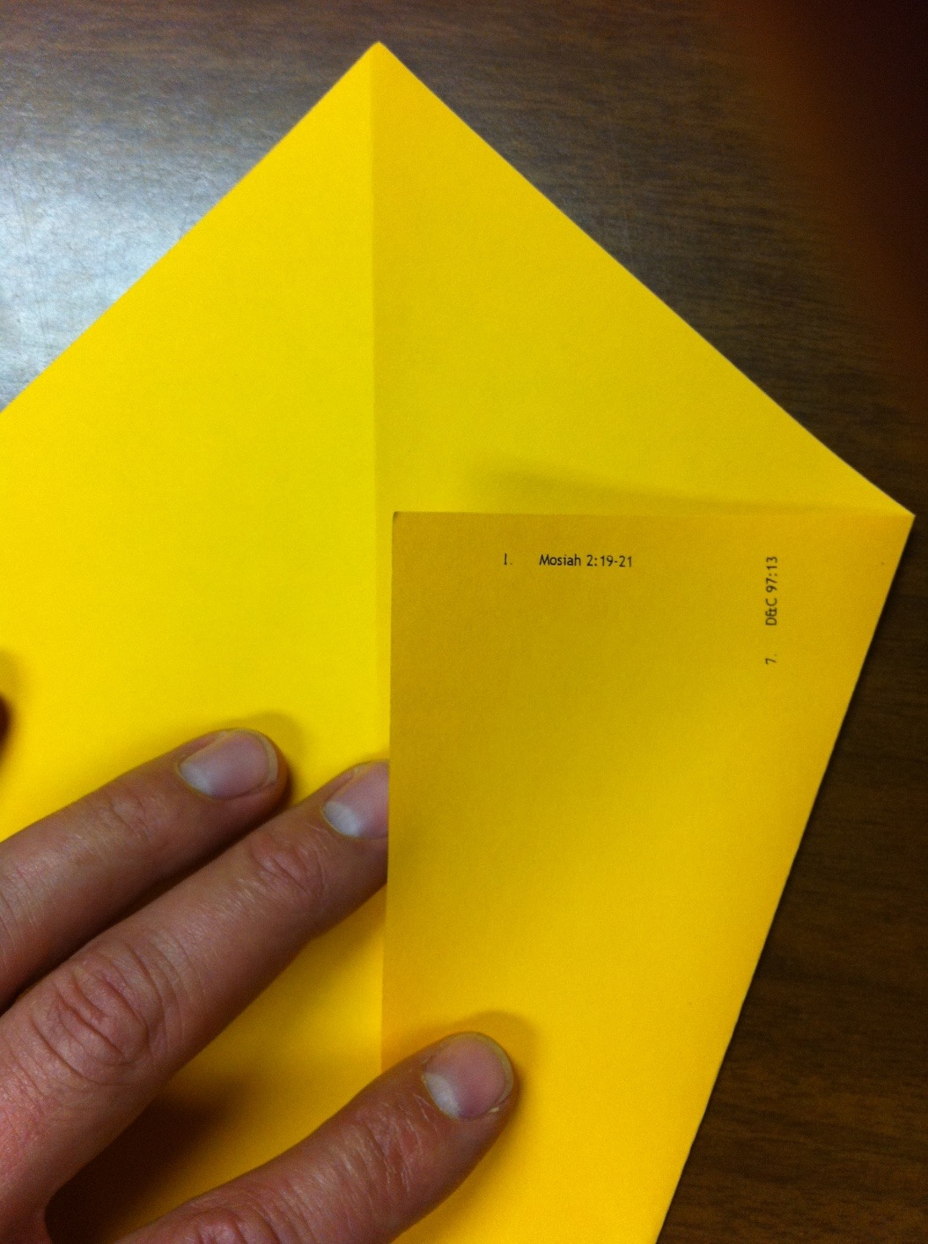
Number 1
Fold the right side over to the center crease.

Slide 9
1. MOSIAH 2:19-21
WRITE SOMETHING TEMPORAL THAT YOU ARE THANKFUL FOR.
“I believe that one of the greatest sins of which the inhabitants of the earth are guilty today is the sin of ingratitude, the want of acknowledgement, on their part, of God and his right to govern and control.” (Joseph F. Smith, Gospel Doctrine, pp. 270).

Slide 10
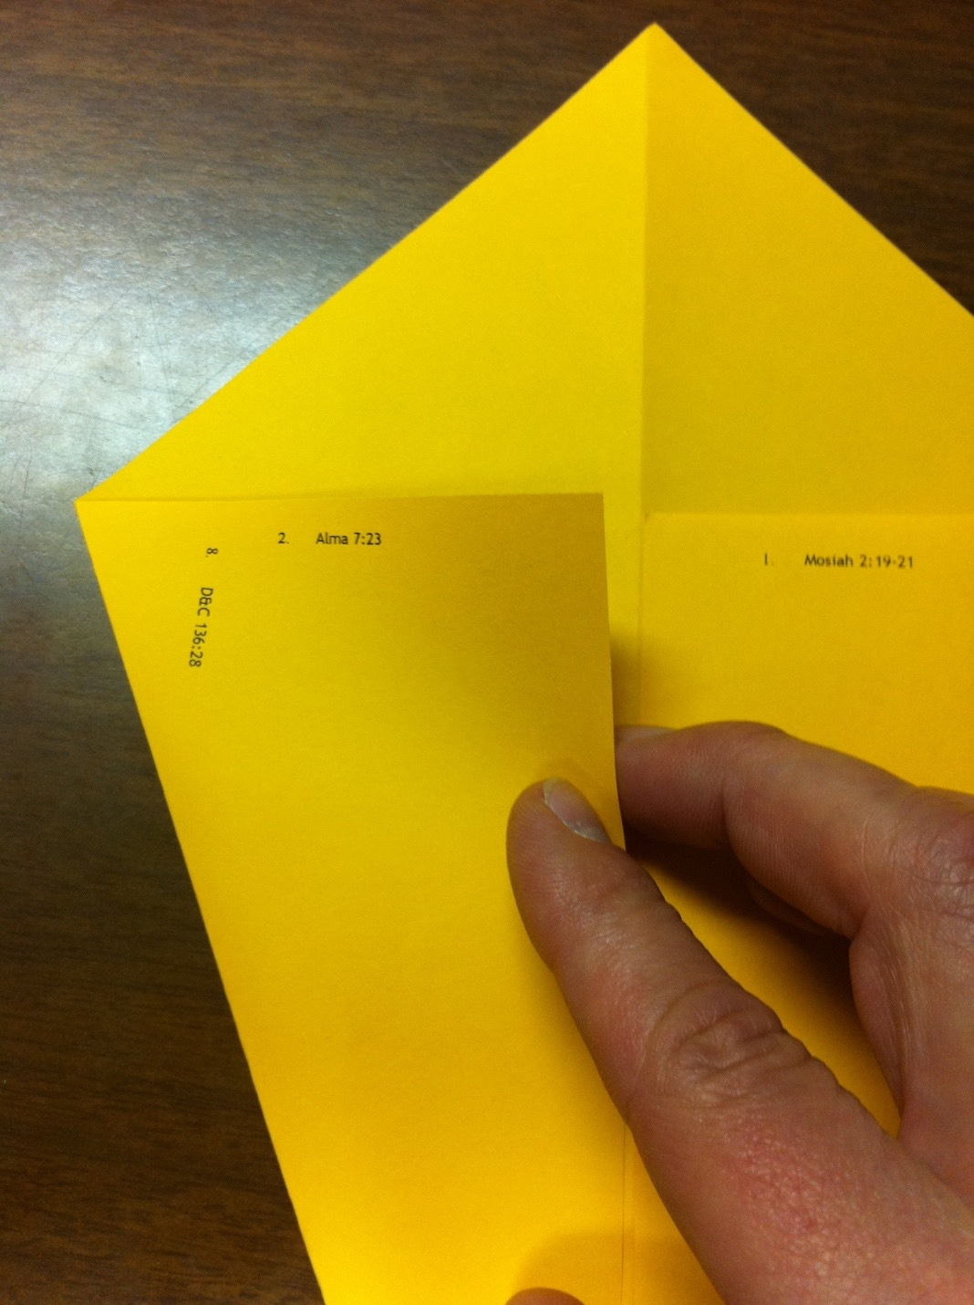
Number 2
Fold the left side over to the center crease.

Slide 11
2. ALMA 7:23
WRITE SOMETHING SPIRITUAL THAT YOU ARE THANKFUL FOR.
It has been said that “an ungrateful man is like a hog under a tree eating acorns, but never looking up to see where they come from” (Timothy Dexter, The New Dictionary of Thoughts, Garden City, N.Y.: Standard Book Co., 1961, p. 308).

Slide 12
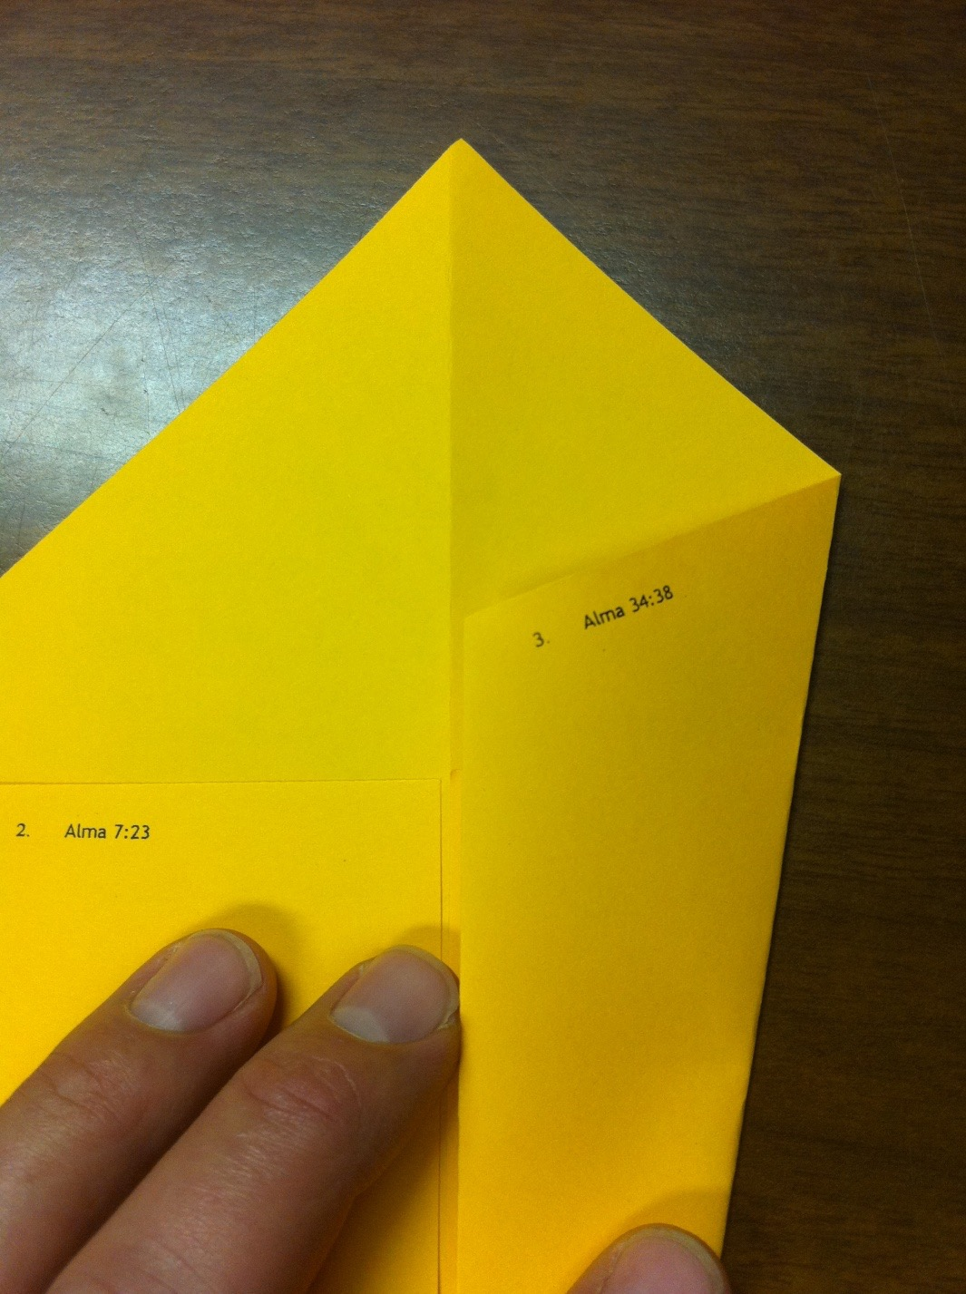
Number 3
Fold the right side over to the center crease once again.

Slide 13
3. ALMA 34:38
WRITE SOMETHING THAT YOU WILL DO FOR SOMEONE THIS THANKSGIVING SEASON.
One thing I can tell you with certainty is this: You cannot predict happiness by the amount of money, fame, or power a person has. External conditions do not necessarily make a person happy. The Brethren who have had assignments in poorer countries report that despite the abject poverty, the people are very happy. The fact is that the external things so valued by the world are often the cause of a great deal of misery in the world.
Those who live in thanksgiving daily, however, are usually among the world’s happiest people. And they make others happy as well.”
(Joseph B. Wirthlin, “‘Live in Thanksgiving Daily’,” Ensign, Sep 2001, 6)

Slide 14
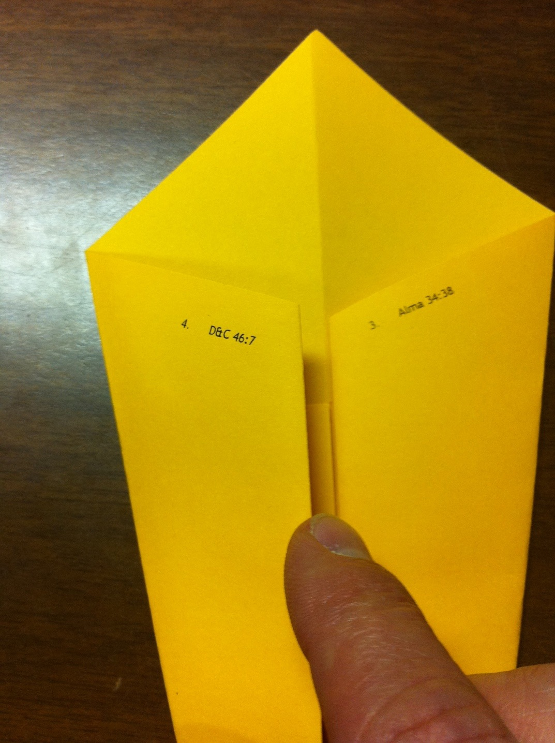
Number 4
Fold the left side over to the center crease.

Slide 15
4. D&C 46:7
WRITE ONE THING YOU CAN DO TO SHOW GRATITUDE TO HEAVENLY FATHER.
“The Pilgrims made seven times more graves than huts. No Americans have been more impoverished than these who, nevertheless, set aside a day of thanksgiving” (H.U. Westermayer)

Slide 16
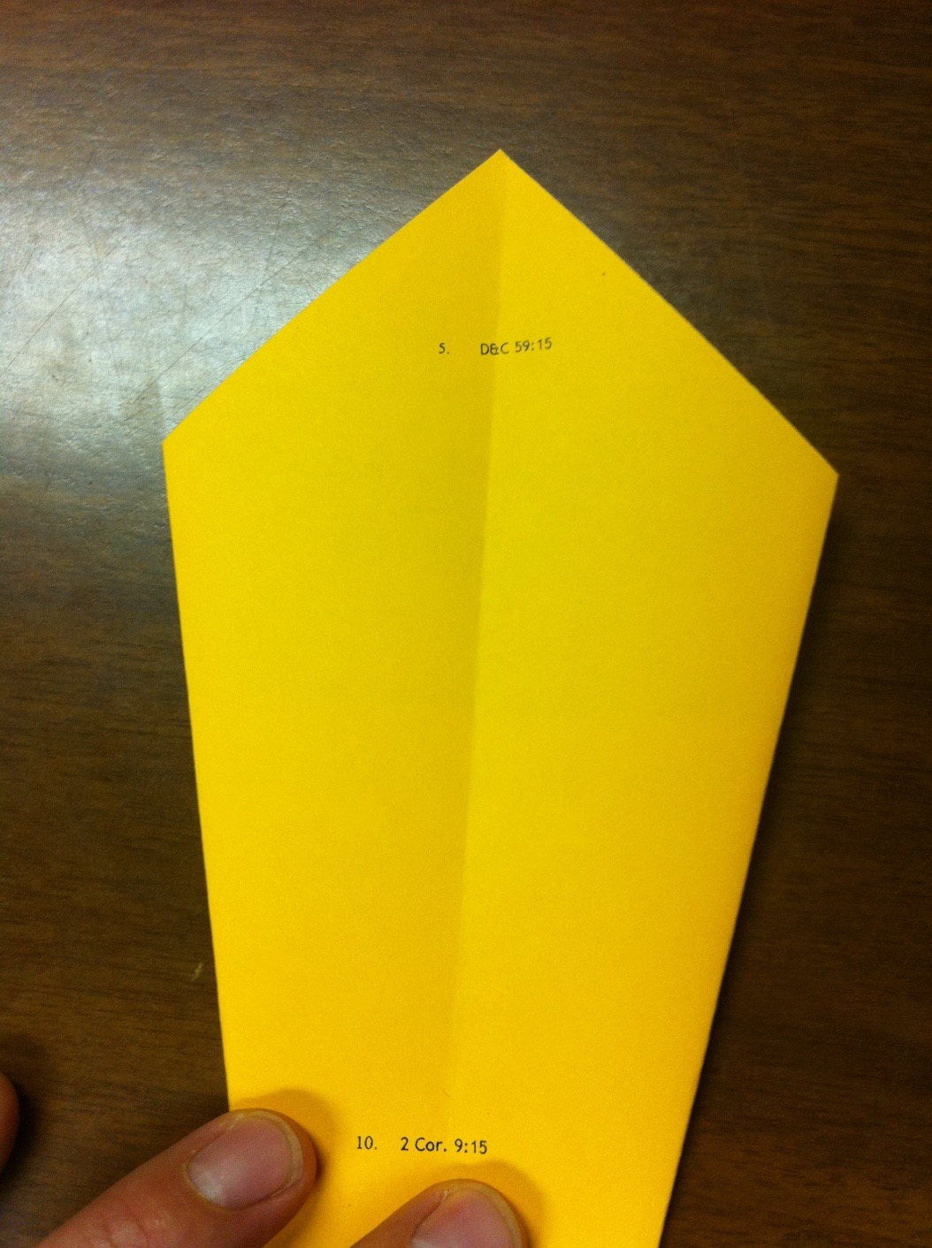
Flip the paper over.

Slide 17
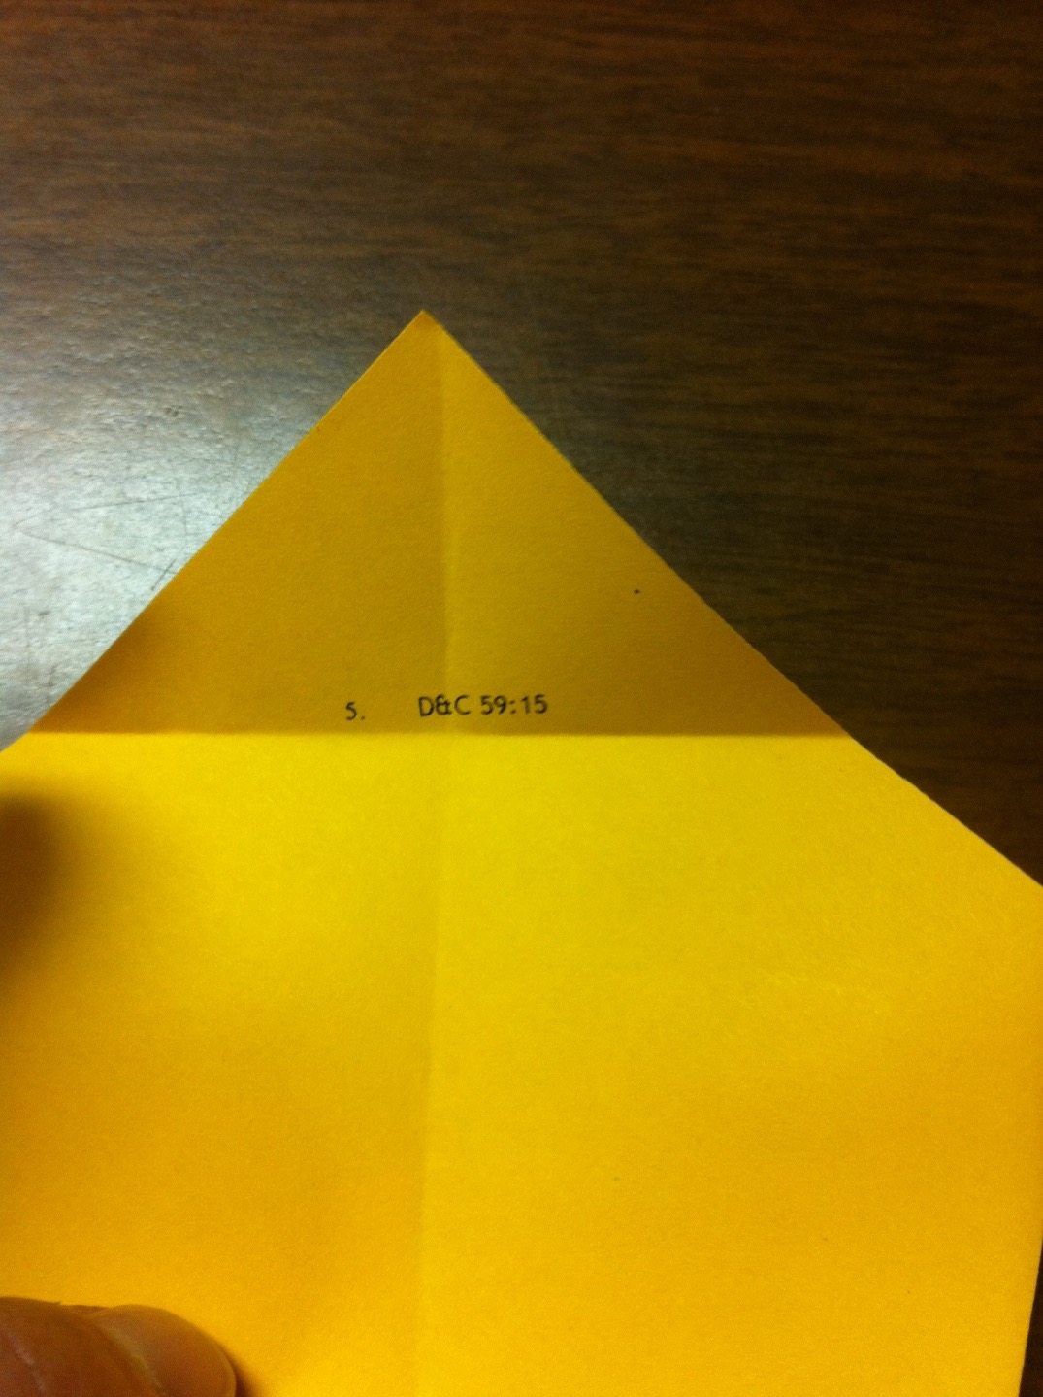
Number 5
Fold the tip down and crease it right under the number 5.

Slide 18
5. D&C 59:15
WRITE THE NAME OF A PERSON IN THIS CLASS THAT YOU ARE THANKFUL FOR.
For flowers that bloom about our feet; For tender grass, so fresh, so sweet; For song of bird, and hum of bee; For all things fair we hear or see, Father in heaven, we thank Thee! ~Ralph Waldo Emerson

Slide 19
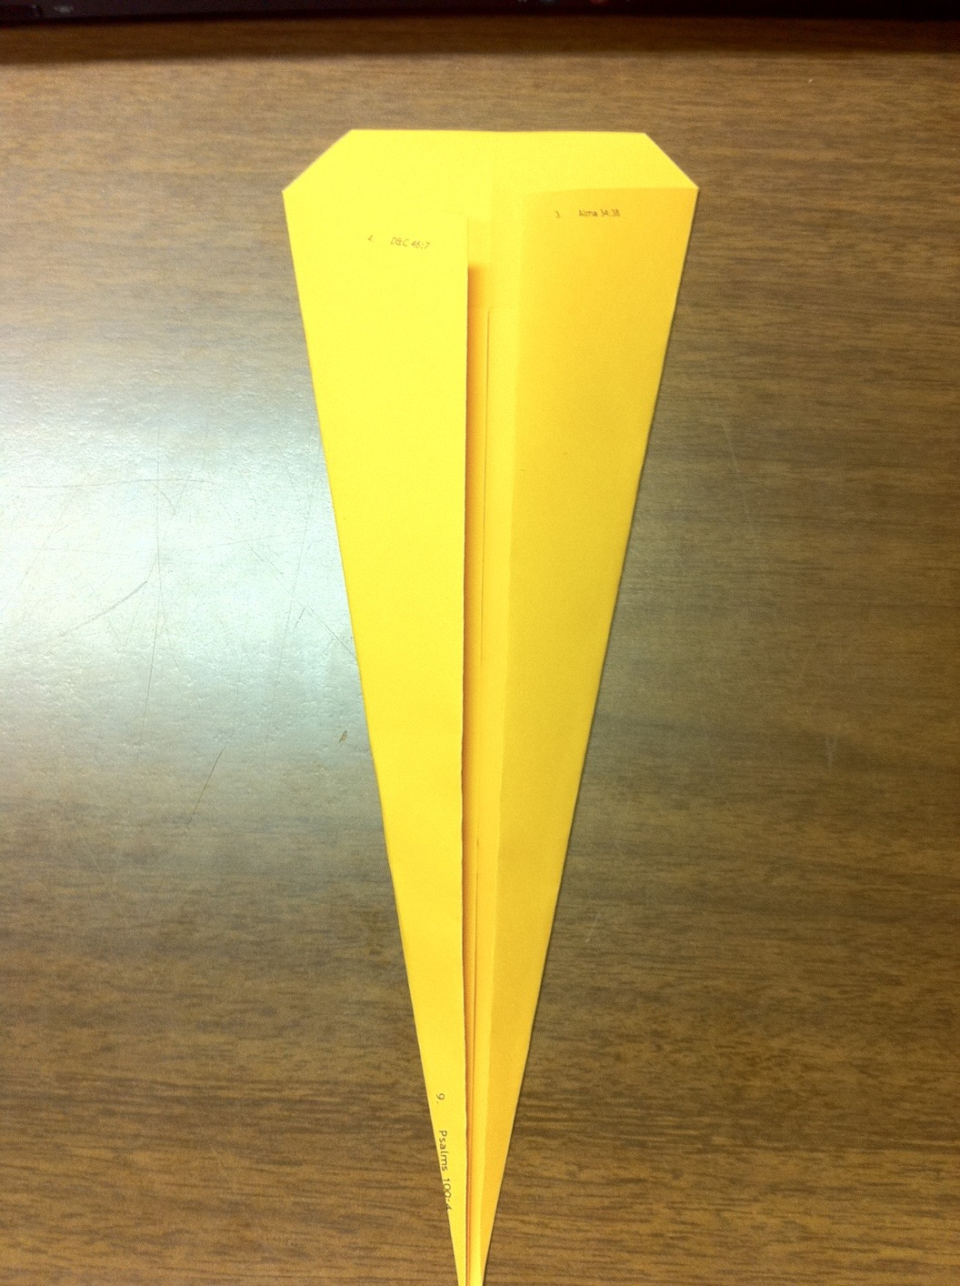
Flip the paper over.

Slide 20
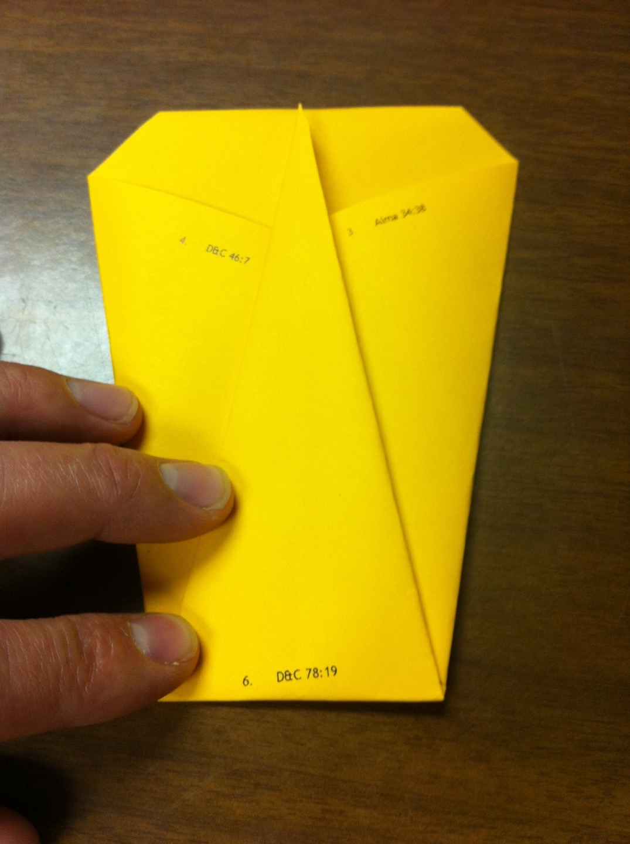
Number 6
Fold the bottom tip up to reveal the number 6.

Slide 21
6. D&C 78:19.
WRITE A TRIAL YOU ARE THANKFUL FOR.
“Feeling gratitude and not expressing it is like wrapping a present and not giving it”
(William Arthur Ward)

Slide 22
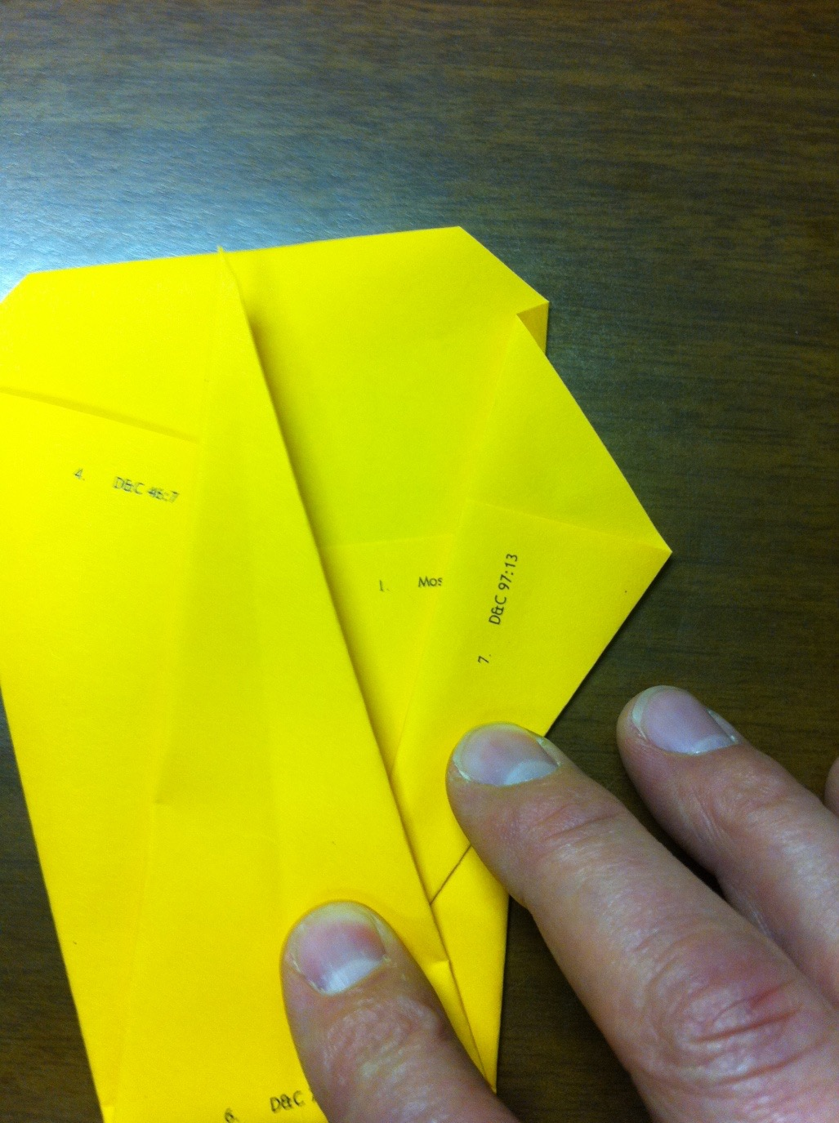
Number 7
Fold the right wing out.

Slide 23
7. D&C 97:13
WRITE DOWN WHY YOU ARE GRATEFUL FOR TEMPLES.
“God gave you a gift of 86,400 seconds today. Have you used one to say thank you?”
(William A. Ward)

Slide 24
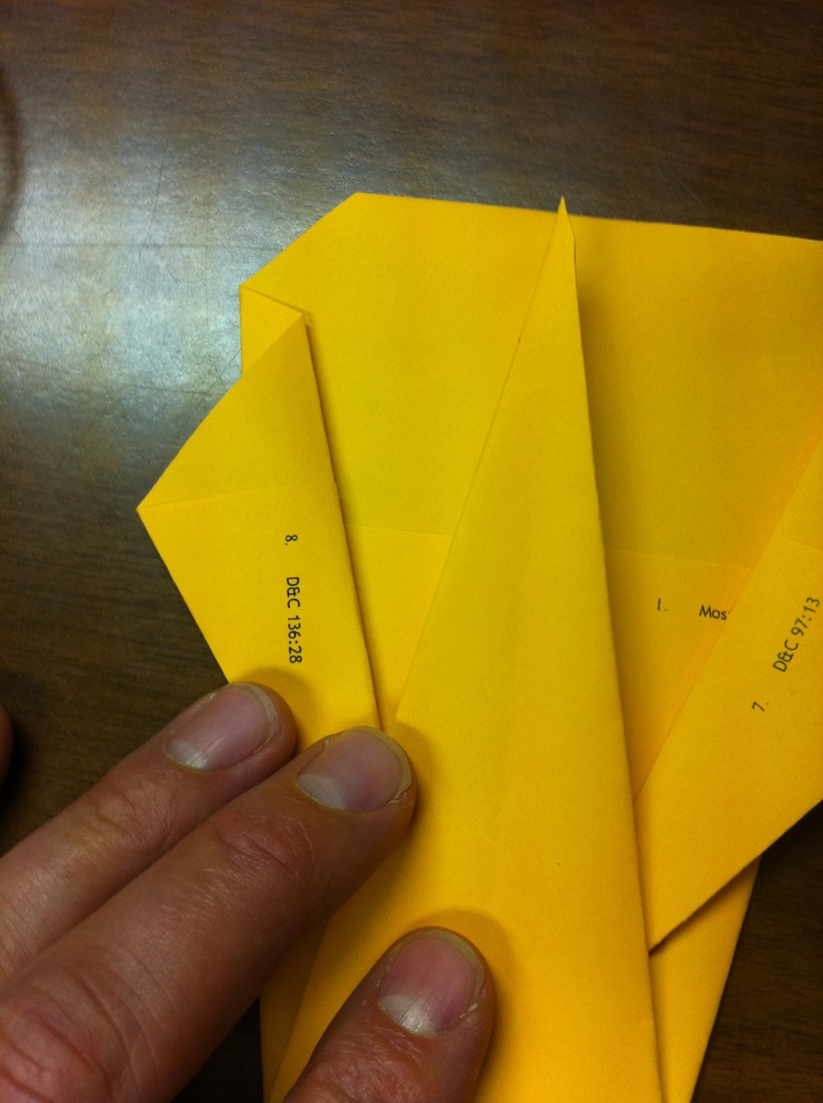
Number 8
Fold the left wing out.

Slide 25
8. D&C 136:28
WRITE DOWN YOUR FAVORITE HYMN.
“How wonderful it would be if we could help our children and grandchildren to learn thanksgiving at an early age. Thanksgiving opens the doors. It changes a child's personality. A child is resentful, negative—or thankful. Thankful children want to give, they radiate happiness, they draw people.” (Sir John Templeton)

Slide 26
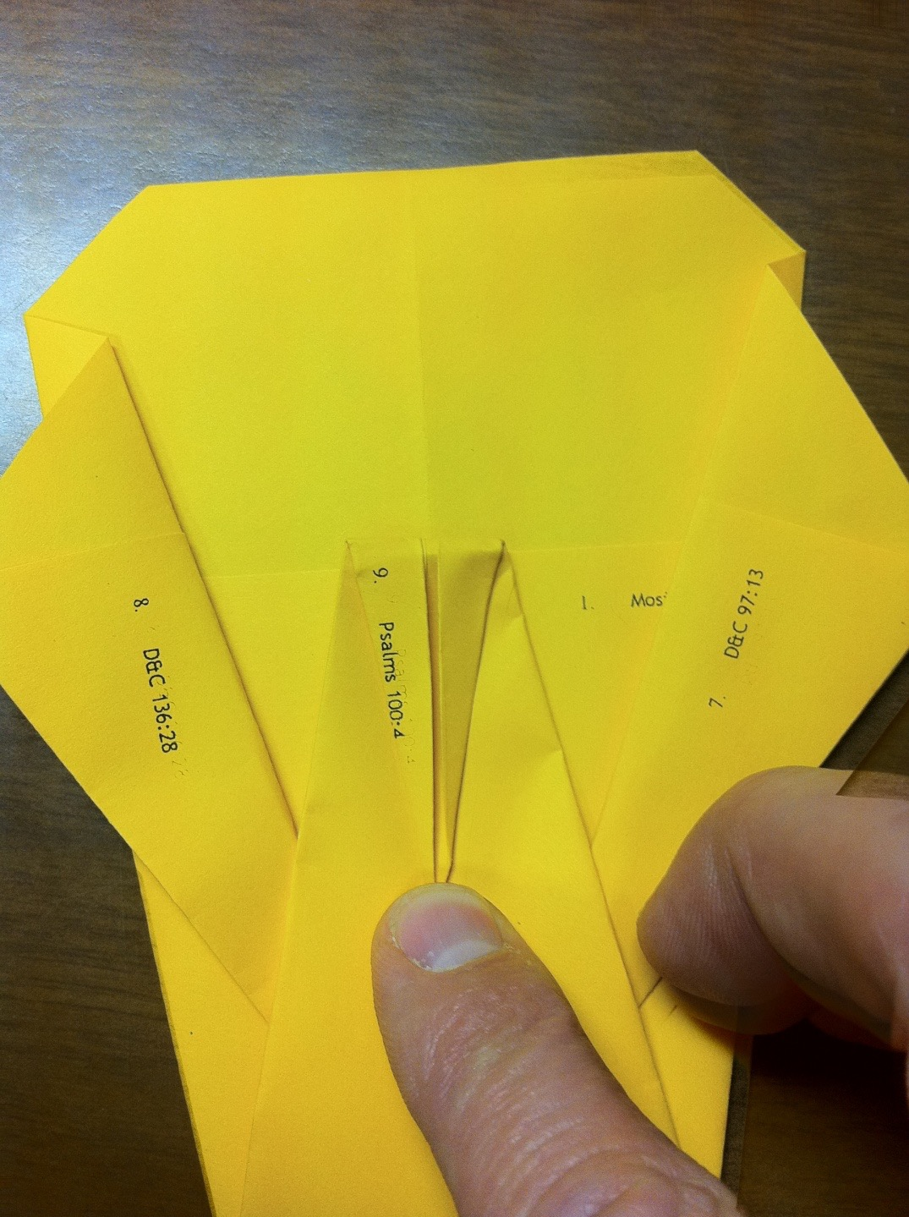
Number 9
Fold the beak down.

Slide 27
9. PSALMS 100:4
TELL YOUR NEIGHBOR WHY YOU ARE THANKFUL FOR THEM.
“On Thanksgiving Day 1918 a worship service was arranged by representative chaplains from the major denominations. (Chaplain) B. H. Roberts was assigned a seat at the rear of the review stand and had not been asked to participate on the program. During the service the conducting officer abruptly announced, "Elder Roberts, the Mormon chaplain from Utah, will now step up and lead the Thanksgiving Psalm." Dazed, Roberts arose and walked forward; he was familiar with the Psalms but not with that title. The impression then came that he should read "The One Hundredth Psalm." Opening his Bible he read aloud the lines. Returning to his seat, Roberts noticed that his fellow chaplains were looking not at him but at the floor. He concluded that this public invitation had been an attempt to embarrass him and the Church. Back at his tent he knelt in prayer, thanking the Lord for coming to his aid in this moment of need. (Truman G. Madsen, Defender of the Faith: The B. H. Roberts Story , p.311)

Slide 28
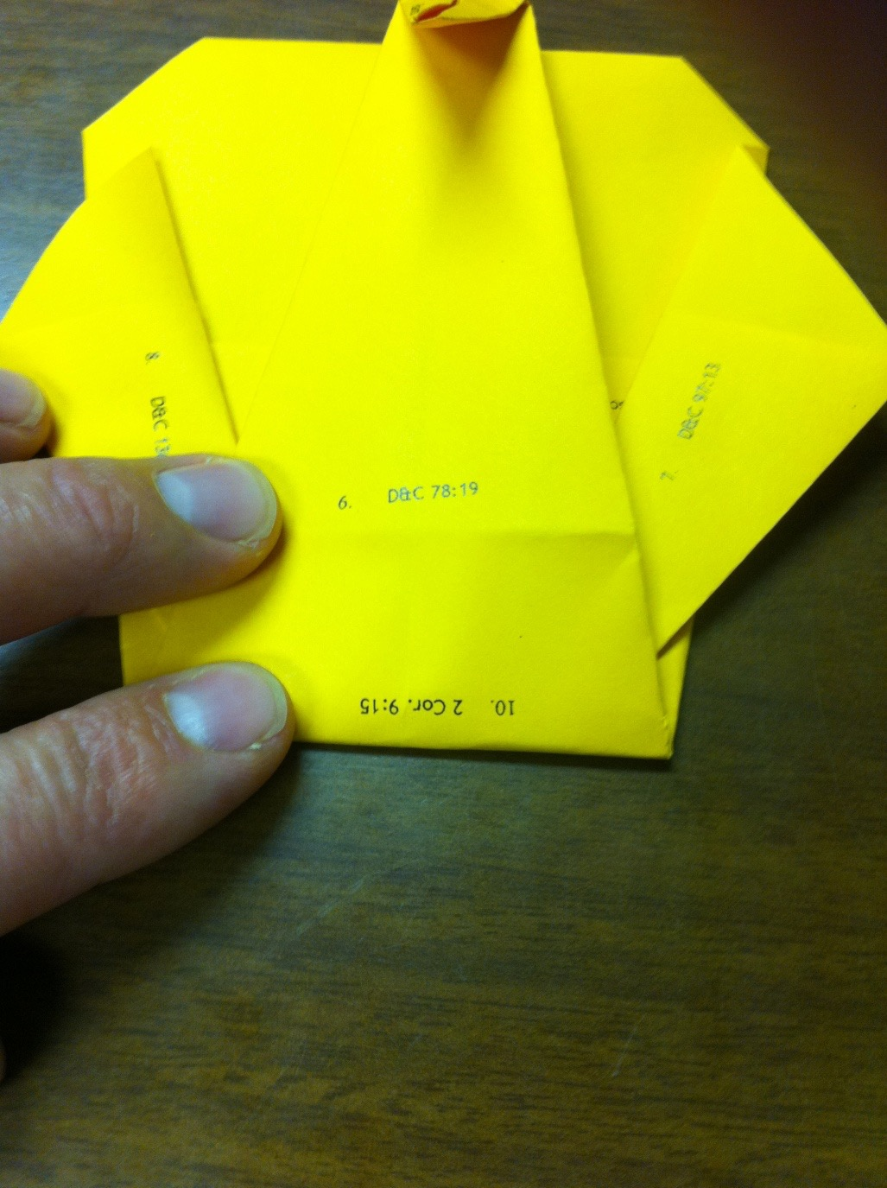
Number 10
Fold the bottom up to reveal Number 10 (upside down).

Slide 29
10. 2 CORINTHIANS 9:15
WRITE DOWN YOUR FAVORITE THANKGIVING FOOD.
In the Doctrine and Covenants, the Lord calls the gift of the Holy Ghost “the unspeakable gift” (D&C 121:26). It is the source of testimony and spiritual gifts. It enlightens minds, fills our souls with joy, teaches us all things, and brings forgotten knowledge to our remembrance. The Holy Ghost also “will show unto [us] all things what [we] should do.”
(Joseph B. Wirthlin, “The Unspeakable Gift,” Liahona, May 2003, 26–29)

Slide 30
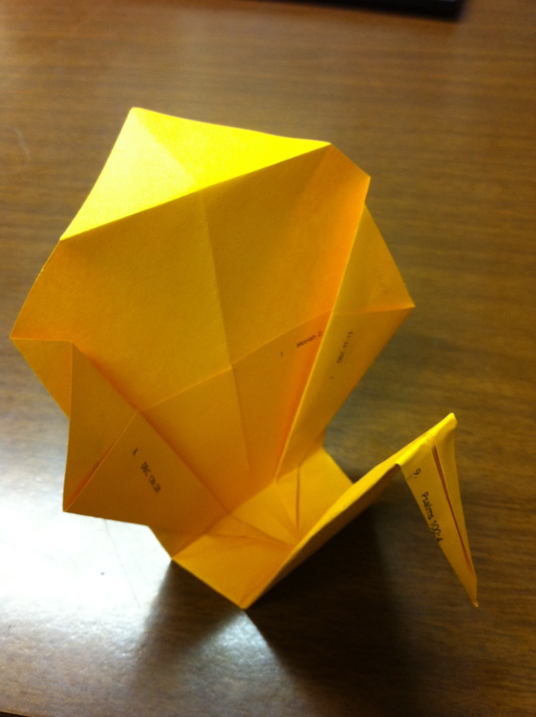
Almost finished!

Slide 31
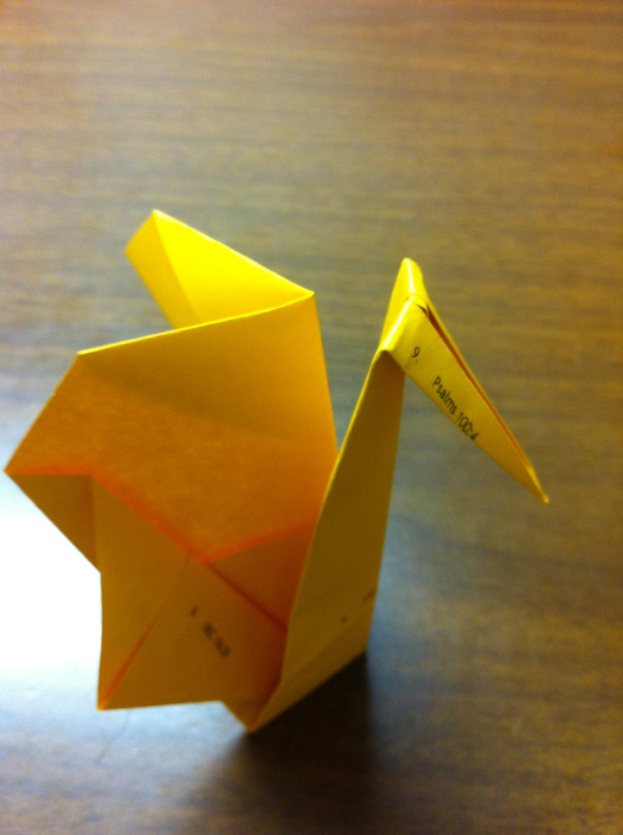
Finished Bird
You can give your bird a little extra shape by creasing him through the back.

Slide 32
The story is told of a group of men who were talking about people who had influenced their lives and for whom they were grateful. One man thought of a high school teacher who had introduced him to Tennyson. He decided to write and thank her. In time, written in a feeble scrawl, came the teacher’s reply:
“My dear Willie:
“I can’t tell you how much your note meant to me. I am in my 80s, living alone in a small room, cooking my own meals, lonely and like the last leaf lingering behind. You will be interested to know that I taught school for 50 years, and yours is the first note of appreciation I have ever received. It came on a blue, cold morning, and it cheered me as nothing has for years.”
We owe an eternal debt of gratitude to all of those, past and present, who have given so much of themselves, that we might have so much ourselves.
-Thomas S. Monson, in Conf., Oct. 1998

Slide 33
Invitation:
Express Thanks
Write and deliver a letter (not a note, a text, or an e-mail) to someone. I realize that you automatically thought of me but we don’t have enough paper and you’d be so late for next period. Think of someone else.
Notes:
Show Turning Point video to help introduce invitation #2

