Slide 1

Teaching Templates
Plug-n-Play Templates with an emphasis on the Teaching Pattern

Slide 2
1: Small Group (Introduction)
Teaching Templates for
The Basic Pattern Outcomes

Slide 3
Principles and Doctrines
Practice:
Think of a favorite scripture or scripture story.
Share the context
Identify the doctrine (gospel truth).
  Usually one or two words (‘faith’, ‘obedience’, etc)
Show understanding of a principle (moral of the story).
  Usually a sentence that uses “we” or “if…then”
Feel the importance by sharing a personal application
  Typically uses “I statement (“If I…” or “I will…” or “I just know that if I…”)

Slide 4
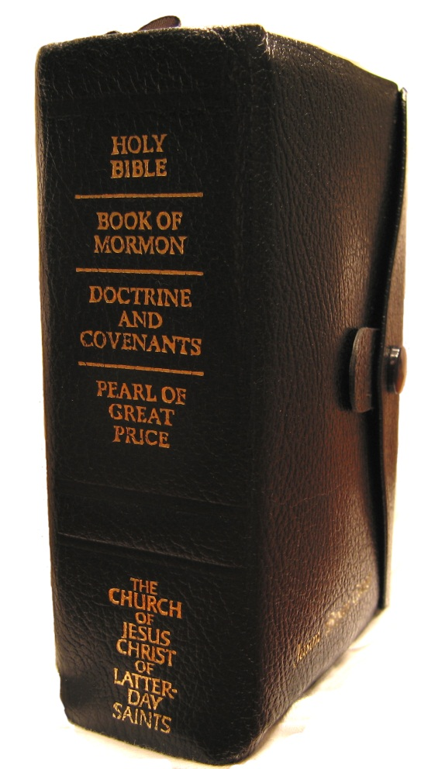
Insert scripture passage
Insert scripture passage
Insert scripture passage
Insert scripture passage
Insert scripture passage
Insert scripture passage
Share the context (storyline).
Identify a doctrine (gospel truth).
Understand (share) a principle (moral of the story).
Feel the importance by sharing a personal Application (“I once…” or “If I…” or “I will…”)

Slide 5
2: Teaching Outline
Teaching Templates for
The Basic Pattern Outcomes

Slide 6
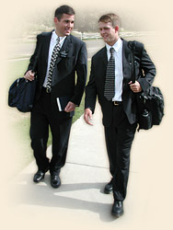
“What we’re asking is for the missionary to prepare an outline [lesson plan] during personal and companion study, personalized for who will be taught that day” (in “Be One of the Greatest,” New Era, Mar. 2004, 14).
“Missionaries prepare outlines to plan how they are going to teach an investigator according to his or her needs. The outline [lesson plan] helps the missionaries conceive the presentation in their own minds. If the presentation is well conceived, it is clear, and then the words will come easily as missionaries teach by the Spirit” (Elder Charles Didier, “Teaching from the Heart,” Ensign, June 2004, 8).

Slide 7
Teaching Template
Prepare a Missionary Teaching Outline
Scripture:____________________________
Context:___________________________________________________________
Identify: One doctrine (great phrase) in your verses.
Understand & Feel: Think of an example. How have you seen the power of this doctrine in your own life?
Apply: What do you think God wants us to do because of this principle?
Insert Passage
Insert Passage
Insert Passage
Insert Passage
Insert Passage
Insert Passage
Insert Passage

Slide 8
3: Around the Room
Teaching Templates for
The Basic Pattern Outcomes

Slide 9
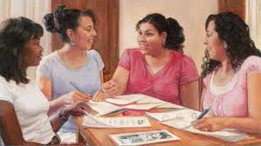
“The wise use of writing exercises and small group work can help teachers enhance the conditions of learner readiness and participation and “be an effective way to have the Holy Spirit help students make personal application of gospel principles” (Teaching the Gospel: A Handbook for CES Teachers and Leaders [1994], 41).

Slide 10
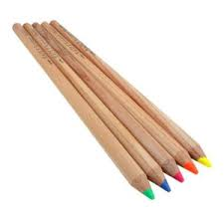
Around the Room
Working in pairs, you will have 90 seconds per verse (station) to discover a principle/lesson/truth
Write a statement of truth, based on the block, in your study journal.
After, you will see questions/scenarios that you will respond to using your notes.
Example: 1 Nephi 16:2-3 — “The guilty taketh the truth to be hard”
Principle: When something true, I should examine my life and seek repentance, rather than being a rebel.

Slide 11

Teaching Template: Around the Room
Insert scripture passage
Insert scripture passage
Insert scripture passage
Insert scripture passage
Insert scripture passage
Insert scripture passage
Insert scripture passage
Insert scripture passage
Insert scripture passage
Insert scripture passage
Insert scripture passage
Insert scripture passage

Slide 12

Let’s begin

Slide 13

Rotate
Write down a principle/lesson/truth
In your journal.
After, you will see questions/scenarios that you will respond to using your notes.

Slide 14
Rotate
Write down a principle/lesson/truth
In your journal.
After, you will see questions/scenarios that you will respond to using your notes.
Copy and Paste this slide for as many rotations as you have around the room

Slide 15

You’re done!

Slide 16

Take out your cell phone
Please respond (appropriately) to this question: What is something you are struggling with right now in life? (hardships, questions, problems, etc)
http://www.polleverywhere.com/
Please respond to the questions, concerns, problems, etc of your peers using the principles you have found in today’s study.

Slide 17
4: Group Rotations
Teaching Templates for
The Basic Pattern Outcomes

Slide 18

“Small group activities can often allow a greater number of students to participate and can provide a safe environment where students can share feelings, thoughts, and testimony with each other. These activities can also provide opportunities for students to teach the gospel to others and help prepare them to teach the gospel in the future. Discussions in small groups can enable students to develop communication skills and strengthen appropriate social and spiritual relationships.” (Teaching the Gospel: A Handbook for CES Teachers and Leaders).

Slide 19
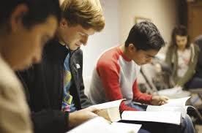
Rotation
Below are a few blocks of scripture. Every few minutes, you will rotate to a new group of people to discuss the content of the next block.
Insert scripture passage
Insert scripture passage
Insert scripture passage
Insert scripture passage
Insert scripture passage
Insert scripture passage
Context: What is the background of this story?
Identify: Find one or two doctrines in this verse.
Understand: Are there any challenging words in the verse that need clarification? What’s the moral or application of the story? What have the prophets taught about this doctrine?
Feel: How have you seen the power of this principle your life? Is there a hymn or primary song that can help? A Mormon Message? An object lesson that would demonstrate application?
Apply: What do you think God wants us to do because of this principle? What goal could a person make to better live this principle?

Slide 20
5: Learn and Teach
Teaching Templates for
The Basic Pattern Outcomes

Slide 21
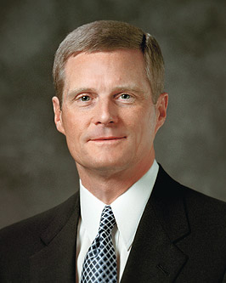
“Learning by faith requires spiritual, mental, and physical exertion and not just passive reception.”
Elder David A. Bednar

Slide 22

Learn it and Teach it
Identify principles from your passage and then teach it to a small group of your peers. In return, you will hear each member of your group teach their passage to you as well.
Insert scripture passage
Insert scripture passage
Insert scripture passage
Insert scripture passage
Insert scripture passage
Insert scripture passage
Context: What is the storyline of this chapter?
Identify: One doctrine (phrase) in your verses.
Understand: Think of an analogy or object lesson that helps teach the doctrine/principle.
Feel: How have you seen the power of this doctrine/principle in your life?
Apply: What do you think God wants us to do because of this principle?

Slide 23
Group 1
Group 2
Group 4
Group 3
Group 5

Slide 24
2
2
1
1
3
3
5
4
5
4
2
1
3
2
1
2
3
5
4
1
3
5
4
5
4

Slide 25
1
2
1
2
1
2
Group 1
Group 2
1
1
2
2
4
4
4
3
Group 4
3
5
3
4
4
Group 3
5
5
3
3
Group 5
5
5

Slide 26
6: Drawing
Teaching Templates for
The Basic Pattern Outcomes

Slide 27
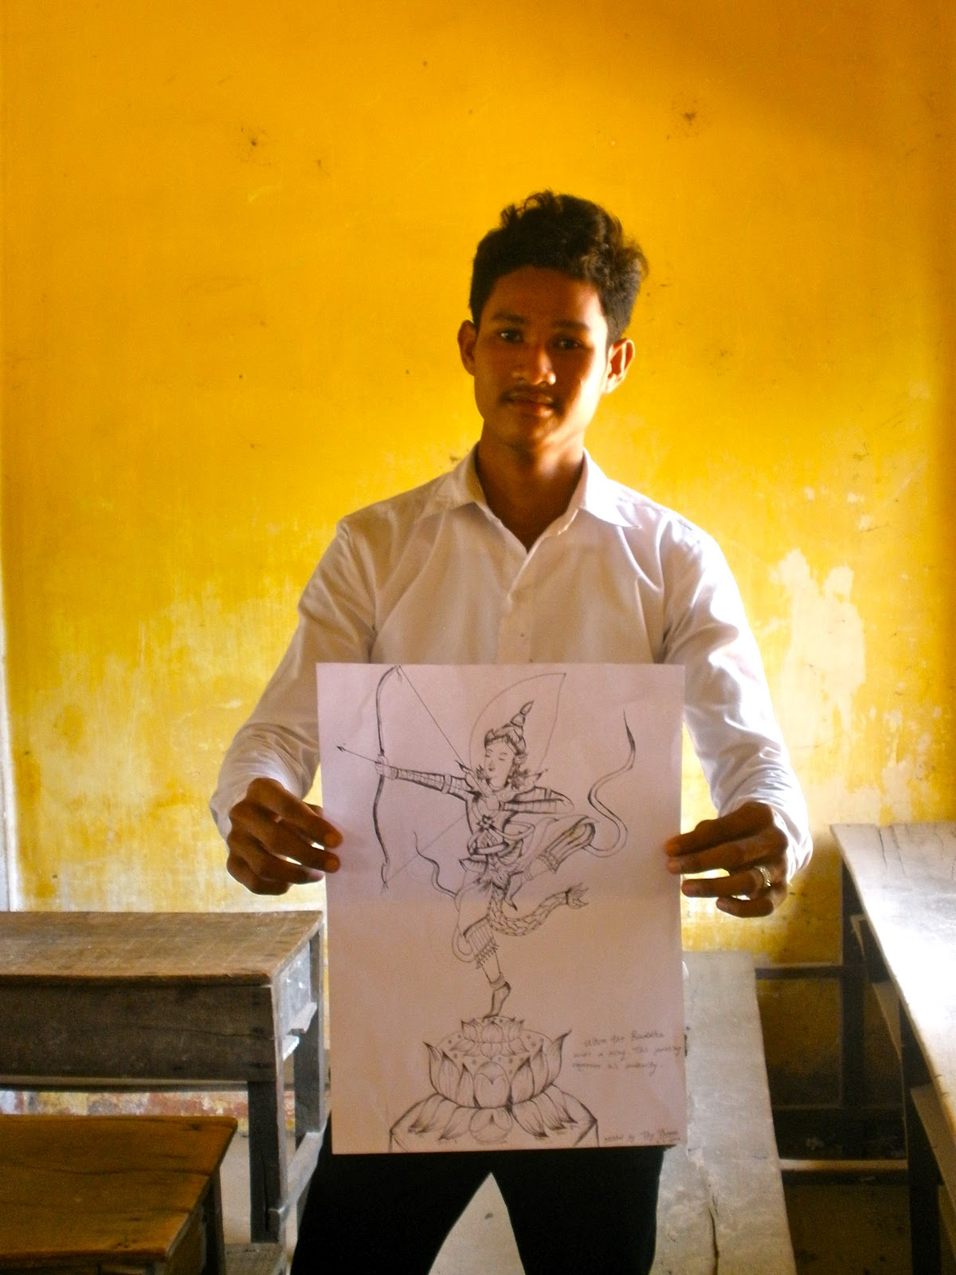
“It is often difficult to teach the intangible aspects of the gospel. The Savior often referred to earthly objects (like bread, water, candles, and bushels) to help His listeners understand spiritual principles.
“Pictures can be used to help students visualize what the people, places, events, objects, and symbols in the scriptures looked like.” (Teaching the Gospel: A Handbook for CES Teachers and Leaders).

Slide 28

Drawing
Draw a picture of your story and then point out principles from your drawing. In return, you will see pictures and see applications from each member of your group.
Insert scripture passage
Insert scripture passage
Insert scripture passage
Insert scripture passage
Insert scripture passage
Insert scripture passage
Context: What is the background of this story?
Identify: Find one or two doctrines in this verse.
Understand: Are there any challenging words in the verse that need clarification? What’s the moral or application of the story? What have the prophets taught about this doctrine?
Feel: How have you seen the power of this principle your life? Is there a hymn or primary song that can help? A Mormon Message? An object lesson that would demonstrate application?
Apply: What do you think God wants us to do because of this principle? What goal could a person make to better live this principle?

Slide 29
7: Finding Yourself
Teaching Templates for
The Basic Pattern Outcomes

Slide 30
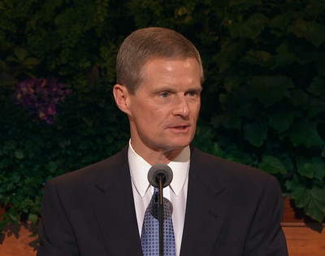
“Writing down what we learn, think, and feel as we study the scriptures is another form of pondering and a powerful invitation to the Holy Ghost for continuing instruction” (Elder Bednar, “Because We Have Them before Our Eyes, New Era, Apr. 2006, 6–7).

Slide 31
Finding Yourself in the Scriptures
Insert scripture passage
Insert scripture passage
Insert scripture passage
Insert scripture passage
Insert scripture passage
Insert scripture passage
Element/Symbol | Interpretation | So What? | Personal Experience
Identify the... Context People Things Actions taken Consequences of Actions Feelings experienced | Figure out... The interpretations of the elements/ Symbols How the elements are like general principles and practices. How the elements are like ME and God. What/Who do I think this story is really about? | Ask... What connections do I see? What is the moral of the story? What PRINCIPLE could I use from this story to help me in my life NOW? | Consider... When was a time in my life that I saw the “so what” happen? How could this principle affect future decisions?

Slide 32
8: Jesus Satan You
Teaching Templates for
The Basic Pattern Outcomes

Slide 33
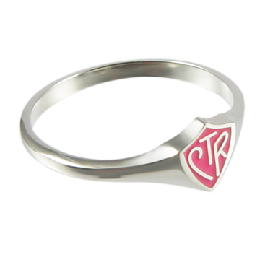
“Symbols help with this spiritual communication. Through symbols, the Lord forges a link with us by using the things of this earth to represent the things of heaven. He has given us revelations, prophecies, teachings, ordinances, and ceremonies filled with symbols that can give us spiritual insights if we are prepared to receive them.” (February 2007 New Era)

Slide 34
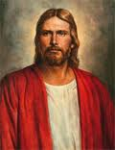
Jesus Satan You
You will be assigned one passage; look for symbols or principles of Jesus and Satan and then ask yourself how the principles you’ve written apply you.
Insert scripture passage
Insert scripture passage
Insert scripture passage
Insert scripture passage
Insert scripture passage
Insert scripture passage
Jesus | Satan | You
What symbols and principles of the Savior are in this passage? | What symbols or principles of Satan are in this passage? | What application or conclusion can be drawn for myself based on the symbols of Jesus and Satan in the passage?

Slide 35
9: Speed Dating
Teaching Templates for
The Basic Pattern Outcomes

Slide 36

“You can help one another stay strong and make good decisions. Getting together as friends can be a great setting. Some youth feel comfortable talking and socializing with members of the opposite sex. But others feel very nervous and awkward. This is not unusual. Those who are less comfortable can learn from those who are more comfortable.” (Brad Wilcox, New Era, Aug. 2001)

Slide 37
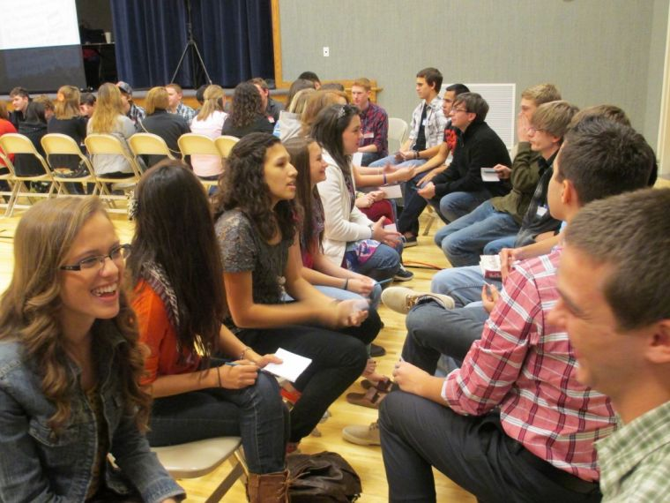
Speed Dating
You will meet 12 new people today; as you meet your new friend, share one thing about yourself with them, work through the teaching questions, and then ask them a random question
Insert scripture passage
Insert scripture passage
Insert scripture passage
Insert scripture passage
Insert scripture passage
Insert scripture passage
Insert scripture passage
Insert scripture passage
Insert scripture passage
Insert scripture passage
Insert scripture passage
Insert scripture passage
Context: What is the background of this story?
Identify: Find one doctrines in this verse.
Understand: What’s the moral or application of the story?
Feel: How have you seen the power of this principle your life?
Apply: What do you think God wants us to do because of this principle?
What are your post High-School plans?
Choose a second language?
Underwater or outer space?
Favorite shoe brand?
Favorite commandment?
Favorite soup?
If you could choose your mission, where would it be?
Favorite bread?
Favorite apostle?
Favorite primary song?
Favorite Temple?
Why did your parents name you your name?
Favorite Animal?
Favorite actor or actress?
What is your favorite vacation?
Who is your celebrity crush?
Favorite thing to do in the summer?
Favorite hymn?

Slide 38
10: Social Media
Teaching Templates for
The Basic Pattern Outcomes

Slide 39
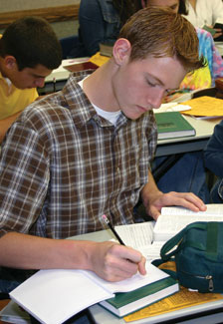
“Occasionally, inviting students to respond to a thought-provoking question in writing helps deepen and clarify their thinking. Inviting students to respond to a question in writing before sharing their thoughts with the class gives them time to formulate their ideas and receive impressions from the Holy Ghost. Students may be more inclined to share their thoughts when they have written them first, and what they share will often be more meaningful.” (Teaching the Gospel: A Handbook for CES Teachers and Leaders).

Slide 40




Social Media
You will study a few passages of scripture today; for each one, you will need to choose to a Hashtag, Status Update, Tweet or Instagram Caption to demonstrate a truth from the passage.
Insert scripture passage
Insert scripture passage
Insert scripture passage
Insert scripture passage
Insert scripture passage
Insert scripture passage
After reading your passage, create one of the following:
Create a tweet that summarizes a principle based on the passage
What would a Facebook status update sound like if a person were to post about a truth found in this passage
Create a caption for an Instagram image of the passage
What hashtag would summarize this passage?

Slide 41
11: Mormon Ads
Teaching Templates for
The Basic Pattern Outcomes

Slide 42
“It is often difficult to teach the intangible aspects of the gospel. The Savior often referred to earthly objects (like bread, water, candles, and bushels) to help His listeners understand spiritual principles.
“Pictures can be used to help students visualize what the people, places, events, objects, and symbols in the scriptures looked like.” (Teaching the Gospel: A Handbook for CES Teachers and Leaders).

Slide 43
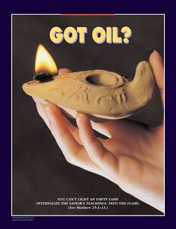
Mormon Ads
Create a Mormon Ad based on principles from your assigned block of scripture
Insert scripture passage
Insert scripture passage
Insert scripture passage
Insert scripture passage
Insert scripture passage
Insert scripture passage
Create a Mormon Ad
  Read the verse together and identify a principle or application
  Create a catchy phrase or title for your Ad
  Draw a picture that illustrates the principle of the verse (include the scripture reference and part of the verse on your drawing)
Context: What is the background of this story?
Identify: Find one or two doctrines in this verse.
Understand: What have the prophets taught about this doctrine?
Feel: How have you seen the power of this principle your life?
Apply: What do you think God wants us to do because of this principle?

Slide 44
12: Line upon Line
Teaching Templates for
The Basic Pattern Outcomes

Slide 45
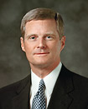
“The Lord’s pattern and process for giving us spiritual knowledge is found in the phrase “line upon line, precept upon precept” and describes a central feature of the Lord’s pattern.” (Elder Bednar, September 2010 Ensign)

Slide 46
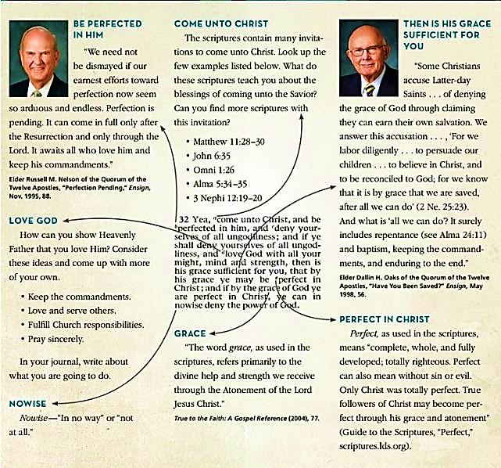

Slide 47
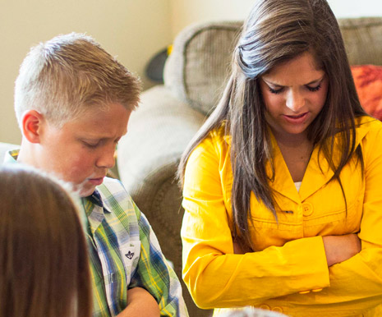
Line Upon Line
Use quotes, the Bible Dictionary, Conference Talks, etc to bring a scripture passage to life by creating a “Line Upon Line” message..
Insert scripture passage
Insert scripture passage
Insert scripture passage
Insert scripture passage
Insert scripture passage
Insert scripture passage
Context: What is the background of this story?
Identify: Find one or two doctrines in this verse.
Understand: What have the prophets taught about this doctrine?
Feel: How have you seen the power of this principle your life?
Apply: What do you think God wants us to do because of this principle?

Slide 48
13: Something new in the Scriptures
Teaching Templates for
The Basic Pattern Outcomes

Slide 49

Something New?

Slide 50
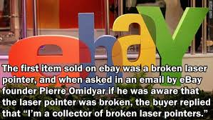
What was the first item sold on eBay?

Slide 51
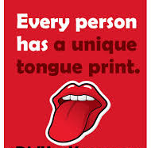
Something unique about all tongues?

Slide 52
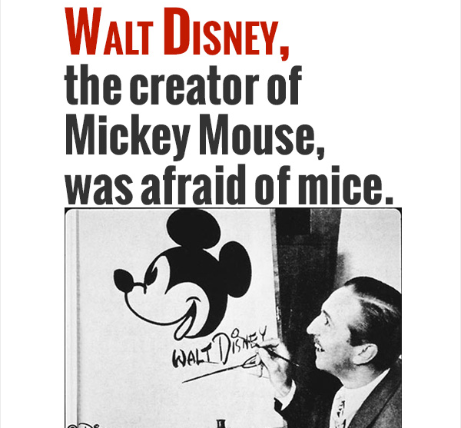
Walt Disney had one fear….

Slide 53

Coke vs Diet Coke

Slide 54
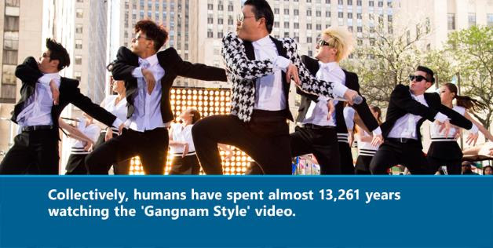
Gangum Style

Slide 55
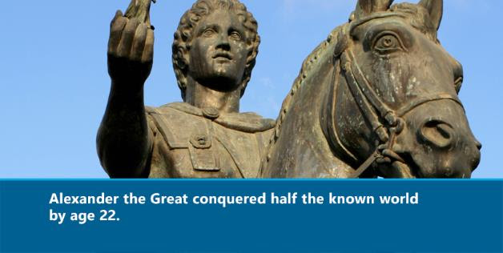
Alexander the Great

Slide 56
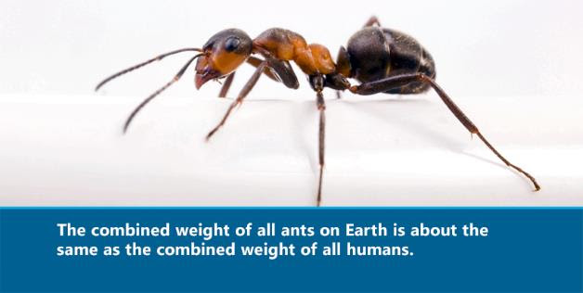
How many ants are in the world?

Slide 57
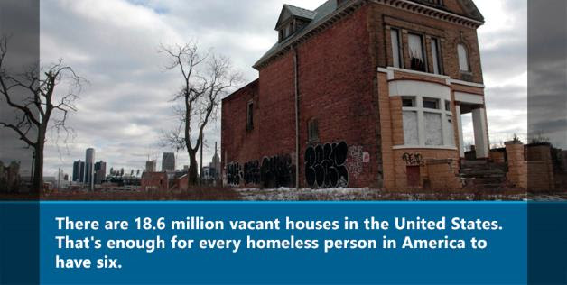
How many Americans are homeless?

Slide 58
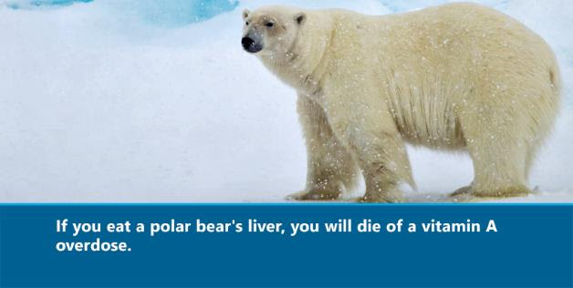
What would happen if you ate a Polar Bear?

Slide 59
Something New In the Scriptures
Insert scripture passage
Insert scripture passage
Insert scripture passage
Insert scripture passage
Insert scripture passage
Insert scripture passage
Search your assigned block of scripture. Share something that others may not have known about…
The Context
A Doctrine or Principle
Or
An Application
Found within your scripture passage.

Slide 60
14: mormon.org chat
Teaching Templates for
The Basic Pattern Outcomes

Slide 61
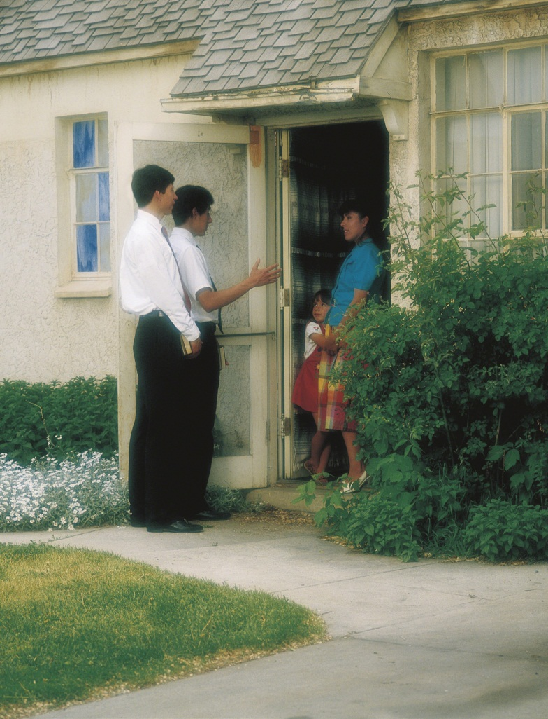
What can I do to prepare most effectively to serve as a full time missionary?

Slide 62
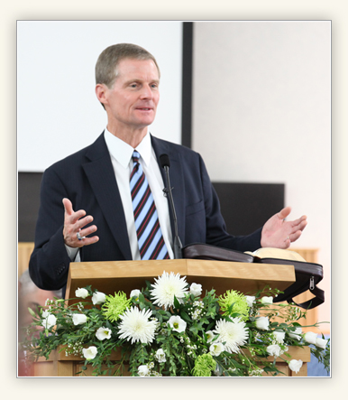
What can I do to prepare most effectively to serve as a full time missionary?
One of the questions I am asked most frequently by young men is this: “What can I do to prepare most effectively to serve as a full-time missionary?” The single most important thing you can do to prepare for a call to serve is to become a missionary long before you go on a mission.
In our customary Church vocabulary, we often speak of going to church, going to the temple, and going on a mission. Let me be so bold as to suggest that our rather routine emphasis on going misses the mark.
My earnest hope for each of you young men is that you will not simply go on a mission—but that you will become missionaries long before you submit your mission papers, long before you receive a call to serve, long before you are set apart by your stake president, and long before you enter the MTC.
http://www.youtube.com/watch?v=Z0xg-U_TApI (Elder Bednar Becoming a Misionary)

Slide 63
Scan your assigned passage and identify missionary teaching topics and doctrines
Insert scripture passage
Insert scripture passage
Insert scripture passage
Insert scripture passage
Insert scripture passage
Insert scripture passage
Visit the URL below and ask the volunteers at Mormon.org to help answer a question based on the doctrines you’ve identified in your passage.
http://www.mormon.org/chat

Slide 64
15: Quiz
Teaching Templates for
The Basic Pattern Outcomes

Slide 65
Scan your assigned passage and create a matching quiz based on principles in your block.
Insert scripture passage
Insert scripture passage
Insert scripture passage
Insert scripture passage
Insert scripture passage
Insert scripture passage
Round 1
EXAMPLE
Read the verses to the left and select which principles best goes with that verse.
1. ____ If we recognize our weaknesses and are humble before God, then God
will make us weak people strong.,
2. ____ People who mock others will eventually mourn.
3. ____ Without charity, we can not go to the Celestial Kingdom.
4. ____ The life of Christ shows us the more excellent way of living.
5. ____ Faith, hope and charity are the start of all righteousness.
6. ____ Having God’s Spirit with you makes you unstoppable.
7. ____ If we want a witness (manifestation) from God, then we have to try to
be faithful first.
8. ____ Hope makes you steady in producing many good works.
A. 12:2
B. 12:4
C. 12:6
D. 12:11
E. 12:26
F. 12:27
G. 12:28
H. 12:34

Slide 66

Complete another group’s quiz.
Then select your FAVORITE principle and circle it.
Round 2

Slide 67
You will receive another group’s paper with a highlighted favorite principle. Find something to help us feel the importance of that principle and invite us to make an application based on it.
Round 3
Feel: How have you seen the power of this principle your life? What personal or scriptural example demonstrates this principle? Is there a hymn or primary song that can help? A cross reference? An object lesson?
Apply: What do you think God wants us to do because of this principle? What goal could a person make to better live this principle?

Slide 68
16: Dinner Table
Teaching Templates for
The Basic Pattern Outcomes

Slide 69
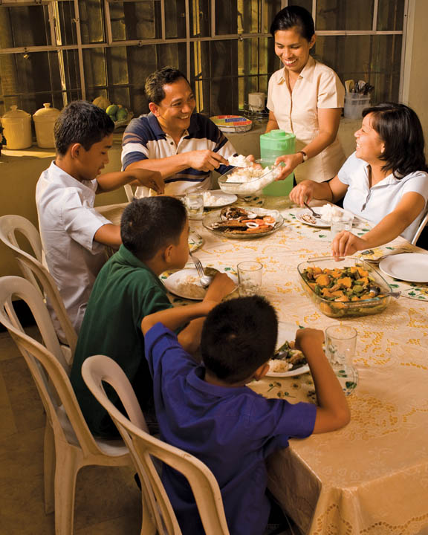
A role play of a family at the dinner table that evening. Pick a father and a mother and then randomly choose 3-4 children. The parents just simply ask, “What did you learn in seminary today?" (sometimes the parents have to push a little to avoid simple answers).

Slide 70
17: Fish Bowl
Teaching Templates for
The Basic Pattern Outcomes

Slide 71
Scan your assigned passage and think of a question or topic or doctrine to discuss in a group.
Insert scripture passage
Insert scripture passage
Insert scripture passage
Insert scripture passage
Insert scripture passage
Insert scripture passage
FISHBOWL PROCESS
A small group of students (as many as half the class) arrange themselves in a circle in the center of a room. To begin the discussion, the teacher or a student within the fishbowl offers an open-ended question, and the fishbowl group discusses it. Students might initially be self-conscious as part of the group "on stage," but they generally grow comfortable as the conversation flows. Leave an empty seat in the fishbowl for an outside participant who wants to speak. He or she should move to the vacant seat and join the discussion until someone else from outside the circle wants to join. That person then taps the first person on the shoulder, and they quietly switch places.

Slide 72
18: Teaching
Teaching Templates for
The Basic Pattern Outcomes

Slide 73
18: Teaching
Recommendation for Teaching Scriptures from Elder Scott
Find a powerful scripture rich with truth.
Formulate a well-expressed statement of truth to be taught.
Think of an example from the everyday life to illustrate more understandably that truth.
Share a personal testimony of the worth of that truth.
Extend a challenge or commitment to act on the truth.
(Elder Richard G. Scott, February 4, 2005, Jordan Institute of Religion)
1. Scripture Reference: ___________________________________________
2. Doctrine&Principle:_____________________________________________________________________________________________________________
3. Example/Story:________________________________________________________________________________________________________________
4. PersonalExpereince/Testimony:___________________________________________________________________________________________________
5. Invitation/Challenge:___________________________________________
Insert scripture passage
Insert scripture passage
Insert scripture passage
Insert scripture passage
Insert scripture passage
Insert scripture passage

Slide 74
19: Silent Lesson
Teaching Templates for
The Basic Pattern Outcomes

Slide 75
Silent lessons can put students in a position where they are responsible
to capture their own valuable insights. This type of instruction is important
because, as Elder David A. Bednar explained, “the most important learnings
in life are caught—not taught.”
Elder Bednar counseled
teachers to “get out of the way” and said, “I would just simply pose this
question: How do I invite these young people to learn for themselves?” Silent lessons can do just that.

Slide 76


Let all the earth keep silence before him: Hab. 2:20 .
Be still, and know that I am God: Ps. 46:10 .
In quietness and in confidence shall be your strength: Isa. 30:15 .
He that keepeth his mouth keepeth his life: Prov. 13:3 .

Slide 77
Silent Lesson
“Today’s class will be a Silent Lesson. We’ll focus less on using our ears/mouth and more on using our eyes. Please open your scriptures to _____. All you need today is scriptures and something to write with.
Insert scripture passage
Insert scripture passage
Insert scripture passage
Insert scripture passage
Insert scripture passage
Insert scripture passage

Slide 78
20: Peculiar Parlance
Teaching Templates for
The Basic Pattern Outcomes

Slide 79

Unlike other Christians, members of The Church of Jesus Christ of Latter-day Saints call the ordinance of eating bread and water in remembrance of Christ the “sacrament,” not “communion.”
We also call our local congregations “wards,” our young men “priests”.
The vocabulary takes some time to master. But where did all these unusual terms come from? Here’s the origin of words unique to the LDS Church.

Slide 80
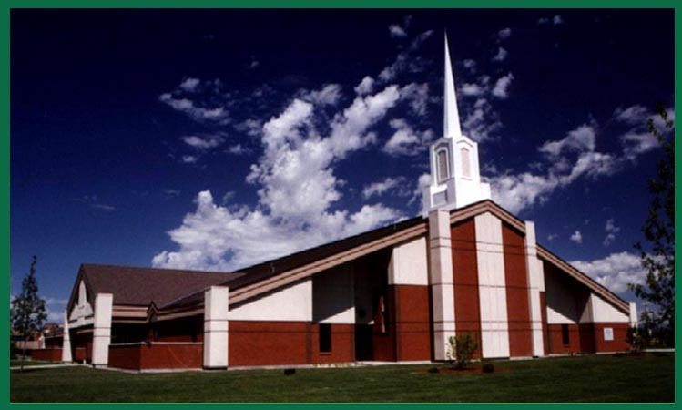
Stakes
The term “stake” is a reference to the imagery in Isaiah 54:2 of a stake holding a tent (the Church) in place. The verse reads, “Enlarge the place of thy tent, and let them stretch forth the curtains of thine habitations: spare not, lengthen thy cords, and strengthen thy stakes.”

Slide 81
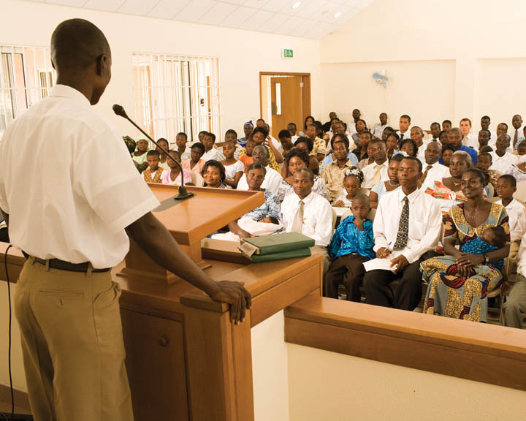
Ward
Joseph Smith borrowed the term “ward” from the term used for political districts of frontier municipalities when he created the first “wards” in Nauvoo. The city was divided by 1844 into 10 wards with three more in the surrounding area.

Slide 82

Beehive
Brigham Young loved the symbol of the beehive, which represented harmony, cooperation and work to the early pioneers. Because of this association, “Beehive” was the first name by which young women were known and is now the name for 12- and 13-year-old girls in the Church. In fact, one of the original requirements for Beehives was to care for an actual beehive for 1 year.

Slide 83

Mia Maid
The term “Mia Maid” — the Church’s name for girls 14 and 15 years old — is a historical reference to the Mutual Improvement Association (M.I.A., a forerunner to today’s Young Men and Young Women organizations and where “Mutual” comes from). The MIA emblem was a rose, which symbolized love, faith and purity.

Slide 84

Laurel
Laurels — the oldest girls in the young women program at 17 and 18 years of age — are so named in reference to the laurel wreath. The wreath is traditionally given as a symbol of significant achievement, honor and accomplishment. As Laurels grow to adulthood, they work toward finishing their preparation to make sacred covenants and receive temple ordinances.

Slide 85

Pearl of Great Price
A reference to a short parable found in Matthew 13:45-46: “Again, the kingdom of heaven is like unto a merchant man, seeking goodly pearls: Who, when he had found one pearl of great price, went and sold all that he had, and bought it.” The name suggests that the teachings found in the book are of great worth.

Slide 86

Relief Society
A name that refers to the organization’s purpose of administering relief to those in need. These sisters pursue the “relief of poverty, relief of illness; relief of doubt, relief of ignorance — relief of all that hinders the joy and progress of woman.”

Slide 87

Tithing
The term “tithing” is a word that means to give one-tenth of one’s income annually to the Lord through His Church. The word is used in the Old Testament, as early as Abraham paying tithing to Melchizedek.

Slide 88

Word of Wisdom
Lord describes the health code as “A Word of Wisdom, for the benefit of the council of high priests, assembled in Kirtland, and the church, and also the saints in Zion — To be sent greeting; not by commandment or constraint, but by revelation and the word of wisdom, showing forth the order and will of God in the temporal salvation of all saints in the last days” (D&C 89:1-2).

Slide 89

Peculiar Parlance
Find a word in your passage that may be difficult to understand and seek to find what the word means and what the Lord hopes we do to apply that doctrine.
Insert scripture passage
Insert scripture passage
Insert scripture passage
Insert scripture passage
Insert scripture passage
Insert scripture passage

Slide 90
21: Write and Pass
Teaching Templates for
The Basic Pattern Outcomes

Slide 91

Pass and Write
1- You will receive a copy of a page of scripture (put your name at the top).
2- When we begin, start reading your page. As you read, mark and give commentary to get the most out of the passage; underline important phrases, circle special words, write your thoughts and testimony in the margins.
4- Every 4 minutes I will say “pass” and then you will pass your paper.
5- When we are through, you will have a propitious personalized passage prepared by your prodigious peers

Slide 92
22: Study Techniques
Teaching Templates for
The Basic Pattern Outcomes

Slide 93
Study Techniques
Insert scripture passage
Insert scripture passage
Insert scripture passage
Insert scripture passage
1. Zinger -- Find verses in the first block of scripture that are awesome and should be highlighted.
2. Questions -- Find any questions you might have from that block of scripture. Maybe a word that you don't understand, or you wonder why that was included....
3. I Know Because -- Find something in this next block of scriptures that you know to be true or have a testimony of.
4. Scripture Mastery Cross Reference -- Find verses in the block of scriptures that relate with one of our 25 Scripture Mastery verses.

Slide 94
23: Bumper Stickers
Teaching Templates for
The Basic Pattern Outcomes

Slide 95
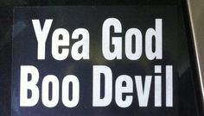





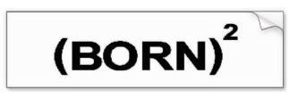


Slide 96
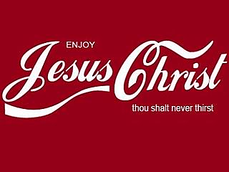
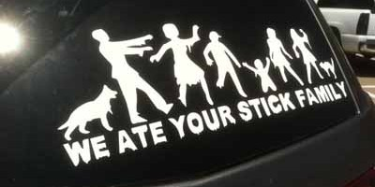
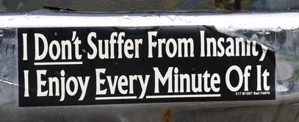
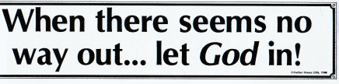

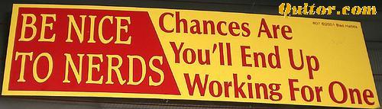

Slide 97

Insert scripture passage
Insert scripture passage
Insert scripture passage
Insert scripture passage
Insert scripture passage
Insert scripture passage
Insert scripture passage
Insert scripture passage
Simply read through your verse(s) and then create a fun/clever/inspirational bumper sticker based on a principle or doctrine found in your passage. Be sure to include the scripture reference on your sticker.

Slide 98
24: A Message from the Heart
Teaching Templates for
The Basic Pattern Outcomes

Slide 99

[Insert block to be studied]
You will have 10-15minutes to read through a block of scripture. As you study, underline meaningful phases and verses and then prepare a short message using the learning pattern and teach it to your partner:
CONEXT: Share The Storyline
IDENTIFY: Identify (+mark) A Powerful Phrase UNDERSTAND: Share A Personal Or Scriptural Story That Helps with Understanding
FEEL: Bear Testimony Of What You Are Sharing
APPLY: Extend An Invitation To Act

Slide 100
A Message from the Heart
CONEXT: Share The Storyline
IDENTIFY: Identify (+mark) A Powerful Phrase
UNDERSTAND: Share A Story That Helps with Understanding
FEEL: Bear Testimony Of What You Are Sharing
APPLY: Extend An Invitation To Act

Slide 101
25: Poetry
Teaching Templates for
The Basic Pattern Outcomes

Slide 102
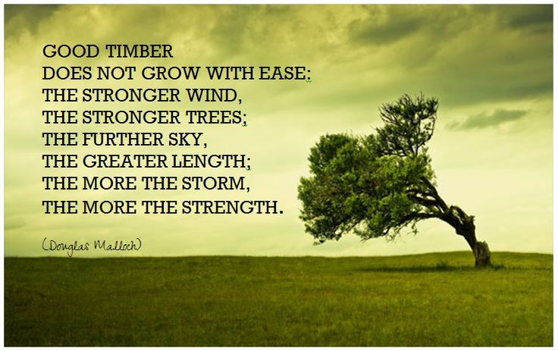

Slide 103
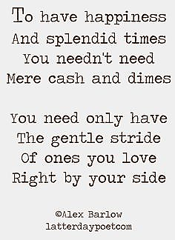

Slide 104
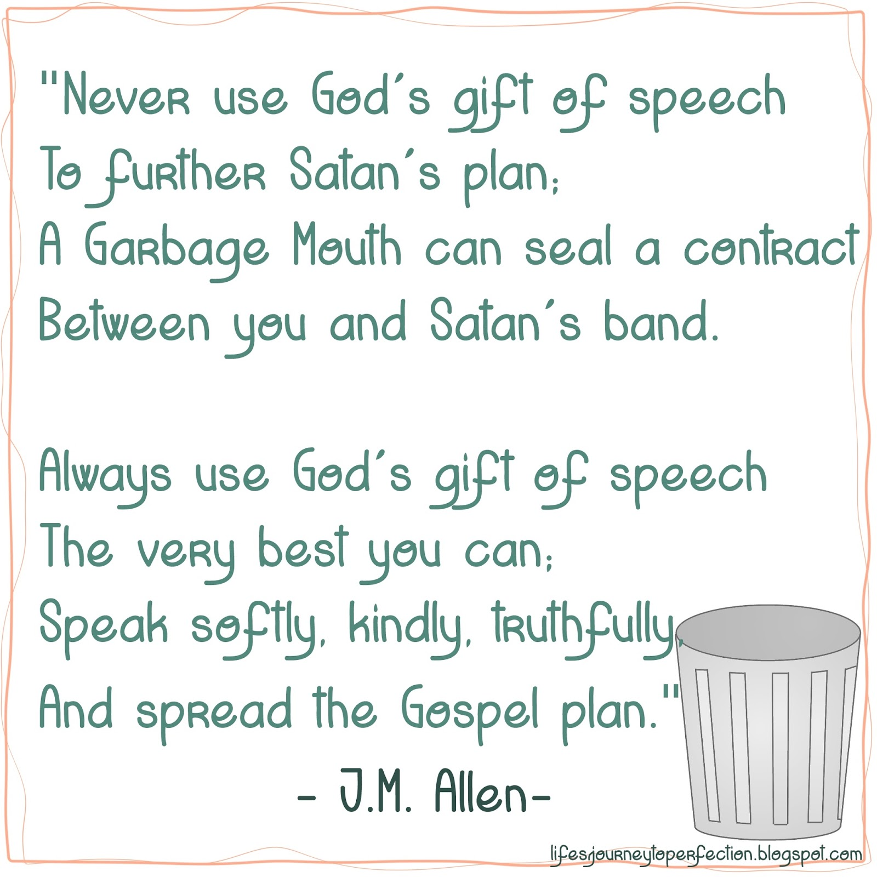

Slide 105

You will have 10 minutes to read through a block of scripture and find a principle. As you study, underline meaningful phases and verses. You will then have 10 minutes to prepare a poem about one principle from your passage.
Insert scripture passage
Insert scripture passage
Insert scripture passage
Insert scripture passage
Insert scripture passage
Insert scripture passage
Insert scripture passage
Insert scripture passage

Slide 106
26: Personal Study Model
Teaching Templates for
The Basic Pattern Outcomes

Slide 107
Personal Scripture Study Model
Part I
Four groups will be formed:
  Quote group
  Student manual group
  Story group
  Mormon Message group

Slide 108
Personal Scripture Study Model
Part II
A student will be chosen to come up to the front of the class
S/he will begin reading
S/he will keep reading until someone in the class notices a doctrine (fact) or a principle (how to act)
The doctrine/principle will be written on the board

Slide 109
Personal Scripture Study Model
  Part III
  To help us understand, apply and feel the importance of the doctrine/principle, groups will search for:
  A quote
  Insights from the student manual
  Other stories from the scriptures
  A Mormon Message
Each student will write a summary statement in their journals and then share it within their group – and then share how they could share that message outside of class.

Slide 110
27: Personal Study Model II
Teaching Templates for
The Basic Pattern Outcomes

Slide 111
Personal Scripture Study Model II
Tell the story about your passage
Explain the doctrine in the passage
Describe why this doctrine is important to God
Share why this doctrine is important to you
Insert scripture passage
Insert scripture passage
Insert scripture passage
Insert scripture passage
Insert scripture passage
Insert scripture passage
Insert scripture passage
Insert scripture passage

Slide 112
28: Studying Together
Teaching Templates for
The Basic Pattern Outcomes

Slide 113
Scripture Study
Students are assigned a letter “A” or “B” and read a passage, looking for keywords and converting principles
“A’s” are paired with “B’s” and they read the entire passage or chapter together and then share the keywords and converting principles they found originally
Partnerships look for crossreferences to strengthen a keyword and principle
Each student writes down one key principle based on the study
Each partnership combines the key principles into one and writes it on the board
As a class, identify one principle that they feel the author of the chapter would approve of
A. Insert scripture passage
B. Insert scripture passage

Slide 114
29: Musical Chairs
Teaching Templates for
The Basic Pattern Outcomes

Slide 115

Musical Chairs
Desks are paired up.
You will be assigned a passage to study and then write a 2minute teaching outline using CIFUA approach (Share the context, identify a principle, share a story or experience about it, and then testify and share an invitation to act)
We will them remove one desk
When the music begins, you’ll walk around the room and then sit down when the music stops.
If you are left standing, you will teach your mini-lesson to the whole class
(the people who are seated teach their mini lesson to each other)
Insert scripture passage
Insert scripture passage
Insert scripture passage
Insert scripture passage
Insert scripture passage
Insert scripture passage
Insert scripture passage

Slide 116
30: Stump the Chump
Teaching Templates for
The Basic Pattern Outcomes

Slide 117
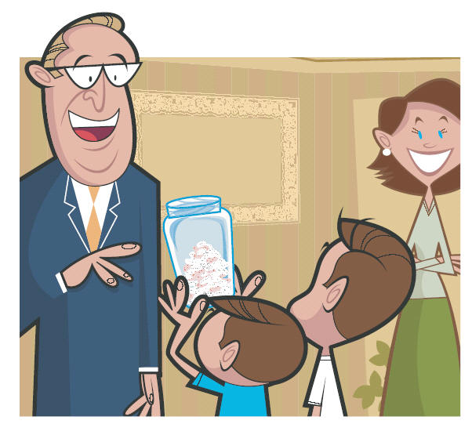
Stump the Chump
You will try to stump me today! (yeah, good luck!)
You will receive a cards with a scripture passage from the block we will study today.
You will have 5 minutes to study your passage and formulate one question about:
The Context
A doctrine in the passage
A principle found in the passage
Something random in the passage.
If I answer correctly, I get a point. If I do not answer correctly, you get a point.
Good luck – you’ll need it!
Insert scripture passage
Insert scripture passage
Insert scripture passage
Insert scripture passage
Insert scripture passage
Insert scripture passage
Insert scripture passage

Slide 118
31: Notecards from Heaven
Teaching Templates for
The Basic Pattern Outcomes

Slide 119
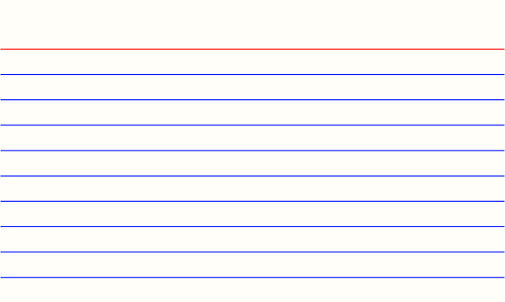
Notecards from Heaven
You will receive a notecard and you’ll be given 10 minutes to study your passage and find a quote to go with it. You’ll write the quote on the notecard along with why you love it and the verse that it relates to.
After, we’ll pass cards around the room so you can read other great quotes and look up other great passages.
In the end, you’ll wind up with a random notecard. Take it with you and let it’s message strengthen you today.
Insert scripture passage
Insert scripture passage
Insert scripture passage
Insert scripture passage
Insert scripture passage
Insert scripture passage
Insert scripture passage
Insert scripture passage
Insert scripture passage
Insert scripture passage

Slide 120
32: Shoes
Teaching Templates for
The Basic Pattern Outcomes

Slide 121

Shoes
Have each student take off one shoe and add it to the pile. During the lesson, each time someone makes a comment, they can come take their shoe back. If they don’t make a comment, their shoe will not be returned!

Slide 122
33: Struggles
Teaching Templates for
The Basic Pattern Outcomes

Slide 123
Struggles
I had the students anonymously share something they were struggling with. I typed up the answers (next slide). At the end of ANY lesson, an easy 10 minute discussion can develop by simply asking, "Choose one of the problems you see on the screen. How can today's lesson help someone with that challenge?"
This exercise does a few things. First, it reminds students that scriptures have answers. Second, it helps them learn to 'connect the dots' between their own struggles and the scriptures. A third bonus is that it creates a very genuine dialogue which bonds the class; students hearing advice from peers, based on the principles in that day's study, is powerful.
Another way to use this list is to share it with kids and assign then a problem from the list; next, give them a set of verses to study for that day's block/lesson and have them find solutions to their assigned problem.

Slide 124
Addiction
Anger Management
Apathy
Becoming Less Judgmental
Being A Better Leader
Breaking Up Appropriately
Budget and Finances
Chastity and Virtue
Chronic Illness
Connecting Meaningfully with Others
Courage In Dating
Dealing With Family Drama
Developing Charity
Eating Disorders
Effective Prayer
Effective Use Of Time
Enduring Trials
Fear And Anxiety
Feeling A Desire To Attend Church Activities
Finding Answers To Gospel Questions
Handling Anxiety
Insecurity And Inadequacy
Juggling My Schedule
Keeping Thoughts Pure
Knowing The Best Course To Take In Life
Living With Roommates
Loneliness And Feeling Helpless
Maintaining Balance With Electronics
Making The Temple A Priority
Managing Stress
Marriage Miscommunications
Member Missionary Work
Not Being Offended
Overcoming Doubts
Overcoming Procrastination
Peer Pressure
Pornography
Praying Sincerely
Preparing For A Mission
Preparing For The Temple
Recognizing The Holy Ghost
Remembering Covenants
Sabbath Day Observance
Same Gender Attraction
Scripture Study – making it meaningful
Self-Mastery
Self-Worth And Self-Esteem
Sexual Abuse
Should I Go On A Mission
Spiritual Atrophy
Suicide
The Process Of Repentance
Trusting Answers From God
Understanding The Atonement
STRUGGLES

Slide 125
34: Fishing
Teaching Templates for
The Basic Pattern Outcomes

Slide 126
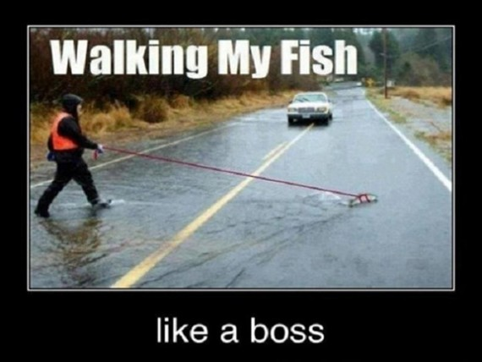

Slide 127
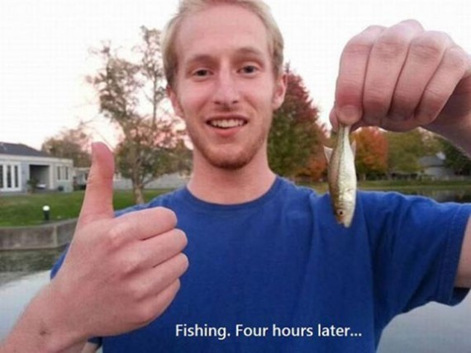

Slide 128
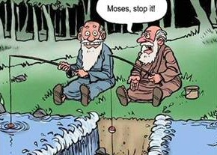

Slide 129
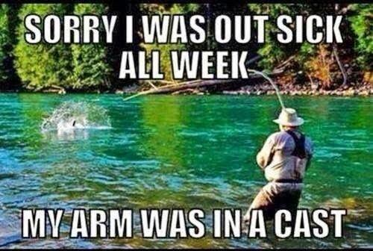

Slide 130
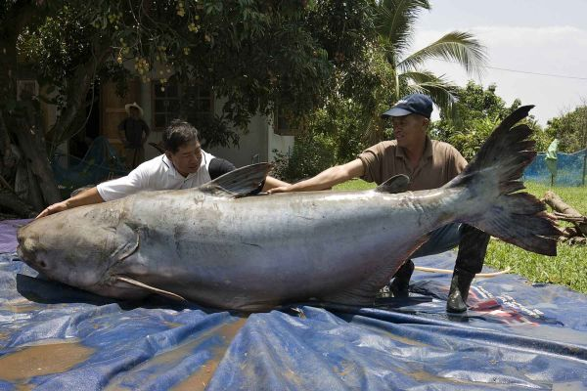


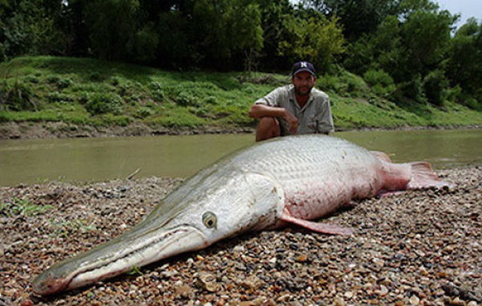

Slide 131
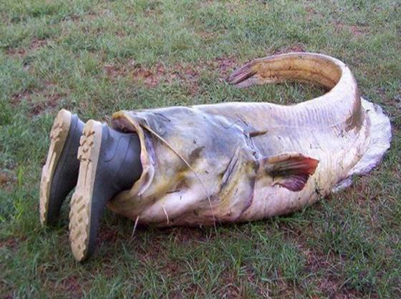

Slide 132

Fishing
Insert scripture passage
Insert scripture passage
Insert scripture passage
Insert scripture passage
Insert scripture passage
Insert scripture passage
Insert scripture passage
Find the context.
Identify the doctrine/principle.
Share a related scripture or quote.
How can this apply to us?

Slide 133
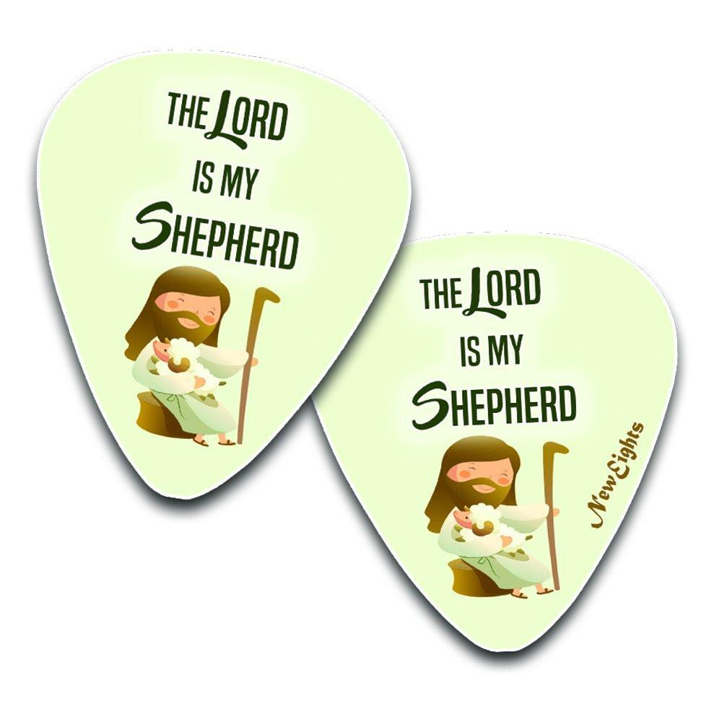
35: Pick a Verse
Teaching Templates for
The Basic Pattern Outcomes

Slide 134
PICK A VERSE
You will read chapter __________; as you read and as you come to a verse that contains a meaningful phrase, come write your name next to that verse number on the board. After everyone has read the chapter and written their name on the board, we’ll have a discussion as we walk through the chapter together. When we get to a verse that you’ve written your name next to, you’ll be asked to share what you loved about that passage (yes, more than one person can write their name next to a verse)
11.
12.
13.
14.
15.
16.
17.
18.
19.
20.
21.
22.
23.
24.
25.
26.
27.
28.
29.
30.

Slide 135

36: Digging Deeper
Teaching Templates for
The Basic Pattern Outcomes

Slide 136
Dig Deeper
The Goal is 80 Points!
You will have 10 minutes to study your assigned section. Then, each person will verbally participate to earn points for our class.
Points will be given as follows:
1 pt = Context (Why did the Lord reveal the section you studied?)
1 pt = A Powerful Principle (stated or implied) shared with the class
2 pts = An inspired question (one that must be answered with a principle)
2 pts = A response to answer another person’s inspired question
2 pts = A response to someone’s comment by adding your insight
3 pts = Sharing an experience that taught you the truth of a principle shared

Slide 137
Dig Deeper
Team 1 – Insert scripture passage Team 4 – Insert scripture passage
Team 2 – Insert scripture passage Team 5 – Insert scripture passage
Team 3 – Insert scripture passage Team 6 – Insert scripture passage
You will have 10 minutes to study your assigned section. Then, each person will verbally participate to earn points for our class.
Points will be given as follows:
1 pt = Context (Why did the Lord reveal the section you studied?)
1 pt = A Powerful Principle (stated or implied) shared with the class
2 pts = An inspired question (one that must be answered with a principle)
2 pts = A response to answer another person’s inspired question
2 pts = A response to someone’s comment by adding your insight
3 pts = Sharing an experience that taught you the truth of a principle shared

Slide 139
Teaching Philosophy
The reason behind the Teaching and Learning Pattern

Slide 140
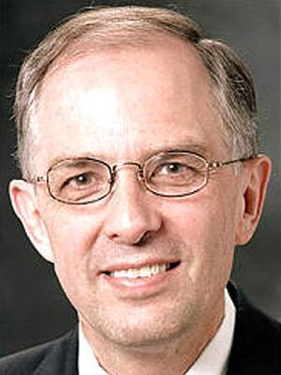

“Spiritual understanding rarely comes from a lecture. Spiritually, the classroom of faith becomes less like a lecture hall and more like a fitness center. Students do not get stronger by watching someone else do the exercises. As students learn and then participate, their spiritual strength increases. Invite students to teach and to share; encourage them to act in faith and to report on what they are learning.” (Elder Neal L Anderson, 28 February 2014 Evenimg with a General Authority).

Slide 141

There are four ways students can participate in class:
Listening to the teacher
Working alone
Working with a partner
Working within a group

Slide 142

The Role of the Learner

Slide 143
The Role of the Learner
“A sense of purpose exists in a class where teachers expect students to fulfill their role as learners and assist them in doing so and where students are trusted to contribute in significant ways…Such teachers will encourage with love and will lift their students to reach their potential as learners and disciples of Jesus Christ” (The Gospel Teaching and Learning Handbook).

Slide 144
What does C.I.U.F.A. stand for?
Context & content
Identify doctrines and principles from the block
Understand doctrines and principles from the block
Feel the importance
Apply the doctrines and principles

Slide 145
Principles and Doctrines
Story: Christ heals a blind man
Context: The Pharisees were testing Jesus’ teachings
Identify a Doctrine: Charity.
Understand a Principle: When we are kind to others, we essentially are just being kind to Christ.
Feel and Make Application: Is there anyone I should extend a hand of friendship to?

Slide 146

Doctrine: An unchanging truth of the gospel of Jesus Christ.
Modesty
Baptism
Family
Missionary Work
Fasting
Satan

Slide 147
Principle: Concentrated truth, packaged for application; “so, what should be done?”
Because my body is a temple (doctrine), I should dress modestly (principle).
Since the sacrament renews my baptismal covenant (doctrine), I should really try hard to be more obedient (principle).
The prophet has asked that youth not steady date (doctrine), so I should break up with my girlfriend and tell her I love the prophet more than her (principle)

Slide 148
Principles and Doctrines
Story: The First Vision
Context: 1820 religious excitement
Identify a Doctrine: God Speaks to Prophets.
Understand a Principle: When I obey the Prophet, I will be blessed for doing what they ask me to do.
Feel and make Application: Is there anything that the Prophet has asked me to do that I am not doing?

Slide 149
Principles and Doctrines
Story: Jesus Fasts for 40 Days
Context: Jesus is in the desert for 40 days to be with God
Identify a Doctrine: Fasting.
Understand a Principle: When we fast, we learn to control our bodies and this helps us gain protection against Satan.
Feel and Make Application: What should I fast for next Fast Sunday?

