Slide 1
St. PatRick

Slide 2
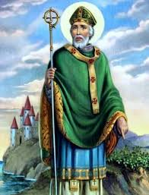
WHAT DO YOU KNOW ABOUT ST. PATRICK?
List Everything You Know
Compare Lists

Slide 3
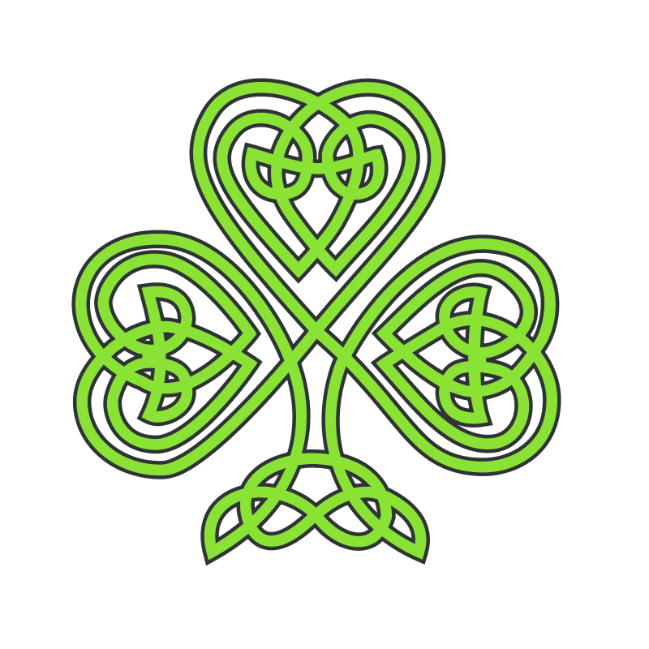
ST. PATRICK FUN FACTS
March 17th is when Patrick died.
St. Patrick wasn't Irish.
St. Patrick was a slave.
Legend says St. Patrick drove all the snakes from Ireland.
The original St. Patrick's day color is blue not green.
The Shamrock is not the symbol of Ireland.
There are more Irish in the USA than Ireland.
St. Patrick's was a ‘dry’ holiday in Ireland until 1970.
http://www.catholic.org/news/saints/story.php?id=45045

Slide 4
Who Was St. Patrick?
St. Patrick, the patron saint of Ireland, is one of Christianity’s most widely known figures. But his life remains somewhat of a mystery. Many of the stories traditionally associated with St. Patrick, including the famous account of his banishing all the snakes from Ireland, are false, the products of hundreds of years of exaggerated storytelling.
(https://www.history.com/topics/st-patricks-day/who-was-saint-Patrick)

Slide 5
ST. PATRICK
It is known that St. Patrick was born in Britain to wealthy parents near the end of the fourth century. He is believed to have died on March 17, around 460 A.D. At the age of 16, Patrick was taken prisoner by a group of Irish raiders who were attacking his family’s estate. They transported him to Ireland where he spent six years in captivity. During this time, he worked as a shepherd, outdoors and away from people. Lonely and afraid, he turned to his religion for solace, becoming a devout Christian.
(https://www.history.com/topics/st-patricks-day/who-was-saint-Patrick)

Slide 6
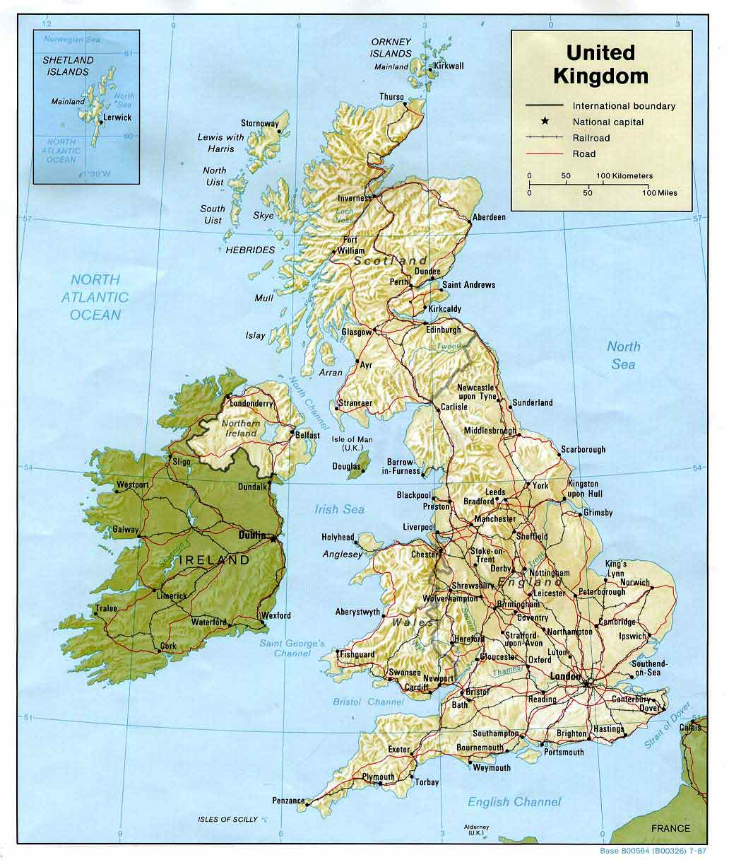
ST. PATRICK
After more than six years as a prisoner, Patrick escaped. According to his writing, a voice—which he believed to be God’s—spoke to him in a dream, telling him it was time to leave Ireland.
To do so, Patrick walked nearly 200 miles to the Irish coast and experienced a second revelation—an angel in a dream told him to return to Ireland as a missionary. Soon after, Patrick began religious training that lasted more than 15 years. After his ordination as a priest, he was sent to Ireland on a mission.
(https://www.history.com/topics/st-patricks-day/who-was-saint-Patrick)

Slide 7
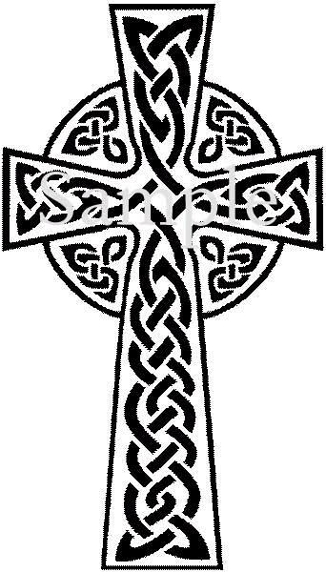
ST. PATRICK
Familiar with the Irish language and culture, Patrick chose to incorporate traditional ritual into his lessons of Christianity. For instance, he used bonfires to celebrate Easter since the Irish were used to honoring their gods with fire. He also superimposed a sun, a powerful Irish symbol, onto the Christian cross to create what is now called a Celtic cross. (https://www.history.com/topics/st-patricks-day/who-was-saint-Patrick)

Slide 8
ST. PATRICK
St. Patrick often used shamrocks to explain the Holy Trinity and entire kingdoms were eventually converted to Christianity after hearing his message.

Slide 9
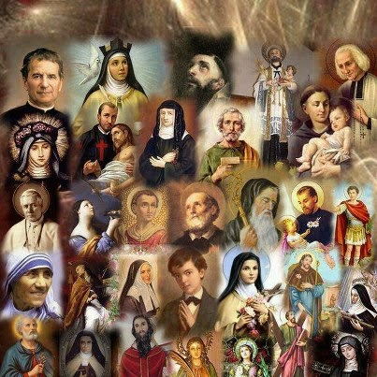
How do Catholics Define Saints?
The Catholic Church believes that saints are ordinary and typical human beings who made it into heaven, human beings who lived holy lives in obedience to God's will and are now in heaven for eternity.

Slide 10
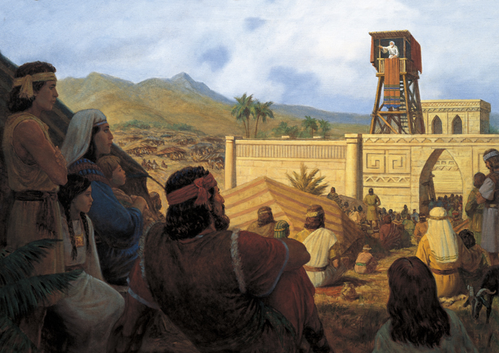
How do Mormons Define Saints?
Bible Dictionary: The word saint is a translation of a Greek word also rendered “holy,” the fundamental idea being that of consecration or separation for a sacred purpose; but since what was set apart for God must be without blemish, the word came to mean “free from blemish.” (see Acts 9:13, 32, 41; Rom. 1:7; 1 Cor. 1:2; Philip. 1:1; 1 Pet. 1:14–15).

Slide 11
Do Catholics & Other Christians Pray To Saints?
The historic Christian practice of asking our departed brothers and sisters in Christ—the saints—for their intercession dates to the earliest days of Christianity and is shared by Catholics, Eastern Orthodox, the other Eastern Christians, and even some Anglicans—shared by more than three quarters of the Christians on earth.
In addition to our prayers directly to God and Jesus (which are absolutely essential to the Christian life), there are abundant reasons to ask our fellow Christians in heaven to pray for us. The Bible indicates that they are aware of our prayers, that they intercede for us, and that their prayers are effective (else they would not be offered). It is only narrow-mindedness that suggests we should refrain from asking our fellow Christians in heaven to do what we already know them to be anxious and capable of doing.
www.catholic.com

Slide 12
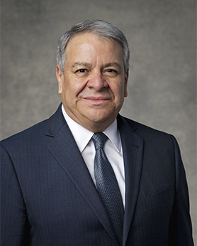
NEW TESTAMENT SAINTS
We read in the New Testament that the members of the Church of Jesus Christ were called Christians for the first time in Antioch (see Acts 11:26), but they called each other Saints. How stirring it must have been for them to hear the Apostle Paul call them “fellow citizens with the saints, and of the household of God” (Ephesians 2:19) and also say they were “called to be saints” (Romans 1:7; emphasis added).
To the degree that members of the Church live the gospel and follow the counsel of the prophets, they will, little by little and even without noticing it, become sanctified. Humble members of the Church who conduct daily family prayer and scripture study, engage in family history, and consecrate their time to worship in the temple frequently, become Saints. They are those who are dedicated to creating eternal families. They are also those who set apart time from their busy lives to rescue those who have become alienated from the Church and encourage them to return and sit at the Lord’s table. They are those elders and sisters and mature couples who respond to a call to serve as the Lord’s missionaries. Yes, my brothers and sisters, they become Saints to the degree that they discover that warm and wonderful feeling that is called charity, or the pure love of Christ (see Moroni 7:42–48).
Benjamín De Hoyos Of the Seventy April 2011, General Conference

Slide 13
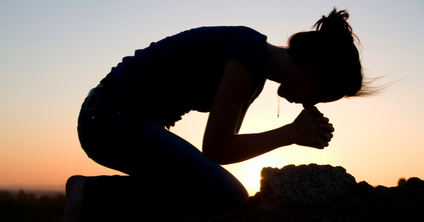
Do Mormons Pray to or Worship Saints?
To whom do we pray?
Do we worship past prophets, apostles or Joseph Smith?

Slide 14
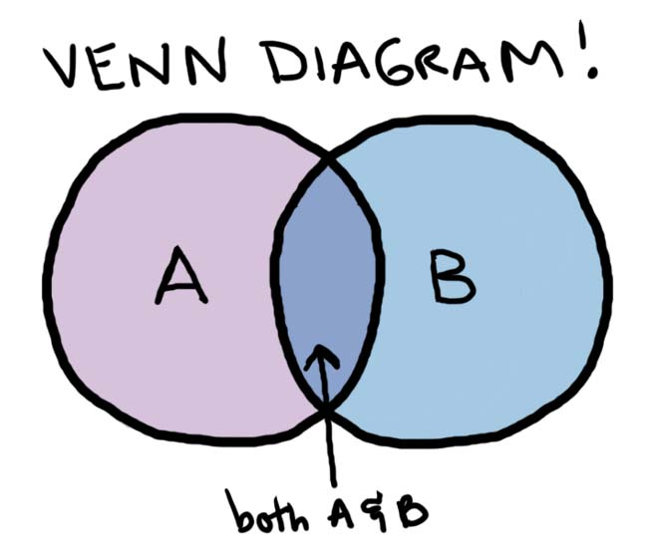
Are Mormons & Catholics Similar In Beliefs About Saints/Angels?
Both religions acknowledge that God may sometimes work through deceased holy persons, now angels, in order to answer prayers or intervene on behalf of God’s children. These are worthy of veneration but not worship. According to both faiths, whatever that intervening being brings or does, it is only a manifestation of the Father’s power and will. It is never to be connected with the power or will of God’s angelic representative. (ldsmag.com/article-1-4082)

