Slide 1
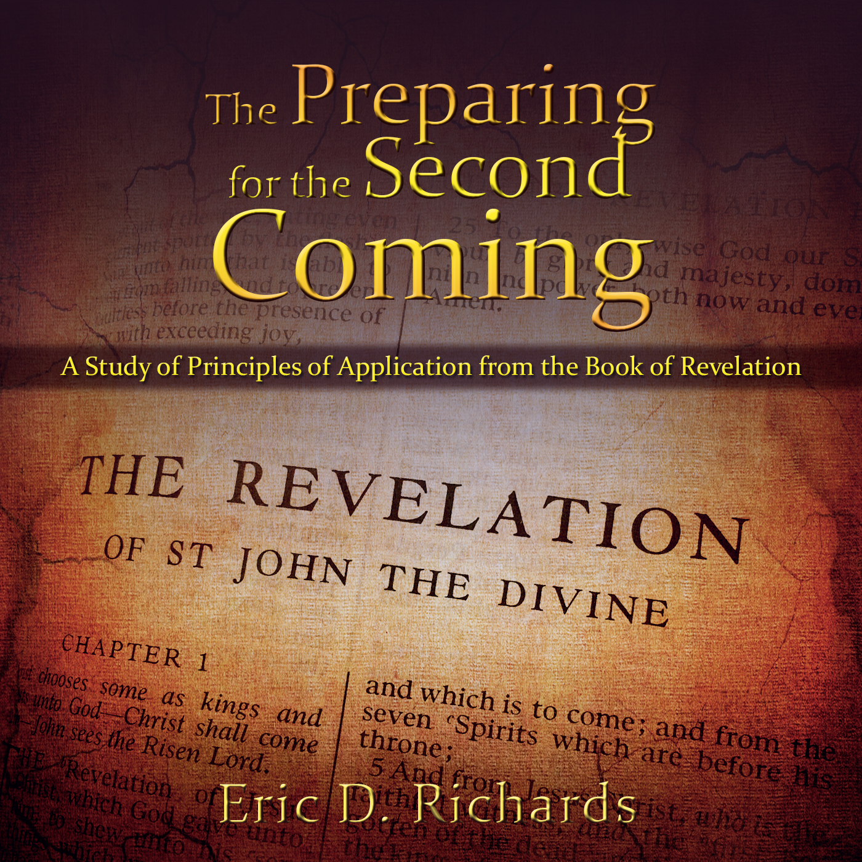
The Book of Revelation:
Preparing for
The Second Coming

Slide 2
Chapter 8
Six Judgments

Slide 3
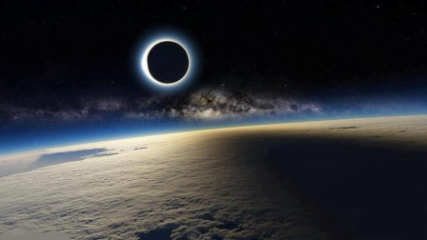
The Sixth Seal
Revelation 8:1
"What is meant by the half hour of silence has not yet been revealed. If it is to be reckoned on the basis of "the Lord's time" of 1000 years to a day, the duration would be some 21 of our years." (Bruce R. McConkie, Doctrinal New Testament Commentary, 3 vols. [Salt Lake City: Bookcraft, 1965-1973], 3: 499.)

Slide 4
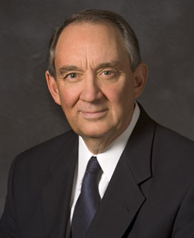
What if the answer doesn’t ‘fit’?
Some of you struggle with certain doctrines or practices of the Church, past or present; they just don’t quite seem to fit for you. I say, so what? That’s okay. You’re still young. Be patient, but be persistent. Keep studying them, thinking about them, and praying about them. Everyone has questions. I suppose even the prophets themselves had and have some questions. But don’t throw away the jewels you do have in the meantime. Hold on to them; build on them.
Did you know that the two greatest intellectual achievements of the first half of the last century (the General Theory of Relativity and Quantum Mechanics) are in some points in conflict with each other? They cannot both be right in every detail. Yet scientists rely on both of these theories every day to advance scientific knowledge, knowing that someday the differences will be understood, reconciled, and corrected.

Slide 5
What if the answer doesn’t ‘fit’?
Like the scientist who uses relativity and quantum mechanics, we do not discard the gospel or our testimony because not every piece “fits” today.
Years ago a Church leader used the following metaphor: Have you ever watched a stonemason build a rock wall? He will sometimes pick up a rock that just does not fit anywhere in the niches in the wall. But does he abandon the wall and walk away? No, he simply sets the rock aside and keeps building until a niche appears where it fits and then proceeds until the wall is finished. So perhaps should we temporarily set aside questions that we continue to struggle with and that we cannot quite seem to answer today, having faith that at sometime in the future a niche will appear in the rock wall of our testimony where they fit perfectly.

Slide 6
What if the answer doesn’t ‘fit’?
“Don’t abandon the rock wall of your testimony because one or two rocks don’t seem to fit.”
(Elder Richard G Hinckley, 15 May 2007 BYU Devotional).
In what ways can silence be a blessing?

Slide 8
Her thoughts?
Did he hear me?
Should I repeat my question?
Is he paying attention to me?
Am I not good enough for him?
Am I not asking correctly?
Am I not using the right language?
Is there some secret code I don’t know?
Is he pre-occupied?
What is his problem?
Does he not love me and my daughter like he seems to love everyone else?

Slide 9
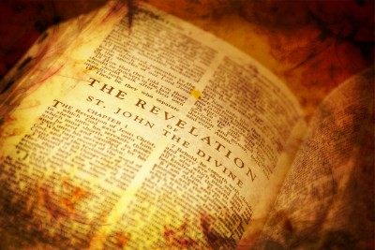
Application for Preparation
Are you faithful when the Lord is silent?

Slide 10
LIST Scriptural Instruments
The Trumpet
War
Assemble (Numbers 10:1-10)
Feast of Trumpets (Leviticus 23:24; Numbers 29:1) celebrating Joseph’s release from prison in Egypt
Walls of Jericho (Joshua 6:4-20).
Second Coming (Joel 2:1; Zechariah 9:14-16)
The resurrection from the dead (I Corinthians 15:52; I Thessalonians 4:16).

Slide 11
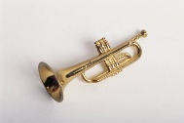
Trumpets Revelation 8:2-12; 9:1-2, 13-16
Hail and fire mingled with blood, destroying plants (Revelation 8:7)
A great burning mountain (volcanos?) is cast into the sea (Revelation 8:8-9)
1/3 of fresh water (Revelation 8: 10-11)
WORMWOOD: Bitter herb
1/3 of heavenly bodies turn dark (Revelation 8:12)
5-month battle (Revelation 9:1-2)
13-month war [Armageddon] (Revelation 9:13-16)
D&C 77:12
D&C 88:88-89

Slide 12
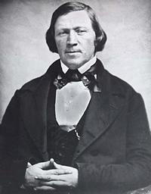
The Sixth Seal
“When the testimony of the Elders ceases, the Lord will say to them, "Come home; I will now preach my own sermons to the nations of the earth." All you know the sermon that will be preached with fire and sword, tempests, earthquakes, hail, rain, thunders and lightnings and fearful destruction. You will hear of magnificent cities, now idolized by the people, sinking in the earth,. The sea will heave itself beyond its bounds, engulfing mighty cities. Famine will spread over the nations, and nation will rise up against nation, kingdom against kingdom, and states against states” (Brigham Young, Journal of Discourses 8:123).

Slide 13
What to avoid to AVOID THE DESTRUCTION
“Many gospel principles come in pairs, meaning one is incomplete without the other (agency and responsibility; mercy and justice; faith and works, etc).
When Satan is successful in dividing doctrinal pairs, he begins to wreak havoc upon mankind. One of Satan’s most crafty strategies isn’t a frontal attack on our agency but a sneaky backdoor assault on responsibility. Without responsibility, every good gift from God could be misused for evil purposes.
For example, freedom of speech without responsibility can be used to create and protect pornography. The rights of a woman can be twisted to justify an unnecessary abortion.
With negative consequences removed, you now have agency unbridled, as if there were no day of reckoning…
SHARE EXAMPLES OF THIS FROM THE SCRIPTURES…

Slide 14
What to avoid to AVOID THE DESTRUCTION
1 Samuel 15:21
1 Nephi 3:31
Alma 1:3–4
Moses 4:14
2 Samuel 12:9, 12
Jonah 1:3
Alma 39:3
1 Samuel 15:13–14
1 Samuel 15:23
Numbers 14:2
1 Nephi 3:28
1 Nephi 18:10–11
1 Nephi 17:17–18
1 Nephi 17:21
Helaman 13:38
Matthew 25:25–26
1 Samuel 2:29
One word to summarize

Slide 15
CASE STUDY
August 2017 BYU Education Week Elder Robbins
https://speeches.byu.edu/talks/lynn-g-robbins_be-100-percent-responsible/

Slide 16
Application for Preparation
Do you take responsibility?
Do you repent quickly?

Slide 17
Trumpets in Revelation 8-9
The Seventh Angel: Christ Comes
Revelation 8:13
Three Woes
Battles at the time of Adam Ondi Ahman (Rev. 9:1-12.)
The final great war (Armageddon) (Rev. 9:12-21; 10; 11:1-14.)
The destruction of the wicked when Christ appears to the World (Bruce R. McConkie, The Millennial Messiah, 381-387.)

Slide 18
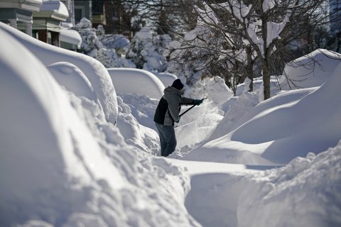
Great or Dreadful?
Notes:
I hate winters in Utah. I don’t snow ski or snow board or ice skate. Our first Christmas in Utah it was -26 degrees when we pulled out of our garage heading to San Diego. I’ve been miserable each winter. I don’t like winter. I dread it each year. Let’s say my boss offered me a three week all expenses paid vacation to Hawaii once the temperatures stayed below freezing for 10 consecutive days. How would my attitude and demeanor about winter change with this offer from my employer? I’d check the weather each day, hoping for cold so I could get my trip in. My feelings about winter and the cold haven’t changed, but because of his promises, my attitude and approach have changed dramatically. The Second Coming

Slide 19
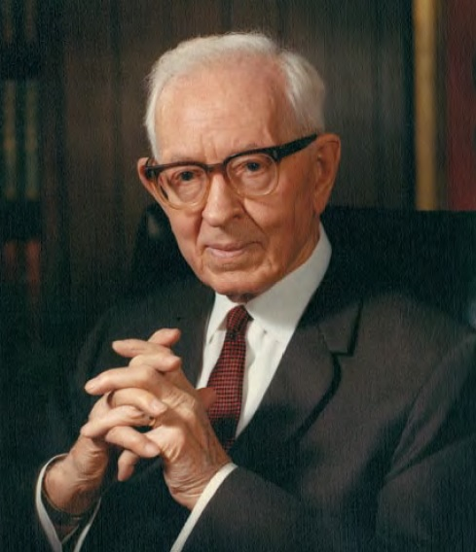
“I know these are unpleasant things. Don't you think the Lord has given us these things that we might know and we might prepare ourselves through humility, through repentance, through faith, that we might escape from these dreadful conditions that are portrayed by these ancient prophets? So I pray everyday of my life that the Lord will hasten His work; I am praying for the end of the world because I want a better world. I want the coming of Christ. I want the reign of peace. I want the time to come when every man can live in peace and in the spirit of faith, humility and prayer.” (Joseph Fielding Smith, Signs of the Times [Salt Lake City: Deseret Book Co., 1952], 132, 148-49.)

Slide 20
The Book of Revelation:
Preparing for
The Second Coming

