Slide 1
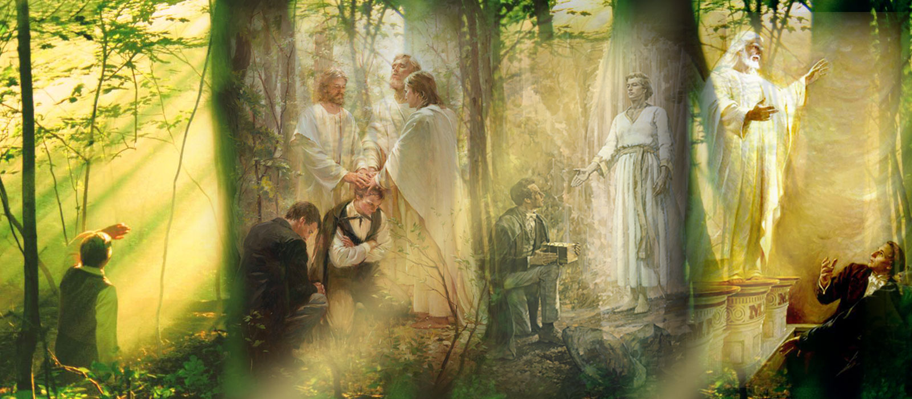
The Apostasy
6th Seal Events

Slide 2
The Great Apostasy
“After the deaths of the Savior and His Apostles, men corrupted the principles of the gospel and made unauthorized changes in Church organization and priesthood ordinances. … “During the Great Apostasy, people were without divine direction from living prophets. Many churches were established, but they did not have priesthood power to lead people to the true knowledge of God the Father and Jesus Christ …This apostasy lasted until Heavenly Father and His Beloved Son appeared to Joseph Smith in 1820 and initiated the restoration of the fullness of the gospel” (True to the Faith: A Gospel Reference[2004], 13).

Slide 3
APOSTASY OR RESTORATION EVENTS
0 Christ born
Began ministry
Crucified
33 Apostles taught
42 Peter Ordains Bishop Linus (Catholic lineage)
Paul returns to Rome and finds apostacy under Linus’ rule (see Romans 1) and ordains a new leader (another man named Linus; see 2 Tim 4:21)
70 Romans destroy Jerusalem (Jews dispersed)
76 Linus formally established Roman Catholic church and is killed

Slide 4
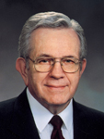
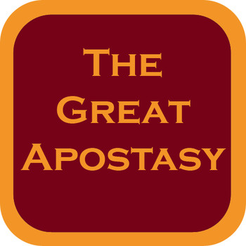
“James was killed in Jerusalem by Herod. Peter and Paul died in Rome. Tradition holds that Philip went to the East. Much more than this we do not know.
“They scattered; they taught, testified, and established the Church. And they died for their beliefs, and with their deaths came the dark centuries of apostasy.
“The most precious thing lost in the Apostasy was the authority held by the Twelve—the priesthood keys. For the Church to be His Church, there must be a Quorum of the Twelve who hold the keys and confer them on others” (“The Twelve,” Ensign or Liahona, May 2008, 84).

Slide 5
APOSTASY OR RESTORATION EVENTS
180 Irenaeus – Infant Baptism
312 Contantine has vision of a cross above the sun bearing the words, ‘Conquer by This.’
Constantine holds council at Nicea
382 Vulgate (Jerome – Latin translation of the Bible)
Second Nicean Council - Saint Worship
Pope Joan (?)
1095 First Crusade (Pope Urban) ‘Salvation for success’ (200,000 died in 9 crusades)
1100 Great Schism

Slide 6
“As the centuries passed, the flame flickered and dimmed. Ordinances were changed or abandoned. The line was broken, and the authority to confer the Holy Ghost as a gift was gone. The Dark Ages of apostasy settled over the world” (“The Cloven Tongues of Fire,” Ensign, May 2000, 8).
http://www.christianity.com/church/church-history/timeline/1601-1700/story-behind-king-james-bible-11630052.html

Slide 7
APOSTASY OR RESTORATION EVENTS (con’t)
Pope Innocent III – Indulgences
Renaissance
1390 John Wycliff (Latin Bible to English)
1455 Guttenberg
Columbus
1505 William Tyndale (Greek/Hebrew Bible to English)
1515 Martin Luther
1523 Martin Luther excommunicated
1534 Henry VIII – Episcopalian Church
John Calvin - Presbyterians
John Knox – Puritans

Slide 8
APOSTASY OR RESTORATION EVENTS (con’t)
1611 King James (English bible)
Puritans move to Boston
1776 Revolutionary War
1783 U.S. Constitution
1805 Joseph Smith born
First Vision
1830 The Church is Restored

Slide 9
Acts 5:42
And daily in the temple, and in every house, they ceased not to teach and preach Jesus Christ.

Slide 10
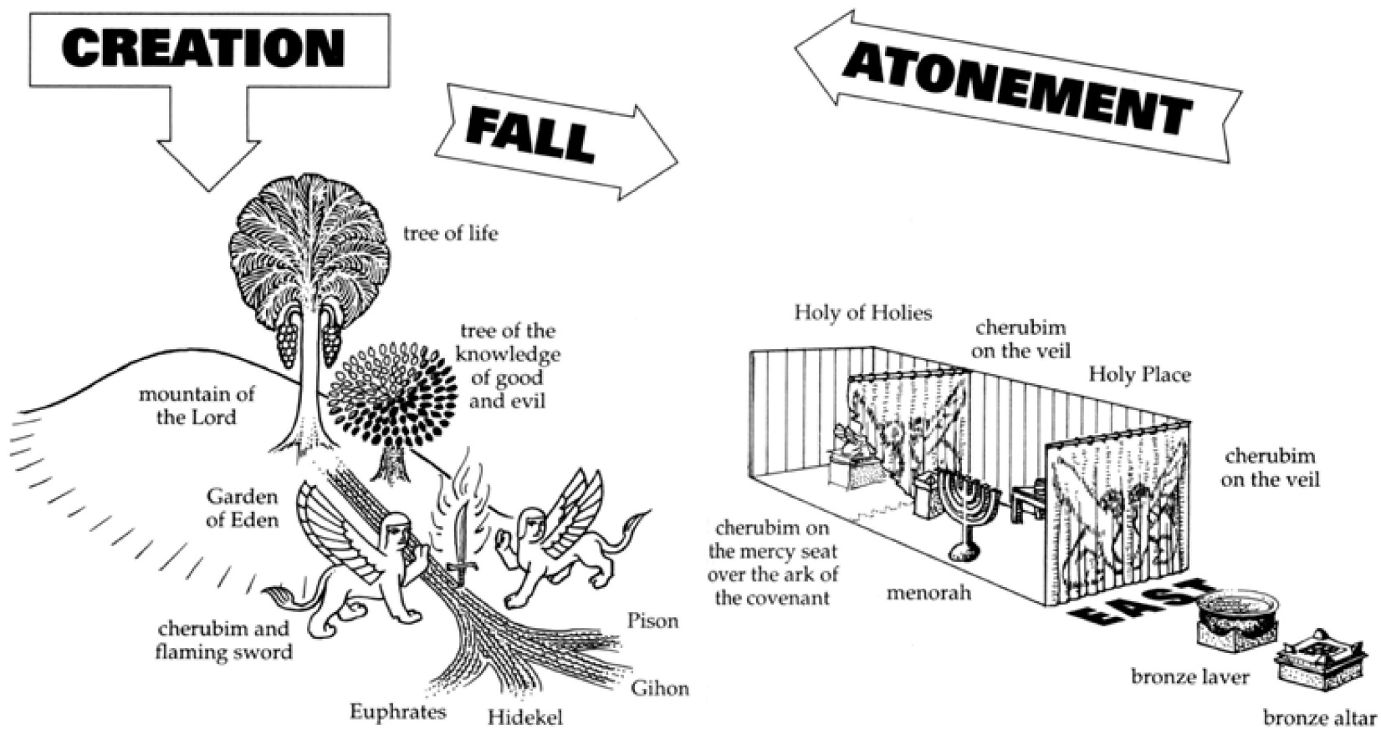
Where do you ‘see’ the temple?

Slide 11
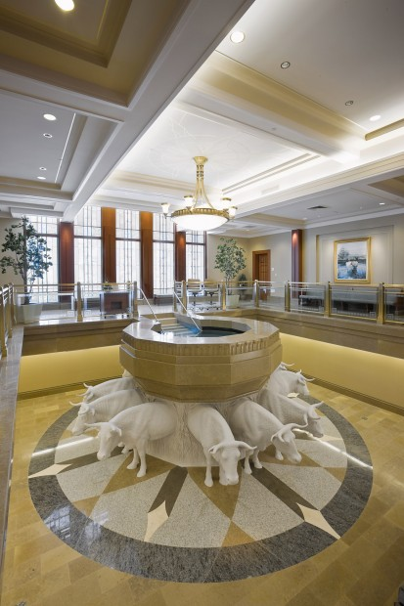
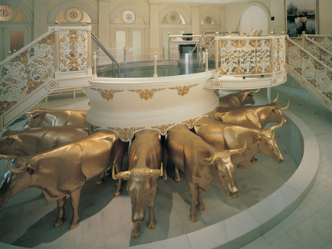
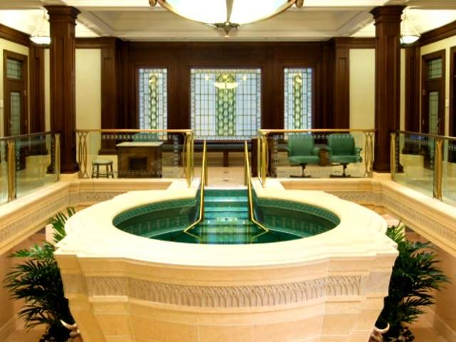
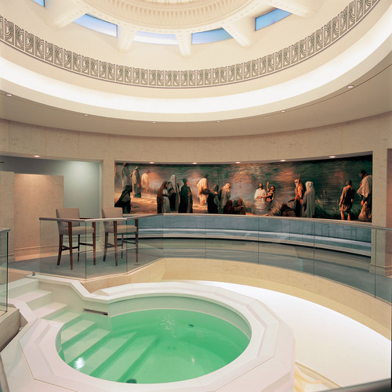
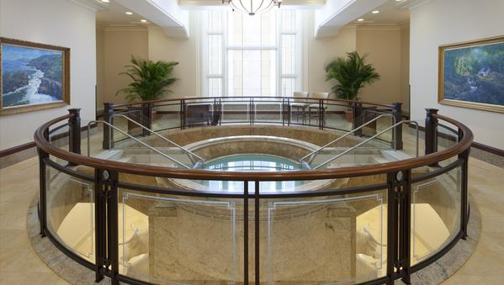
Salt Lake Temple Font
Gilbert Temple Font
Draper Temple Font
Trujillo Peru Temple Font
Copenhagen Denmark Temple Font

Slide 12
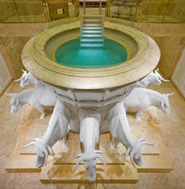
Baptismal Font Symbols
The Font placed below ground
The death and resurrection of the recipient of this ordinance.
The Ox
The symbol of the tribe of Joseph.
The Font resting on the backs of Oxen
The burden has been laid upon the birthright tribe of Joseph.

Slide 13
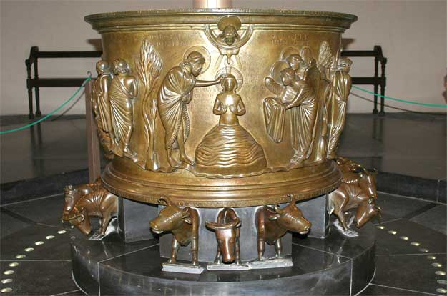
Belgium, St. Barhélemy of Renier de Huy (11th Century)

Slide 14
Why are the Catholic bishops so concerned about Mormons baptizing the dead? The Mormons didn’t invent baptism of the dead. The practice has a significant history within mainstream Christianity.
What’s the difference, anyway, between baptizing the dead and baptizing babies? A tiny infant will have as much understanding as a dead person — none at all. Indeed, given that all Christian Churches believe that the soul lives on after death, doesn’t it make more sense to baptize dead adults than live babies?
Apart from which, if the Catholic bishops hold that the beliefs of the Mormons are pure baloney and their rituals meaningless, how can it matter to them what mumbo-jumbo Mormons might mutter?
Interestingly, a clear trace of baptism of the dead has lingered in official practice to the present day, in the form of prayers for divine intercession on behalf of the unbaptized souls. The radical Corinthians and the Marcionites were especially energetic baptizers of the dead. The Synods of Hippo (393AD) and Carthage (397AD) voted, after bitter debate, to condemn the practice.

Slide 15
Whether Hinduism, Presbyterian, Jainism, Judaism, Islam, Catholicism or whatever is the true religion, what if it’s Mormonism? What if it’s an everyday occurrence on the other side that Catholics and Protestants are left standing dumbstruck at the Gates, gasping: “Mormons! Who’d have believed it?” And maybe a wife berating her husband: “There! I told you it would be the Mormons! But would you listen?! Now it’s eternal hellfire for the two of us, I hope you’re satisfied.”
In that scenario, shouldn’t all members of all other religions be literally eternally grateful to the Mormons for sharing their saving grace even unto and after death?
If, on the other hand, it isn’t the Mormons at all, those who turn out to have been right can wave a merry farewell to the followers of Brigham Young as they trundle downwards to their eternal doom.
http://www.belfasttelegraph.co.uk/opinion/columnists/eamonn-mccann/eamonn-mccann-what-if-mormons-are-right-and-catholics-and-protestants-wrong-28532064.html

Slide 16
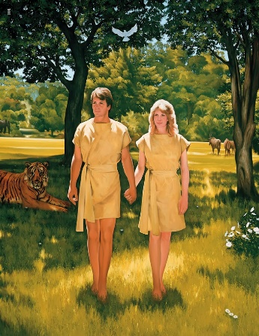
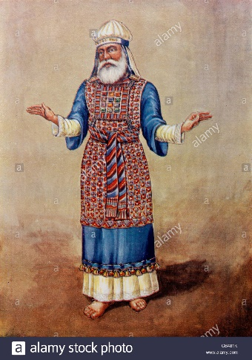
Temples are places of preparation and protection

Slide 17
https://www.youtube.com/watch?v=SkTz_NQqKA8
Temple Garments

Slide 18
Isaiah 56:5
Adam was given the responsibility of naming the animals (see Gen. 2:19–20).
In receiving Eve as his wife, Adam named her. (See Gen. 3:20.)
God himself, “blessed them, and called their name Adam.” (Gen. 5:2.) Abram’s name changed to Abraham. (See Gen. 17:5.)
Jacob’s name changed to Israel (See Gen. 35:10.)
At baptism, we take upon ourselves the name of Christ, and that becomes the name by which we are called. (See Mosiah 5:7–12.)
The higher covenants of the temple also involve the giving and receiving of names.
The one giving the name assumes responsibility for protecting, loving, and nurturing the one receiving the new name. And the recipient of the name, in turn, is to honor the name-giver and follow his counsel.

Slide 19
“By partaking of the sacrament we witness our willingness to participate in the sacred ordinances of the temple... When we witness our willingness to take upon us the name of Jesus Christ, we are signifying our commitment to do all that we can to achieve eternal life in the kingdom of our Father. We are expressing our determination to strive for exaltation in the celestial kingdom.” (Elder Oaks, Taking Upon the Name of Christ, April 1985 General Conference)

Slide 20
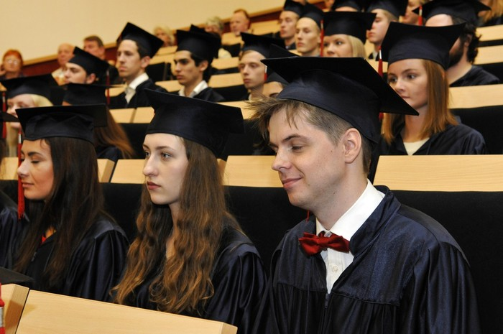
MATRICULATION CEREMONIES
The students gather outside the door, dressed in robes and caps, while their professors gather within
One student knocks with a gavel on the door to announce her presence
The head officiator asks who is there
The student outside responds that she represents every woman, a vicarious voice for all
The officiator asks what is sought
The student says she seeks to awaken the spirit and dedicate her life to knowledge that can only be found within the institution of higher knowledge
The officiator allows the student to enter, noting that all others who seek to follow the same path may also enter

Slide 21
https://www.youtube.com/watch?v=8wFtkDf9-dI

Slide 23
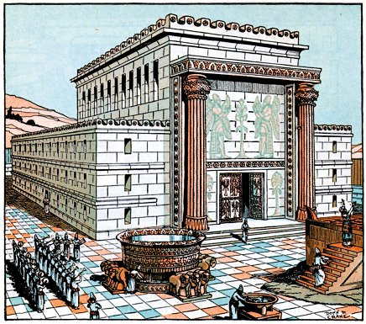
Solomon’s Temple
Alma 42:24
Female
Symbol of Mercy
Male
Symbol of Justice
Preparatory Gospel
Aaronic Priesthood
Laws of Justification
1st Commandment in the Law
Priests
First and Second Death
Jachin
Boaz
Crowning Gospel
Melchizedek Priesthood
Laws of Sanctification
2nd Commandment in the Law
Kings
First & Second Comforter
Revelation 1:5-6

Slide 24
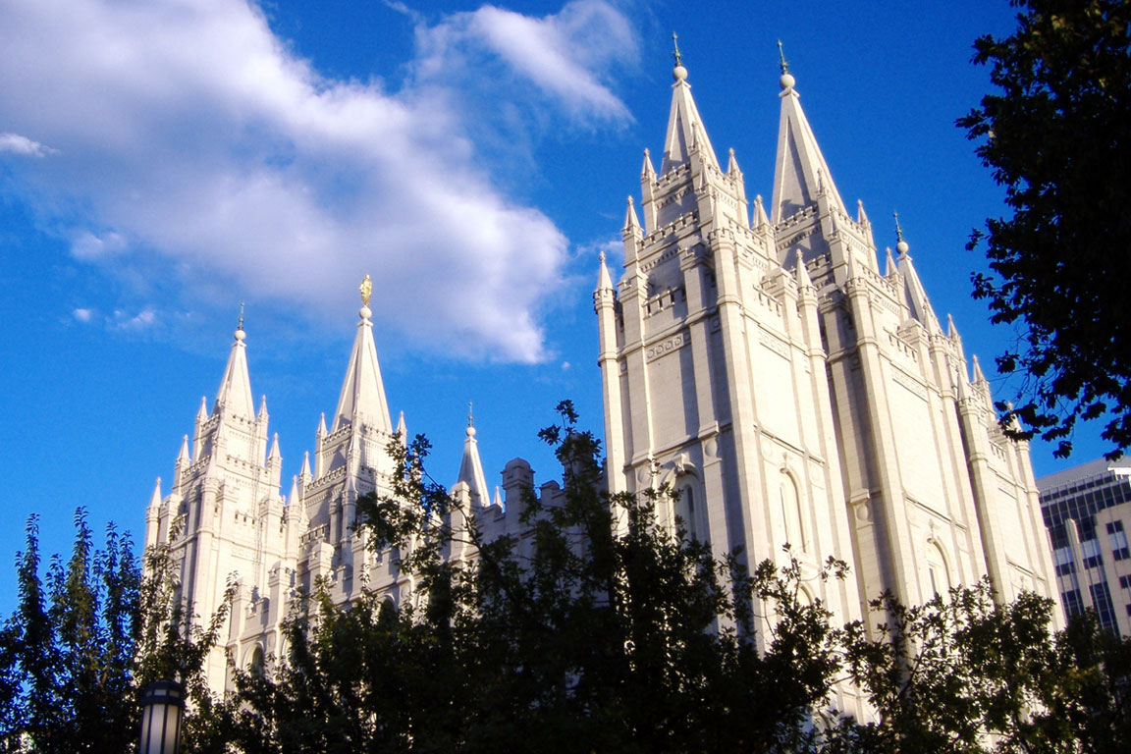
The three West towers represent the Presiding Bishopric
(Aaronic Priesthood)
The twelve pinnacles represent the High Council.
The three East towers represent the 1st Presidency (The Melchizedek Priesthood)
The twelve pinnacles represent the Twelve Apostles.

Slide 25
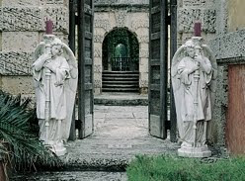
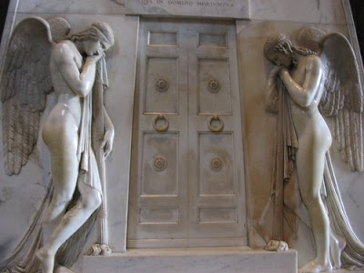
Eve – Physical Death
Adam – Spiritual Death
“Because Adam and Eve had eaten the fruit, their physical condition changed. As God had promised, they became mortal. They and their children would experience sickness, pain, and physical death. Because of their transgression, Adam and Eve also suffered spiritual death. This meant they and their children could not walk and talk face to face with God.” (Gospel Principles Manual, Chapter 6)

Slide 27
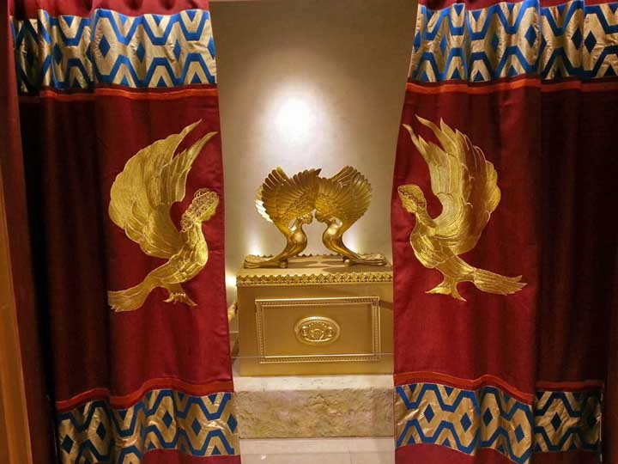
The Veil
Moses was instructed to place a veil over the ark of the covenant. (See Exodus 40:1-3.)
Hebrews 10:19-20
What is the veil and how can we have it removed?
Ether 3:19-20
Ether 4:15

Slide 28
The Veil
Moses was instructed to place a veil over the ark of the covenant. (See Exodus 40:1-3.)
“Some in the Church have erroneously concluded that somehow that veil is automatically removed at the time of physical death; and at the time of physical death that we automatically remember everything that took place in our pre-earthly existence. The fact of the matter is, the scriptures and the prophets do not teach that.” (Daniel H. Ludlow, 1995 Ricks College devotional, (former director of the Correlation Department).
““The veil of forgetfulness of the first estate apparently will not be suddenly, automatically, and totally removed…” (Elder Neal A. Maxwell, The Promise of Discipleship [2001], 119, 122, quoted in Family History Student Manual Chapter 9).”

Slide 29
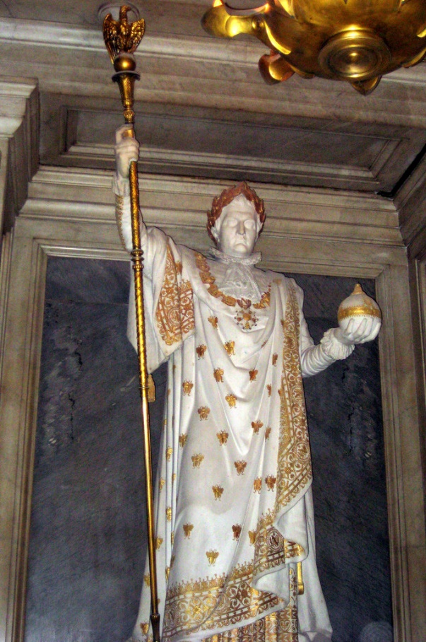
Consecrated oil laid upon the altar
Clergy dress in liturgical robes and miters
Psalm 122:1–2 is read: “I was glad when they said unto me: We will go into the house of the Lord. Our feet shall stand in thy gates: O Jerusalem.”
Administration of an oath, including questions and affirmative responses
Queen kneels at the altar, laying her right hand on the Bible and promising faithfulness.
The leading clergy prays for clean hearts, granting wisdom to the queen, coming into the kingdom through Christ, submitting to ordinances, and prayers of incense with uplifted hands are spoken.
The Archbishop says, “O Lord and heavenly Father who, by anointing with Oil, didst make and consecrate kings, priests, and prophets, to teach and govern thy people Israel…”

Slide 30
The Queen approaches the altar and is anointed and clothed in new robes and girdle.
An orb, a scepter, a ring or key, and the crown are given.
“The Princes and Princesses, the Peers and Peeresses shall put on their coronets and caps, and the trumpets shall sound, and by a signal given, the great guns at the Tower shall be shot off…”
The Archbishop approaches the queen, kneels, places his hands between the Queen’s, and with everyone else repeating and audibly replacing his name with their own, says “I, (name) will be faithful and true to you, our Sovereign Lady, Queen of this Realm and Defender of the Faith, and unto your heirs and successors according to law. So help me God.”

Slide 31
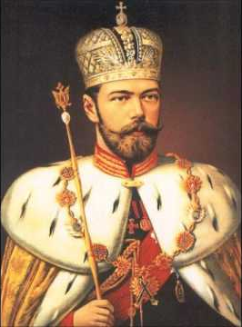
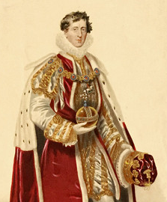
● Scepter - temporal power ● Orb - spiritual power ● Ring (or key) – Seal, bind, decree ● Crown - royal honor

Slide 32
Isaiah 22:20-25
“I will clothe him with thy robe, and strengthen him with thy girdle, and I will commit thy government into his hand: and he shall be a father to the inhabitants of Jerusalem, and Judah.
The key of the house of David will I lay upon his shoulder.”

Slide 33
Leviticus 16:17
And there shall be no man in the tabernacle of the congregation when he goeth in to make an atonement in the holy place, until he come out, and have made an atonement...

Slide 34
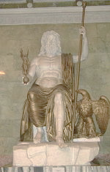
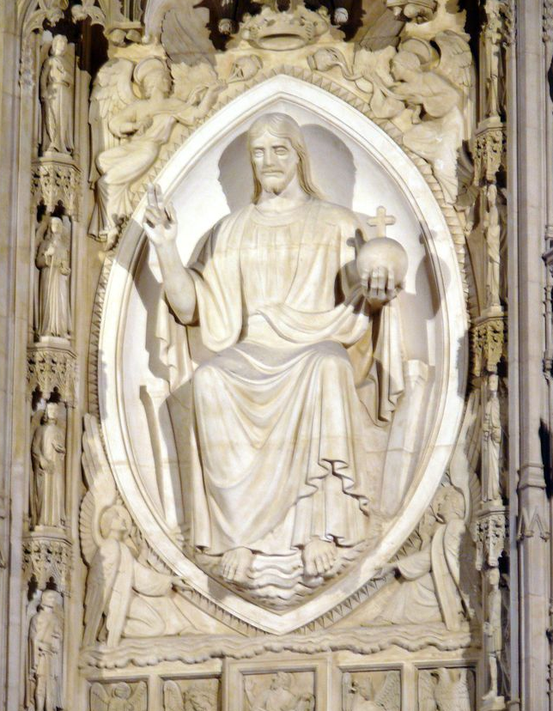
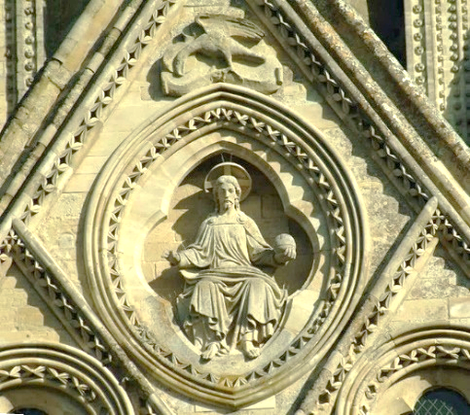
Regensburg Cathedral
Statue of Jupiter
Cathedral of Salsbury
US National Cathedral

Slide 35
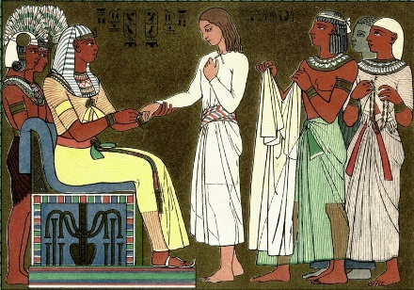
Joseph – Pharoah’s ring Seal of Faith : Sealing of Secrets

Slide 36
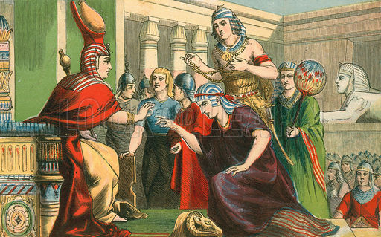
Joseph – Pharoah’s ring Seal of Faith : Sealing of Secrets

Slide 37
Genesis 41:38-45 Pharaoh makes him ruler of all Egypt—Joseph marries Asenath—Asenath bears Manasseh and Ephraim
And Pharaoh took off his ring from his hand, and put it upon Joseph’s hand, and arrayed him in vestures of fine linen, and put a gold chain about his neck;
And they cried before him, Bow the knee:

Slide 38
Luke 15:11-23 Jesus gives the parables of the lost sheep, the piece of silver, and the prodigal son
But the father said to his servants, Bring forth the best robe, and put it on him; and put a ring on his hand, and shoes on his feet: And bring hither the fatted calf, and kill it; and let us eat, and be merry:

Slide 39
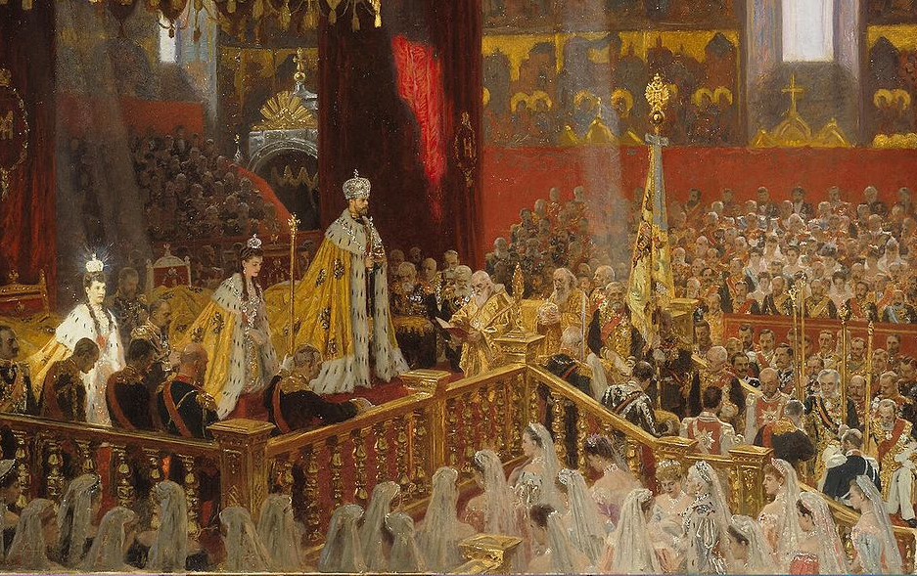
Coronation Nicholas II – Czar of Russia

Slide 40
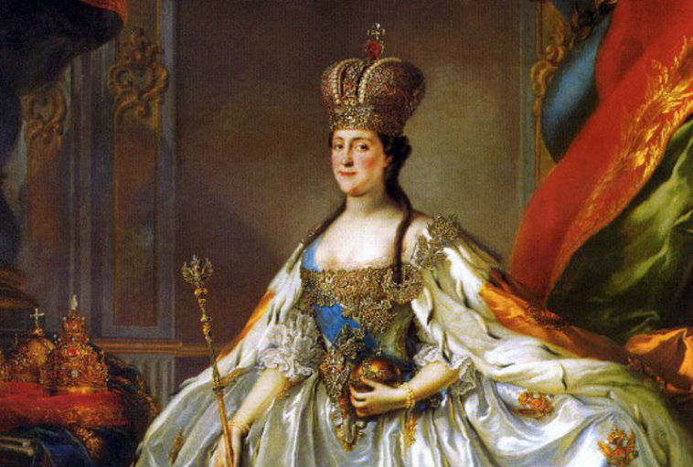
Completion of Catherine the Great

Slide 41
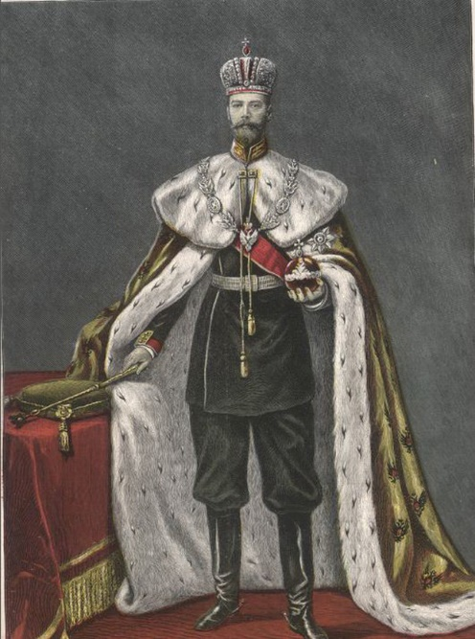
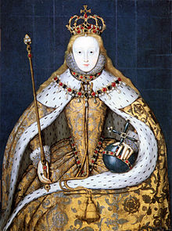
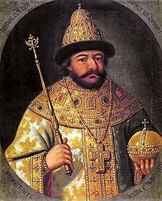
National Cathedral

Slide 42
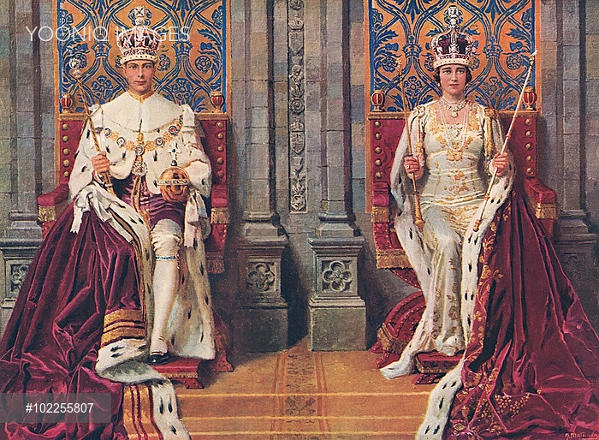
King George VI and Queen Elizabeth

Slide 43
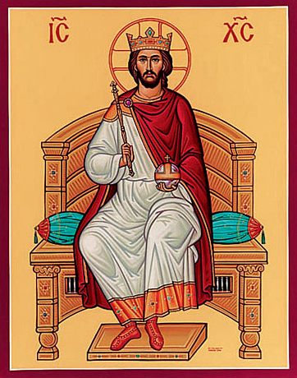
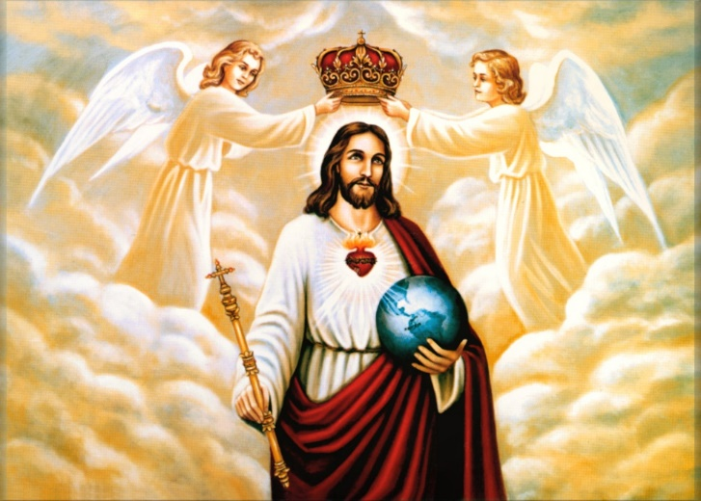
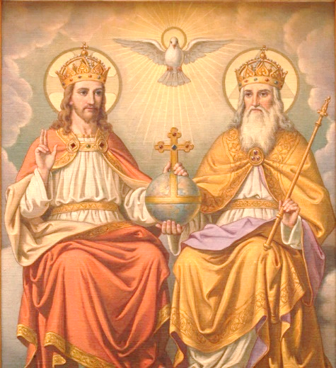
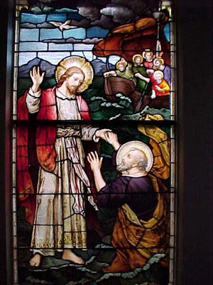
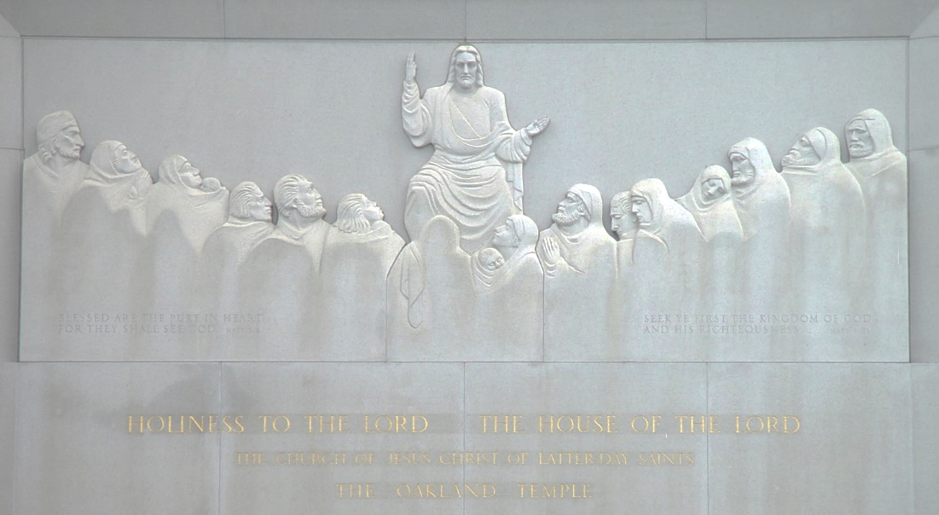

Slide 44
What events/evidences of the Apostacy have you learned about or witnessed?

Slide 45
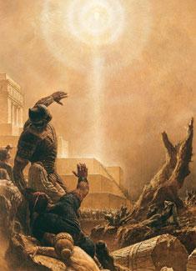
The Great White God

Slide 46
Similarities between Quetzalcoatl and Christ
He was born of a virgin.
He was the God of the Morning Star.
He invented books, the calendar, and gave corn to the people.
He was a symbol of death and resurrection.
He was the god of the Aztec Priesthood.
He was white and had a beard.
He came from the sky, and when he left he promised to return.
He created a new world inhabited by people that were brought to life with his blood. The blood came from wounds on his body.

Slide 47
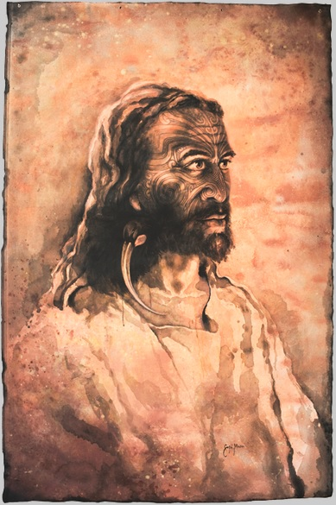
The Maori God

Slide 48
In 1830, Arama Toiroa (Toy-rowa) gathered his relatives together just before his passing. His people asked, ‘Where can we find a church where we can worship the true God?’ “Toiroa answered, ‘There will come to you a true form of worship; it will be brought from the east, even from beyond the heavens. It will be brought across the great ocean. When this Kara’kia form of worship is introduced amongst you, you will know it, for one shall stand and raise both hands to heaven. When you see this sign, enter into that church.” (In 1884 Elders Alma Greenwood and Ira Hinckley brought the gospel to the Wellington).
NEW ERA, JUNE 1981, MAORI TRADITIONS AND THE MORMON CHURCH

Slide 49
In March 1881, Maori chiefs assembled to discuss religious problem, including why there were so many different churches within the bounds of Christianity and which one should the Maoris join. The most respected chief among them, Po’tanga’roa answered with one word, “Tai’hoa,” which means “wait.”
He retired to his own home and meditated, fasted, and prayed about the problem for three days. When he returned to the convention, he addressed his people, saying: “My friends, the church for the Maori people has not yet come among us. You will recognize it when it comes. Its missionaries will travel in pairs. They will come from the rising sun. They will visit with us in our homes. They will learn our language and teach us the gospel in our own tongue. When they pray they will raise their hands.”
NEW ERA, JUNE 1981, MAORI TRADITIONS AND THE MORMON CHURCH

Slide 50
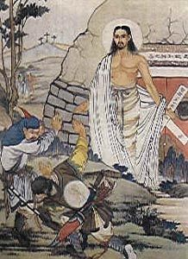
The Great Yellow God

Slide 51
In Western China are the Chiang Min. Professor Torrance, the distinguished theologian in the University of Edinburgh, Scotland, wrote: ‘The religious observances of the Chiang seem to derive from a period in Israel’s history … The Chiang worship on a high place, with an altar of unhewn stones, a sacred tree behind the altar, and a white stone between them. God, whom they called Abba Malak, came to his people through the sacred tree (Abba means father and Malak is Hebrew for angel). They had a sacred rod in the form of a snake twisting round a pole, and they called their faith ‘the white religion’”
Torrance, Rev. T., China’s Missionaries: Ancient Israelites (Thynne & Co. 1937)

Slide 52
Christianity in Chinese Characters
船 Chinese for SHIP
八 (eight) 口(mouths) in a 舟 (boat).
鬼 Chinese for DEVIL
丿(Alive) in a 田 (garden) 儿 (walks) a 厶(deceiver).
禁 Chinese for FORBIDDEN
Before two 林 (trees) stands 示(God).
魔 Chinese for TEMPTATION
Under 广 (cover) near 林 (two trees) resides the 鬼 (devil).
靈 Chinese for HOLY SPIRIT
Coming from above like 雨 (rain) are three 口口口 (beings) who work 巫 (signs and wonders).
義 Chinese for RIGHTEOUSNESS
羊 (A lamb) over 我 (you).

Slide 53
The Restoration
“The gospel of Jesus Christ was lost from the earth through the apostasy following the earthly ministry of Christ’s Apostles. That apostasy made necessary the Restoration of the gospel. Through visions, the ministering of angels, and revelations to men on the earth, God restored the gospel. The Restoration started with the Prophet Joseph Smith and has continued to the present through the work of the Lord’s living prophets.”

Slide 54
“Will those who have built upon the rock of Christ withstand winds, hail, and the mighty shafts in the whirlwind? You know they will.
This is the Church and kingdom of God on earth. Truth has been restored. Live with confidence, optimism, faith, and devotion. Be serious about life’s challenges but not frightened or discouraged by them. “Fear not, little flock. … Look [to Christ] in every thought; doubt not, fear not” (D&C 6:34, 36).
Jeffrey R. Holland Ensign Nov 2004

Slide 55
The Savior Restored His Priesthood, Church, and Gospel

