Slide 1

All things Testify
A study on the symbolism in numbers

Slide 2
HANDOUT!!!!
A study on the symbolism in numbers

Slide 3
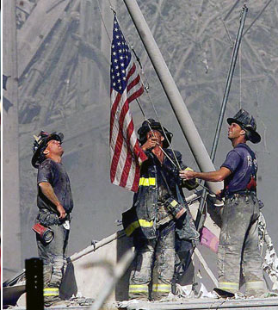
What does this symbolize to you?

Slide 4
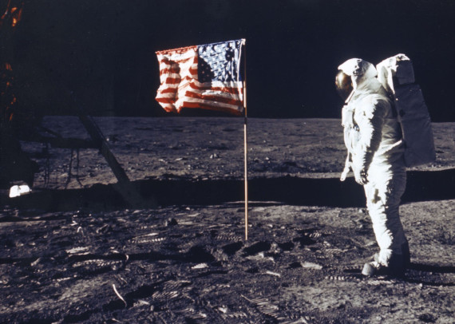
What does this symbolize to you?

Slide 5
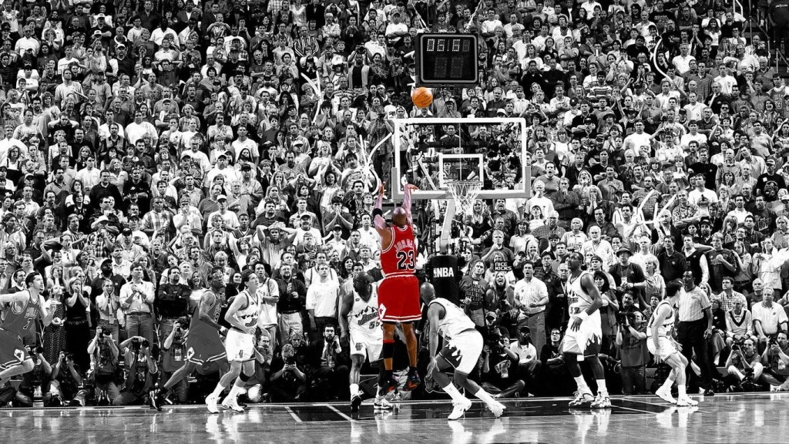
What does this symbolize to you?

Slide 6
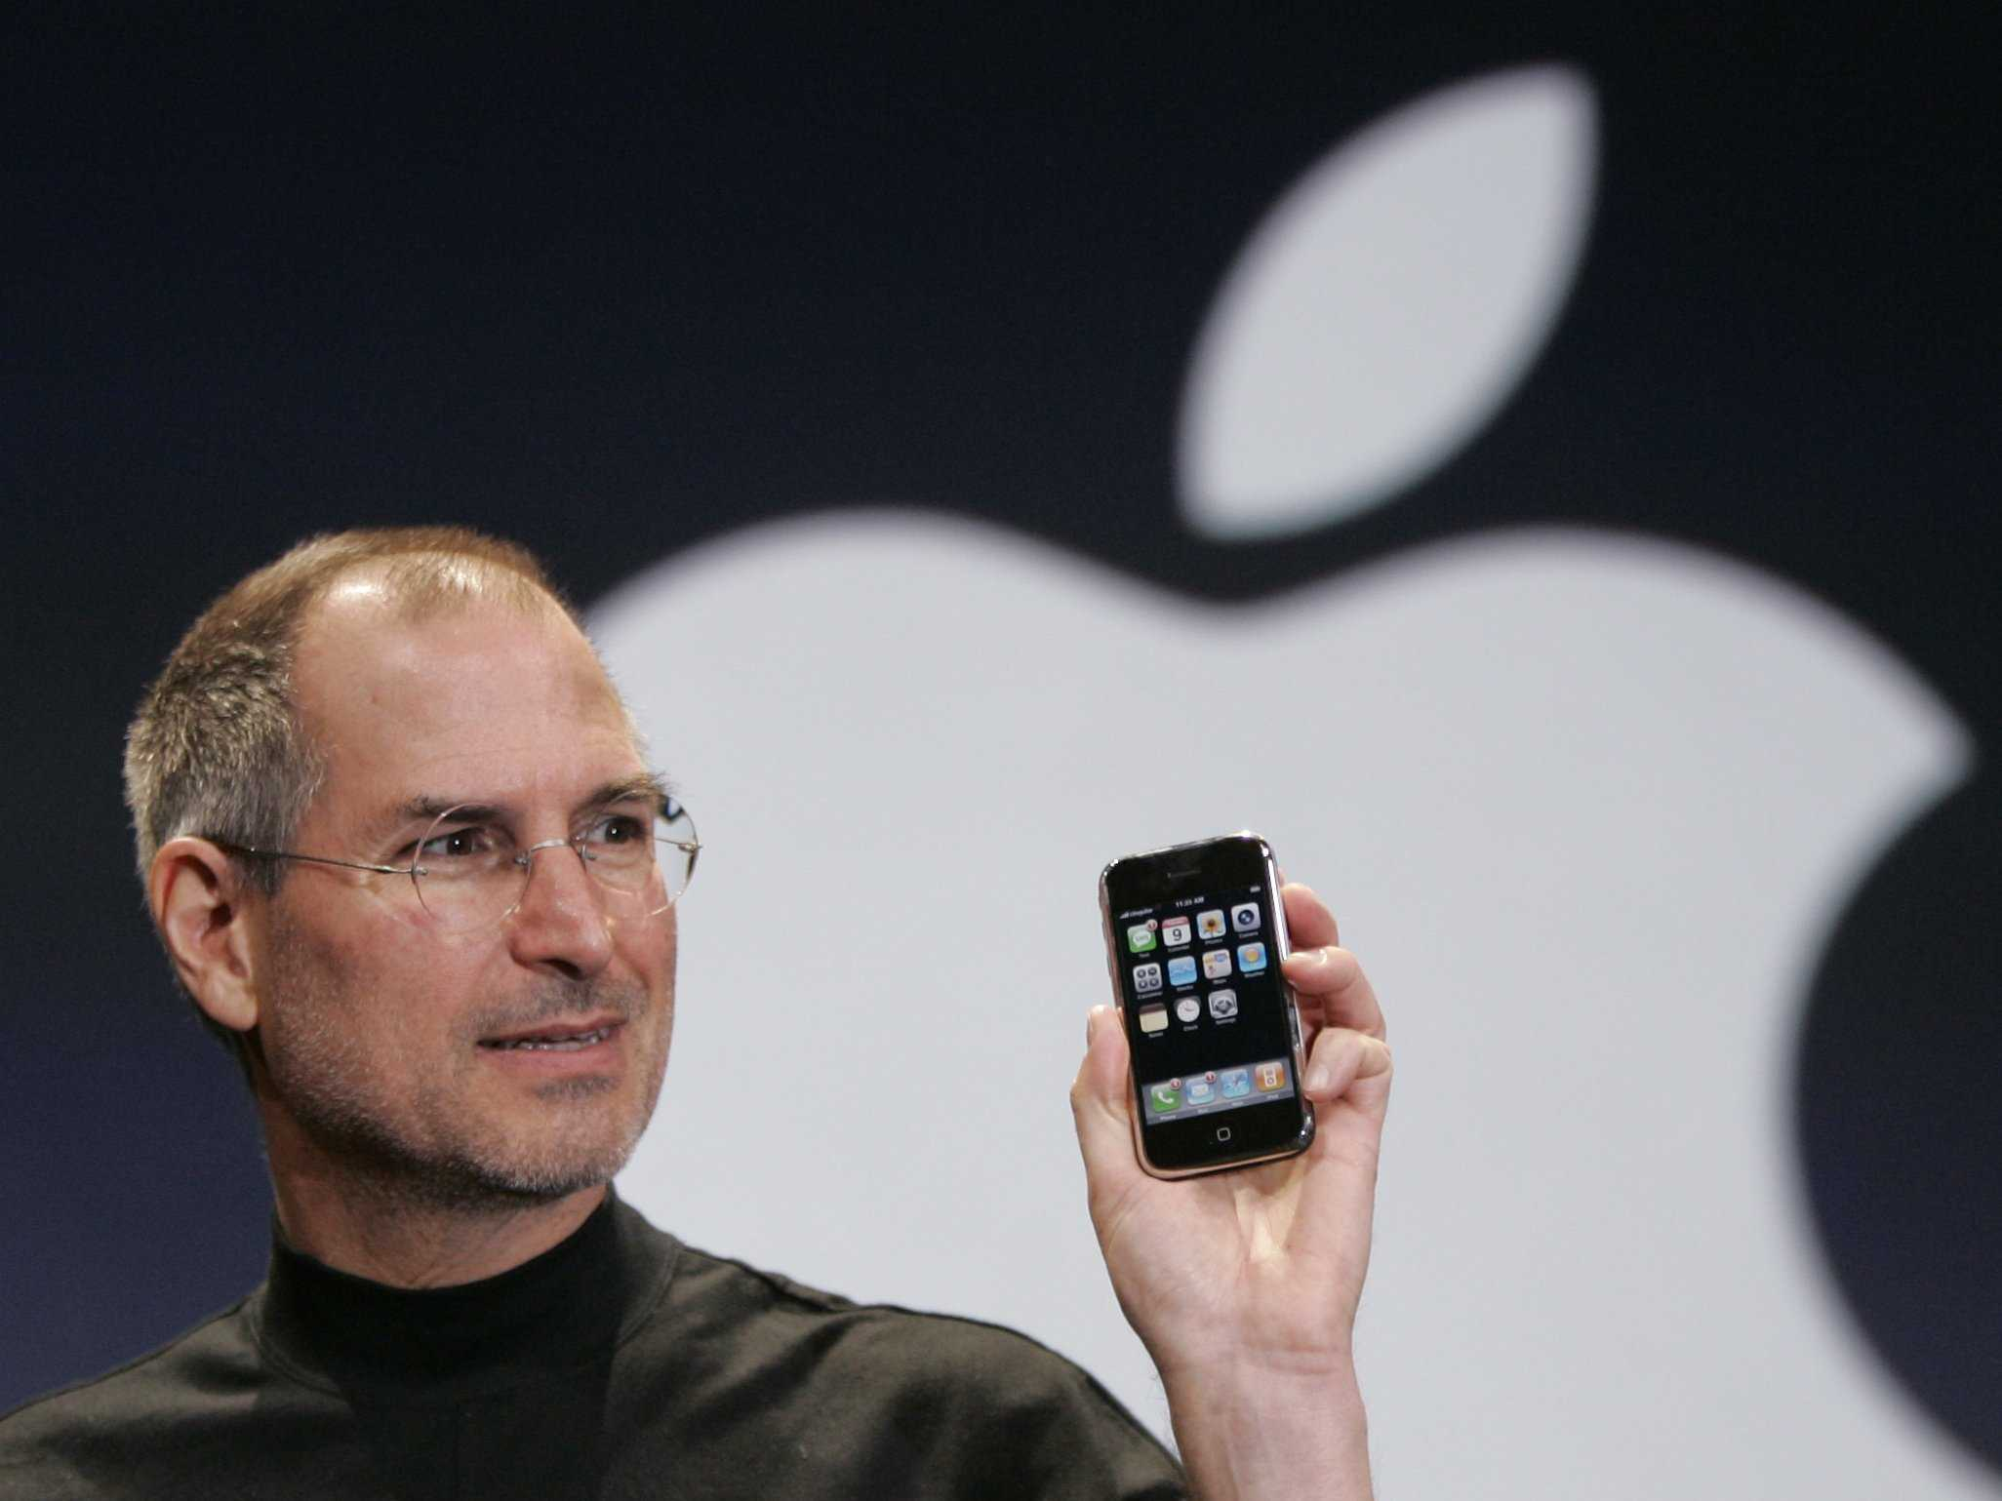
What does this symbolize to you?

Slide 7
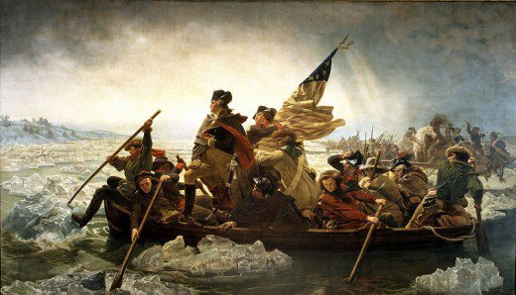
What does this symbolize to you?

Slide 8

What does this symbolize to you?

Slide 9
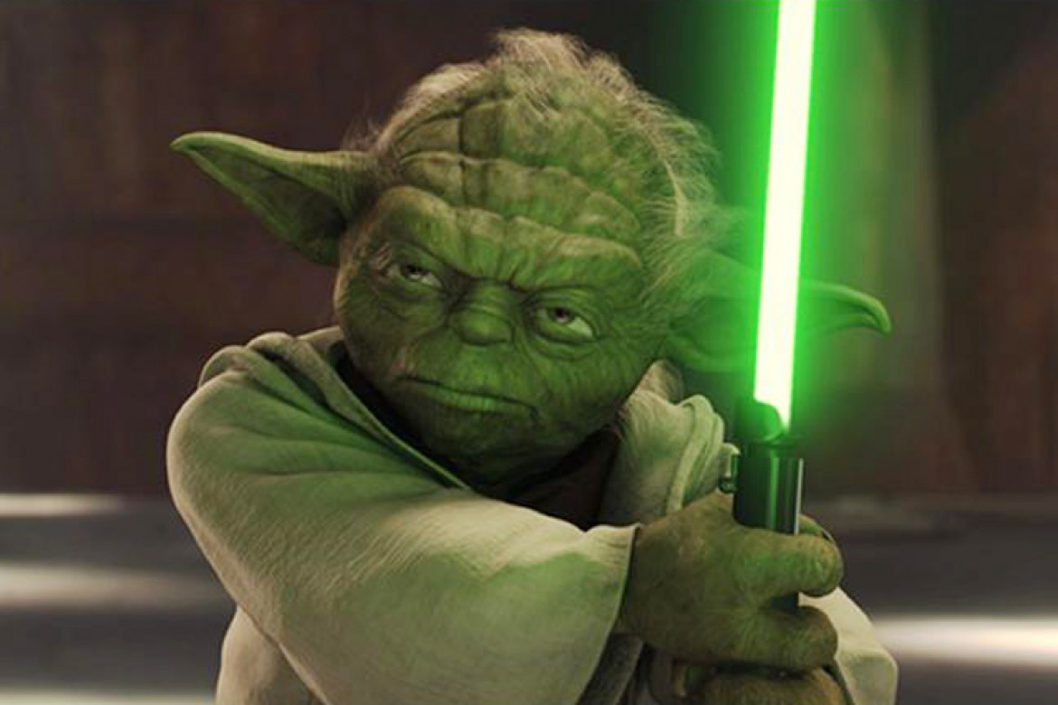
What does this symbolize to you?

Slide 10
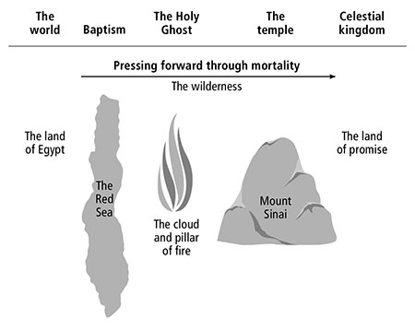

Slide 13
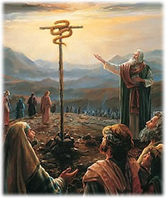
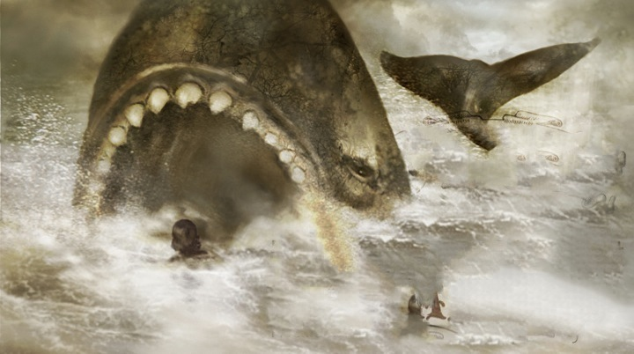
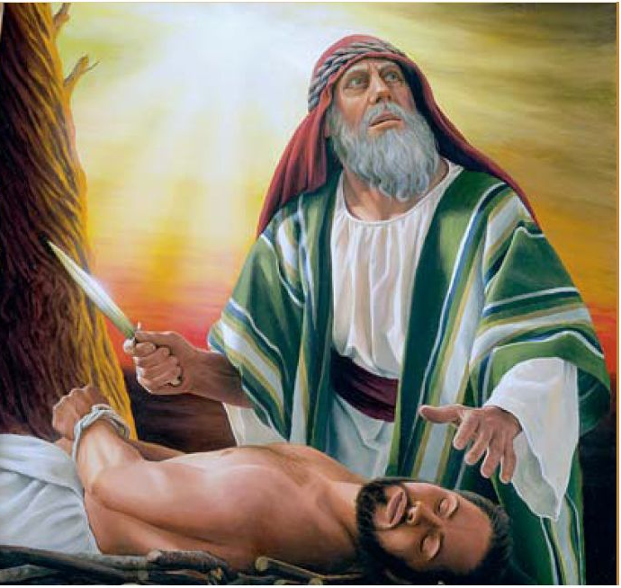
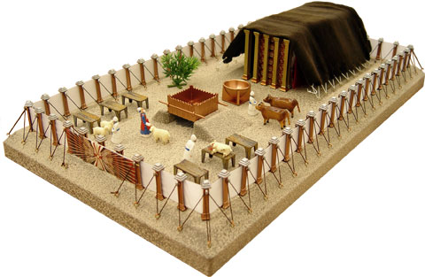
WHY DOES THE LORD USE SYMBOLS?

Slide 14
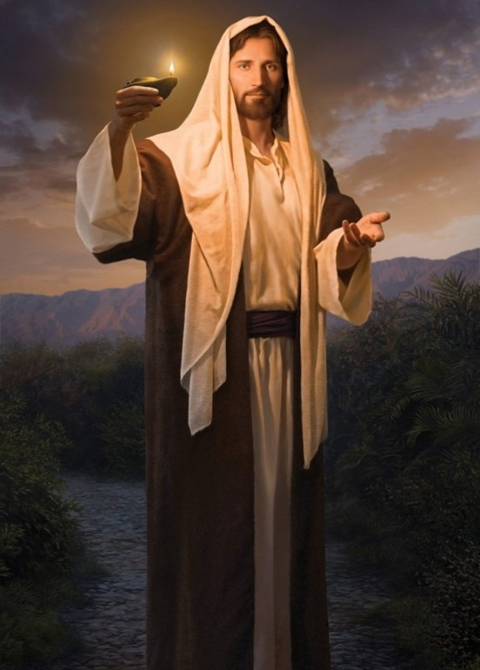
“God teaches with symbols; it is his favorite method of teaching.” (Elder Orson F. Whitney, Improvement Era, July, 1927 p. 861.)
"It is wholesome and proper to look for similitudes of Christ everywhere and to use them repeatedly in keeping him and his laws uppermost in our minds." (Bruce R. McConkie, Promised Messiah, p. 453)
“When we can grasp the ideas that Christ is the Master Teacher, the universe is His classroom, and the curriculum is the Atonement, we will never read the scriptures the same way again.” (Todd Parker, BYU Devotional “All Things Testify”)

Slide 15
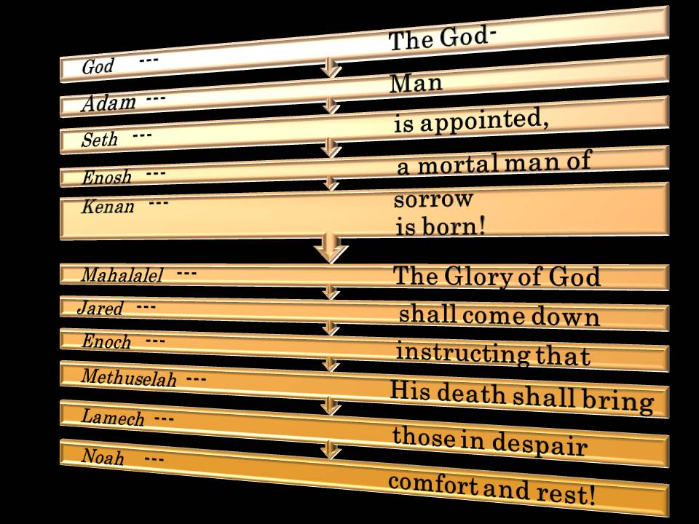

Slide 16
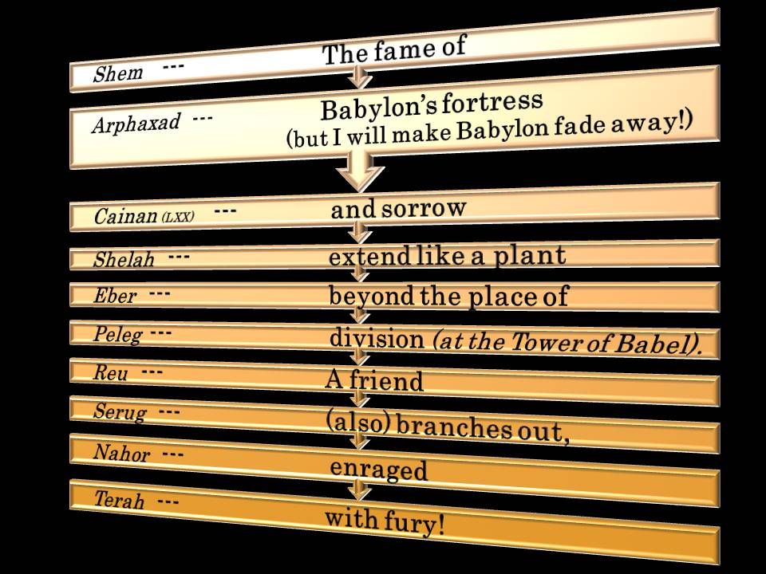

Slide 17
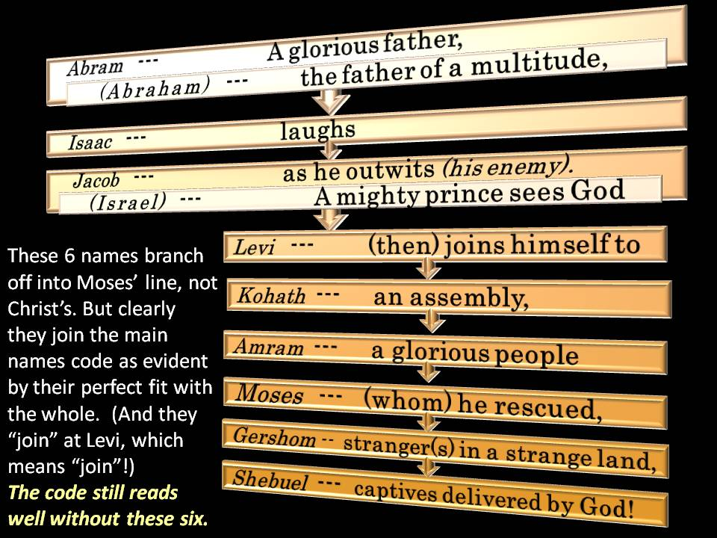

Slide 18
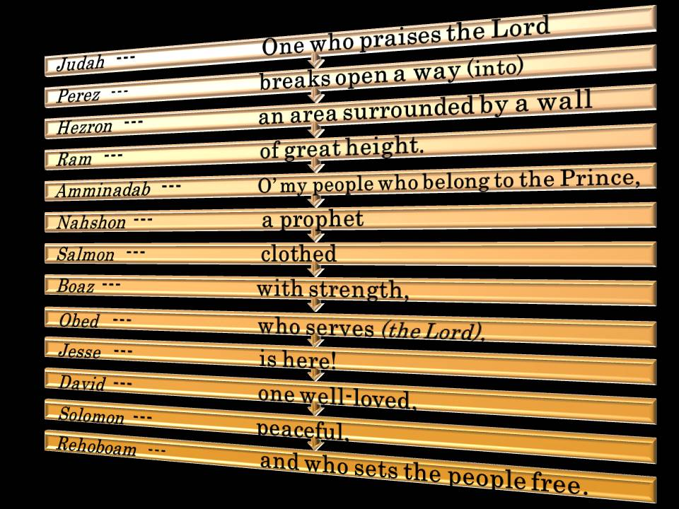

Slide 19
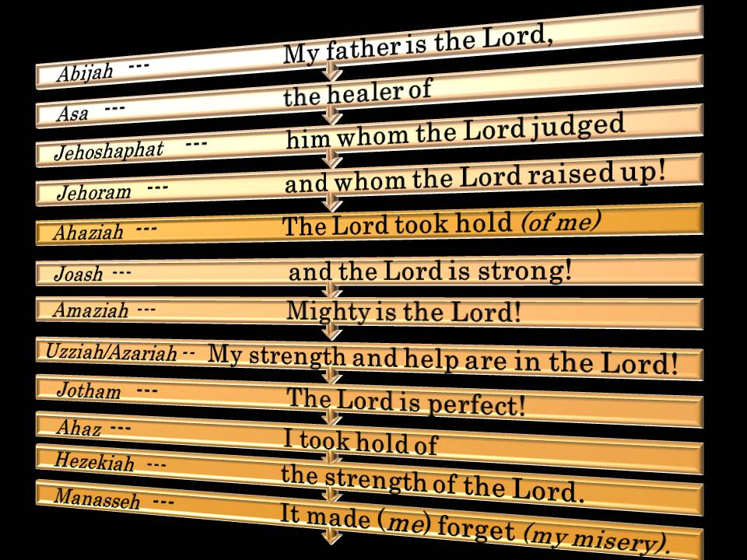

Slide 20
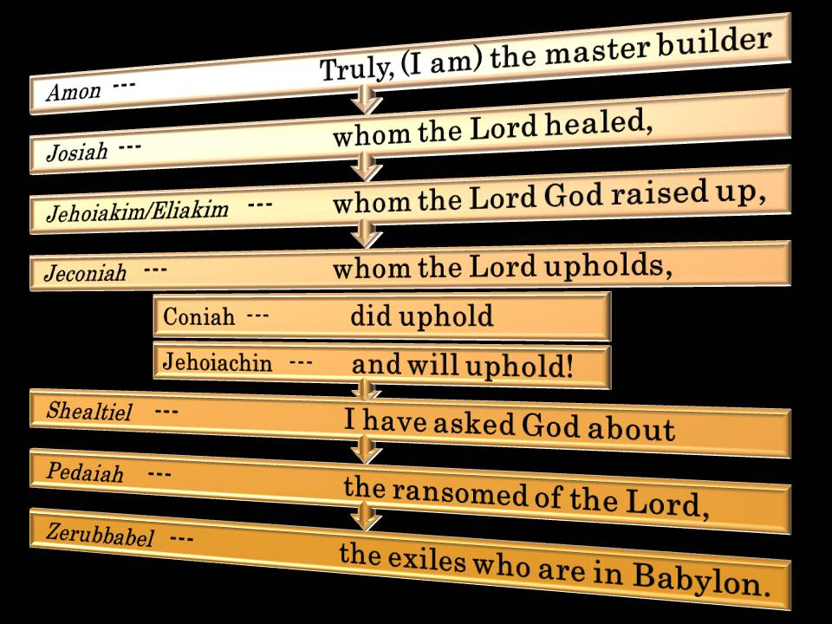

Slide 21
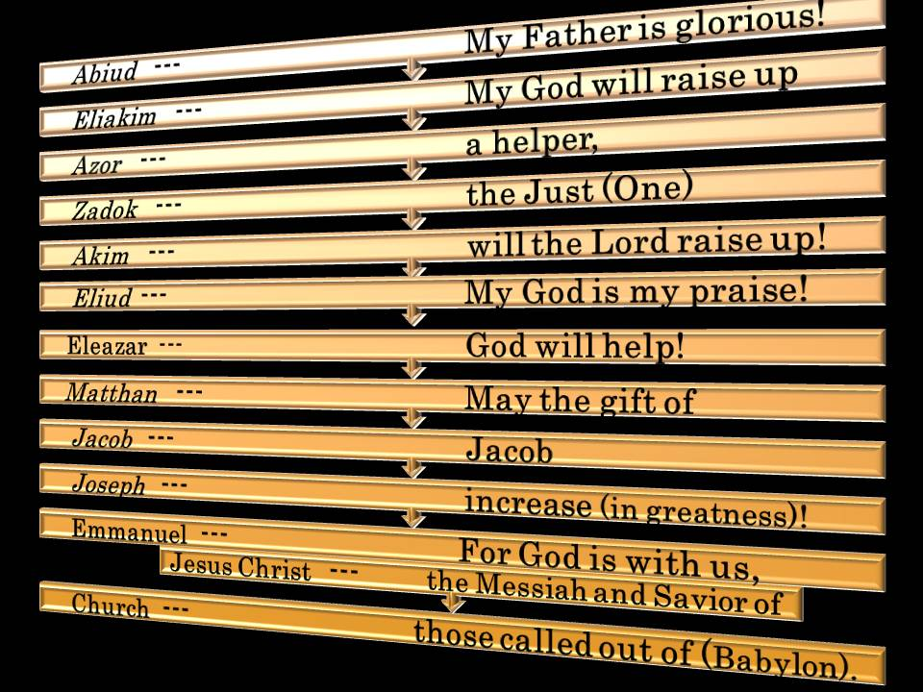

Slide 22
Abraham’s Covenant

Slide 23
SEASONS
Fall Winter Spring Summer

Slide 24
SEASONS
Fall Winter Spring Summer |  | For as in Adam all die, even so in Christ shall all be made alive. I Cor. 15:22

Slide 25
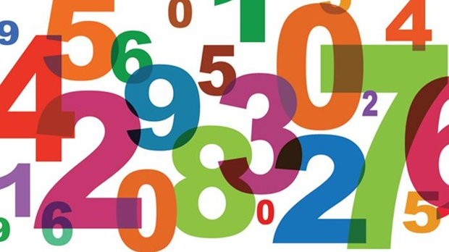
Hebrew Numbers and Letters
Each Hebrew number is a symbol, full of many inner meanings; numbers and letters are the language for the Jewish people, and they are knit to their religious practices as well as their everyday habits.

Slide 26
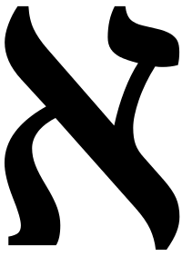
1 (aleph)
1
God, Unity, Holiness
Pictograh: Ox (God)
“The LORD is one and His name one. (Zech. 14:7-9)
“Hear, O Israel: The Lord our God, the Lord is one” (Deuteronomy 6:4)
John 10:30 “I and my Father are one.”
1st Commandment: “Thou shalt have no other gods before Me.”
Holy Matrimony – One flesh

Slide 27
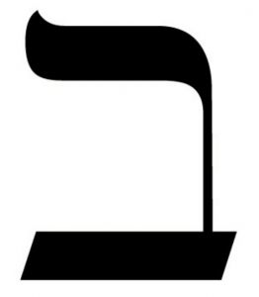
2 (beth)
2
Division
Pictographic meaning: House
Two trees in the Garden; Two cherubim guard Ark of the Covenant
No man can serve two masters
Two angels sent to Sodom (Genesis 19:1); two spies were sent to Jericho (Joshua 2:1)
Two of every animal entered the ark
Two tablets contained the Ten Commandments

Slide 28

3 (gimel)
3
Covenants
Pictograph: Camel (unclean beast)
Godhead
Three primary feast days in Israel: Passover, Pentecost, and Tabernacles.
Tabernacle has three places: outer court, the Holy Place, and the Most Holy Place
The Lord talked for three hours to the brother of Jared.
1/3 in the Pre-Earth Life; 3 degrees of glory in the afterlife
Noah had three sons (Gen 6:10); The Ark was three stories high and 300 hundred cubits long
Satan tempts Jesus three times; three temptations of Eve (food, pleasant to the eyes; desired to make one wise).
Jesus was in grave for three days and three nights; Peter denied Christ three times (Luke 22:54-62); three prayers in Gethsemane (Mt. 26:39,42,44); On Golgotha were three crosses; darkness reigned for some three hours while he was on the cross; three days of darkness in the Americas

Slide 29
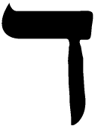
4 (daleth)
4
Earth, Man, Trials
Pictographic meaning: door, draw in, knock.
On the fourth the world itself was finished (Gen. 1:14-19)
Four rivers in the Garden of Eden
Four corners of the earth, four seasons
Four horsemen (Rev 6); Four beasts surround God’s throne (Rev. 4:6)
Four times Eve is mentioned in the Bible by name (● Genesis 3:20 ● Genesis 4:1 ● 2 Corinthians 11:3 ● 1 Timothy 2:13)
Roman soldiers divided up His clothes into four parts (John 19:23).
In the parable of the sower (Matthew 13) there are four kinds of soil
Forty days of the Flood; 40 days of fasting; 40 years in the wilderness.

Slide 30
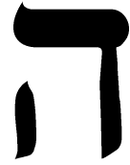
5 (hey)
5
Atonement/grace
Pictographic meaning: breath, spirit, grace (always spoken by whispering)
  God put the hey in Abram’s name to make him Abraham. He put the hey at the end of Sarai to make her Sarah. God also did this with Joshua, changing his name to Jehoshua (Num. 13:16).
Five offerings for forgiveness (Burnt, Sin, Meal, Trespass, and Peace Offering)
David chose five smooth stones to fight Goliath.
“And he gave some apostles, prophets, evangelists, pastors or teachers (Ephesians 4:11-12)”
This tabernacle contained five curtains (Exodus 26:3), five bars (Exodus 26:26 - 27), five pillars and five sockets (Exodus 26:37) and an altar five cubits long and five cubits wide (Exodus 27:1).
The woman by the well had had five husbands (Jn. 4:18)
Five is found 318 times in the Bible. 318 servants in Abram’s house rescued Lot (Gen. 14:14). *REMIND ME TO TALK ABOUT 318 at the end*

Slide 31
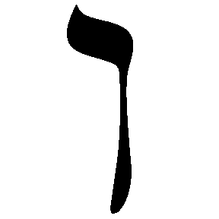
6 (vav)
6
Incomplete; Wicked
Pictograph: Vav is a nail
Man was created on the sixth day (Gen. 1:24-31); Hebrew slave was to serve for six years (Ex. 21:2)
The mark of the beast is 666 (Rev 13:18)
Moses had to wait for six days before he was allowed to go up the mount to meet the Lord (Ex. 24:16-18).
6000 of the earth’s life before the 2nd Coming.
King Nebuchadnezzar’s Golden Image was 60 cubits high and 6 cubits wide.
Goliath was six cubits and six inches tall (see 1 Samuel 17:4) wearing six pieces of armor (1 Samuel 17:5–7), with a spear weighin six hundred shekels (1 Samuel 17:7).
Six pots of water to wine (John 2:6)
66 books in the King James Bible.
24 hours (4 x 6). 12 twelve months in a year (6 x 2). Sixty minutes (6 x 10). Sixty seconds (6 x 10).

Slide 32
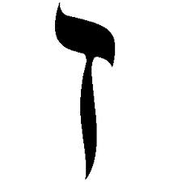
7 (zayin)
7
Complete, whole, perfect
Zayin is a weapon in Hebrew
Seven seals (Rev 7:2); the seven stars; the Seven Churches; and the seven lamps (Rev. 1:20). There is a lamb with 7 horns and 7 eyes (Rev. 7:7); 7 angels with 7 trumpets (Rev. 8:2); 7 thunders (Rev 10:3); a dragon with 7 heads and 7 diadems (Rev 13:3); a beast with 7 heads (Rev19:9); 7 angels having the 7 last plagues (Rev 15:1); and 7 golden bowls of the wrath of God (Rev 15:7) and a scarlet-colored beast with 7 heads (Rev 18:17) which are 7 mountains (Rev 18:23) and 7 kings (Rev. 18:24).

Slide 33
7 (zayin)
7
Joshua’s 7 days' march with the 7 priests blowing 7 trumpets as they went around the walls of Jericho, and the 7-times march on the 7th day (Neh. 9:6).
Humans have a gestation is 7 day times 40 weeks.
7 days of creation; 7 colors of the rainbow; 7 seas of the ocean; 7 continents; 7 notes make a perfect scale
7 dispensations; 7 times 70 for forgiving
7 churches are noted in the land of Zarahemla. (Mosiah 25:33); 7 converted Lamanite cities and lands are listed. (Alma 23:7-13); The Nephite monetary system is based on the number 7. (Alma 11); 7 are killed by Ammon at the Waters of Sebus. (Alma 18:16)
Enoch was “the seventh from Adam” (Jude 1:14).

Slide 34
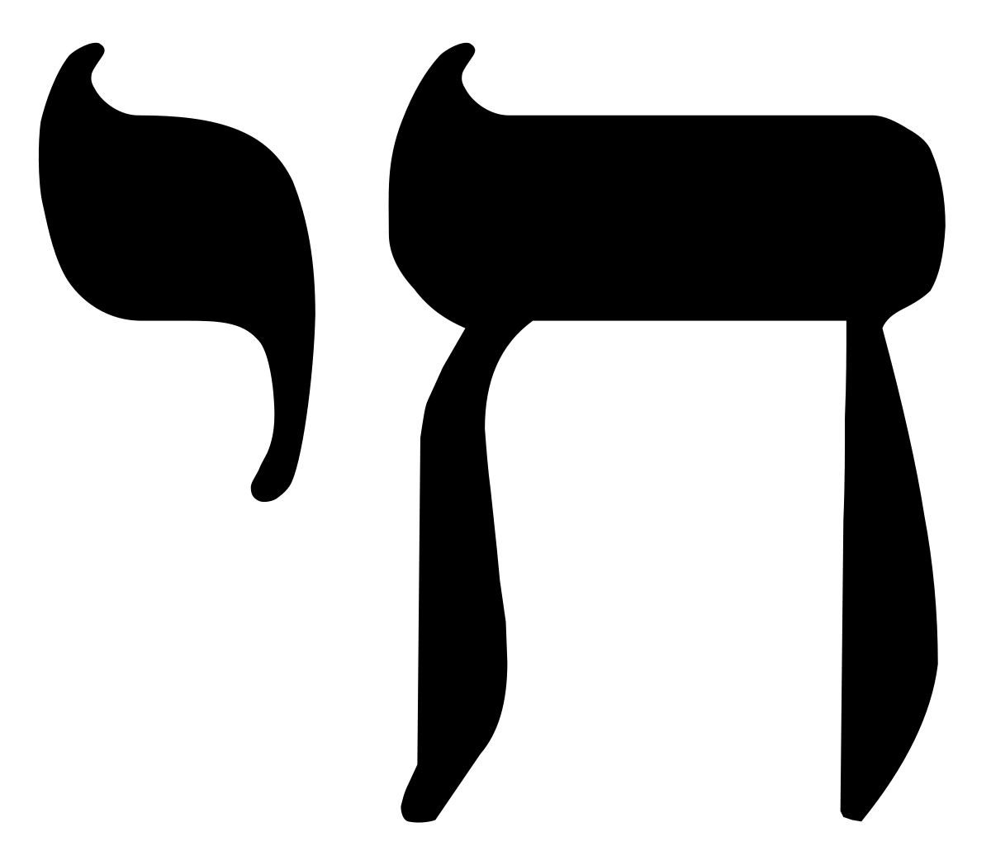
8 (chet)
8
New Beginning
Chet is a fence in Hebrew; a new room.
The temple had eight steps (Ezek 40:31,34,37,41)
Eight souls were saved from the flood.
David was the eighth son of Jesse; Solomon was the eighth son of David.
Bethlehem mentioned eight times in the New Testament.
Transfiguration occurred on the “eighth day” (Luke 9:28); Jesus raised on the “eighth day”
Jaredites eight barges (see Ether 3:1).
Nephi and his family eight years in the wilderness (see 1 Nephi 17:4).
Alma and his new converts traveled “eight days’ journey into the wilderness” to escape King Noah (Mosiah 23:3).
The High Priest of the temple wore 8 different articles of clothing (1 crown, 2 breastplate, 3 robe, 4 apron, 5 white undergarments, 6 belt, 7 cap, 8 pants.)

Slide 35
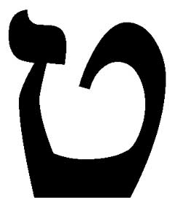
9 (teth)
9
Posterity, judgment
Pictographic meaning: basket or a snake eating it’s tail, making a circle
Nine fruits of the spirit Gal. 5:22, 23, 22
Nine gifts of the Spirit in 1 Cor. 12:8- 10, 8
Nine beatitudes in Matt. 5:3-11
Noah’s generation was the ninth from Adam
Jesus on the cross from the 6th to the 9th hour
Human gestation lasts 9 months.

Slide 36
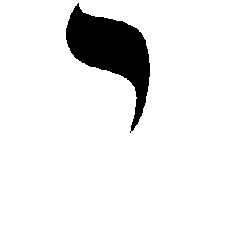
10 (yod)
10
Divine Order
Ten Commandments, Ten Plagues, Ten percent tithing
Abraham’s servant brought 10 camels as gifts to Rebecca.
Ten Virgins (5 wise, 5 foolish).
Ten lost tribes of Israel.
Ten times was the name of God uttered by the high priest on the Day of Atonement
The Passover lamb was selected on the 10th day of the month (Exodus 12:3)

Slide 37
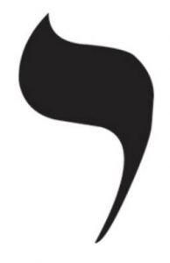
12 (ay or yod-aleph)
12
Priesthood, Government
12 apostles; 12 Tribes of Israel
12 foundations in the New Jerusalem (Rev. 21:14). 12 angels (Rev. 21:12) and 12 pearls at the gates (Rev. 21:21). The city is foursquare at 12,000 furlongs (Rev. 21:16). The wall is 144 cubits high (Rev. 21:17), which is 12 x 12. A tree with 12 kinds of fruit 12 times a year eaten by 12 times 12,000 (See Revelation 21.)
Twelve spies to the Promised Land (Num. 14:22).
The baptismal font (see 1 Kings 7:23–26; 2 Chronicles 4:3–5) on the back of twelve oxen facing the four cardinal directions.
When Jesus feeds the 5,000, his Disciples pick up 12 basketfuls of leftovers.
Jesus’ says his disciples may have “more than twelve legions of angels” (Matthew 26:53; see also see D&C 13)
The woman had an issue of blood twelve years (see Mark 5:25–34)

Slide 38

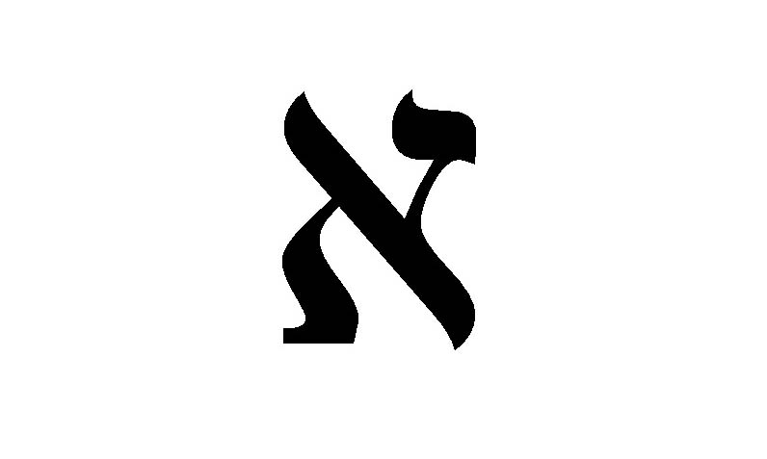
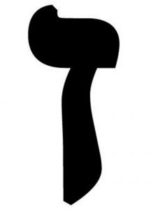
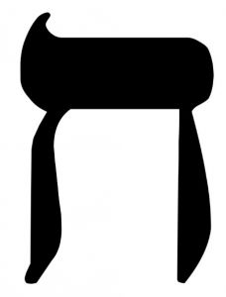

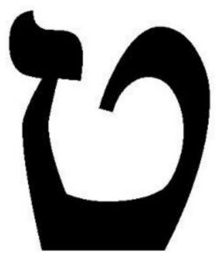
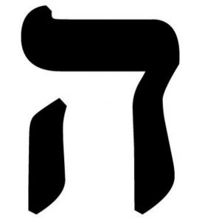
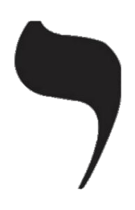
Numbers
6: Nail
7: Weapon
8: Inner room
9: Eternity/Posterity
10: Divine order
12: Priesthood; reigning
1: Ox (God)
2: House
3: Camel (Unclean beast)
4: Door
5: Hey (whispered)

Slide 39
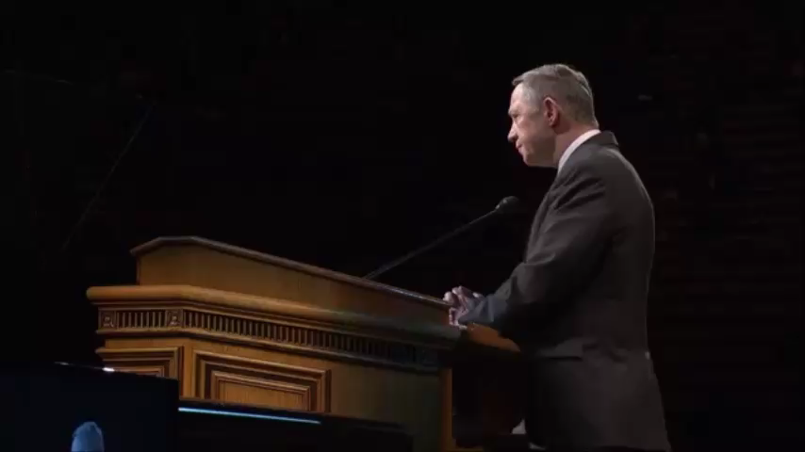
VIDEO (“All Things Testify”)
https://www.youtube.com/watch?v=E5Mm0mrHng4

Slide 40
VIDEO (“All Things Testify”)
https://www.youtube.com/watch?v=E5Mm0mrHng4

Slide 41
Hebrew Numerology
A study on the symbolism in numbers

