Slide 1
The Book of Revelation

Slide 2
The book of Revelation: Pre-Test
Name 3 things you remember about John
How many churches does John write letters to in Revelation 2-3?
Numbers are symbolic; can you name a few? (see Rev 4-5)
What do the 7 seals represent? (see Rev 6-7)
What will happen with the 2 witnesses at Jerusalem? (see Rev 11)
What are other names for Satan? (see Rev 12-13)
What will happen at Adam-Ondi-Ahman? Who are the 144,000?
What role has Moroni played with the Second Coming? (see Rev 14)
What do you know about Armageddon? (See Rev 16)
Name a few things that will happen during the Millennium? (see Rev 20)
On what basis will we be judged at the Final Judgment? (see Rev 20)
What will the earth look like when it becomes Celestialized? (See Rev 21-22)
Notes:
Patmos is located 50 miles offshore of western Turkey. The island is about 10 miles long and 5 miles wide.
Since there is no further identification of the writer other than “John,” it presumes a familiarity on the reader’s part. It is therefore not just anyone named “John,” but the apostle John, who is now an old man.
Emperor Domitian was assassinated in A.D. 96. Late in his reign, he forced his subjects to address him as “Lord and God.” Those who refused were harshly punished. Many Christians were exiled to penal colonies or executed.

Slide 3
Fun Facts about John & Revelation
There are 404 verses in Revelation (we will study around 300 of them in this course).
John & Jesus are cousins (his mom, Salome, was Mary’s sister - Matthew 27:56; Mark 15:40).
John was called “the disciple whom Jesus loved” (John 21:20-24) and “a son of thunder” by Christ.
Nephi was told by an angel not to write all John had seen (1 Ne. 14:18-27)
In Greek, Revelation is titled Apocalypsis, which literally means the ‘removal of the veil’.
The book is called “Revelation” not “Revelations”
Revelation is the only one of two books authored by a human that would eventually become a translated being (see John 21:19-23).
Notes:
Patmos is located 50 miles offshore of western Turkey. The island is about 10 miles long and 5 miles wide.
Since there is no further identification of the writer other than “John,” it presumes a familiarity on the reader’s part. It is therefore not just anyone named “John,” but the apostle John, who is now an old man.
Emperor Domitian was assassinated in A.D. 96. Late in his reign, he forced his subjects to address him as “Lord and God.” Those who refused were harshly punished. Many Christians were exiled to penal colonies or executed.

Slide 4
Fun Facts about John & Revelation
Revelation says that the final war will be fought in the Valley of Megiddo in Israel, called the “ideal battlefield” by Napoleon
The blood of the evil army will flow as high as horses’ bridles (Revelation 14:20)
24 titles for Christ in Revelation
Prophet Joseph Smith: “The book of Revelation is one of the plainest books God ever caused to be written.”
JST 20% of the verses.
Notes:
Patmos is located 50 miles offshore of western Turkey. The island is about 10 miles long and 5 miles wide.
Since there is no further identification of the writer other than “John,” it presumes a familiarity on the reader’s part. It is therefore not just anyone named “John,” but the apostle John, who is now an old man.
Emperor Domitian was assassinated in A.D. 96. Late in his reign, he forced his subjects to address him as “Lord and God.” Those who refused were harshly punished. Many Christians were exiled to penal colonies or executed.

Slide 5
Story Time!
PLEASE DO NOT SAY THE NAME OF THIS STORY OUTLOUD….
PLEASE DO NOT SAY THE NAME OF THIS STORY OUTLOUD….
PLEASE DON’T….☺

Slide 6
Wants pawn term, dare worsted ladle gull hoe left wetter murder inner ladle cordage honor itch offer lodge dock florist. Disc laddle gull orphin worry ladle cluck wetter putty ladle rat hut, en fur disc raisin pimple caulder ladle rat rotten hut. Wan moaning, rat rotten hut’s murder colder inset, “Ladle rat rotten hut, heresy ladle basking winsome burden barter and shirker cockles. Tick disc lady basking tudor cordage offer groin murder hoe lifts honor udder site offer florist. Shaker lake, dun stopper laundry wrote, and younder nor sorghum stenches dun stopper torqur wet strainers.
“Hoe-cake, murder.” respendent ladle rat rotten hut, end tickle ladle basking on stuttered oft. Honor wrote tutor cordage offer groin murder, ladle rat rotten hut mitten anolmalous woof.
“Wail, wail, wail,” set disc wicket woof, “evenescent ladle rat rotten hut. Wares or putty ladle gull goring wizard ladle basking?”

Slide 8
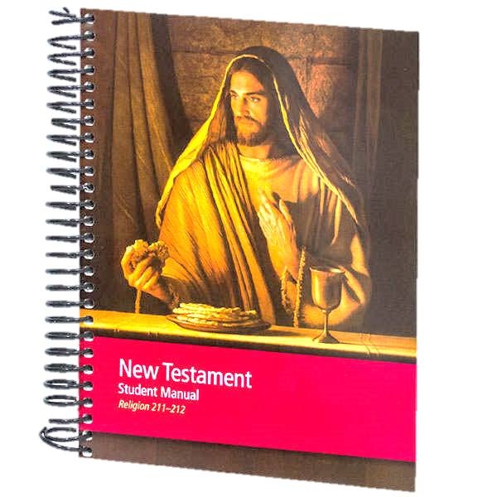
Ensign, Oct. 1983, “Book of Revelation Overview”
Ensign, Dec. 1987, “Seeing the Book of Revelation”
New Testament Institute/Seminary Student Manual

Slide 9
Where is true doctrine found?
Scriptures?
Conference Talk?
Book written by a prophet or apostle?
For the Strength of Youth pamphlet?
Hymn Book?
Ensign/New Era?
Announcements made by the First Presidency
“The voice of the First Presidency and the united voice of those who hold the keys of the kingdom shall always guide the Saints.” (Joseph Fielding Smith, Ensign, July 1972)

Slide 10
Statements and Quotations
“Not every statement made by a Church leader, past or present, necessarily constitutes doctrine. A single statement made by a single leader on a single occasion often represents a personal, though well-considered, opinion, but is not meant to be officially binding for the whole Church. Isolated statements are often taken out of context, leaving their original meaning distorted.” (The Church of Jesus Christ of Latter-day Saints, Approaching Mormon Doctrine, May 4, 2007)
"As I say, it never ceases to amaze me how gullible some of our Church members are” (Harold B. Lee, "Admonitions for the Priesthood of God", Ensign, Jan 1973).
“Even with the best of intentions, Church government does not always work the way it should. Human nature may express itself on occasion, but not to the permanent injury of the work” (Boyd K Packer, BYU Devotional and Fireside Speeches, 1990–1991 (Provo, Utah: University Publications, 1991), 84.)

Slide 11
Where is true doctrine found?
Core Doctrine — Essential for salvation
Supportive Doctrine — Elaborate on core doctrine, but are not essential for salvation
Policy Doctrine — Authoritative teachings of the LDS Church involving application of doctrines
Esoteric Doctrine — Known perhaps by prophets or may have once been authoritatively taught in the church, but no longer are, and are not essential for salvation

Slide 12
true DOCTRINE
Revelation 1:1 – Doctrines?
The Greek word for “signify” is semaino which means to “show by signs or tokens”. (NOTE: Doctrine and Covenants 129:4-5).
Cross-Reference Acts 1:3
Infallible Proofs
Tekmerion (Greek). From tekmor, meaning to show or prove by sure signs or tokens.

Slide 13
The Book of Revelation

