Slide 1
The Book of Revelation

Slide 2
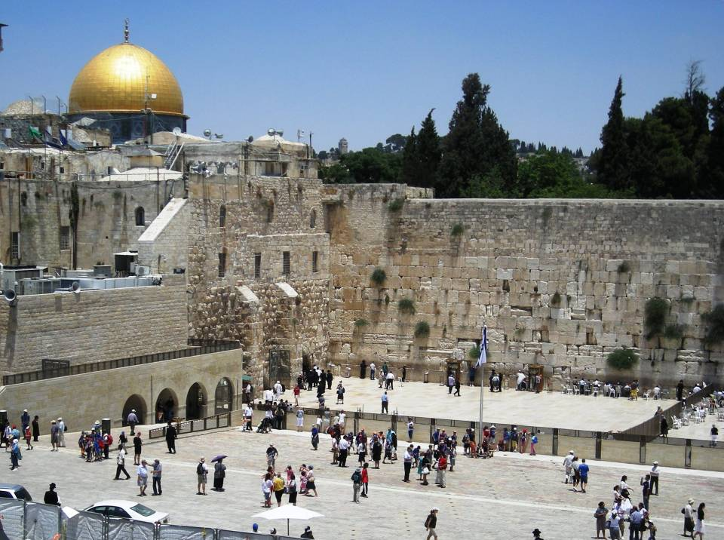
The History of Rome

Slide 3
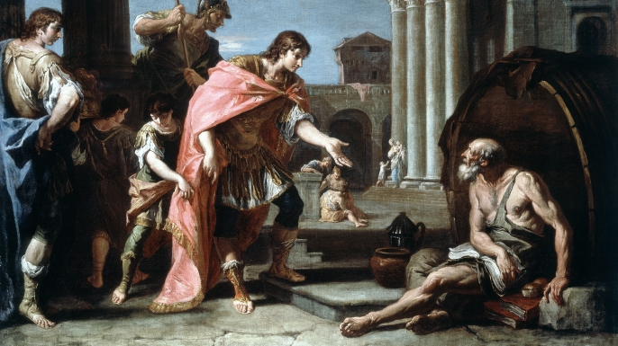
Alexander “The Great”
Taught by Aristotle
Never lost a battle in 15 years
Conquered the known world by age 25
Named 70 cities after himself—and one after his horse, Bucephalus.
His body was preserved in a vat of honey.

Slide 4
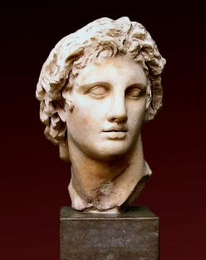
Alexander “The Great”
356 BC - 323 BC
HELENISM (Modern-Day Humanism)
Humans are the ultimate creation
Human mind is the source of all truth
Aristotle, Socrates, Plato
Human body is the ultimate source of beauty
Human heart determines right/wrong
Major Institutions
Theatre (Art and Dramas)
Education (Gymnasium)
Etymology?
To sweat in the nude
Sports (Arena)
Jewish Prohibitions
Theatre (too much worldliness)
Gymnasium (too much skin)
Arena (too much violence)
Jewish Worship
Sabbath
Dress
Diet
Moral Cleanliness

Slide 5
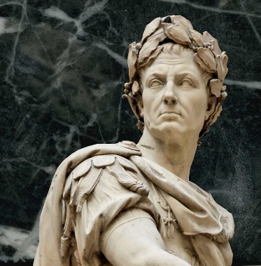
Julius Caesar
44BC
Who killed Julius Caesar? (hint: ‘Et tu’)
Octavius (Nephew) becomes first Emperor of the Roman Empire
Changes his name to ‘Caesar Augustus’
‘Augustus’ means ‘ ‘more than human’.
Herod (Governor of Galilee) has 3 Options:
Take his life, run, hope Octavius ignores him
Herod sails to Rhodes; pledges loyalty
Makes him “King” of Judea, and also is given part of Decapolis to rule.

Slide 6
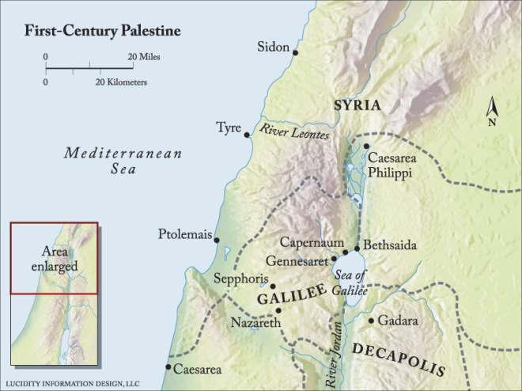
Decapolis
Mark 5:1-13, 15-20

Slide 7
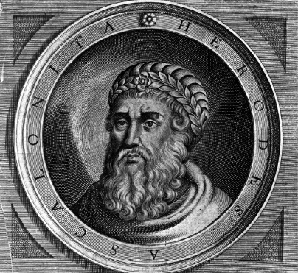
King Herod “The Great”
Wanted a legacy
Builds roads and aqueducts
10 wives; executed multiple sons
Age 70, suffering with painful kidney disease
Imprisoned Rabbis and wealthy men and ordered their execution to take place...
…on the day he died (so somebody would mourn at his passing)
Worst news ever…
Wise Men (Magi)
5 miles away….
The New King is learning to walk
Matthew 2:1-16 (Outsmarted)

Slide 8
Roman Emperors
Caesar Augustus died in 14AD, succeeded by his son Tiberius (executed John the Baptist)
Tiberius was succeeded in 41AD by his uncle, Claudius (expelled the Jews from Rome)
Claudius was succeeded by Nero in 54AD (a brutal psychopath, blaming/killing Christians for the Great Fire of Rome in 64AD; Paul and Peter were executed by Nero)
Nero committed suicide in 68AD and was succeeded by Vespasian
Vespasian was succeeded by Titus, who destroyed the Temple in Jerusalem in 70AD.
Titus was followed by his brother Domitian (who ordered the death of John).

Slide 9
“During this time, all the Apostles except John had been killed. John was banished to Patmos after being plunged into boiling oil in Rome by Domitian. He did not suffer anything from it. It is said that all in the audience of the Colosseum were converted to Christianity upon witnessing this miracle.” (New Testament Seminary Student Manual, 2015).

Slide 10
John the Beloved
Saint Augustine said: “The Gospel of John is deep enough for an elephant to swim in and shallow enough for a child not to drown.”
Master storyteller with imagery and metaphors (Jesus didn’t just feed 5000; He is the Bread of Life. Jesus didn’t just heal a blind man; He is the Light of the World.)
John mentions “life” and “I Am” more than any other book.
Presents Jesus’ teachings as conversations.
ONLY FOUND IN JOHN
Water to wine, Nicodemus, the woman at the well, nobleman’s son, impotent man at the pool, man horn blind, the Good Shepherd, Lazarus, washing the Apostles’ feet, discourses on the Holy Ghost, prayers in Gethsemane, and Thomas doubts.
Gospel | Exclusive | Common
Mark Matthew Luke John | 7% 42% 59% 92% | 93% 58% 41% 8%

Slide 11
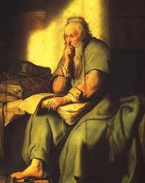
John’s Testimony
John 1:1-5
1 John 1:4-7
1 John 4:7-11
Revelation 22:17,20

Slide 12
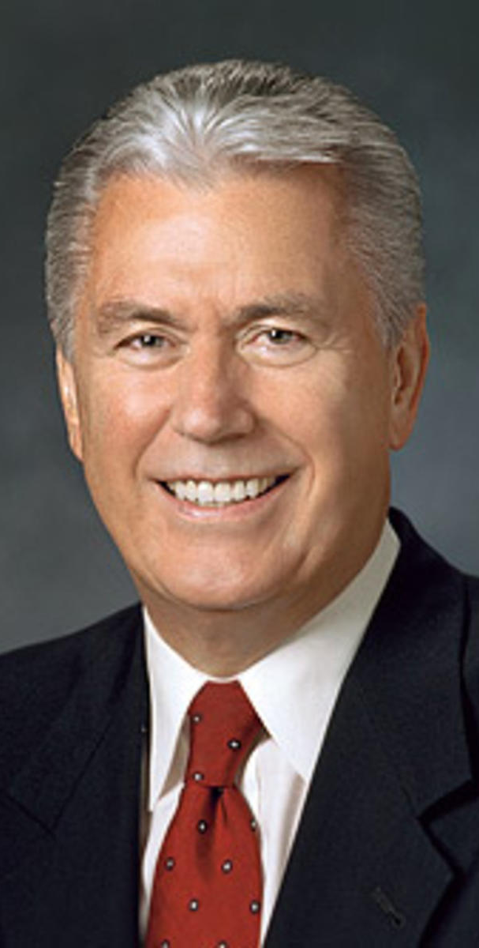
"Sometimes I think we may see obedience as the metaphorical hammer against the iron anvil of the commandments in an effort to shape us through constant heating and repeated battering, into holier, heavenly matter. No doubt about it, there are times when we need a stern call to repentance. Certainly, there are some who may be reached only in this manner.
“But perhaps there is a different metaphor. Maybe obedience is not so much the process of bending, twisting, and pounding our souls into something we are not. Instead, it is the process by which we discover what we truly are made of. Obedience is not a punishment but as a liberating path to our divine destiny. And gradually, the corruption, dust, and limitations of this earth begin to fall away. Eventually, the priceless, eternal spirit of the heavenly being within us is revealed, and a radiance of goodness becomes our nature." (Pres Uchtdorf, April 2016 General Conference)

Slide 13
The Book of Revelation

