Slide 1
Happy Thanksgiving!

Slide 2
HYMNS…

Slide 3
92 For the Beauty of the Earth 1. For the beauty of the earth, For the beauty of the skies, For the love which from our birth Over and around us lies, [Chorus] Lord of all, to thee we raise This our hymn of grateful praise.

Slide 4
94 Come, ye thankful people, come Come, ye thankful people, come; Raise the song of harvest home. All is safely gathered in Ere the winter storms begin. God, our Maker, doth provide For our wants to be supplied. Come to God's own temple, come; Raise the song of harvest home.

Slide 5
219 Because I have been Given Much Because I have been given much, I too must give; Because of thy great bounty, Lord, each day I live; I shall divide my gifts from thee With every brother that I see Who has the need of help from me.

Slide 6
93 Prayer of Thanksgiving 1. We gather together to ask the Lord's blessing; He chastens, and hastens his will to make known; The wicked oppressing now cease from distressing. Sing praises to his name; He forgets not his own.

Slide 7
241 Count Your Blessings 1. When upon life's billows you are tempest-tossed, When you are discouraged, thinking all is lost, Count your many blessings; name them one by one, And it will surprise you what the Lord has done. [Chorus] Count your blessings; Name them one by one. Count your blessings; See what God hath done. Count your blessings; Name them one by one. Count your many blessings; See what God hath done.

Slide 8
Children All Over the World All over the world at the end of day, Heav'nly Father's children kneel down and pray, Each saying thank you in his own special way, Saying thank you, thank you in his own special way. "Gracias." (grah-see-ahs) "Malo." (mah-loh) "Wir danken dir." (veer don-ken deer) All over the world tender voices hear. Some say "tak," (tahk) others "merci," (mare-see) "Kansha shimasu," (kahn-shah shee-mah-sue) we thank thee. Our Heavenly Father hears them; He understands each tongue. Our Heav'nly Father knows them; He loves them, loves them, ev'ry one.

Slide 9
Sprit of Thanksgiving Mormon Message

Slide 11
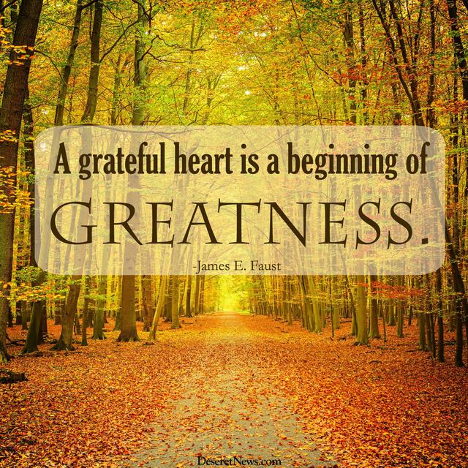

Slide 16
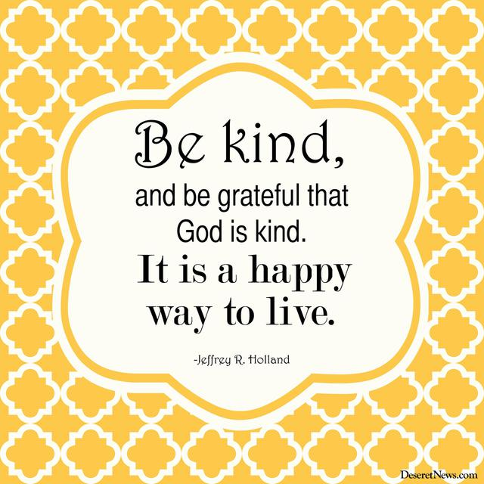

Slide 17
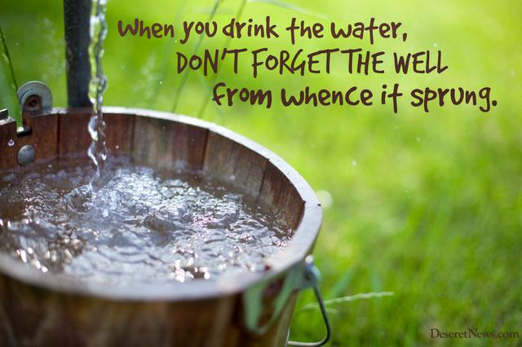
Quentin L. Cook

Slide 21
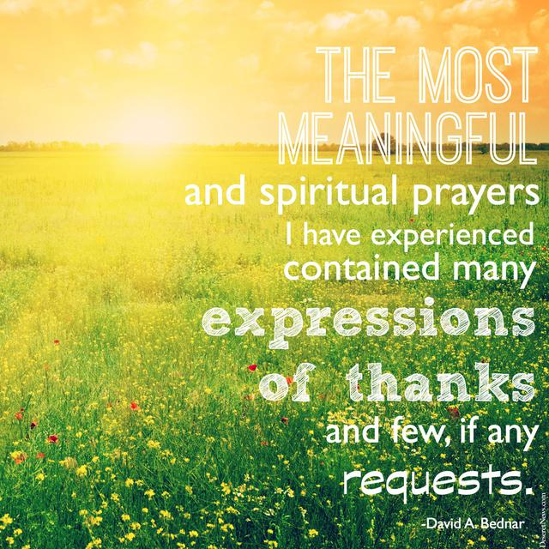

Slide 22
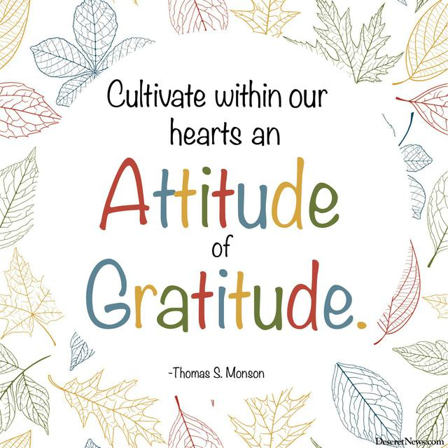

Slide 23
Share…
Something you are grateful for.
And.., if you are brave and extra grateful, share “WHY” you are grateful for it.
“Thank-amony” vs Testimony

Slide 24
Are you grateful for…
5 THINGS?
10 THINGS?
50 THINGS?
100 THINGS?
Could you list them?

Slide 25
Choose one invitation….
LIST 100 THINGS YOU’RE GRATEFUL FOR
• 10 living people you are grateful for.
• 10 people who have died you are grateful for.
• 10 physical abilities you are grateful for.
• 10 material possessions you are grateful for.
• 10 things about nature you are grateful for.
• 10 things about today you are grateful for.
• 10 places on earth you are grateful for.
• 10 modern-day inventions you are grateful for.
• 10 foods you are grateful for.
• 10 things about the gospel you are grateful for.
Write a sincere letter of thanks to someone

Slide 26
Happy Thanksgiving!

