Slide 1
Acquiring Spiritual Knowledge
A Paradigm Shift
Notes:
Template 07

Slide 2
Some things are more important than other things
Useful and accurate but change frequently. Usually “What” or “When?”
Valuable & verifiable (scientific method) and expand over time. Usually “How?”
Eternal Truths
The “Why”
Photosynthesis, creation, water cycle, cancer research, etc.
Bus schedules, dates of tests, menu items at Café Rio, scores, etc.

Slide 3
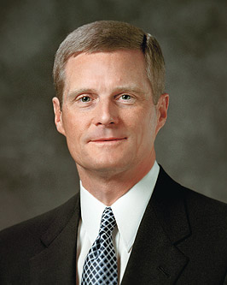
Hard Questions
“I have observed a common characteristic among the instructors who have had the greatest influence in my life. They have helped me to seek learning by faith. They refused to give me easy answers to hard questions. In fact, they did not give me any answers at all. Rather, they pointed the way and helped me take the steps to find my own answers.
“I certainly did not always appreciate this approach, but experience has enabled me to understand that an answer given by another person usually is not remembered for very long, if remembered at all. But an answer we discover or obtain through the exercise of faith, typically, is retained for a lifetime. The most important learnings of life are caught—not taught” (David A. Bednar, “Seek Learning by Faith”, Ensign, Sep 2007, 67).

Slide 4
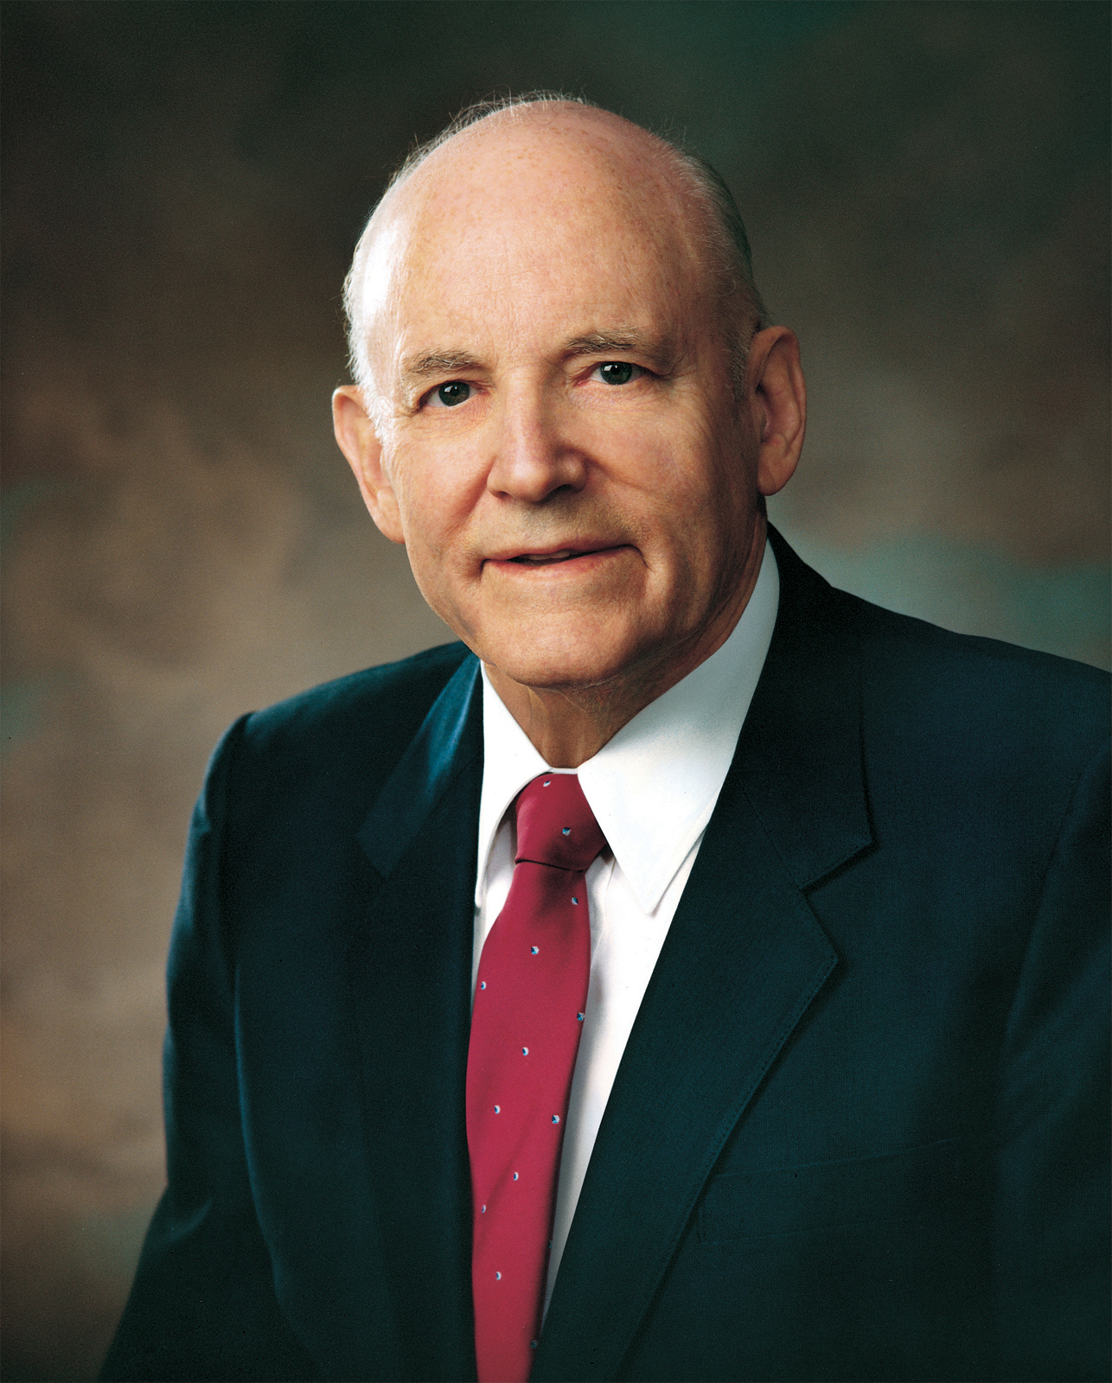
Questions are normal
“I have sympathy for young men and young women when honest doubts enter their minds and they engage in the great conflict of resolving doubts. These doubts can be resolved, if they have an honest desire to know the truth, by exercising moral, spiritual, and mental effort. They will emerge from the conflict into a firmer, stronger, larger faith because of the struggle. They have gone from a simple, trusting faith, through doubt and conflict, into a solid substantial faith which ripens into testimony” (Howard W. Hunter, “Secretly a Disciple?” Improvement Era, Dec. 1960, 948).

Slide 5
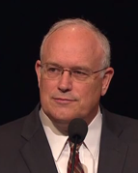
A Revealed Pattern
“Learning spiritual things requires a different approach than learning scientific things. The scientific method and intellect are very helpful, but they alone will never bring spiritual knowledge. Learning spiritual things involves the intellect, but that is not enough. We only learn spiritual things by the Spirit” (Paul V. Johnson, A Pattern for Learning Spiritual Things, S&I Broadcast, August 2012.).
Notes:
4. Article of Faith #9

Slide 6
A Revealed Pattern
Act in Faith
  Trust God and turn to Him first in sincere prayer, serious study, obedience to commandments
  Hold fast to what you already know
  Wait patiently (see Article of Faith 9)
Watch how Madison follows this pattern as she has some questions about polygamy.
Notes:
4. Article of Faith #9

Slide 7
Madison and polygamy
https://www.lds.org/media-library/video/2016-05-4000-acquiring-spiritual-knowledge-madisons-story?lang=eng
Notes:
5:12

Slide 8
How did Madison…
Act in Faith
  Trust God and turn to Him first in sincere prayer, serious study, obedience to commandments
  Hold fast to what you already know
  Wait patiently (see Article of Faith 9)
Notes:
4. Article of Faith #9

Slide 9
A Revealed Pattern
Act in Faith
  Trust God and turn to Him first in sincere prayer, serious study, obedience to commandments
  Hold fast to what you already know
  Wait patiently (see Article of Faith 9)
Examine Concepts and Questions with an Eternal Perspective
  Consider/reframe the question in the context of the Plan.
  Examine historical questions in context – but don’t focus solely on history
Notes:
4. Article of Faith #9

Slide 10
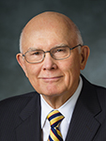
How should we respond when our associates or teachers put forth assertions, proposals, and conclusions that are contrary to what we know?
“I suggest that it may be preferable for our young people to refrain from arguing with their associates about such assertions or proposals.
“They will often be better off to respond by identifying the worldly premises or assumptions in the assertions they face and then by identifying the different assumptions or premises that guide the thinking of Latter-day Saints. This won’t elicit agreement from persons who don’t share our faith, but it can move the discussion away from arguing over conclusions to identifying the real source of disagreement….
“We must … avoid being deceived and persuaded by reasoning and conclusions [that are] based on false premises.”

Slide 11

Suffering is always bad
If there really is a loving God, why would he allow people to suffer?
God should stop all suffering
God doesn’t exist
God doesn’t care

Slide 12
Suffering allows us to grow
Suffering is always bad
If there really is a loving God, why would he allow people to suffer?
God should stop all suffering
God doesn’t exist
God does exist
God gives us agency
God loves all of his children
God doesn’t care

Slide 13
Let’s try it

Slide 14
I feel closer to God in the mountains than at Church
God wants us not only to feel close to Him, but to become like Him.
Serving others is part of learning to be unselfish and Godly.
I can be spiritual without being religious.
God created the earth as the place where His eternal plan would be worked out.
I need time to focus on me.
God created nature for me.
Jesus organized and restored His Church to provide priesthood keys, revelation, ordinances, and covenants so that we might know how to follow Him.
I don’t trust institutions
Notes:
I get more out of being in the mountains than I get going to Church.

Slide 15
All are alike unto God (2 Nephi 26:33)
The Church does not value women.
Should this be about what we want or should we care more about what the Lord wants?
When will the Church start treating women and men equally?
It is unfair that women are not given the same opportunities as men to hold certain callings
A person’s position determines his or her importance
Men and women have different but equally important roles.
Equality and fairness mean that everything must be the same between men and women.
Equality does not mean that men and women are exactly the same.

Slide 16
The World’s Ideas
I determine what is right for me.
What is right or wrong is up to each individual. Don’t judge me.
Love is what is important. It doesn’t matter who you marry or have sex with.
Love is what is important. If God really loves us, he will accept all that we do.
If you really love me, you will be intimate with me.
The line in the Family Proclamation, “Mothers are primarily responsible for the nurture of their children” is a sexist statement and is demeaning to women.
Why can’t women hold the priesthood?
What is the deal with polygamy?

Slide 17
A Revealed Pattern
Act in Faith
  Trust God and turn to Him first in sincere prayer, serious study, obedience to commandments
  Hold fast to what you already know
  Wait patiently (see Article of Faith 9)
Examine Concepts and Questions with an Eternal Perspective
  Consider/reframe the question in the context of the Plan.
  Examine historical questions in context – but don’t focus solely on history
Seek Further Understanding through Divinely Appointed Sources
Notes:
4. Article of Faith #9

Slide 18
Continuum of Attitude
I don’t want to know.
I’m looking for someone to teach me.
I’m willing to work and wait for understanding.
I intend to live according to what I learn.
I already know.

Slide 19
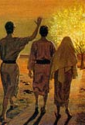
We find what we seek
“…I, Nephi, was desirous also that I might see, and hear, and know of these things, by the power of the Holy Ghost, which is the gift of God unto all those who diligently seek him...
“For he that diligently seeketh shall find; and the mysteries of God shall be unfolded unto them, by the power of the Holy Ghost” (1 Nephi 10:17, 19).

Slide 20
Acquiring Spiritual Knowledge
A Paradigm Shift
Notes:
Template 07

