Slide 1
Three parables
Matthew 25
Parable of the sheep & goats
Parable of the Talents
Parable of the 10 Virgins

Slide 2
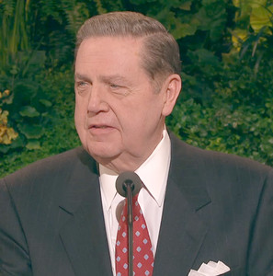
“[A young returned missionary shared during a testimony meeting] He … told of coming home from a date shortly after he had been ordained an elder at age 18. Something had happened on this date of which he was not proud. He did not go into any details, nor should he have done so in a public setting. To this day I do not know the nature of the incident, but it was significant enough to him to have affected his spirit and his self-esteem.
“As he sat in his car for a while in the driveway of his own home, thinking things through and feeling genuine sorrow for whatever had happened, his nonmember mother came running frantically from the house straight to his car. In an instant she conveyed that this boy’s younger brother had just fallen in the home, had hit his head sharply and was having some kind of seizure or convulsion. The nonmember father had immediately called for an ambulance, but it would take some time at best for help to come.

Slide 3
“‘Come and do something,’ she cried. ‘Isn’t there something you do in your Church at times like this? You have their priesthood. Come and do something.’ …
“… On this night when someone he loved dearly needed his faith and his strength, this young man could not respond. Given the feelings he had just been wrestling with and the compromise he felt he had just made—whatever that was—he could not bring himself to go before the Lord and ask for the blessing that was needed” (“The Confidence of Worthiness,” Liahona, Apr. 2014, 58–59).

Slide 4
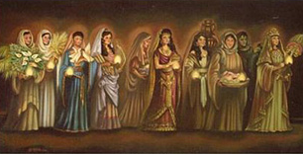
Matthew 25

Slide 5
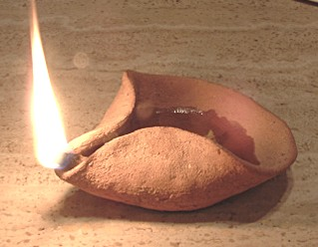
Matthew 25
How many were there?
How many were wise?
How many were foolish?
How many had oil?
How many had enough oil (in vessels?)
How many were sleeping when the bridegroom came?
Matthew 25:1-13

Slide 6
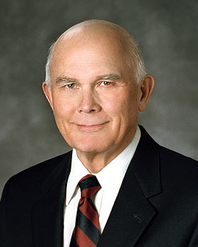
Matthew 25
The arithmetic of this parable is chilling. The ten virgins obviously represent members of Christ's Church, for all were invited to the wedding feast and all knew what was required to be admitted when the bridegroom came. But only half were ready when he came. (Elder Dallin H. Oaks, CR April 2004, 6)

Slide 7
Matthew 25
Why was the Lord so ‘mean’?
Were the ones with oil ‘mean’?

Slide 8
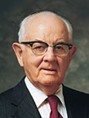
Matthew 25
“This was not selfishness or unkindness. The kind of oil that is needed to illuminate the way and light up the darkness is not shareable. How can one share obedience to the principle of tithing; a mind at peace from righteous living; an accumulation of knowledge? How can one share faith or testimony? How can one share attitudes or chastity, or the experience of a mission? How can one share temple privileges? Each must obtain that kind of oil for himself. …
“In the parable, oil can be purchased at the market. In our lives the oil of preparedness is accumulated drop by drop in righteous living. … Each act of dedication and obedience is a drop added to our store” (Faith Precedes the Miracle[1972], 255–56).

Slide 9
Matthew 25
What does the oil represent?
D&C 45:56-57
What do the lamps represent?
Oil = Conversion through the Holy Ghost
Lamps = Testimony of the Gospel

Slide 10
Matthew 25 – Elder Bednar

Slide 11
Matthew 25 – Elder Bednar

Slide 12
Matthew 25
What does the oil represent?
D&C 45:56-57
What do the lamps represent?
Oil = Conversion through the Holy Ghost
Lamps = Testimony of the Gospel
What is the symbolism of the marketplace?

Slide 13
Matthew 25
Parable of the talents
Write down 10 things you are good at - don’t be afraid to brag a bit.
What is the difference between talent and ability?
Cross Reference to D&C 60:2 and Matt 5:14-16.
An ability becomes a talent when we turn it over to the Lord.
How many talents do you have from your list of 10 abilities?

Slide 14
Matthew 25
Parable of the talents
Name people in the (real or scriptural) who turned their abilities into talents to forward the gospel cause.

Slide 15
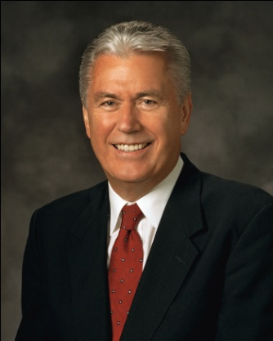
“We spend so much time and energy comparing ourselves to others—usually comparing our weaknesses to their strengths. This drives us to create expectations for ourselves that are impossible to meet. As a result, we never celebrate our good efforts because they seem to be less than what someone else does...
“God wants to help us to eventually turn all of our weaknesses into strengths, but He knows that this is a long-term goal. He wants us to become perfect, and if we stay on the path of discipleship, one day we will. It’s OK that you’re not quite there yet. Keep working on it, but stop punishing yourself (President Uchtdorf, October 2011)

Slide 16
Matthew 25
President Faust explained, “This church does not necessarily attract great people but more often makes ordinary people great. A major reason this church has grown from its humble beginnings to its current strength is the faithfulness and devotion of millions of humble and devoted [members] who have only five loaves and two small fishes to offer in the service of the Master.”

Slide 17
Matthew 25
Does God really reap where he hasn’t sown? Why?
(He looks for our works to bless his other children; if we bury our talents, NOBODY is blessed; at least go sell it or leave it on the road for another to find it, but DO NOT bury it!)
Does God care what career you enter?
How to discover talents:
Friends tell you Patriarchal blessings Spirit nags you Trial and error Why do people hesitate to develop talents? Fear Comparison

Slide 18
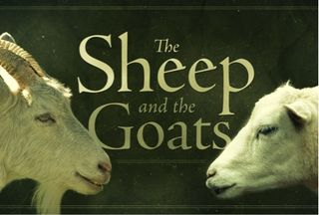
Matthew 25
Parable of the sheep and goats
How does the parable in Matt 25:31-34 fit with the parable in Matt 25:35-40?
Is it completely easy to tell If you are a sheep or a goat?

Slide 19
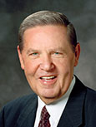
“‘No one who has not faced what I faced that night will ever know the shame I felt and the sorrow I bore for not feeling worthy to use the priesthood I held. It is an even more painful memory for me because it was my own little brother who needed me and my beloved nonmember parents who were so fearful and who had a right to expect more of me. But as I stand before you today, I can promise you this,’ he said. ‘I am not perfect, but from that night onward I have never done anything that would keep me from going before the Lord with confidence and asking for His help when it is needed. Personal worthiness is a battle in this world in which we live,’ he acknowledged, ‘but it is a battle I am winning. I have felt the finger of condemnation pointing at me once in my life, and I don’t intend to feel it ever again if I can do anything about it. And, of course,’ he concluded, ‘I can do everything about it’” (“The Confidence of Worthiness,” 59).

Slide 20
Application
Matthew 25
Can the Lord easily tell if you are you a sheep or a goat?
What abilities are you willing to turn over to the Lord?
What are you are doing to add oil to your personal store?

