Slide 1
Matthew 23

Slide 2
Silent Auction Hangman

Slide 3
This is a combination of “Name that Tune” (I can name that tune with 4 notes…) and “Hangman”
Draw a blank line for each letter in the word. ...
Each team starts off with an *; if they discover the word, they earn the number of points they bid to figure out the word – and the lowest score wins.
TO PLAY:
Teams silently bid on how many letters they need to solve the puzzle; lowest bid goes first
You reveal letters based on their bid number
If the team guesses the word correctly....they get the same number of points as the number of letters they used to bid; that is, if the team bid “4 letters” and guessed the word using the 4 letters, they would get 4 points.
If the lowest bidding team doesn’t guess the word correctly, the next higher bidding team gets to go next

Slide 4
_ _ _ _ _ _ _ _
1 2 3 4 5 6 7 8
Notes:
Pharisee, outwardly, Hypocrisy, woe, phylacteries, synagogues, Zacharias, chickens, sepulchres,

Slide 5
P H A R I S E E
Notes:
Pharisee, outwardly, Hypocrisy, woe, phylacteries, synagogues, Zacharias, chickens, sepulchres,

Slide 6
_ _ _ _ _ _ _ _ _
1 2 3 4 5 6 7 8 9
Notes:
Pharisee, outwardly, Hypocrisy, woe, phylacteries, synagogues, Zacharias, chickens, sepulchres,

Slide 7
O U T W A R D L Y
Notes:
Pharisee, outwardly, Hypocrisy, woe, phylacteries, synagogues, Zacharias, chickens, sepulchres,

Slide 8
_ _ _ _ _ _ _ _ _
1 2 3 4 5 6 7 8 9
Notes:
Pharisee, outwardly, Hypocrisy, woe, phylacteries, synagogues, Zacharias, chickens, sepulchres,

Slide 9
H Y P O C R I S Y
Notes:
Pharisee, outwardly, Hypocrisy, woe, phylacteries, synagogues, Zacharias, chickens, sepulchres,

Slide 10
_ _ _
1 2 3
Notes:
Pharisee, outwardly, Hypocrisy, woe, phylacteries, synagogues, Zacharias, chickens, sepulchres,

Slide 11
W O E
Notes:
Pharisee, outwardly, Hypocrisy, woe, phylacteries, synagogues, Zacharias, chickens, sepulchres,

Slide 12
_ _ _ _ _ _ _ _ _ _ _ _
1 2 3 4 5 6 7 8 9 10 11 12
Notes:
Pharisee, outwardly, Hypocrisy, woe, phylacteries, synagogues, Zacharias, chickens, sepulchres,

Slide 13
P H Y L A C T E R I E S
Notes:
Pharisee, outwardly, Hypocrisy, woe, phylacteries, synagogues, Zacharias, chickens, sepulchres,

Slide 14
_ _ _ _ _ _ _ _ _
1 2 3 4 5 6 7 8 9
Notes:
Pharisee, outwardly, Hypocrisy, woe, phylacteries, synagogues, Zacharias, chickens, sepulchres,

Slide 15
S Y N A G O G U E
Notes:
Pharisee, outwardly, Hypocrisy, woe, phylacteries, synagogues, Zacharias, chickens, sepulchres,

Slide 16
_ _ _ _ _ _ _
1 2 3 4 5 6 7
Notes:
Pharisee, outwardly, Hypocrisy, woe, phylacteries, synagogues, Zacharias, chickens, sepulchres,

Slide 17
C H I C K E N
Notes:
Pharisee, outwardly, Hypocrisy, woe, phylacteries, synagogues, Zacharias, chickens, sepulchres,

Slide 18
_ _ _ _ _ _ _ _ _
1 2 3 4 5 6 7 8 9
Notes:
Pharisee, outwardly, Hypocrisy, woe, phylacteries, synagogues, Zacharias, chickens, sepulchres,

Slide 19
S E P U L C H E R
Notes:
Pharisee, outwardly, Hypocrisy, woe, phylacteries, synagogues, Zacharias, chickens, sepulchers,

Slide 20
Look for these words in Matthew 23:
Pharisee, outwardly, hypocrisy, woe, phylacteries, synagogues, sepulcher.
Notes:
Pharisee, outwardly, Hypocrisy, woe, phylacteries, synagogues, Zacharias, chickens, sepulchers,

Slide 21
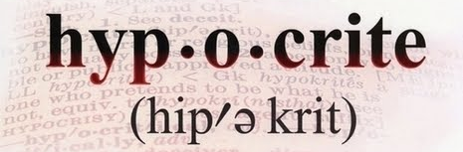
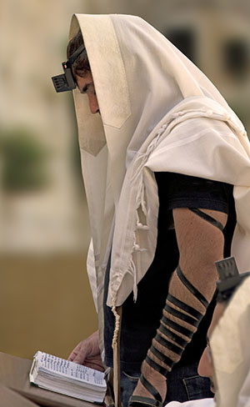
Matthew 23
The word hypocrite is translated from a Greek word meaning "actor," and refers to one who pretends, exaggerates a part, or is deceitfully inconsistent in his or her actions.
Matthew 23:1–12: Is wearing a phylactery bad?
Notice at all the “wo’s” in Matthew 23:13-36.
Notes:
Pharisee, outwardly, Hypocrisy, woe, phylacteries, synagogues, Zacharias, chickens, sepulchers,

Slide 22
MATTHEW 23 | HYPOCRITICAL ACTIONS OF THE SCRIBES AND PHARISEES
Verse 13
Verse 14
Verse 15
Verses 16–22
Verse 23
Verses 25–28
Verses 29–30
Matthew 23

Slide 23
MATTHEW 23 | HYPOCRITICAL ACTIONS OF THE SCRIBES AND PHARISEES
Verse 13 | They not only rejected Christ, His Church, and His offer of salvation, but they also tried to prevent others from accepting Christ and salvation.
Verse 14 | They were greedy and materialistic and preyed upon others’ misfortunes.
Verse 15 | They tried to recruit others to their false beliefs.
Verses 16–22 | Through their oaths, they showed more reverence for the temple’s gold and furnishings than for the Lord, whom the temple honors.
Verse 23 | They obeyed rules but ignored the more important doctrines and principles the rules were based on.
Verses 25–28 | They hid internal greed and self-indulgence beneath an exterior show of righteousness. They looked clean and attractive externally, but internally they were corrupt and spiritually decayed.
Verses 29–30 | They rejected living prophets while claiming allegiance to dead prophets.
Matthew 23
How were the scribes and Pharisees being hypocritical?
Notes:
Pharisee, outwardly, Hypocrisy, woe, phylacteries, synagogues, Zacharias, chickens, sepulchers,

Slide 24
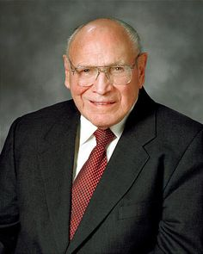
Matthew 23
“Are we righteous in fact, or do we feign obedience only when we think others are watching? The Lord has made it clear that He will not be fooled by appearances, and He has warned us not to be false to Him or to others. Do we, indeed, actually live the gospel, or do we just manifest the appearance of righteousness so that those around us assume we are faithful when, in reality, our hearts and unseen actions are not true to the Lord’s teachings? Do we take on only the ‘form of godliness’ while denying the ‘power thereof’?
Notes:
Pharisee, outwardly, Hypocrisy, woe, phylacteries, synagogues, Zacharias, chickens, sepulchers,

Slide 25
Matthew 23
Hypocrisy = Belief - Actions
Notes:
Pharisee, outwardly, Hypocrisy, woe, phylacteries, synagogues, Zacharias, chickens, sepulchers,

Slide 26
Matthew 23
[Belief (10) – Actions (0)] =
you are a 10 on the hypocrisy scale
Notes:
Pharisee, outwardly, Hypocrisy, woe, phylacteries, synagogues, Zacharias, chickens, sepulchers,

Slide 27
Matthew 23
[Belief (0) – Actions (10)] =
you are a 10 on the hypocrisy scale
Are you a hypocrite?
Notes:
Pharisee, outwardly, Hypocrisy, woe, phylacteries, synagogues, Zacharias, chickens, sepulchers,

Slide 28
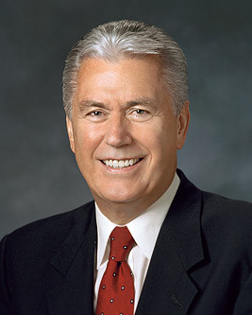
Matthew 23
“If you define hypocrite as someone who fails to live up perfectly to what he or she believes, then we are all hypocrites. None of us is quite as Christlike as we know we should be. But we earnestly desire to overcome our faults and the tendency to sin. With our heart and soul we yearn to become better with the help of the Atonement of Jesus Christ.”
Notes:
Pharisee, outwardly, Hypocrisy, woe, phylacteries, synagogues, Zacharias, chickens, sepulchers,

Slide 29
Matthew 23
What is the opposite of hypocrisy?
Notes:
Pharisee, outwardly, Hypocrisy, woe, phylacteries, synagogues, Zacharias, chickens, sepulchers,

Slide 30

Matthew 23
Notes:
Oranges Rea. Intent

Slide 31
Matthew 23
Notes:
Oranges Rea. Intent

Slide 32
Matthew 23
What are the different forms of hypocrisy?
Looking righteous (overcompensating)
Looking righteous…but not too righteous
Looking rebellious but are righteous
Judging others that don’t belong to our faith
Judging others within our faith
Notes:
Pharisee, outwardly, Hypocrisy, woe, phylacteries, synagogues, Zacharias, chickens, sepulchers,

Slide 33
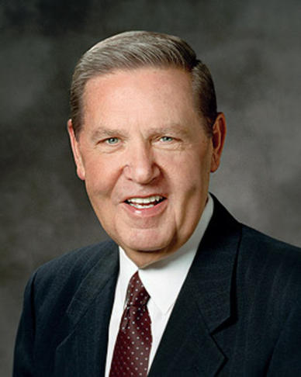
Matthew 23
Which doctrines have been misunderstood that have lead to hypocrisy within the church?
I testify that God loves each of us—insecurities, anxieties, self-image, and all. He doesn’t measure our talents or our looks; He doesn’t measure our professions or our possessions. He cheers on every runner, calling out that the race is against sin, not against each other. I know that if we will be faithful, there is a perfectly tailored robe of righteousness ready and waiting for everyone, “robes … made … white in the blood of the Lamb.”
Notes:
Pharisee, outwardly, Hypocrisy, woe, phylacteries, synagogues, Zacharias, chickens, sepulchers,

Slide 34
Priesthood Holder Motives & Actions
 | PURE MOTIVES | IMPURE MOTIVES
RIGHTEOUS ACTIONS
UNRIGHTEOUS ACTIONS

Slide 35
Priesthood Holder Motives & Actions
 | PURE MOTIVES | IMPURE MOTIVES
RIGHTEOUS ACTIONS
UNRIGHTEOUS ACTIONS |  | Rebel

Slide 36
Priesthood Holder Motives & Actions
 | PURE MOTIVES | IMPURE MOTIVES
RIGHTEOUS ACTIONS
UNRIGHTEOUS ACTIONS | Natural Man | Rebel

Slide 37
Priesthood Holder Motives & Actions
 | PURE MOTIVES | IMPURE MOTIVES
RIGHTEOUS ACTIONS |  | Hypocrite
UNRIGHTEOUS ACTIONS | Natural Man | Rebel

Slide 38
Priesthood Holder Motives & Actions
 | PURE MOTIVES | IMPURE MOTIVES
RIGHTEOUS ACTIONS | Disciple | Hypocrite
UNRIGHTEOUS ACTIONS | Natural Man | Rebel

Slide 39
Priesthood Holder Motives & Actions
 | PURE MOTIVES | IMPURE MOTIVES
RIGHTEOUS ACTIONS | Disciple* | Hypocrite
UNRIGHTEOUS ACTIONS | Natural Man | Rebel
*Not perfect

Slide 40
Matthew 23
What are some cures for hypocrisy?
If you could share one message to people who have witnessed ‘LDS hypocrisy’, what would it be?
Notes:
Pharisee, outwardly, Hypocrisy, woe, phylacteries, synagogues, Zacharias, chickens, sepulchers,

Slide 41
Matthew 23
“Come and add your talents, gifts, and energies to ours. We will all become better as a result….If you expect to find perfect people here, you will be disappointed. But if you seek the pure doctrine of Christ, the word of God “which healeth the wounded soul,” and the sanctifying influence of the Holy Ghost, then here you will find them. In this age of waning faith, when so many feel distanced from heaven’s embrace, here you will find a people who yearn to know and draw closer to their Savior by serving God and fellowmen, just like you. Come, join with us!”
Notes:
Pharisee, outwardly, Hypocrisy, woe, phylacteries, synagogues, Zacharias, chickens, sepulchers,

Slide 42
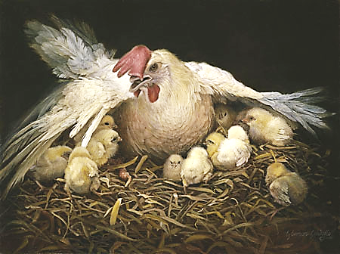
Matthew 23:37–39
Specifically, what can you do to be a good (non-hypocritical) chicken?

Slide 43
2 Nephi 31:13

Slide 44
Matthew 23

