Slide 1
Firsts
John 2

Slide 2
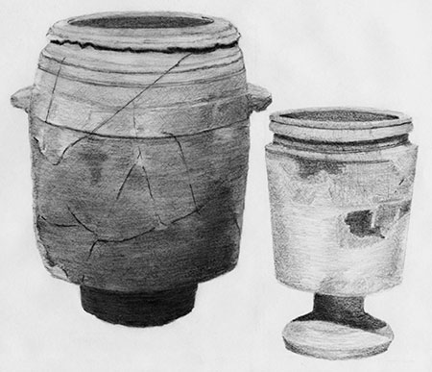
What “Firsts” do you remember?
First day of school
First job
Frist kiss
First time feeling the Holy Ghost
JESUS FIRST MIRACLE: John 2:1-11
Doctrines
Principles of Application

Slide 3
Firkin = nine gallons
Six pots = 150 gallons
How do His first and last miracles relate to each other?
Our Lord is a God of acceleration.
How long does it take to make good wine?
How long does it take to make good wine using bad water?
David’s kingship
Peter’s imprisonment
Daniel’s vision
Book of Mormon translation (field sewed with gypsum).
Elijah escaping from Ahab
Isaiah 40:31

Slide 4
John 2 –Principles
Wine symbolizes doctrine and also the atonement (obviously the atonement). When the marriage has no more wine, it could symbolize their desire for new doctrine; the old wine (doctrine) they drank was good (the Law of Moses was a good thing) but they wanted the higher law from Christ as well. Notice that their forefathers became drunk with false doctrines (Isa 28)-- false doctrine always leads to sin and apostasy.
In another light, with the waterpots in Cana, there were 6. They didn't have runinng water so they would have people wash from one waterpot to another until they were finally cleansed (or became cleanest) by the last waterpot.
There are 6 waterpots and 6 represents 'incomplete'- however, Christ is the 7th waterpot and we're not fully clean until we've come unto Him.
No matter how dirty our sins (water in the waterpots) are, the atonement can cleans us.

Slide 5
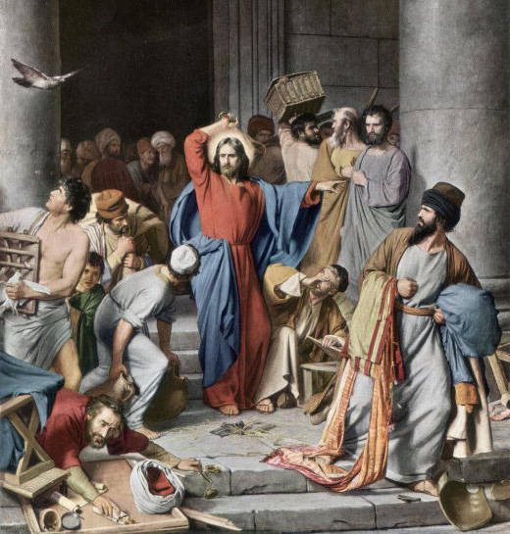
Cleanse the Temple
John 2:13-16
How was he able to clean that space?

Slide 6
How did Jesus’s actions show His reverence for His Father’s house?
How is it possible to show our reverence for the temple even when we are not in the temple?
Why are these stories back to back?

Slide 7
Firsts
John 2

