Slide 1
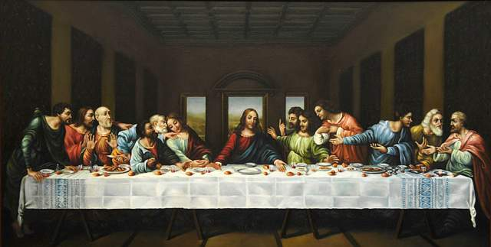
The Upper Room
John 13-17

Slide 2
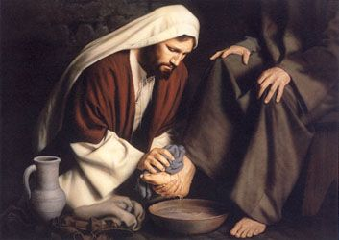
John 13-17
Washing the feet
How would you feel?
Read John 13:1-12 –
Read John 13:13-17
What is the ‘sandal principle’?

Slide 3
John 13-17
In New Testament times, people wore open sandals, walked on mostly dirt roads that accumulated the filth of beasts, and had only irregular access to bathing water. Their feet became very dirty, and washing another person’s feet could have been a distasteful task. … This custom of hospitality was usually performed by the lowest level of servants” (New Testament Student Manual [Church Educational System manual, 2014], 242).
By washing His Apostles’ feet, the Savior not only performed a beautiful act of service, but He also fulfilled the law of Moses and instituted a sacred ordinance (see Bruce R. McConkie, Doctrinal New Testament Commentary, 3 vols. [1965–73], 1:708–9).
This ordinance was restored in our dispensation through the Prophet Joseph Smith (see D&C 88:74–75, 137–41).

Slide 4
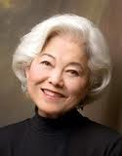
“He's not embarrassed by us, angry at us, or shocked. He wants us in our brokenness, in our unhappiness, in our guilt and our grief.” (Chieko N. Okazaki, Lighten Up, Preface; p. 174)

Slide 5
John 13-17
According John 13:13–16, what example did the Savior set and invite His Apostles to follow?
Based on the Savior’s promise in John 13:17, what blessing will we receive as we follow His example by serving others?
How have you been a blessing to someone TODAY?

Slide 6
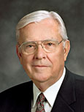
John 13-17
“In your morning prayer each new day, ask Heavenly Father to guide you to recognize an opportunity to serve one of His precious children. Then go throughout the day with your heart full of faith and love, looking for someone to help. If you do this, your spiritual sensitivities will be enlarged and you will discover opportunities to serve that you never before realized were possible” (“Be Anxiously Engaged,” Ensign or Liahona, Nov. 2012, 31).

Slide 7
John 13-17
John 13:34–35: What would help others recognize that the Apostles were disciples of Jesus Christ.
“Love One Another” (Hymns, no. 308)

Slide 8
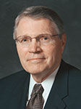
John 13-17
“Two young missionaries knocked on a door, hoping to find someone to receive their message. The door opened, and a rather large man greeted them in a less-than-friendly voice: ‘I thought I told you not to knock on my door again. I warned you before that if you ever came back, it would not be a pleasant experience. Now leave me alone.’ He quickly closed the door.
“As the elders walked away, the older, more experienced missionary put his arm on the younger missionary’s shoulder to comfort and encourage him. Unknown to them, the man watched them through the window to be sure they understood his message. He fully expected to see them laugh and make light of his curt response to their attempted visit. However, as he witnessed the expression of kindness between the two missionaries, his heart was instantly softened. He reopened the door and asked the missionaries to come back and share their message with him.
“… This principle of having love one to another and developing our ability to be Christ-centered in how we think, speak, and act is fundamental in becoming disciples of Christ” (“He Truly Loves Us,”Ensign or Liahona, May 2012, 17).
Elder Paul E. Koelliker

Slide 9
Joseph B. Wirthlin: “Love is the beginning, the middle, and the end of the pathway of discipleship. … In the end love leads us to the glory and grandeur of eternal life. …
“When Jesus gave His disciples a new commandment to ‘love one another; as I have loved you’ [John 13:34], He gave to them the grand key to happiness in this life and glory in the next. Love is the greatest of all the commandments—all others hang upon it. It is our focus as followers of the living Christ” (“The Great Commandment,” Ensign or Liahona, Nov. 2007, 28–29, 30–31).
Elder M. Russell Ballard: “The love the Savior described is an active love. It is not manifested through large and heroic deeds but rather through simple acts of kindness and service” (“Finding Joy through Loving Service,” Ensign or Liahona, May 2011, 47).
President Dieter F. Uchtdorf: “Love is the defining characteristic of a disciple of Christ” (“The Love of God,” Ensign or Liahona, Nov. 2009, 22).

Slide 10
John 13-17
John 14:1–6. What Jesus taught His Apostles to help comfort them.
How is Jesus Christ:
The Way?
The Truth?
The Life?

Slide 11
THE WAY: Elder Lawrence
https://www.youtube.com/watch?v=I8dmTvCmoMc

Slide 12
THE WAY: Elder Lawrence
https://www.youtube.com/watch?v=I8dmTvCmoMc

Slide 13
John 13-17
Joseph Smith taught in the Lectures on Faith "that three things are necessary in order that any rational and intelligent being may exercise faith in God unto life and salvation." These he named as —
1. The idea that he actually exists;
2. A correct idea of his character, perfections, and attributes; and
3. An actual knowledge that the course of life which he is pursuing is according to divine will.
DOCTRINES OF THE GODHEAD
Are they omnipresent?
Are they omnipotent?
Are they omniscient?
GOD is omniscient (Moses 1:6)
JESUS is omniscient (D&C 38:1-2)
HOLY GHOST is omniscient (D&C 42:17)

Slide 14
John 13-17
GOD
What does God look like? (John 14:6-9)
President Joseph F. Smith explained: “Jesus Christ, the Son of God, is ‘the express image’ of His Father’s person (Hebrews 1:3). He walked the earth as a human being, as a perfect man, and said, in answer to a question put to Him: ‘He that hath seen me hath seen the Father’ (John 14:9). This alone ought to solve the problem to the satisfaction of every thoughtful, reverent mind. The conclusion is irresistible, that if the Son of God be the express image (that is, likeness) of His Father’s person, then His Father is in the form of man; for that was the form of the Son of God, not only during His mortal life, but before His mortal birth, and after His resurrection. It was in this form that the Father and the Son, as two personages, appeared to Joseph Smith, when, as a boy of fourteen years, he received his first vision” (Teachings of Presidents of the Church: Joseph F. Smith [1998], 334).

Slide 15
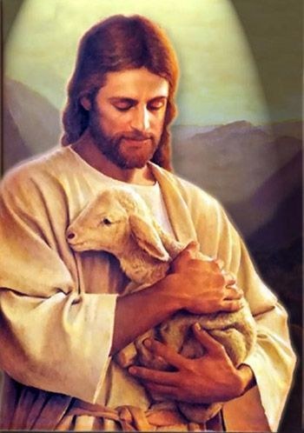
“In all that Jesus came to say and do He was showing us who and what God our Eternal Father is like, how completely devoted He is to His children in every age and nation. In word and in deed Jesus was trying to reveal and make personal to us the true nature of His Father, our Father in Heaven.
“He did this because all of us need to know God more fully in order to love Him more deeply and obey Him more completely. …
“So feeding the hungry, healing the sick, rebuking hypocrisy, pleading for faith—this was Christ showing us the way of the Father.” (“The Grandeur of God,” Elder Holland, Ensign, Nov. 2003, 70, 72).

Slide 16
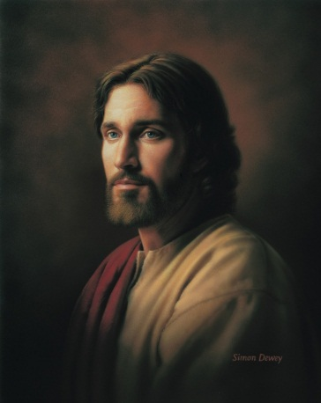
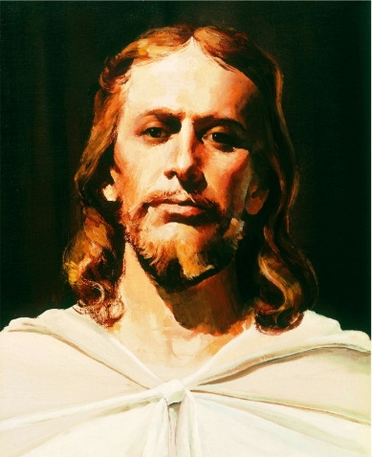
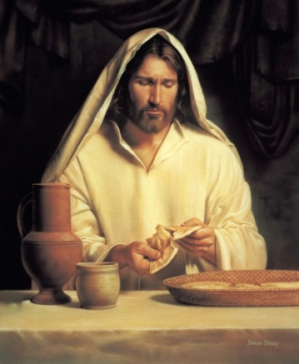
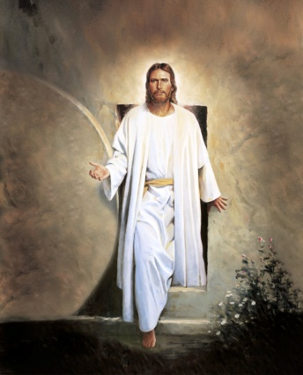
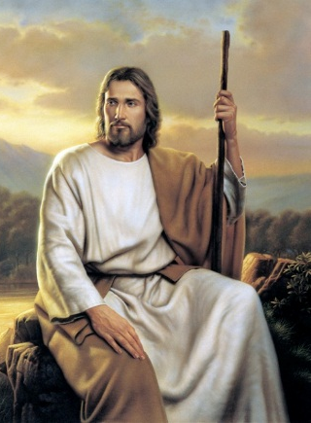
Doctrine and Covenants 93:12–13
In what ways did Jesus ‘express’ His Father’s example?
Define ‘grace’
Grace is not the light at the end of the tunnel.
Grace is the light that moves us through the tunnel.
Grace doesn't help us earn heaven.
Grace helps us learn heaven
Grace is not about filling gaps.
Grace is about filling us.
Grace doesn't just save us from sin.
Grace saves us for heaven.
Grace isn't just a favor He gives to us.
Grace is an investment He made in us.

Slide 17
Grace doesn't just cleanse us.
Grace transforms us.
Grace does not just allow us to go home to heaven.
Grace helps us feel at home when we reach heaven.
Grace is not achieved down the road.
Grace is received right now.
Grace doesn’t make up the difference.
Grace makes all the difference.
Grace is not a finishing touch.
Grace is the Finisher’s touch.

Slide 18
Grace
Brad Wilcox

Slide 19
John 13-17
JESUS
What do you know about the Second Comforter?
Read John 14:18, 21, 27

Slide 20
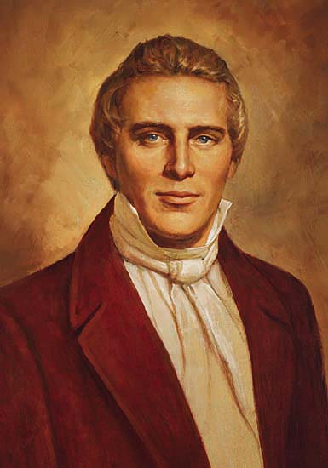
The Prophet Joseph Smith explained: “There are two Comforters spoken of. One is the Holy Ghost, the same as given on the day of Pentecost, and that all Saints receive after faith, repentance, and baptism. …
“The other Comforter spoken of is a subject of great interest, and perhaps understood by few of this generation. After a person has faith in Christ, repents of his sins, and is baptized for the remission of his sins and receives the Holy Ghost, (by the laying on of hands), which is the first Comforter, then let him continue to humble himself before God, hungering and thirsting after righteousness, and living by every word of God, and the Lord will soon say unto him, Son, thou shalt be exalted. When the Lord has thoroughly proved him, and finds that the man is determined to serve Him at all hazards, then the man will find his calling and his election made sure, then it will be his privilege to receive the other Comforter, which the Lord hath promised the Saints, as is recorded in the testimony of St. John, in the 14th chapter, from the 12th to the 27th verses” (in History of the Church, 3:380).

Slide 21
John 13-17
FRIENDS OF CHRIST
Read the following passages, looking to see principles about how Jesus chose His friends (disciples):
Luke 6:12-13
John 15:14
Mark 3:14
John 15:16

Slide 22
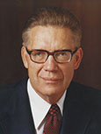
John 13-17
HOLY GHOST
“As long as Jesus was with the disciples in person, there was not the full need for them to have the constant companionship of the Spirit that there would be after Jesus left” (Doctrinal New Testament Commentary, 3 vols. [1965–73], 753).

Slide 23
John 13-17
John 16:5–6
HOLY GHOST
Name as many titles/roles of the Holy Ghost as you can
Read John 14:17, 26, 15:26, 16:8, 13
How have you seen these roles in your life?

Slide 24
John 13-17
Are they one? John 17:11, 21-22
Read John 17:14-16. How can we live like this?

Slide 25
John 13-17
“In the Church, we often state the couplet: ‘Be in the world but not of the world.’ …
“Perhaps we should state the couplet … as two separate admonitions. First, ‘Be in the world.’ Be involved; be informed. Try to be understanding and tolerant and to appreciate diversity. Make meaningful contributions to society through service and involvement. Second, ‘Be not of the world.’ Do not follow wrong paths or bend to accommodate or accept what is not right. …
“Members of the Church need to influence more than we are influenced. We should work to stem the tide of sin and evil instead of passively being swept along by it. We each need to help solve the problem rather than avoid or ignore it” (“The Effects of Television,” Ensign, May 1989, 80).

Slide 26
John 13-17
Why did Jesus teach so much about the Godhead?
Read John 17:3

Slide 27
John 13-17
“It is one thing to know about God and another to know him. We know about him when we learn that he is a personal being in whose image man is created; when we learn that the Son is in the express image of his Father’s person; when we learn that both the Father and the Son possess certain specified attributes and powers. But we know them, in the sense of gaining eternal life, when we enjoy and experience the same things they do. To know God is to think what he thinks, to feel what he feels, to have the power he possesses, to comprehend the truths he understands, and to do what he does. Those who know God become like him, and have his kind of life, which is eternal life” (Doctrinal New Testament Commentary, 3 vols. [1965–73], 1:762).

Slide 28
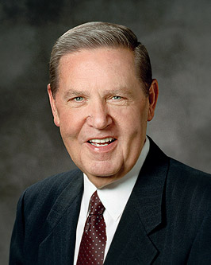
Elder Jeffrey R. Holland: “‘Abide in me’ [John 15:4] is an understandable and beautiful enough concept in the elegant English of the King James Bible, but ‘abide’ is not a word we use much anymore. So I gained even more appreciation for this admonition from the Lord when I was introduced to the translation of this passage in another language. In Spanish that familiar phrase is rendered ‘permaneced en mi.’ Like the English verb ‘abide,’ permanecer means ‘to remain, to stay,’ but even [English speakers] like me can hear the root cognate there of ‘permanence.’ The sense of this then is ‘stay—but stay forever.’ That is the call of the gospel message to [everyone] in the world. Come, but come to remain. Come with conviction and endurance. Come permanently, for your sake and the sake of all the generations who must follow you. …
“… Christ is everything to us and we are to ‘abide’ in Him permanently, unyieldingly, steadfastly, forever. For the fruit of the gospel to blossom and bless our lives, we must be firmly attached to Him, the Savior of us all, and to this His Church, which bears His holy name. He is the vine that is our true source of strength and the only source of eternal life” (“Abide in Me,” Ensign or Liahona, May 2004, 32).

Slide 29
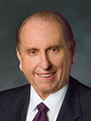
“Let us be of good cheer as we go about our lives. Although we live in increasingly perilous times, the Lord loves us and is mindful of us. He is always on our side as we do what is right. He will help us in time of need. … Our lives can also be filled with joy as we follow the teachings of the gospel of Jesus Christ.
“The Lord admonished, ‘Be of good cheer; I have overcome the world’ [John 16:33]. What great happiness this knowledge should bring to us. He lived for us and He died for us. He paid the price for our sins. May we emulate His example. May we show our great gratitude to Him by accepting His sacrifice and living lives that will qualify us to return and one day live with Him” (“God Be with You Till We Meet Again,” Ensign or Liahona, Nov. 2012, 110–11).

Slide 30
The Upper Room
John 13-17

