Slide 1
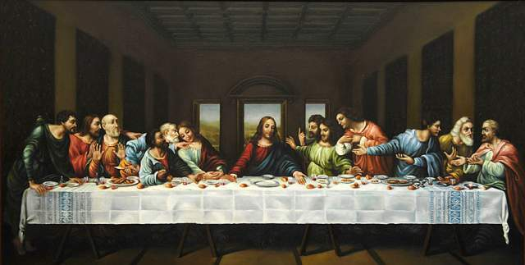
John 13-17
Teachings at the Last Supper

Slide 2
John 13-17
Teachings at the Last Supper
Everyone needs scriptures
We will rotate after 2mins at each station
Rotate when you hear the random sound from the computer
Please, only talk to the person immediately in front of you
The Inner Row moves

Slide 3
John 13-17
In John 13, the Lord provides a huge service for his disciples. Read John 13:5, 13-17.
Talk about some specific service can you do this week for someone else.
What is one of the kindest things you’ve done for someone else?

Slide 4
John 13-17
The last supper was a sacred time for the disciples, except for one. Read John 13:21-30.
How could we as Latter-Day disciples betray our Savior?
Have you ever been betrayed by someone else?
Have you ever been forgiven by someone that betrayed you?

Slide 5
John 13-17
Here comes some love. Read John 13:34-35. Then read Hymn 308.
Talk about the ways that God has shown love for you.
Talk about ways that you have shown love to others.

Slide 6

John 13-17
[Show Bible video “The Last Supper” (5:57)]

Slide 7
John 13-17
A lot of people don’t realize how the Father and the Son are “one.” Read John 14:10-11 and 20-21.
How are the Father and the Son one?
How can you become “one” with the Father and the Son?
Who, in your life, do you feel a oneness with?

Slide 8
John 13-17
Read John 14:15, 21, 23, 24, 28 find and mark the repeated phrase.
How many times is the phrase repeated?
Ask your partner why they love Jesus.
Ask your partner who the first person they ever loved was. ☺

Slide 9
John 13-17
The Holy Ghost is the third member of the Godhead. Read John 14:16-18 and 26-27.
What are three titles given to the Holy Ghost?
How have you felt the help of the Holy Ghost recently?

Slide 10
John 13-17
John 15 continues to show the importance of Love. Mark the word “love” every time it appears in verses 9-19.
Pick a favorite phrase or verse and memorize it together!

Slide 11
John 13-17
Read John 15:13-15.
How has Christ demonstrated his love for his friends?
How can you become a friend of Christ?
Tell your partner about your best friend and why you are BFFs.

Slide 12
John 13-17
In John 16 the Savior drops a bombshell. Read John 16:1-3.
What is going to happen to the apostles? What would you do if you were one of them?
Have you ever protected another person in your life?

Slide 13
John 13-17
In John 16 the apostles were sad about Christ leaving and His death. Read verse 20-22 and discuss how Christ turns sorrow into joy for you.
Share with your partner one of the happiest days of your life.

Slide 14
John 13-17
After teaching and teaching tons of truth and showing them His great power, Christ asks a huge question in John 16:31. Tell your partner your answer to this question. Then tell them why.
Ask your partner three random questions. ☺

Slide 15
John 13-17
[Show Bible video “Jesus warns Peter and offers the Intercessory Prayer” (4:48)]

Slide 16
Done!
Well done!

