Slide 1
Parable of the Laborers
Matthew 20

Slide 2
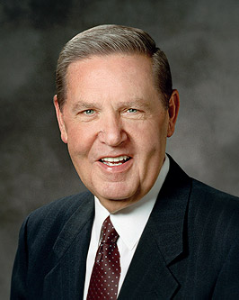
Envy and Jealousy
“There are going to be times in our lives when someone else gets an unexpected blessing or receives some special recognition. May I plead with us not to be hurt—and certainly not to feel envious when good fortune comes to another person? We are not diminished when someone else is added upon. We are not in a race against each other. …The race we are really in is the race against sin, and surely envy is one of the most universal of those” (“The Laborers in the Vineyard,” Ensign or Liahona, May 2012, 31).
What things make you a bit jealous?

Slide 3
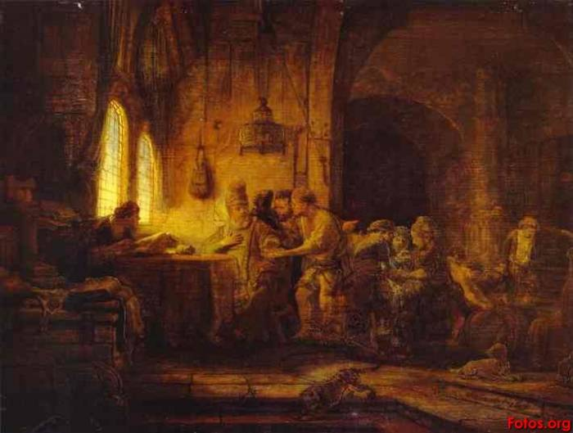
Parable of the Laborers in the Vineyard

Slide 4
Matthew 20
What is the context? (Matt 19)

Slide 5
To The Work
Parable of the Laborers in the Vineyard
Matthew 20:1-16
Symbols
Landowner - Christ
Vineyard - The Church
Laborers - Christians
End of day - Judgment
Reward - Eternal salvation

Slide 6
Matthew 20:1-16
LABORERS (START TIME) | SALARY AGREED ON | HOURS WORKED | AMOUNT PAID
Early in the morning (6:00 a.m.)
3rd hour (9:00 a.m.)
6th hour (12:00 p.m.)
9th hour (3:00 p.m.)
11th hour (5:00 p.m.)

Slide 7
The Parable and Its Message
Owner hires workers – wage = penny
early
third hour
sixth hour
ninth hour
eleventh hour
If you were among the laborers who worked all day, how would you feel if you received the same reward as those who worked for only an hour?
If the reward in this parable represents eternal life, what could the labor represent?
denarius
All paid the same

Slide 8
Matthew 20
Related scriptures with grace / mercy:
2 Nephi 25:23
2 Nephi 2:3
Who brings salvation?
What is the value of ?
8
8
8
+ 1 =
Christ’s Grace
us
exaltation
Moroni 7:5-7, Moroni 10:32, Omni 1:26, 2 Nephi 25:23

Slide 9
Elder Dallin H. Oaks
General Conference October 2000
“The Master’s reward in the Final Judgment will not be based on how long we have labored in the vineyard. We do not obtain our heavenly reward by punching a time clock. What is essential is that our labors in the workplace of the Lord have caused us to become something. For some of us, this requires a longer time than for others. What is important in the end is what we have become by our labors.”

Slide 10
Elder Dallin H. Oaks
General Conference October 2000
“Many who come in the eleventh hour have been refined and prepared by the Lord in ways other than formal employment in the vineyard. These workers are like the prepared dry mix to which it is only necessary to “add water”—the perfecting ordinance of baptism and the gift of the Holy Ghost. With that addition—even in the eleventh hour—these workers are in the same state of development and qualified to receive the same reward as those who have labored long in the vineyard.”

Slide 11
Orson F. Whitney
General Conference April 1928
“Perhaps the Lord needs such men on the outside of His Church to help it along. They are among its auxiliaries, and can do more good for the cause where the Lord has placed them, than anywhere else. Hence, some are drawn into the fold and receive a testimony of the truth; while others remain unconverted … the beauties and glories of the gospel being veiled temporarily from their view, for a wise purpose. The Lord will open their eyes in His own due time. God is using more than one people for the accomplishment of His great and marvelous work. The Latter-day Saints cannot do it all. It is too vast, too arduous for any one people. … We have no quarrel with the Gentiles. They are our partners in a certain sense.”

Slide 12
The Parable and Its Message
Show (“The Laborers in the Vineyard,” April 2012 General Conference

Slide 13
The Parable and Its Message
What kind of laborers does the Lord want to ‘hire’?
What did the lord of the vineyard mean when he asked, “Is thine eye evil, because I am good?” (verse 15).
Elder Jeffrey R. Holland: “Why should you be jealous because I choose to be kind?” (“The Laborers in the Vineyard,” Ensign or Liahona, May 2012, 31).
What is the point of being good if someone can be baptized right before dying and be saved?
What blessings can you enjoy because you have the opportunity to make and keep covenants with Heavenly Father early in your life?

Slide 14
Parable of the Laborers
Matthew 20

