Slide 1
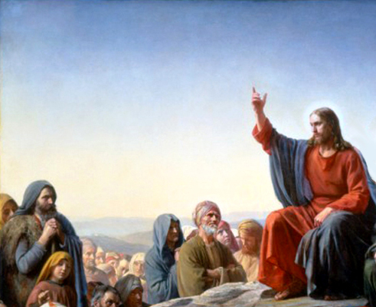
The Sermon on the Mount

Slide 2
The Sermon on the Mount
The Higher Law
The Lord’s Prayer
Treasures in Heaven

Slide 3
The Sermon on the Mount
Weird things that people do to be recognized
1 Peter 2:9
What makes Latter-Day Saints ‘peculiar’ according to the Lord’s definition?

Slide 4
The Sermon on the Mount
“Nobody becomes perfect in this life… Becoming perfect in Christ is a process. We begin to keep the commandments today, and we keep more of them tomorrow. If we chart a course of becoming perfect, and, step by step and phase by phase, are perfecting our souls by overcoming the world, then it is absolutely guaranteed—there is no question whatever about it—we shall gain eternal life. If we chart a course and follow it to the best of our ability in this life, then when we go out of this life, we’ll continue in exactly that same course…The prophet [Joseph Smith] told us that there are many things that people have to do, even after the grave, to work out their salvation”
Bruce R. McConkie, 1978 Devotional Speeches of the Year

Slide 5
The Sermon on the Mount
Basketball

Slide 6

The Sermon on the Mount

Slide 7

The Sermon on the Mount

Slide 8
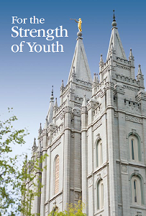
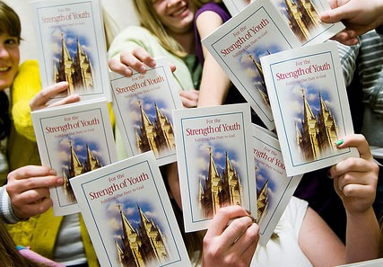
The Sermon on the Mount

Slide 9
Quiz

Slide 10
The Sermon on the Mount
1. Name this booklet
2 Non-Member asks you to Homecoming
3 Homecoming dress
4 Movie for the day-date
5 Turns on the radio on the way to the dance
6 Slow dance
7 Say goodnight

Slide 11
The Sermon on the Mount
1 Nephi 3:5,7.
Telestial - How far can I go before I talk to the bishop?
Terestrial - I want to be good, but not that good
Celestial - I want to be as good as I can be
Matthew 7:21-23
Matthew 7:24-29

Slide 12
The Sermon on the Mount

