Slide 1
Christmas Spirit Test
Name that Christmas Carol

Slide 2
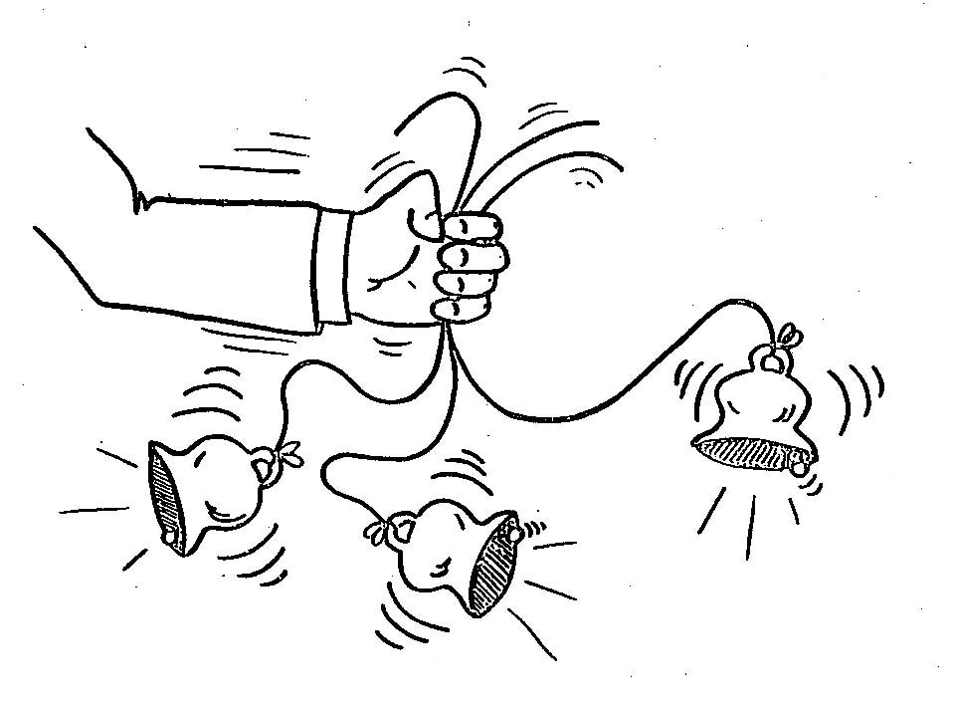
1

Slide 3
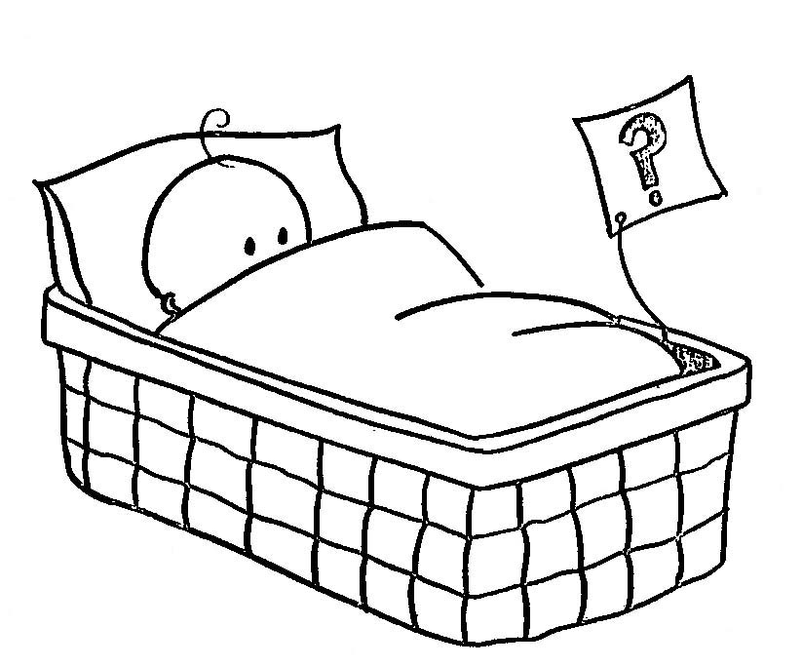
2

Slide 4
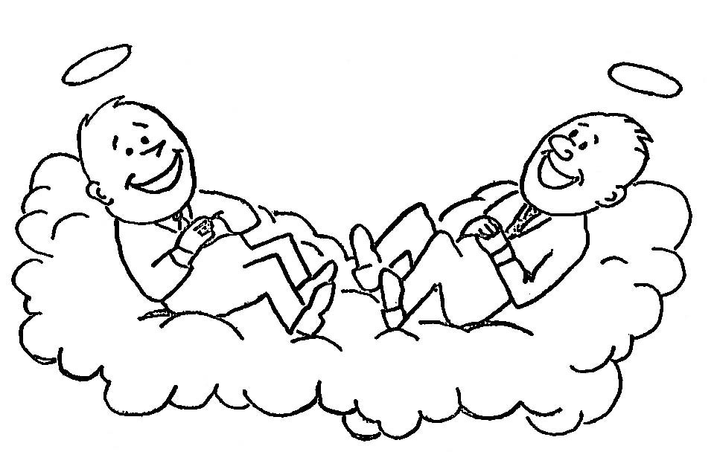
3

Slide 5
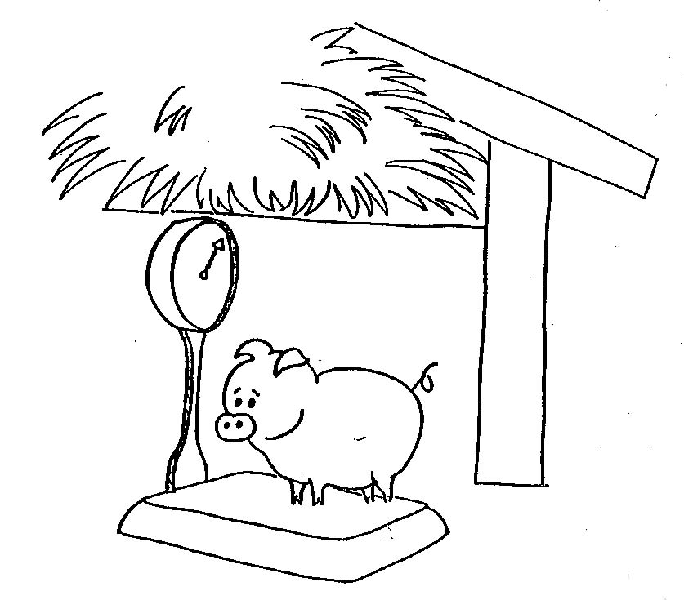
4

Slide 6
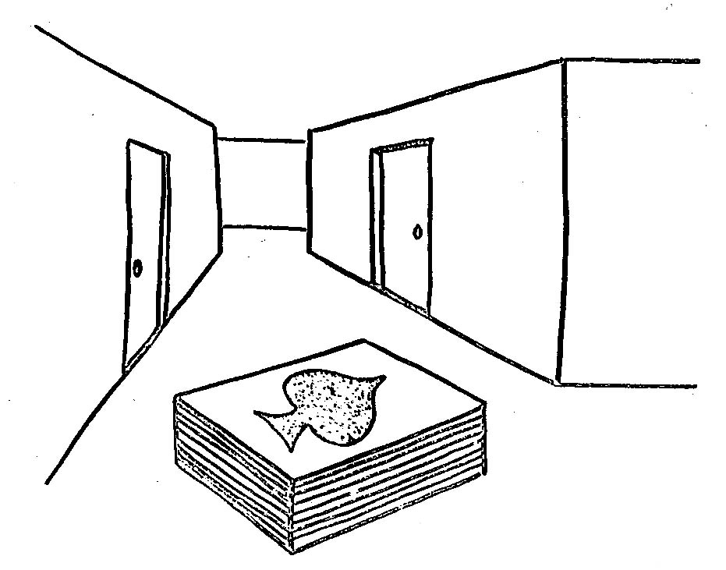
5

Slide 7
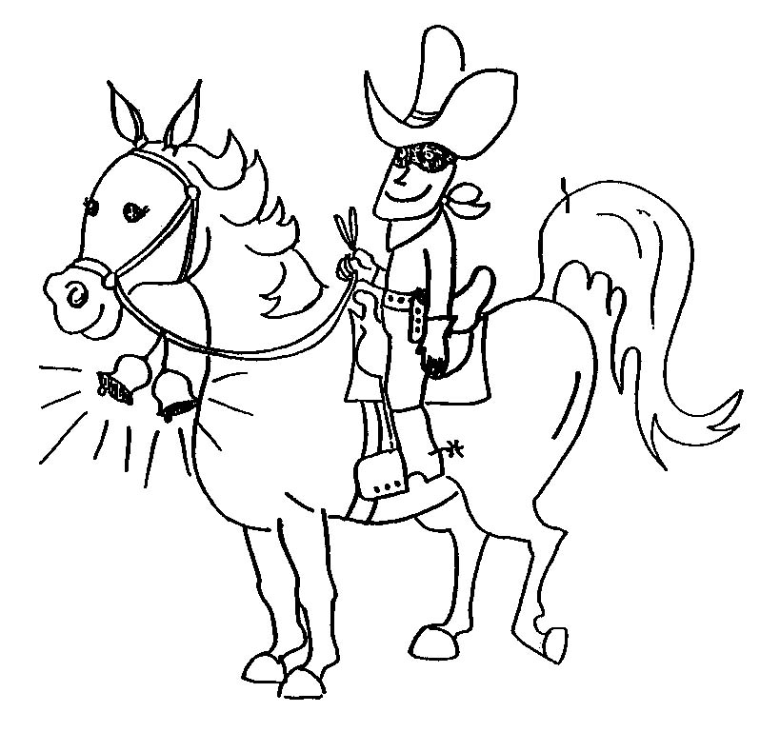
6

Slide 8
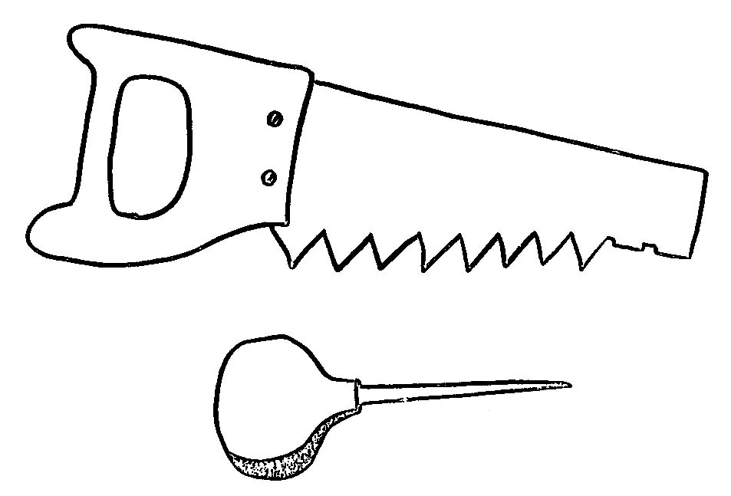
7

Slide 9
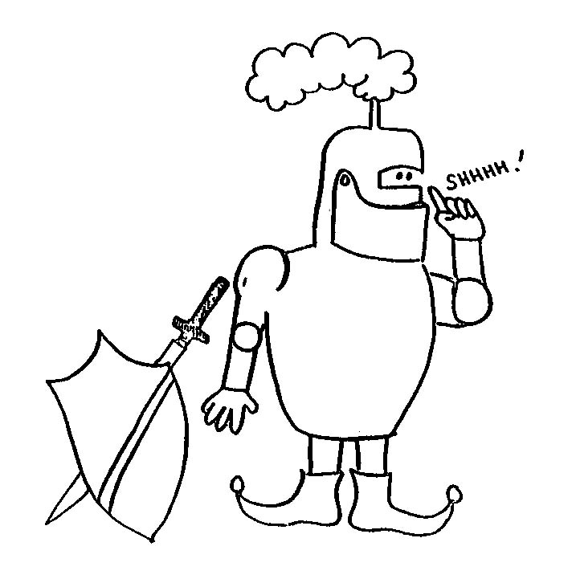
8

Slide 10
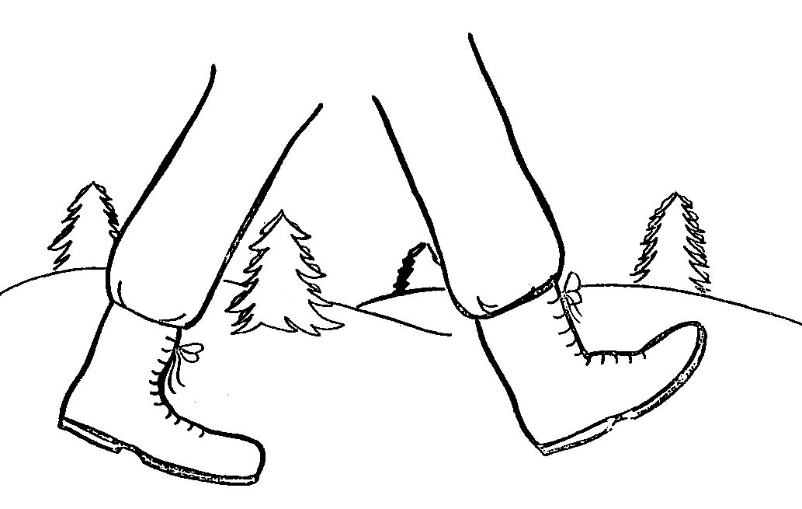
9

Slide 11
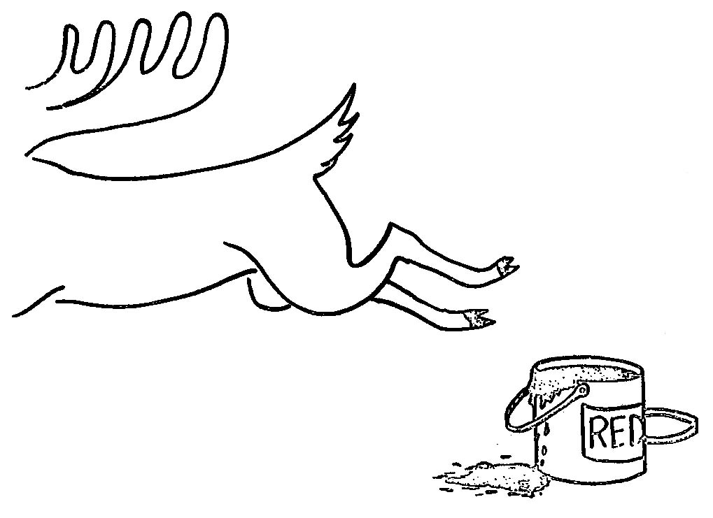
10

Slide 12
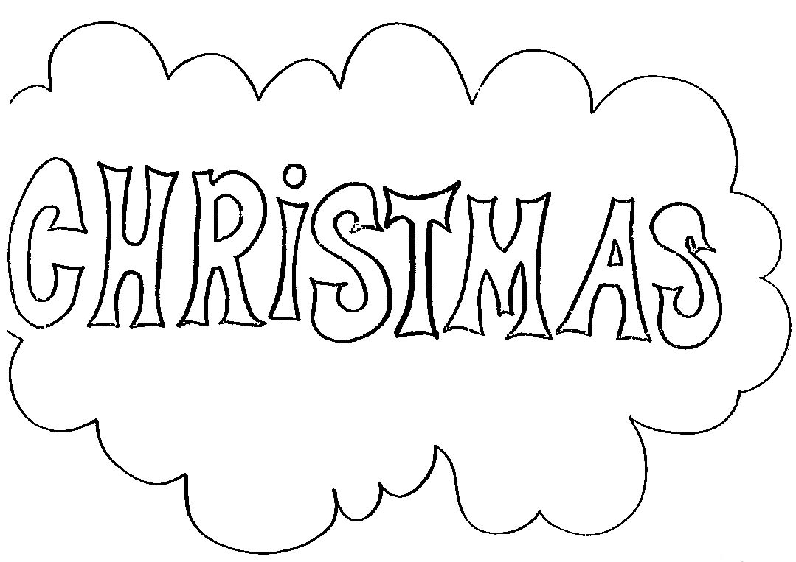
11

Slide 13
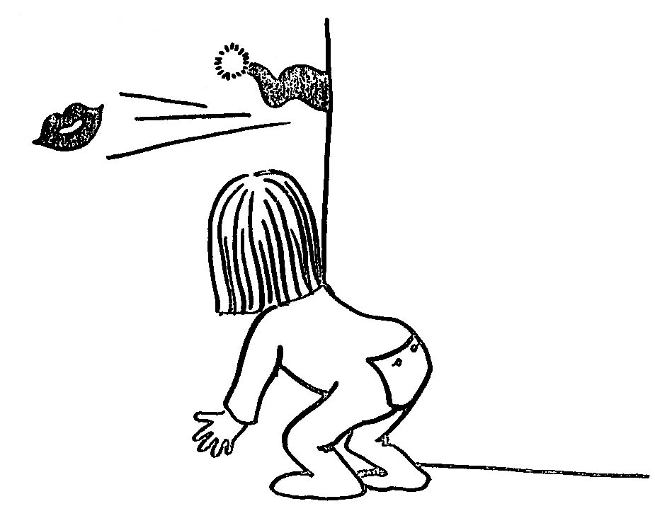
12

Slide 14

13

Slide 15
14

Slide 16
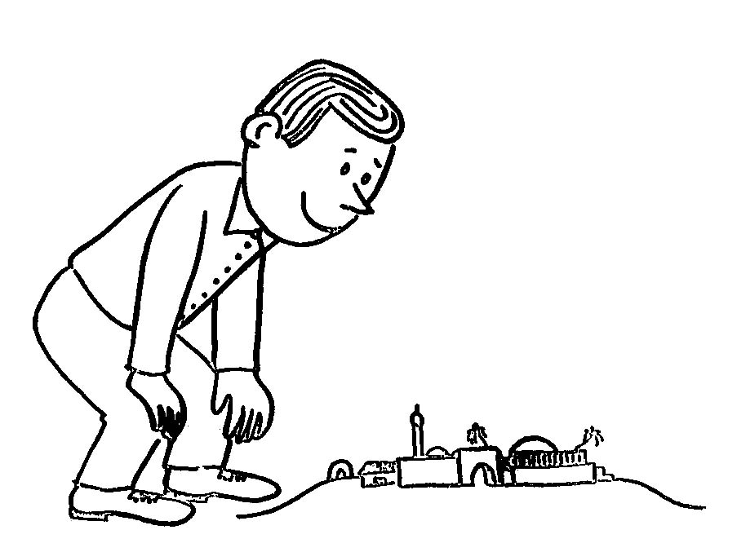
15

Slide 17
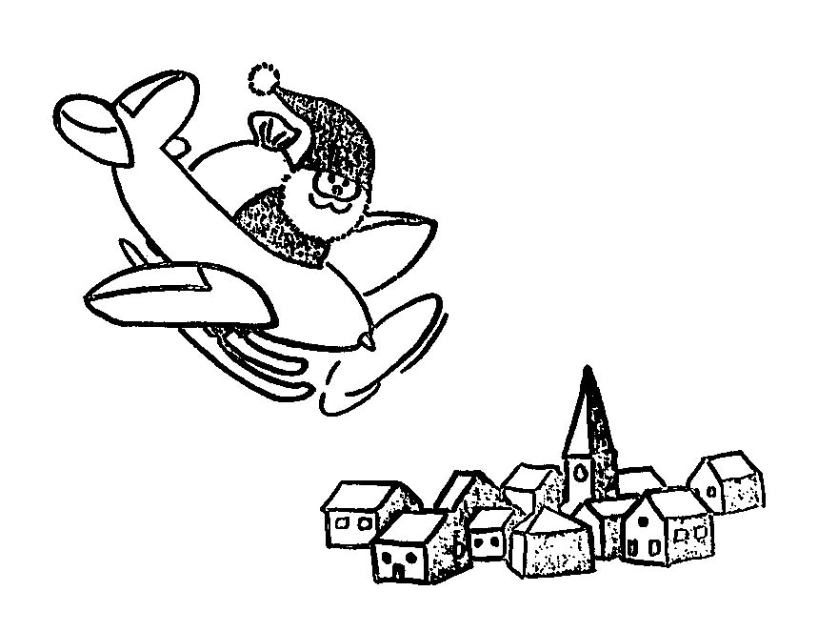
16

Slide 18
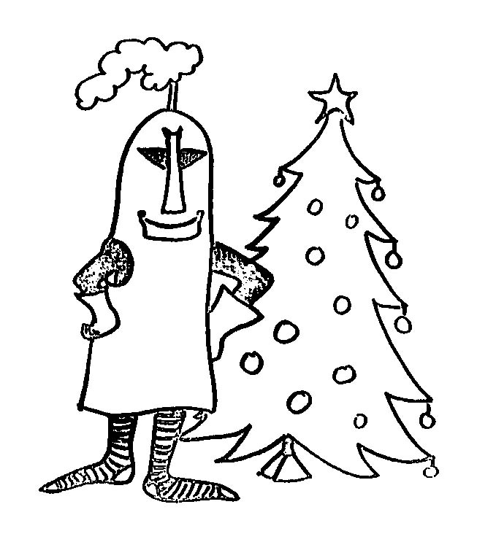
17

Slide 19
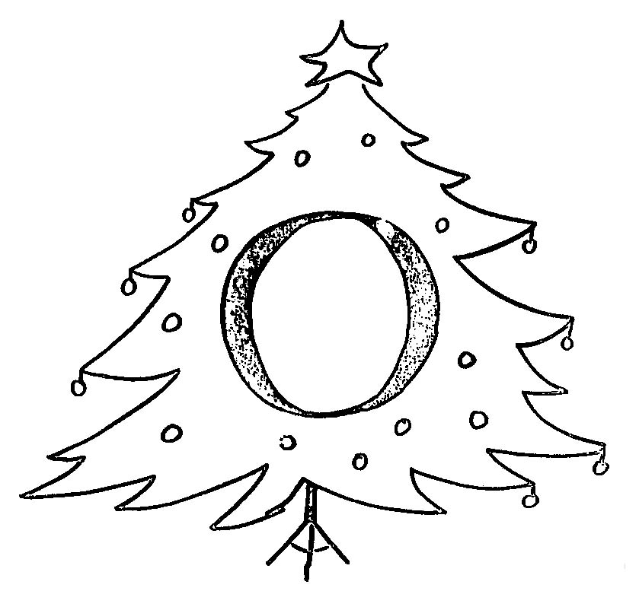
18

Slide 20
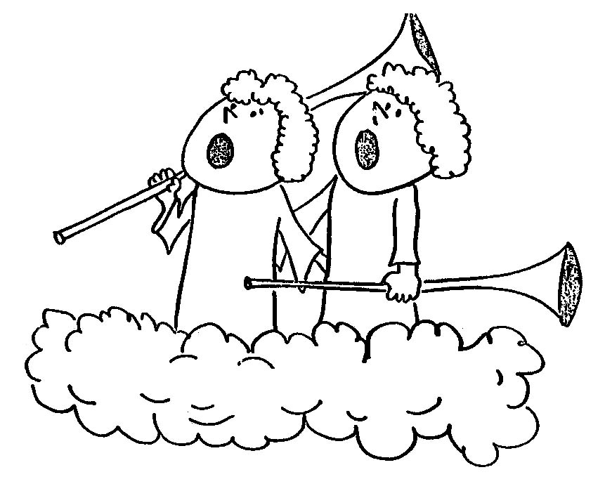
19

Slide 21
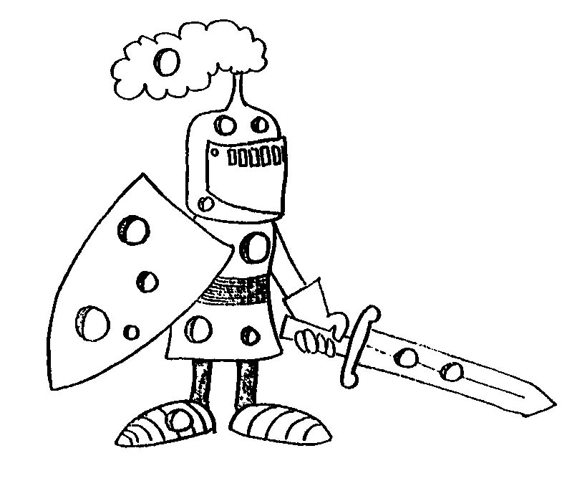
20

Slide 22
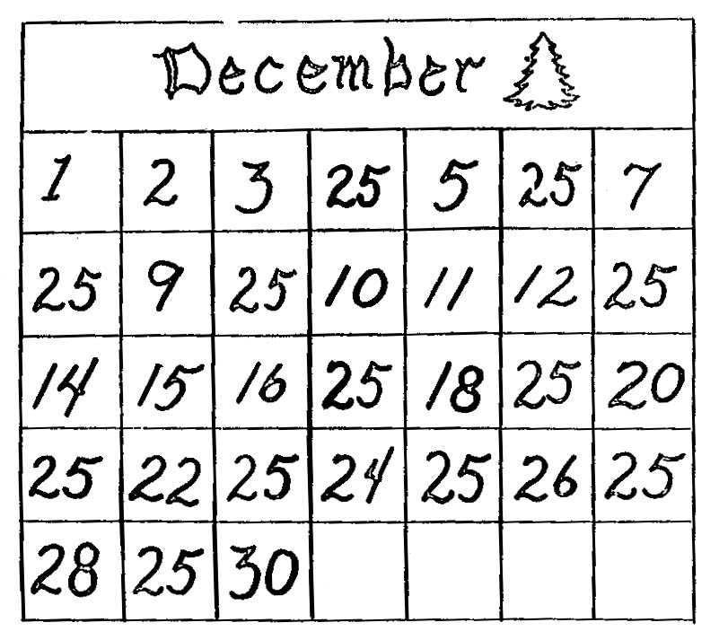
21

Slide 23
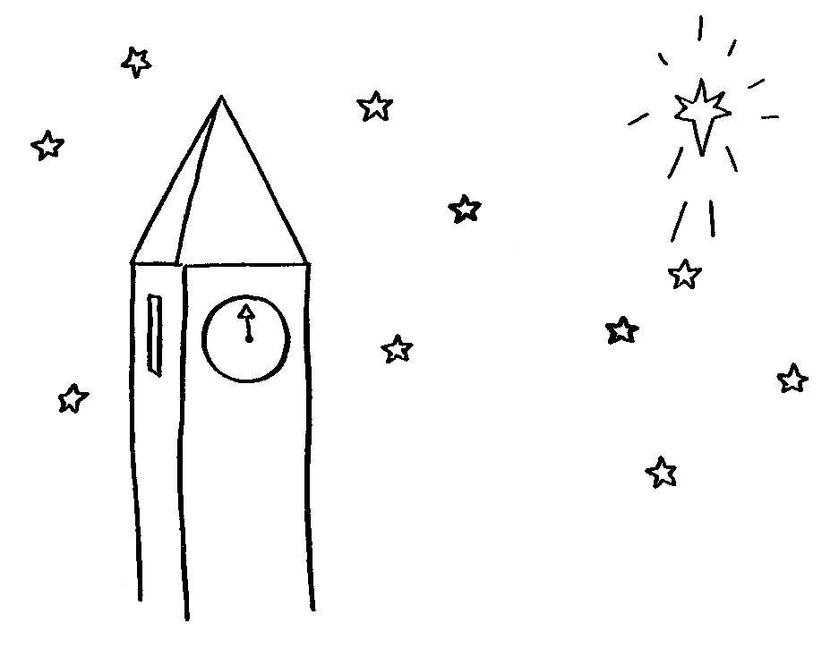
22

Slide 24
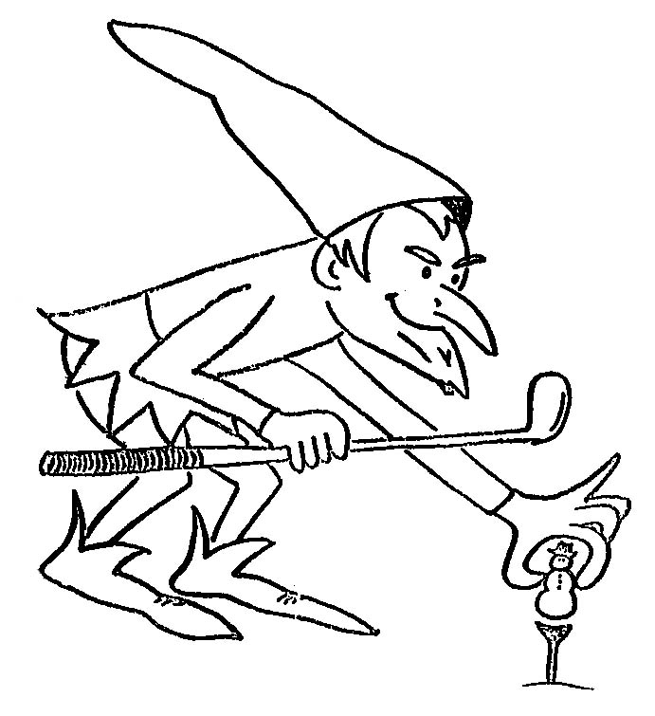
23

Slide 25
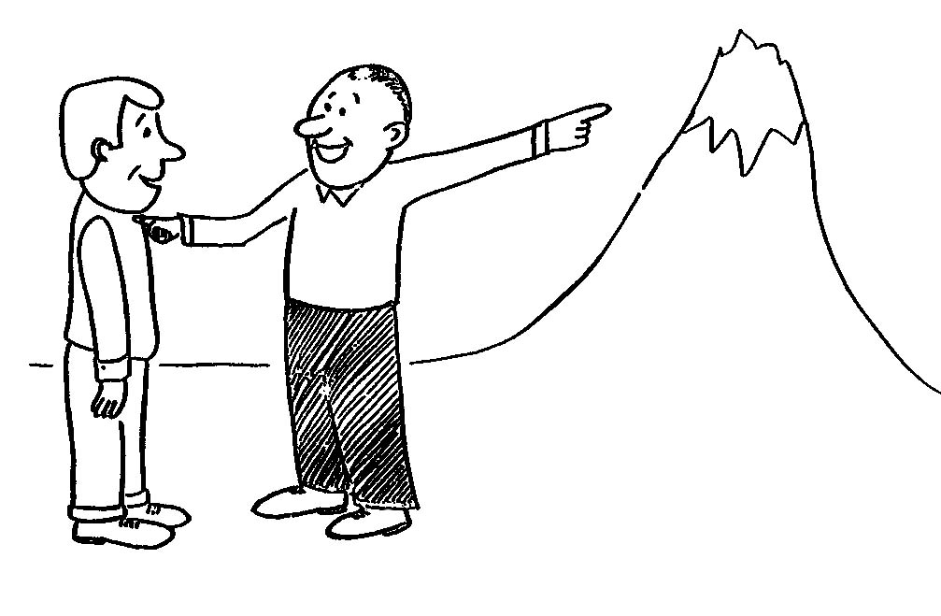
24

Slide 26
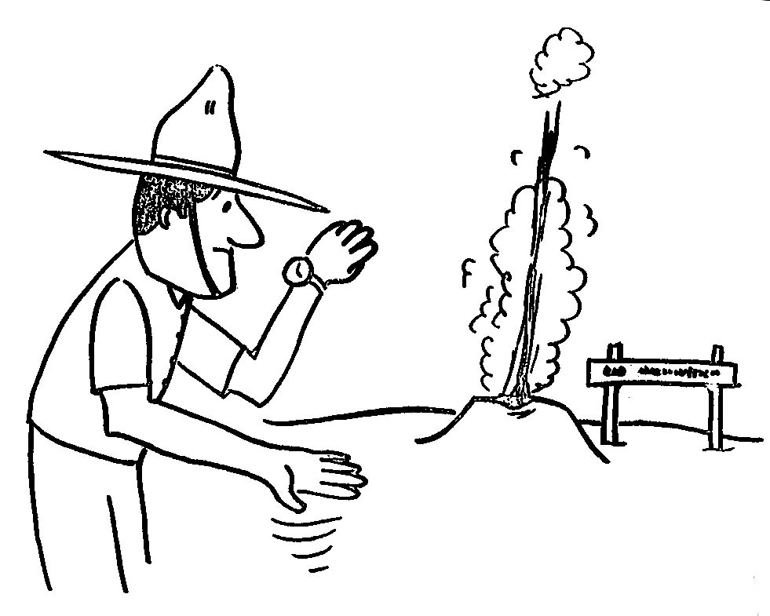
25

Slide 27
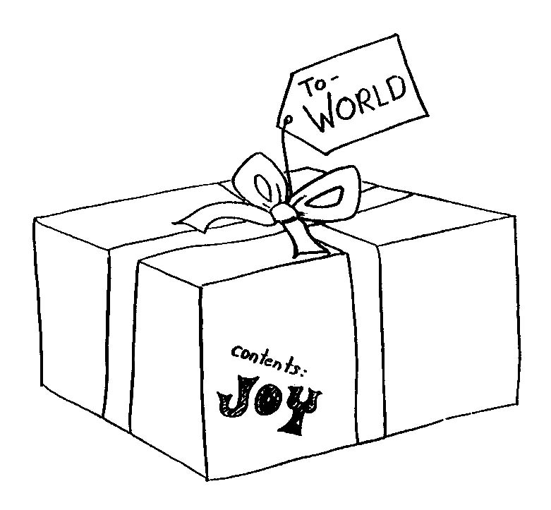
26

Slide 28
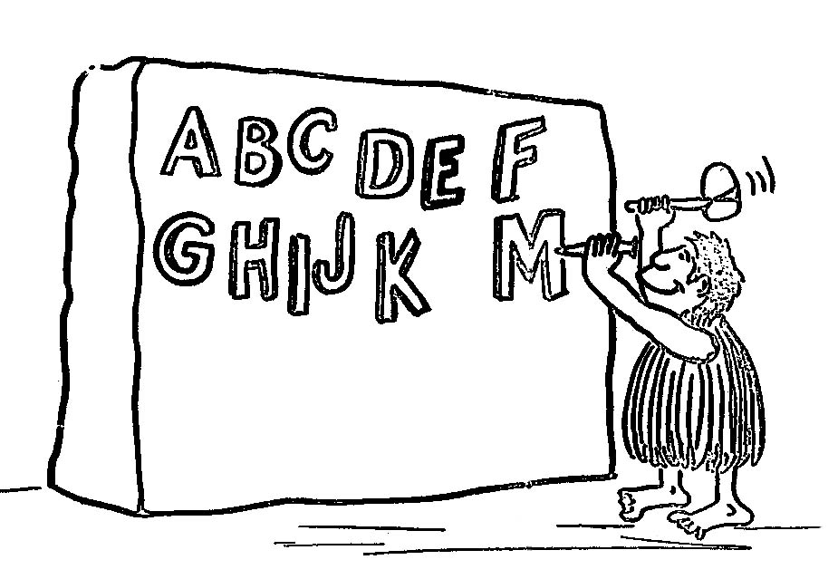
27

Slide 29

28

Slide 30
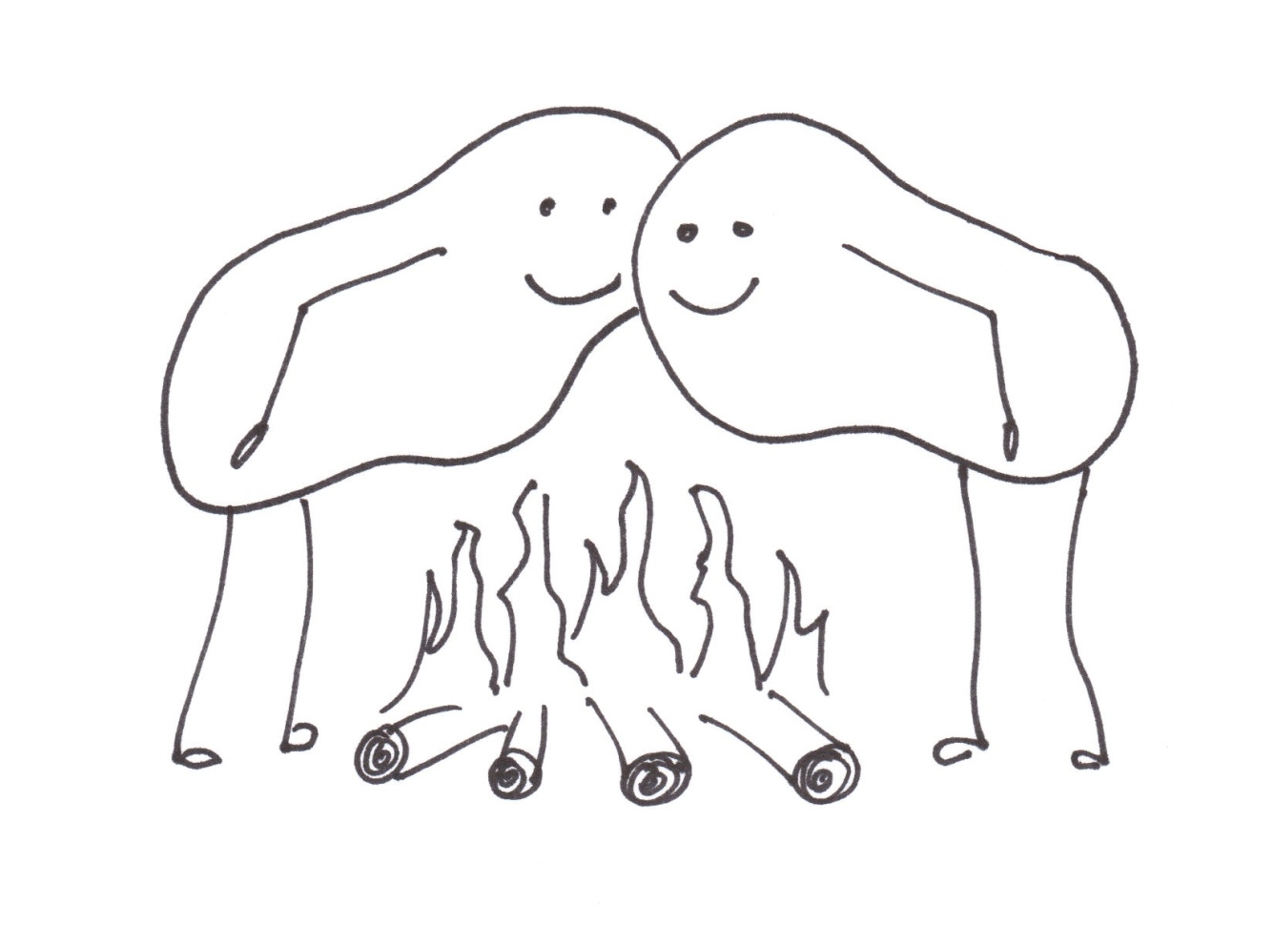
29

Slide 31
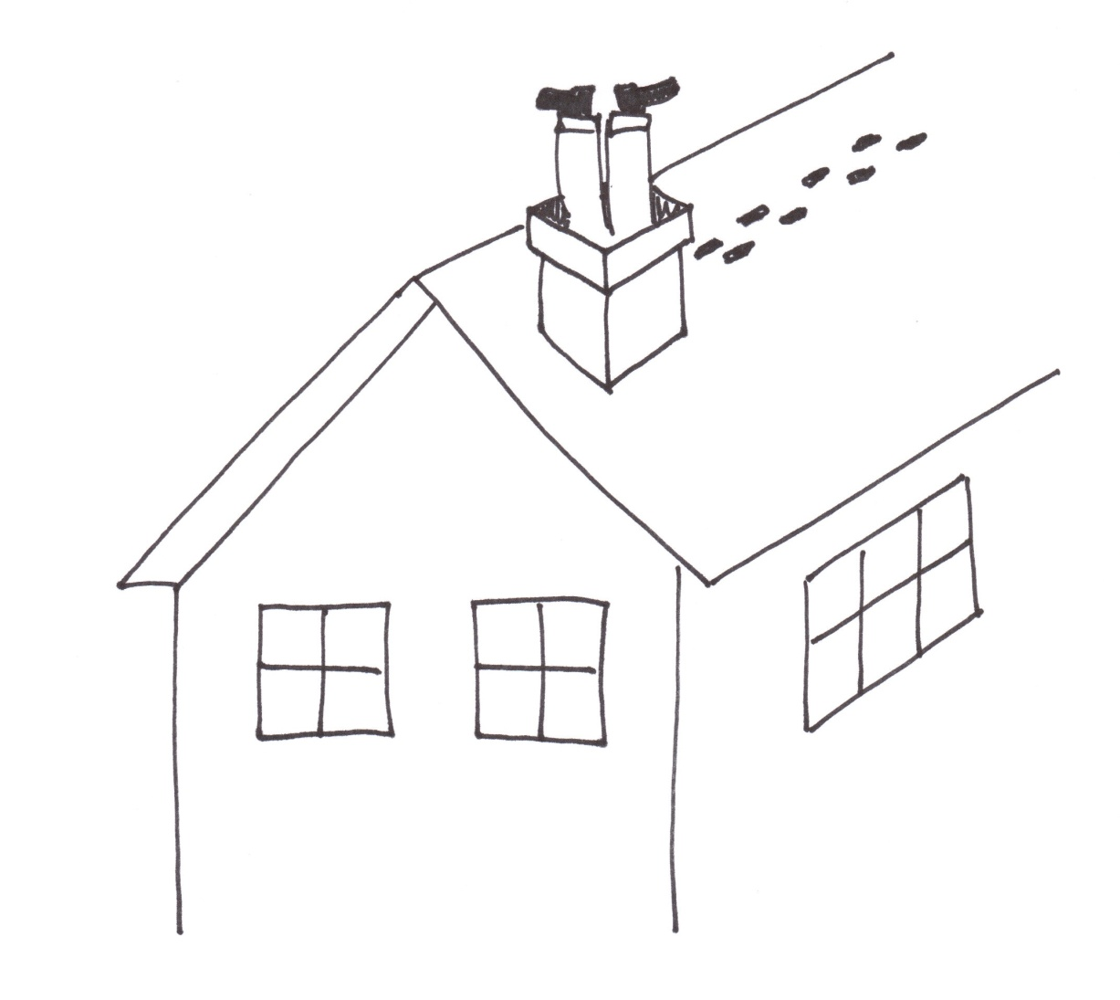
30

Slide 32
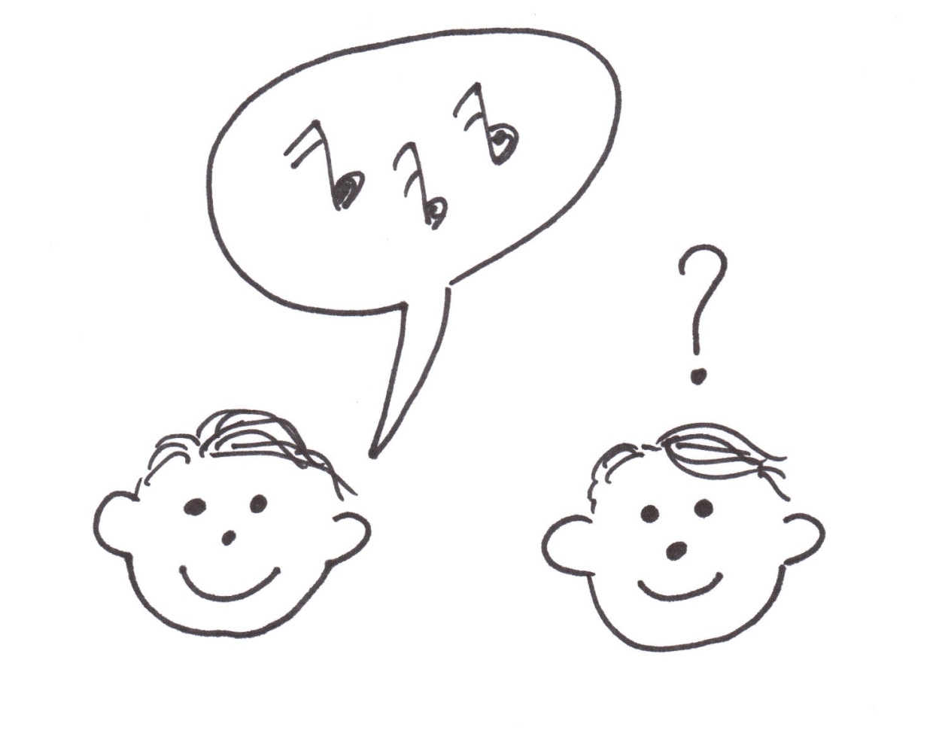
31

Slide 33
1
Jingle Bells

Slide 34
2
What Child is This?

Slide 35
3
God Rest Ye Merry Gentlemen

Slide 36
4
Away in a Manger

Slide 37
5
Deck the Halls

Slide 38
6
Silver Bells

Slide 39
7
All I Want for Christmas is My Two Front Teeth

Slide 40
8
Silent Night

Slide 41
9
Walking in a Winter Wonderland

Slide 42
10
Rudolph the Red-Nosed Reindeer

Slide 43
11
I’m Dreaming of a White Christmas

Slide 44
12
I Saw Mommy Kissing Santa Claus

Slide 45
13
I’m Getting Nothing For Christmas

Slide 46
14
I Saw Three Ships

Slide 47
15
O Little Town of Bethlehem

Slide 48
16
Santa Claus is Coming to Town

Slide 49
17
Twas the Night Before Christmas

Slide 50
18
O Christmas Tree

Slide 51
19
Hark, the Herald Angels Sing or
Angels we have Heard on High

Slide 52
20
O Holy Night

Slide 53
21
The Twelve Days of Christmas

Slide 54
22
It Came Upon the Midnight Clear

Slide 55
23
Frosty the Snowman

Slide 56
24
Go Tell it on the Mountain

Slide 57
25
O Come All Ye Faithful

Slide 58
26
Joy to the World

Slide 59
27
The First Noel

Slide 60
28
Let it Snow, Let it Snow, Let it Snow

Slide 61
29
The Christmas Song
(Chestnuts Roasting on an Open Fire)

Slide 62
30
Up On the House Top

Slide 63
31
Do You Hear What I Hear?

