Slide 1
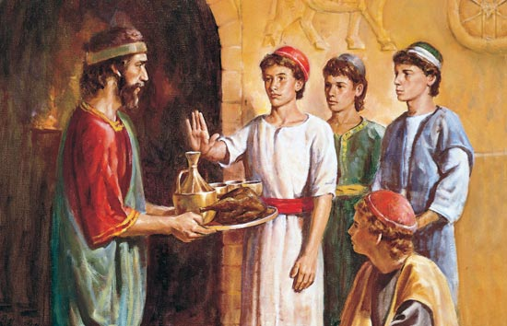
Daniel 1-2

Slide 2
In approximately 605 B.C. and under the direction of King Nebuchadnezzar, the Babylonians besieged Jerusalem. Nebuchadnezzar took items from the temple and a select group of Jews back to Babylon. He commanded an official in his palace to take certain captive Israelite youth and train them for service in his household.

Slide 3
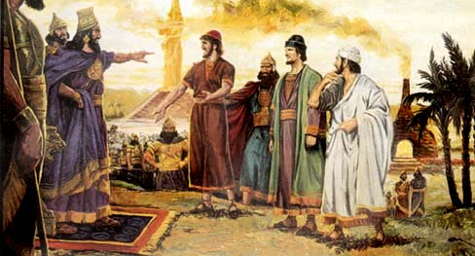
What would happen if we poured a soft drink into the gas tank of a car?
How can consuming unclean foods be like putting soda in the gas tank of a car?
Read Daniel 1:4–17
If Daniel lived in our day, what would he likely choose to take into his body to comply with the Lord’s law of health?
What principle(s) do we learn?

Slide 4
Have you ever had to explain to someone why you do not drink alcohol, tea, or coffee or use tobacco?

Slide 5
Shortly after my mother and I were baptized, she began working as a registered nurse. As a single parent, she didn’t have time to cook, so we began eating more processed and fast foods. Although I was only 12, my health began to decline. I didn’t have the energy I once had. I felt tired and anxious. I gained weight.
I asked my mom how I could get into better shape. Hoping for a medical response, I was a little surprised when she simply said, “Live the principles of the Word of Wisdom.” I thought she would give me advice on calories and carbohydrates and fats, but her answer was exactly what I needed.
For family home evening the following Monday, we reviewed Doctrine and Covenants 89 and outlined an eating and activity plan. Our lifestyle change was dramatic. We both began to feel healthier and happier. I noticed more peace in my life and more quiet promptings from the Holy Ghost.
I am grateful to a loving Heavenly Father, who wants to communicate with us. I know now that we must be prepared physically and spiritually to receive sacred, personal revelations.
Eric D. Richards, Utah, USA (Ensign, June 2009)

Slide 6
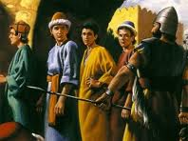
Daniel 1
Read Daniel 1:18–20 about how the Lord blessed Daniel and his friends for being faithful to Him.
What do you think it means to be magnified by the Lord?
Cross reference 1 Corinthians 3:16 and D&C 89:18-21
“Everything harmful is not specifically listed; arsenic, for instance—certainly bad, but not habit forming! He who must be commanded in all things, the Lord said, is a slothful and not a wise servant” (“The Word of Wisdom: The Principle and the Promises,” Elder Boyd K. Packer: April 1996, pp. 22-3)
Who can testify of the power of the Word of Wisdom?

Slide 7
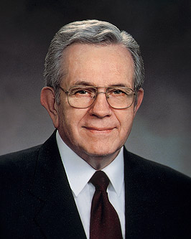
“I have come to know … that a fundamental purpose of the Word of Wisdom has to do with revelation. …
“If someone ‘under the influence’ can hardly listen to plain talk, how can they respond to spiritual promptings that touch their most delicate feelings?
“As valuable as the Word of Wisdom is as a law of health, it may be much more valuable to you spiritually than it is physically”
“The Word of Wisdom does not promise you perfect health, but it teaches how to keep the body you were born with in the best condition and your mind alert to delicate spiritual promptings.” (“Prayers and Answers,” Ensign, Nov. 1979, 20).

Slide 8
“God Gave Them Knowledge” (13:42)
https://www.lds.org/media-library/video/2011-03-10-god-gave-them-knowledge?lang=eng

Slide 9
“God Gave Them Knowledge” (13:42)
https://www.lds.org/media-library/video/2011-03-10-god-gave-them-knowledge?lang=eng

Slide 10
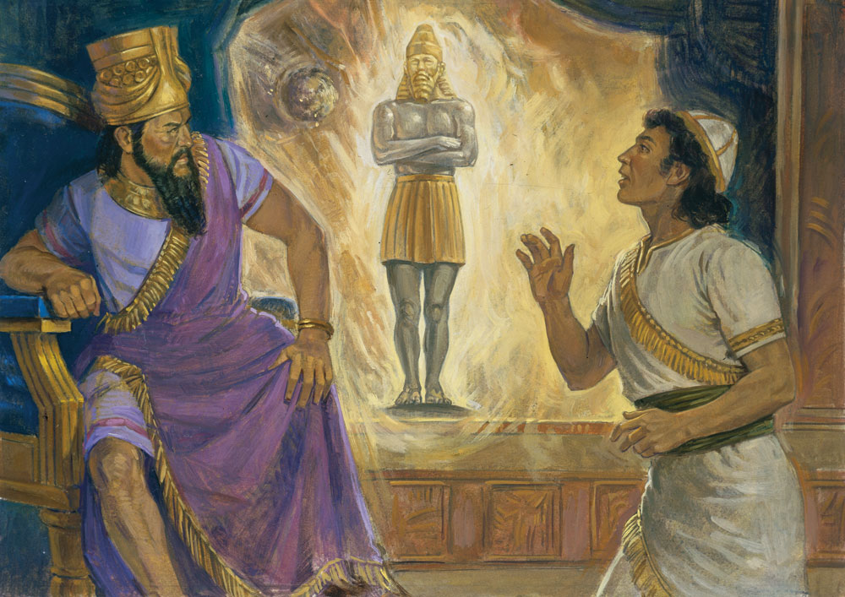
What’s a weird dream you’ve had?
Review Daniel 2:1–11 looking for what troubled Nebuchadnezzar and the wise men.
Read Daniel 2:12–19 looking for the response to King Nebuchadnezzar’s decree.
When have you or someone you know sought Heavenly Father’s help and received needed wisdom and direction?

Slide 11
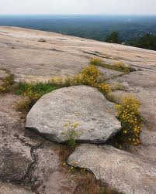
Daniel 2:26–35 Nebuchadnezzar's dream.
Kingdoms of the Earth
HEAD of fine Gold
BABYLON (671 – 538BC) Nebuchadnezzar
MEDES-PERSIANS (538-331BC) Cyrus-Darius
BREAST/ARMS of Silver
BELLY/THIGHS of Brass
Macedonia (331-160BC) Alexander the Great
LEGS of Iron
Rome (160BC-488AD) Caesar
FEET of Clay & Iron
Many Kingdoms
KINGDOM OF GOD (1830 – forever) God of Heaven
Cut out = suggest size and shape
Mountain = patterned after heaven
Without hands = not man-made

Slide 12
Read Daniel 2:44–45 with your partner looking for what Daniel revealed about what God would do.
What might the phrase “cut out of the mountain without hands” mean in verse 45?
Why is it important to understand that the Church was established by God and not by man?
What do you think the phrase “it shall stand for ever” means in verse 44?
What does Daniel’s prophecy teach us about the Church?
Why is it important for us to remember that we are part of God’s kingdom on earth?
How can knowing that the Lord leads His kingdom today help us when we face opposition or when our faith is challenged?
How does it feel to know that you are a part of this kingdom “which shall never be destroyed?”

Slide 13
12 Kingdom of Heaven facts that seem impossible but aren’t.
When President Monson was born in Salt Lake City in 1927, some of the original Mormon pioneers were still living there.
In the year 2000, 34 temples were dedicated. That’s the same number of temples dedicated from 1830 to 1984.
When today’s full-time missionaries were born, only one-third of today’s operating temples existed.
If the first stake in Russia were a child, it would only be a Sunbeam.
The first stake in India would still be in nursery.
The first stake in Ukraine would be just graduating from Primary.
It took the Church 117 years to reach 1 million members worldwide in 1947. It took only 16 more years to reach 2 million, and 8 more to reach 3 million. Today, Church membership has quintupled that number, reaching over 15.3 million.
There are more full-time missionaries serving today than there were Church members worldwide in 1860. The first Church building in Mexico was in use before the Salt Lake Temple was dedicated.
The Church’s 1 millionth full-time missionary was called sometime during 2007.
The Church’s 100th apostle was called in 2015 (Dale G. Renlund).
The Young Women organization operated for six years before the Young Men organization was created. (Young Women was founded in 1869; Young Men was founded in 1875).
Relief Society is the oldest Church auxiliary, organized in 1842. Fittingly, the Primary organization is the youngest auxiliary. It was founded in 1878.
http://utahvalley360.com/2015/11/04/20-crazy-church-history-facts-seem-impossible-arent/

Slide 14
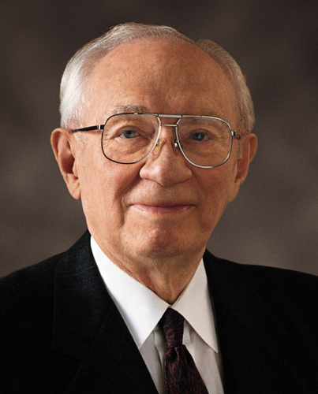
"To my brethren and sisters everywhere, I call upon you to reaffirm your faith, to move this work forward across the world. You can make it stronger by the manner in which you live. Let the gospel be your sword and your shield. Each of us is a part of the greatest cause on earth. Its doctrine came of revelation. Its priesthood came of divine bestowal. Another witness has been added to its testimony of the Lord Jesus Christ. It is literally the little stone of Daniel's dream which was 'cut out of the mountain without hands [to] roll forth, until it has filled the whole earth' (D&C 65:2)" (in Conference Report, Sept.–Oct. 1995, 95; or Ensign, Nov. 1995, 72).

Slide 15
Daniel 1-2

